Slide 1
Intelligent Consumer Experience Enhancement Through Contextual AI
AI-Powered Surveillance and Crowd Management with Natural Language based Querying
Numeronauts
Sujal M H – Project Leader & AI Engineer
Sujnan Kumar – Backend Engineer
Yashas Shetty – Research Lead & Backend Alerts API Developer
Suhan D Shet – Systems Integration Engineer
Diya Shetty – UX Developer
Ms. Amrutha – Project Guide

Slide 2
WHAT IS THE INNOVATION IN YOUR IDEA?
1. Multimodal Intelligence (Vision + Language + Metadata)
Enables context-aware understanding, not just object detection. (E.g., the system understands “a person running with a backpack near the exit”).
2. Natural Language Querying for Surveillance
Users ask questions like “Find people wearing red near Gate 3 in the last 10 minutes”.
3. Hybrid Search Engine
Structured Search (MongoDB) → exact attributes, timestamps, zones.
Semantic Search (FAISS embeddings) → scene meaning, actions, context.
A capability missing in traditional CCTV systems.
4. Real-Time Proactive Alerting (Agentic AI)
Intelligent rules like “Alert when someone enters restricted zone with a bag”.
Behavior heuristics (fall detection, sudden crowd surge, fight patterns).

Slide 3
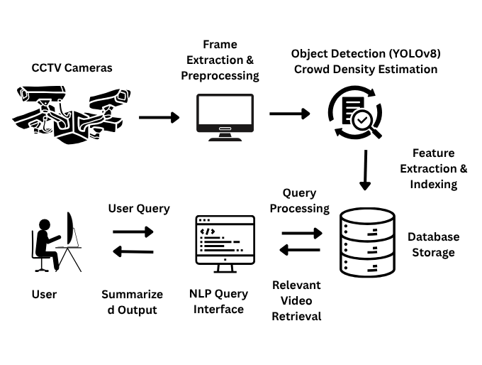
Why It Solves the Challenge Better
Traditional CCTV: manual monitoring, timestamp-based search, no semantics.
Proposed system: - Understands what happened. - Finds when it happened. - Shows exact clips of the event. - Alerts instantly. - Lets users interact like they’re talking to a human analyst.
Improves Response Time
Figure 1: Architectural Flow Diagram

Slide 4
KEY DIFFERENTIATORS:
Natural Language Search: Retrieve events using simple questions instead of timestamps, enabling instant, human-like querying of surveillance footage.
Multimodal Intelligence: Combines object detection, person attributes, captions, and embeddings for deeper context understanding.
Hybrid Search Engine: Merges structured metadata search with semantic vector search for highly accurate, context-aware results.
Proactive Alerting: Smart rule-based alerts with automatic clip generation for events like intrusions, anomalies, or crowd surges.
Multimodal Person Re-ID: Tracks individuals across cameras using fused visual + textual features for stronger identity consistency.
End-to-End Modern Stack: FastAPI + Next.js architecture ensures real-time performance, scalability, and smooth user experience.

Slide 5

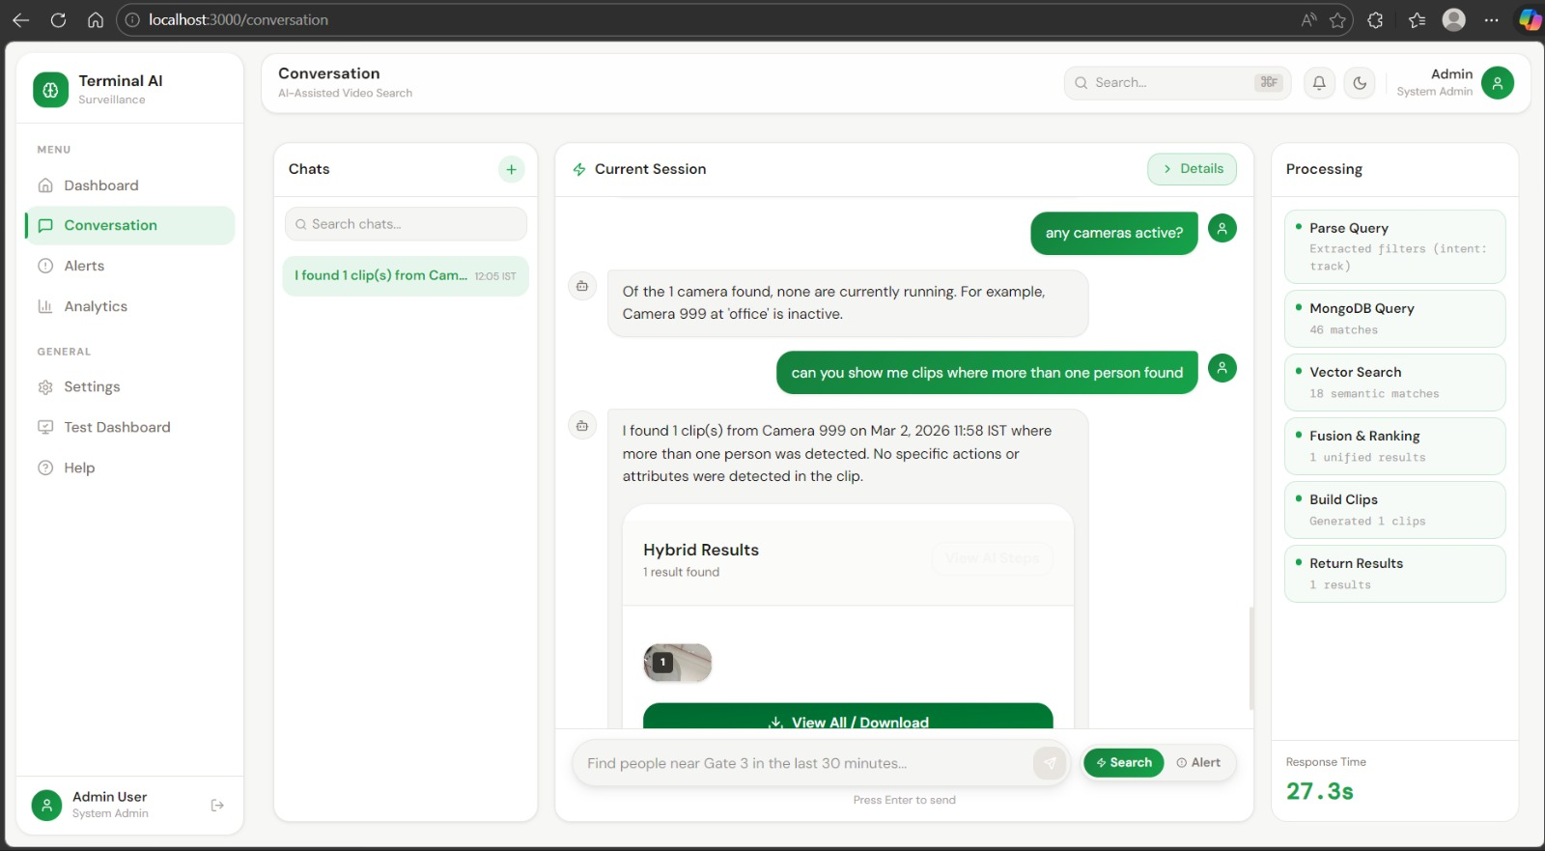
DIAGRAMS
Figure 2: Dashboard
Figure 3: Conversation Page

Slide 6
FUTURE PLANS / POTENTIAL NEXT STEPS
Multi-Camera Re-Identification at Scale
Edge Deployment Optimization
Real-Time Crowd Analytics
Build cross-camera identity tracking with a unified global ID system (Target: 95% re-ID accuracy in next 6 months).
Introduce crowd flow prediction, density heatmaps, and congestion forecasting.
Convert entire pipeline to fully edge-optimized models using ONNX/OpenVINO
(Target: reduce latency by 40% within 3 months).

Slide 7
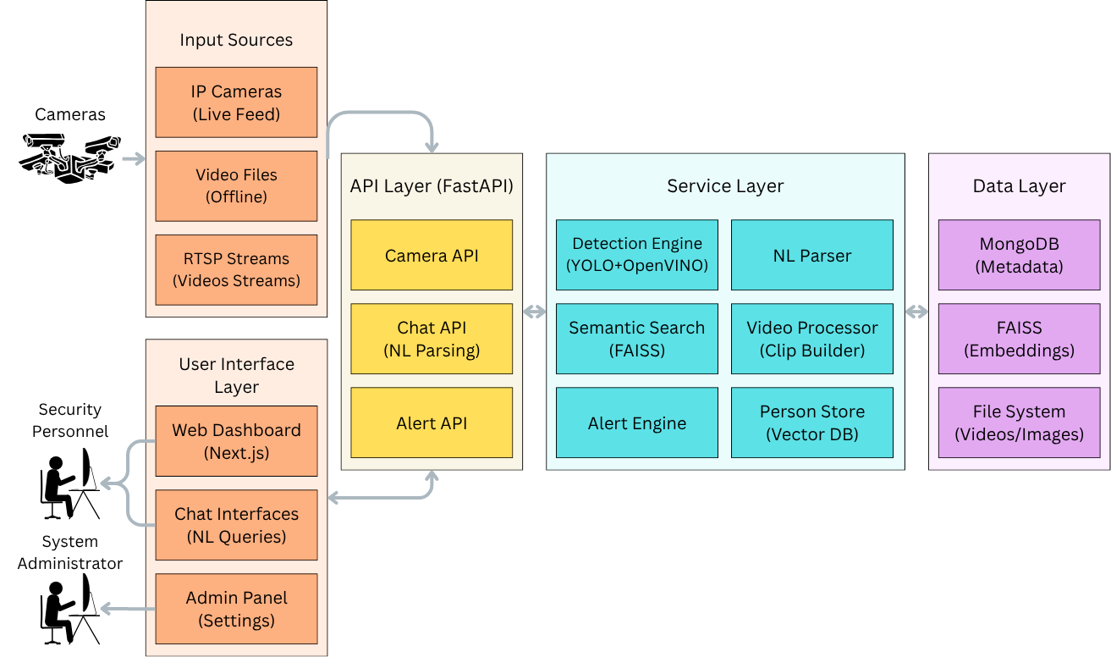
TECHNICAL DETAILS AND REPORTS
Frontend: Next.js
Backend: FastAPI, WebSockets
Computer Vision:
- YOLOv11-seg for detection,
- BoT-SORT + OSNet for tracking,
- OpenVINO for person attributes
Vision-Language Models:
- BLIP-2 for captions
- MiniLM for text embeddings
Semantic Search: FAISS
Database: MongoDB - structured metadata + file storage
Video Processing: OpenCV, FFmpeg
Deployment & Environment: Docker, NVIDIA GPU acceleration, CUDA
Integration Services: LLM-based natural language parser (OpenAI/Ollama)
Figure 4: Technical Architecture Diagram

Slide 8
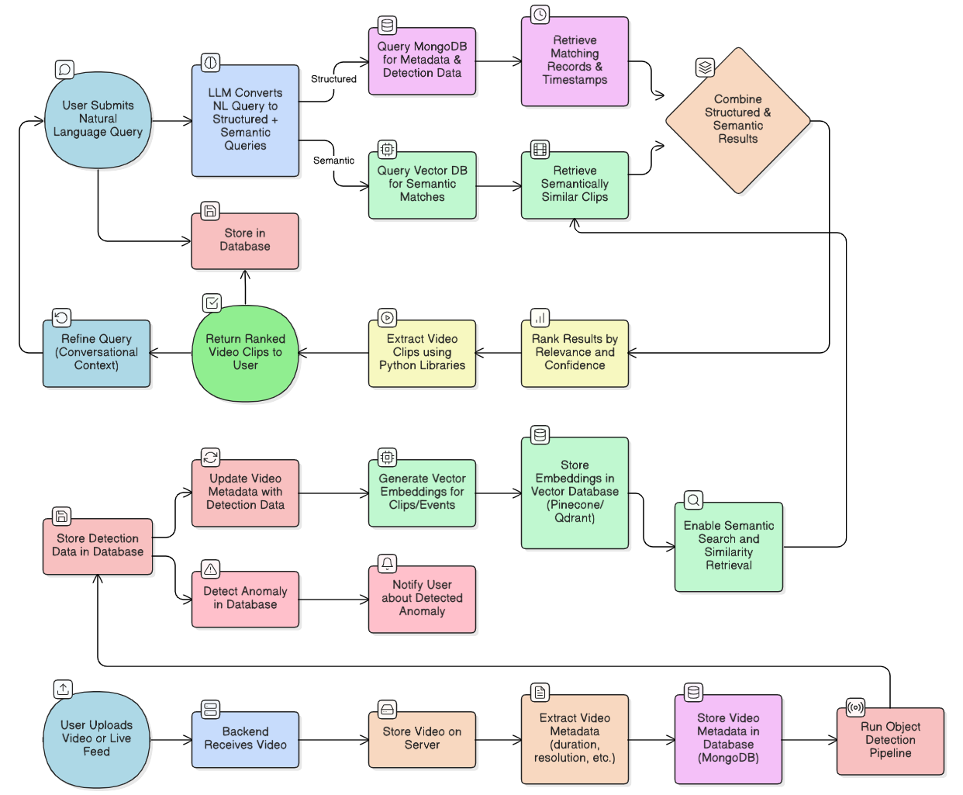
Figure 5: Data flow Diagram

