Slide 1
Bluestock Mutual Fund Analytics Capstone Project
Submitted By: Sujal Patel
Project Type: Data Analytics & Business Intelligence
Technologies: Python, SQLite, Power BI, Pandas, Matplotlib
Executive Summary
This page explains:
Project objective
Data engineering workflow
Analytics performed
Dashboard implementation
Business value generated
Introduction & Problem Statement

Slide 2
Introduction
The mutual fund industry generates large volumes of financial and investor data.
Analyzing this information manually is difficult and time-consuming.
Problem Statement
The project aims to:
Analyze mutual fund performance
Understand investor behavior
Monitor industry growth
Evaluate investment risk
Build interactive dashboards
Objectives
Create ETL pipeline
Build data warehouse
Perform EDA
Create dashboards
Perform advanced analytics
Develop fund recommender system

Slide 3
Data Sources
Datasets Used
Dataset Purpose
dim_fun Fund d details
dim_dat Calendar e data
fact_na v
Daily NAV
history
fact_tra nsactio ns
Investor transactio ns

Slide 4
fact_per Fund formanc performa e nce
fact_au m
Industry AUM
Database Design
SQLite Data Warehouse
|
├── Dimension Tables
│ ├── dim_fund
│ └── dim_date
│
└── Fact Tables
├── fact_nav
├── fact_transactions

Slide 5
├── fact_performance
└── fact_aum
ETL Design
ETL Workflow
Raw CSV Files
↓ Extract
↓ Transform
↓ Validation
↓
SQLite Warehouse

Slide 6
↓
Dashboard & Analytics
Key Transformations
Missing value handling
Duplicate removal
Data type conversion
Standardization
Validation checks
ETL Benefits
Automation
Consistency
Data quality
Scalability
Exploratory Data Analysis (EDA)
Key Findings

Slide 7
Industry Growth
Industry AUM exceeded ₹81 Lakh Crore.
Continuous growth observed.
Leading AMCs
SBI Mutual Fund
ICICI Prudential MF
HDFC MF
Nippon India MF
Kotak MF
Fund Performance
Majority of funds delivered positive returns.
Equity funds outperformed debt funds.
Investor Analytics
State-wise Analysis
Top contributors:
Maharashtra

Slide 8
Delhi
Karnataka
Gujarat
Tamil Nadu
Age Group Analysis
Age Observati Grou on
p
18–2 Low
5 investmen t
26–3 Highest
5 SIP
activity

Slide 9
36–4 Highest
5 investmen t
46–6 Stable
0 investors
60+ Conservati
ve investors
Transaction Analysis
SIP dominates transactions.
Lumpsum contributes larger ticket sizes.
Redemptions are relatively lower.
Dashboard Design
Dashboard Pages

Slide 10
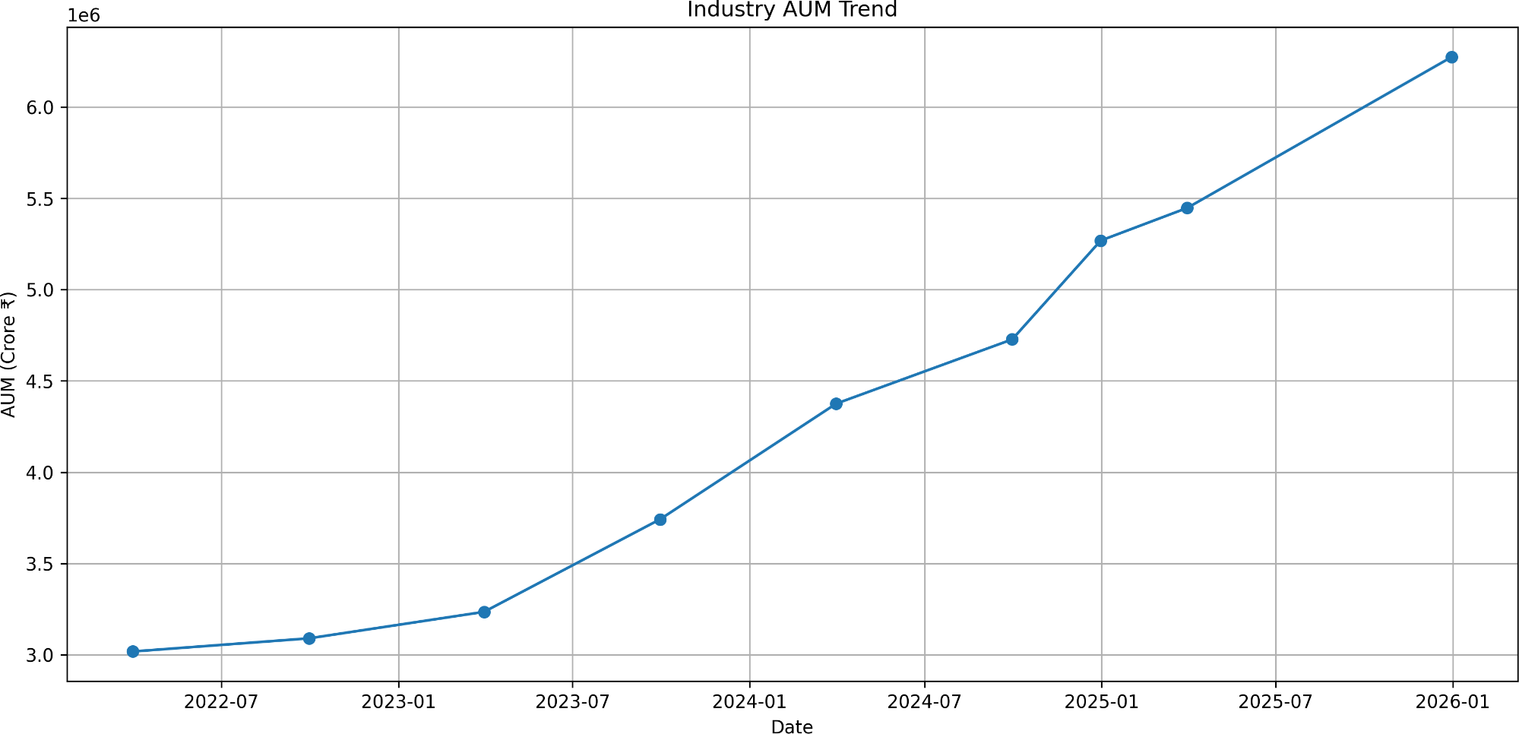
Industry Overview
KPI Cards
AUM Trend
AUM by AMC
Fund Performance

Slide 11
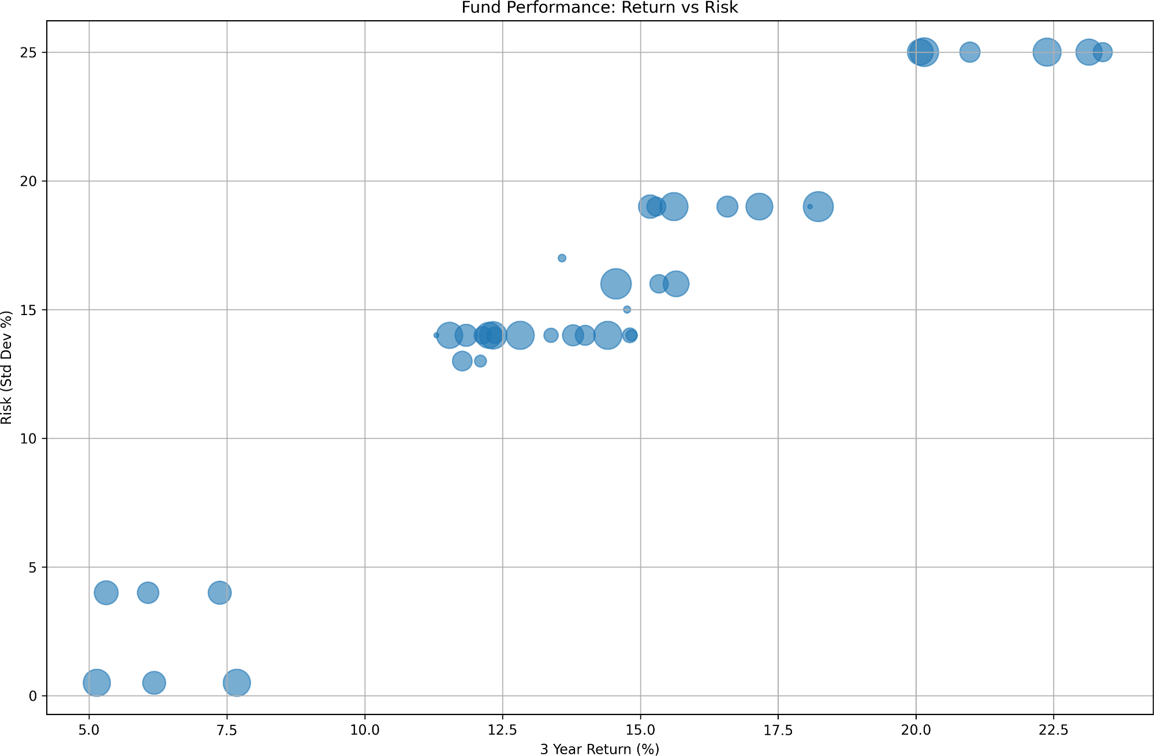
Risk vs Return Scatter Plot
NAV Trends
Fund Scorecard
Investor Analytics

Slide 12
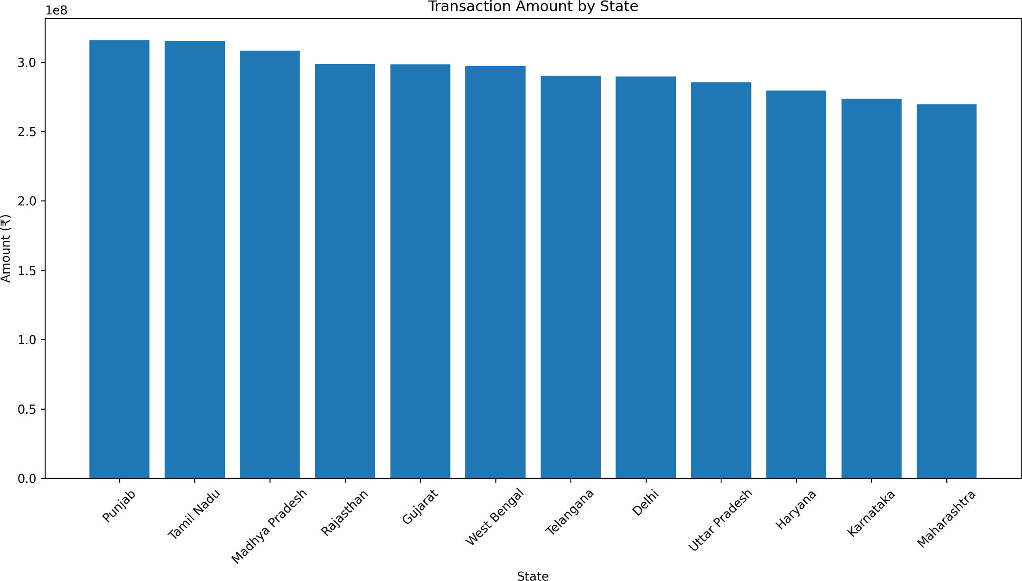
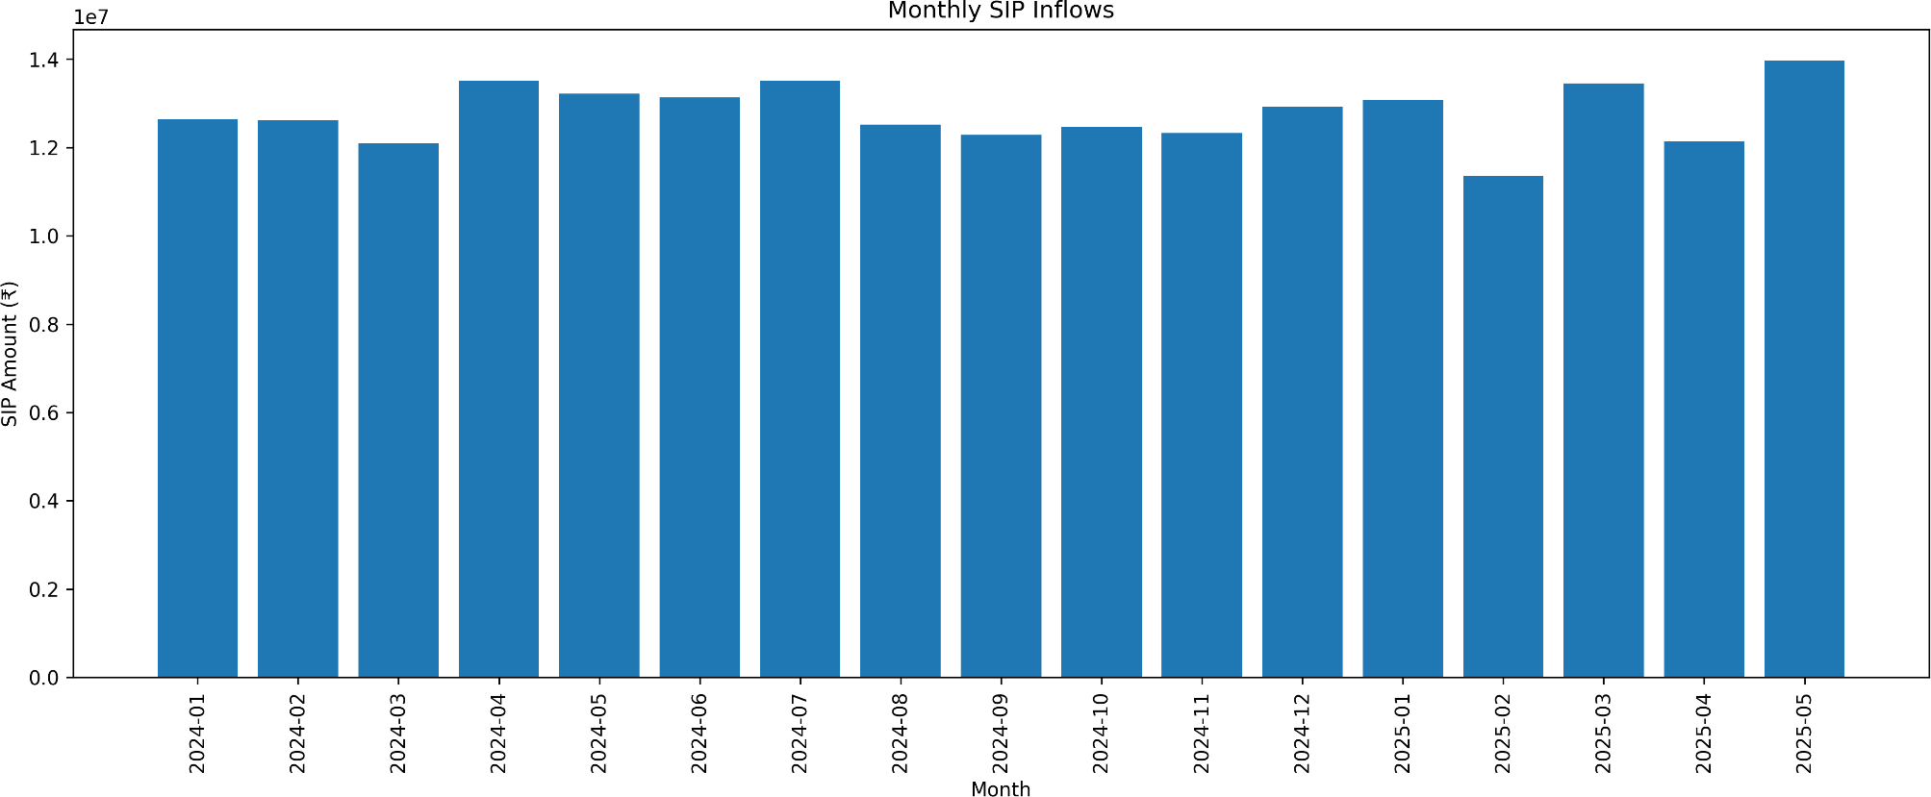
State-wise Investments
SIP/Lumpsum Distribution
Monthly Transactions
SIP & Market Trends

Slide 13
SIP vs Nifty Trend
Category Inflows
Top Categories
Advanced Analytics
Historical VaR & CVaR
Measures downside risk.
Formula
VaR₉₅ = 5th Percentile(Return Distribution)
Benefits
Risk estimation
Capital preservation
Rolling Sharpe Ratio

Slide 14
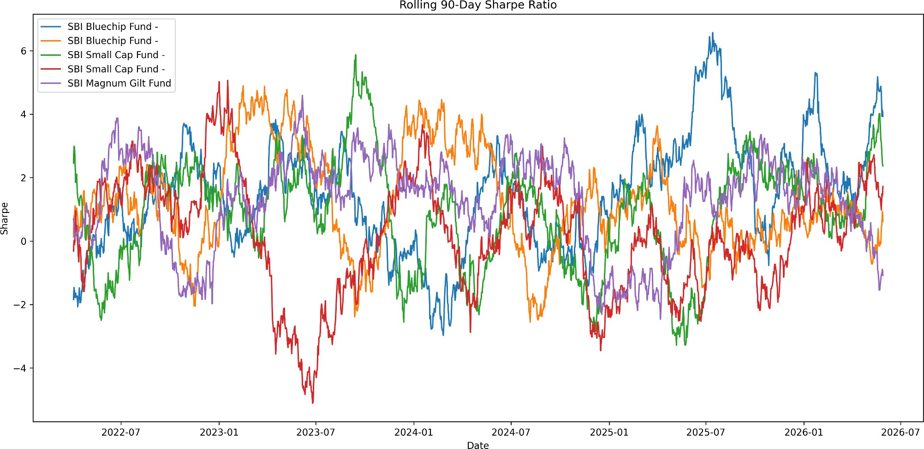
Sharpe Ratio = (Rolling Mean Return ÷ Rolling Standard Deviation) × √252
Measures risk-adjusted performance over time.
Investor Cohort & SIP Continuity Analysis
Cohort Analysis
Investors grouped by first transaction year. Metrics:
Average SIP Amount

Slide 15
Total Invested
Preferred Fund
SIP Continuity
Investor classified as:
Active
Average SIP gap ≤ 35 days
At Risk
Average SIP gap > 35 days Benefits:
Churn prediction
Investor retention
Fund Recommendation System & Key Findings
Fund Recommendation Logic
Input:

Slide 16
Low Risk Moderate Risk High Risk
Output:
Top 3 funds ranked by Sharpe Ratio.
Key Findings
Industry AUM growing steadily.
SIP is the dominant investment mode.
Maharashtra contributes highest investments.
Investors aged 26–45 are most active.
Equity funds remain the preferred category.
Risk-adjusted metrics provide better fund selection.

Slide 17
Conclusion & Recommendations
Conclusion
The Bluestock Mutual Fund Analytics Platform successfully combines:
Data Engineering
Data Warehousing
Financial Analytics
Business Intelligence
to provide actionable investment insights.
Recommendations
Short-Term
Improve dashboard automation
Add more investor segmentation
Long-Term
Live AMFI integration
Real-time NAV updates
Machine Learning fund recommender
Investor churn prediction

Slide 18
Future Scope
Cloud deployment
Power BI Service publishing
Predictive analytics
Portfolio optimization
Thank You

