Slide 1
Fitness Buddy AI
IBM HACKATHON PROJECT
Presented By:
Student name : Sujal Rajesh Saroj
College Name & Department : Ramniranjan Jhunjhunwala College & TYCS

Slide 2
OUTLINE
Problem Statement
Technology used
Wow factor
End users
Result
Conclusion
Git-hub Link
Future scope
IBM Certifications

Slide 3
Problem Statement
Many individuals—especially working professionals, students, and homemakers—struggle to maintain a consistent and healthy lifestyle due to lack of personalized fitness guidance, motivation, and time. Traditional fitness solutions often require expensive memberships, rigid schedules, or in-person consultations that don’t adapt well to individual needs or daily routines.
Proposed Solution: An AI-powered Fitness Buddy that uses Natural Language Processing (NLP) and AI-based personalization to offer users customized home workouts, healthy meal suggestions, motivational tips, and habit-building guidance—all in a conversational format

Slide 4
Technology used
IBM cloud lite services
Natural Language Processing (NLP)
Retrieval Augmented Generation (RAG)
IBM Granite model

Slide 5
IBM cloud services used
IBM Cloud Watsonx AI Studio
IBM Cloud Watsonx AI runtime
IBM Cloud Agent Lab
IBM Granite foundation model

Slide 6
Wow factors
This AI fitness agent will help users save time, stay consistent, and improve their overall health by offering personalized workouts, meal suggestions, and motivational support—all accessible through a simple chat interface. It promotes healthy habits, reduces dependency on rigid schedules or expensive trainers, and empowers users to take control of their well-being with ease and flexibility.
Personalized workout routines based on user goals and preferences
Nutritious meal suggestions tailored to dietary needs (e.g., high-protein, vegan, low-carb)
Daily motivation quotes and mental wellness tips
Habit tracking to build consistency over time
Fitness goal recommendations (weight loss, muscle gain, endurance)
Progress encouragement and check-ins to keep users engaged

Slide 7
End users
Health-conscious Individuals
Gym Trainers & Fitness Coaches
Nutritionists
Medical & Wellness Experts
Rehabilitation Centers
College Athletes or Sports Departments

Slide 8
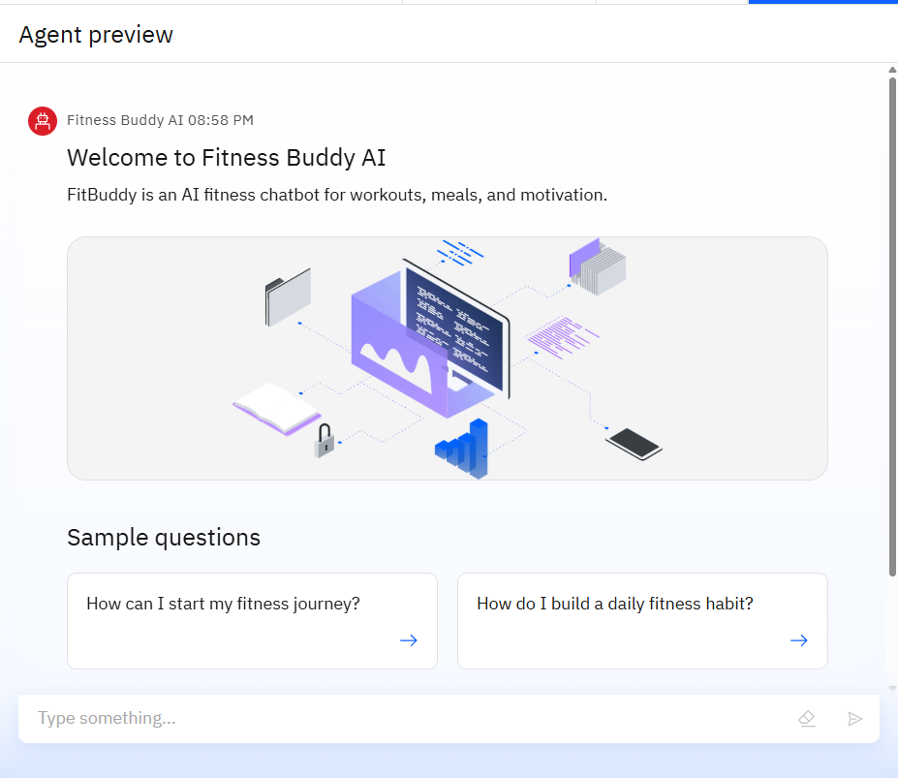
Results
Clean, welcoming interface
Smart starter questions for users
Chat-based fitness guidance
Visuals that reinforce health theme

Slide 9
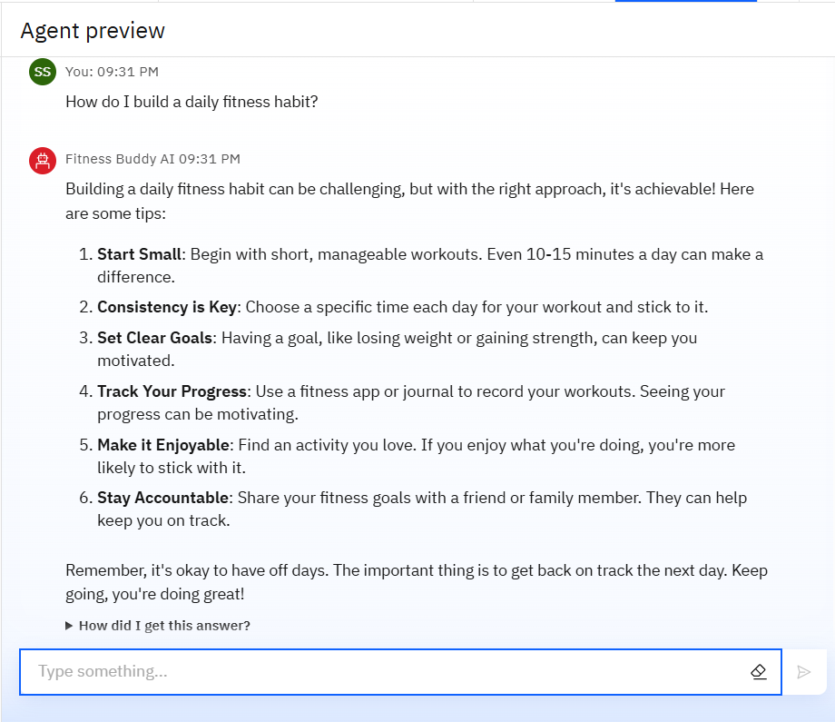
Results
Human-like replies
Clear and structured answers
Beginner-friendly tips
Motivational tone
Quick responses

Slide 10
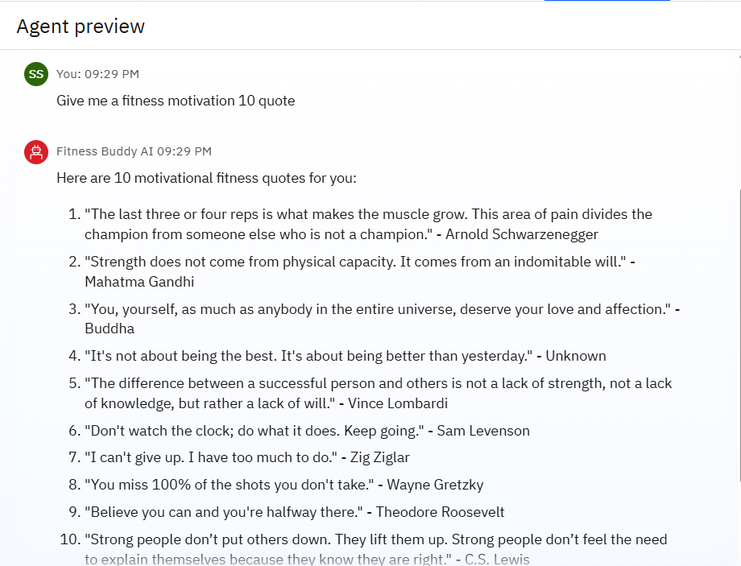
Results
Delivered 10 motivational quotes instantly
Covers mental strength & discipline
Adds inspiration and encouragement to user journeys
Engaging and varied—not just generic line

Slide 11
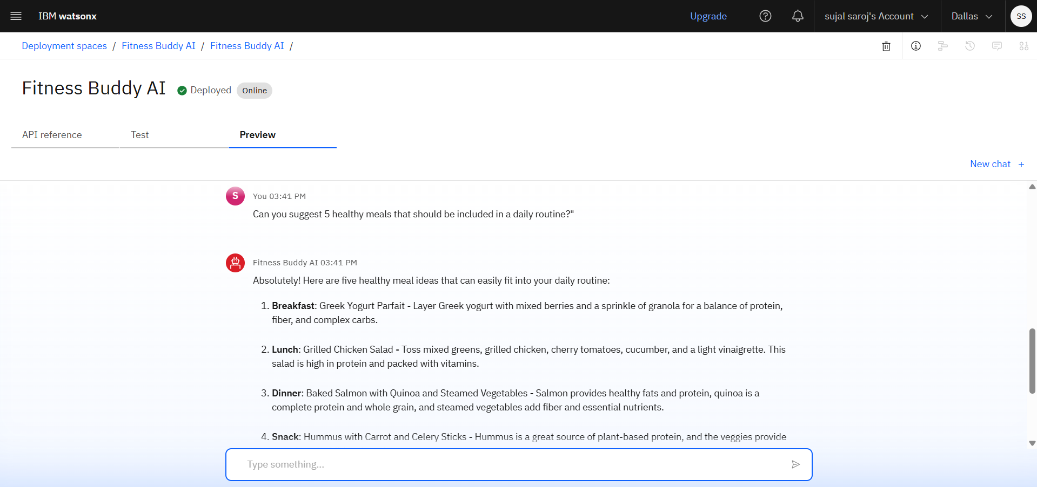
Results
Deployed FitBuddy AI

Slide 12
Conclusion
:
FitBuddy AI can generate workout plans, suggest fitness goals, and even build personalized routines.
It saves time by automating tasks like meal planning, progress tracking, and daily reminders.
FitBuddy enhances motivation, consistency, and efficiency in both beginner and advanced fitness journeys.

Slide 13
GitHub Link
https://github.com/sujalsaroj/IBM-HACKATHON-FitBuddy

Slide 14
Future scope
Multilingual support for users across different regions.
Voice-enabled assistant for hands-free interaction.
Real-time collaboration with fitness coaches and peers.
Smart progress tracking with AI-based plateau detection.
Integration with wearables and fitness apps.
Personalized workout and nutrition plans powered by AI.

Slide 15
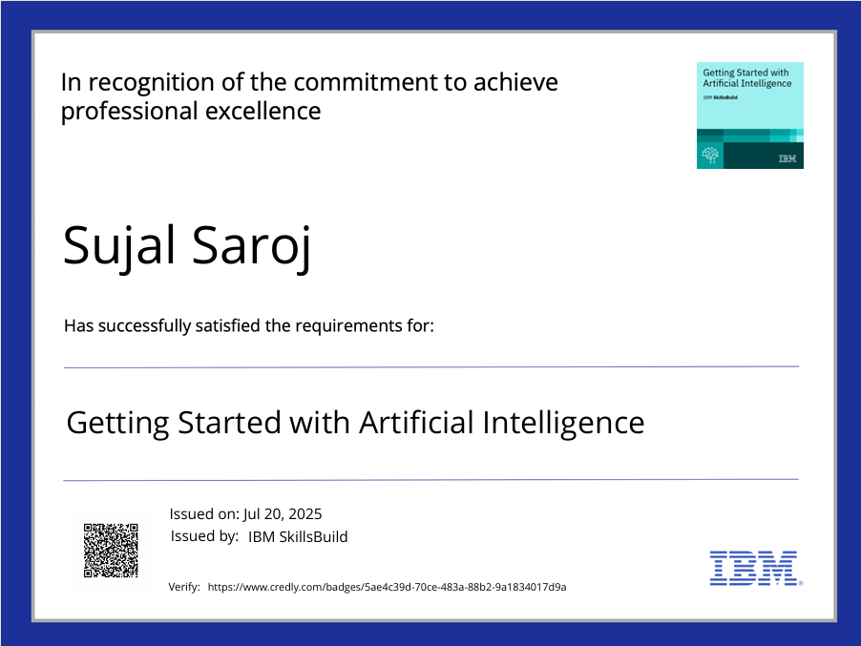
IBM Certifications

Slide 16
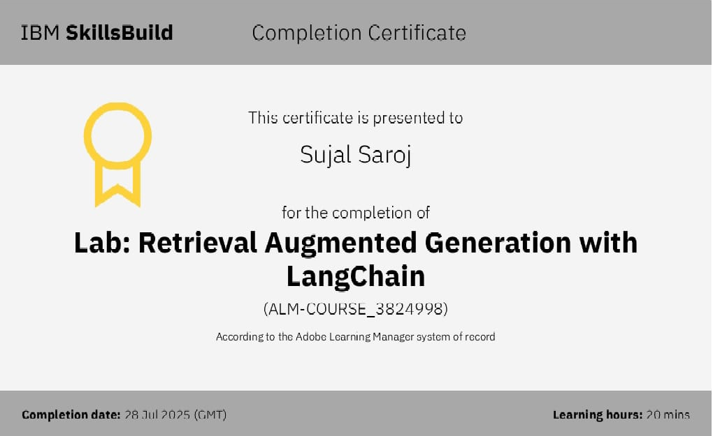

Slide 17


Slide 18
THANK YOU

