Slide 1
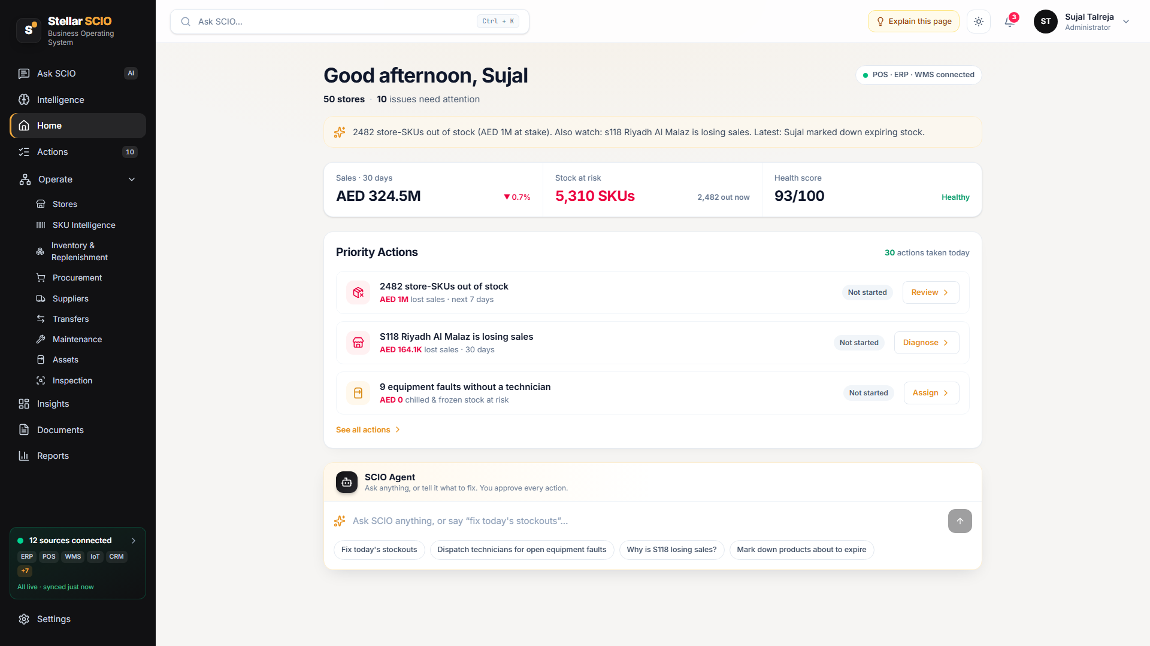
Run your business by asking questions
S
Stellar SCIO
An AI operating system that connects your software, spots problems early, and tells your team what to do next.
Real screen from the SCIO prototype
Stop staring at dashboards. Just ask.
Notes:
Stellar SCIO is an AI operating system for business. Instead of digging through reports, your team simply asks a question and gets a clear answer with the next step.

Slide 2









Your business has the answers, but they are scattered
Each team uses its own software
Problems are found too late
An empty shelf, a broken machine or a late delivery is noticed after it has already cost money.
Sales
Finance
Stock
Hours lost on reports
People copy numbers between spreadsheets just to answer one simple question.
Suppliers
People
Equipment
Decisions based on guesswork
No one sees the full picture, so teams act on gut feeling instead of facts.
None of them talk to each other.
Notes:
Most companies already collect the data they need, but it is split across many tools. So problems are spotted late, reporting eats time, and decisions are often guesses.

Slide 3


Stop staring at
boring dashboards.
Get everything with one prompt.
Where are we losing money this week?
No charts to decode. No reports to build. Just a clear answer and the next step.
Notes:
This is the core idea. Dashboards make people hunt for answers. With SCIO, you type a question in plain words and get the answer, the reason and the next step.

Slide 4



What is Stellar SCIO?
Think of SCIO as a smart operations manager that watches every part of your business, around the clock.
It sees everything
It understands why
It tells you what to do
Connects the software you already use into one live picture of the business.
Finds the real cause behind a number, not just the number itself.
Recommends the next step and the right person to take it. Your team approves.
Notes:
In one line: SCIO is like an operations manager that never sleeps. It sees everything, understands why things happen, and suggests what to do about it.

Slide 5





How it works, in four simple steps
01
02
03
04
Connect
Detect
Explain
Act
Link the tools you already have: sales, finance, stock, suppliers, people and equipment.
SCIO watches the data 24/7 and flags anything unusual: shortages, delays, losses.
It tells you what happened, why, and how much money is at stake, in plain words.
It suggests the fix and who should do it. A person approves before anything happens.
Notes:
Connect your existing systems, SCIO detects issues, explains them simply, and recommends the action. People stay in charge of every decision.

Slide 6
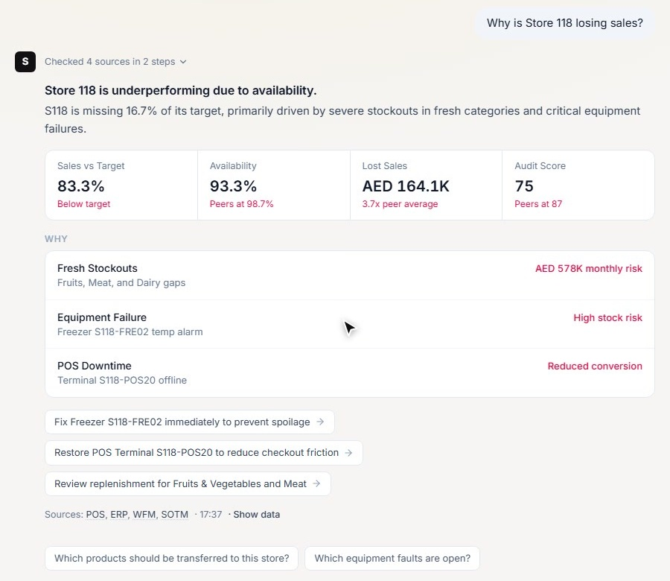

Ask anything, in plain English
A real answer from the prototype: SCIO checked four systems and found three causes, each with its cost.
Questions any business can ask
Why did sales drop last month?
Which customers might we lose?
Which machines need attention this week?
Which suppliers are always late?
Where are we losing money today?
Notes:
You don't need to learn the software. Ask the way you'd ask a colleague. Every answer shows the numbers, the reasons and where the data came from.

Slide 7
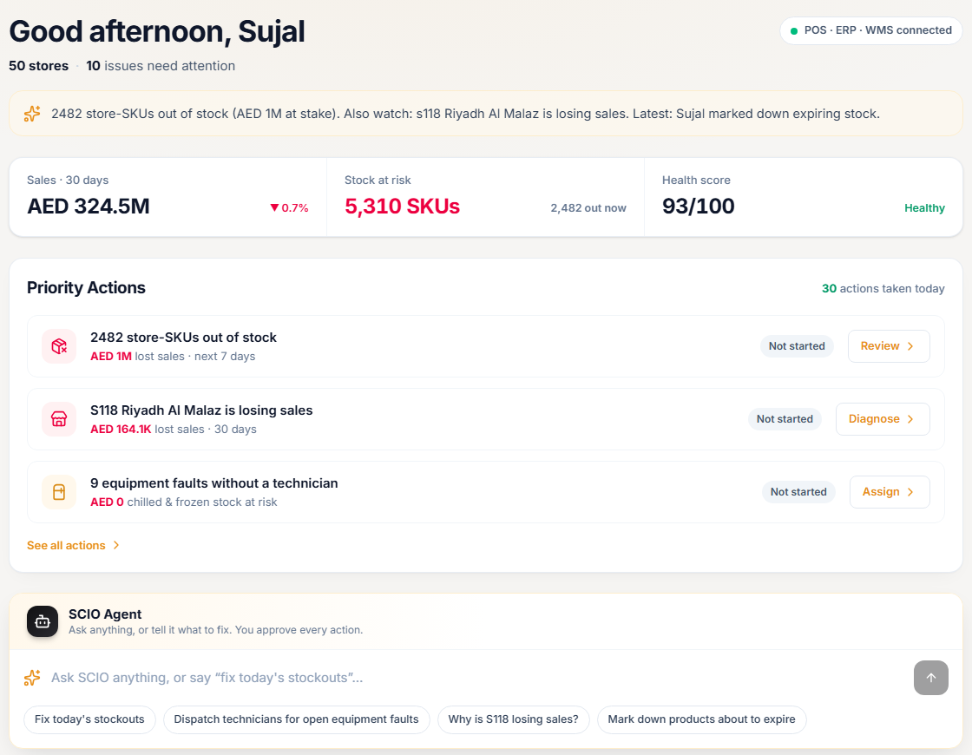



See what matters first, every morning
Ranked by money at stake
The most expensive problems sit at the top, so the team fixes those first.
A clear owner for every issue
Each problem is assigned to the team that can actually fix it.
One click to act
Review the suggested fix and approve it, without switching tools.
Notes:
The home screen replaces the morning report. It lists today's problems in order of business impact, with who owns each one and the suggested fix.

Slide 8
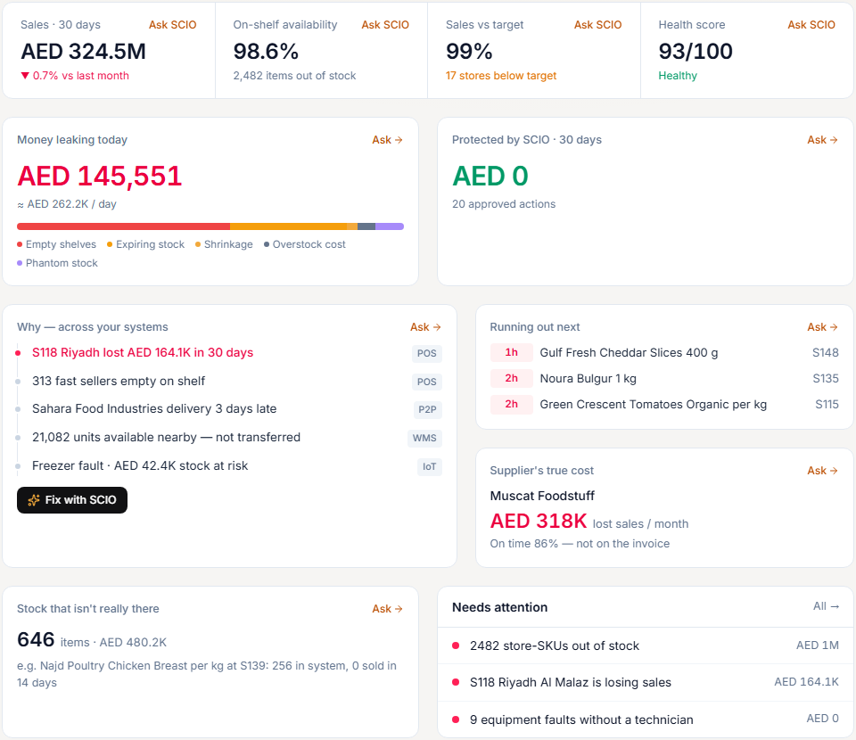
Find the money leaking today
AED 145K
lost today to empty shelves, expiry and shrinkage
646
items the system says are in stock but are not really there
3 days
supplier delay caught before customers felt it
Figures from the SCIO retail demo workspace (sample data).
Notes:
SCIO puts a price on problems. In the demo it shows the money being lost today, stock that only exists on paper, and supplier delays, so teams know where to look.

Slide 9








One place for every team
Sites & Sales
Products & Stock
Purchasing
Suppliers
See which locations are behind target, and why
Know what will run out and what is sitting idle
Track every order and catch billing mistakes
Score vendors on speed and reliability
In the app: Stores
In the app: SKU Intelligence, Inventory
In the app: Procurement
In the app: Suppliers
Stock Movement
Equipment
Quality Checks
Documents & Reports
Move stock to where it is needed most
Spot failing machines before they break
Run audits with AI photo inspection
AI reads invoices; reports in one click
In the app: Transfers
In the app: Maintenance, Assets
In the app: Inspection
In the app: Documents, Reports
Notes:
Every department works from the same platform: sales, stock, purchasing, suppliers, equipment, quality and documents, all connected and all answerable through one question box.

Slide 10
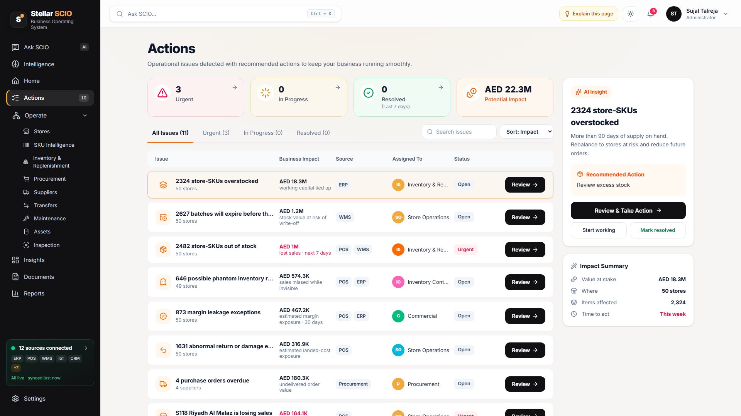
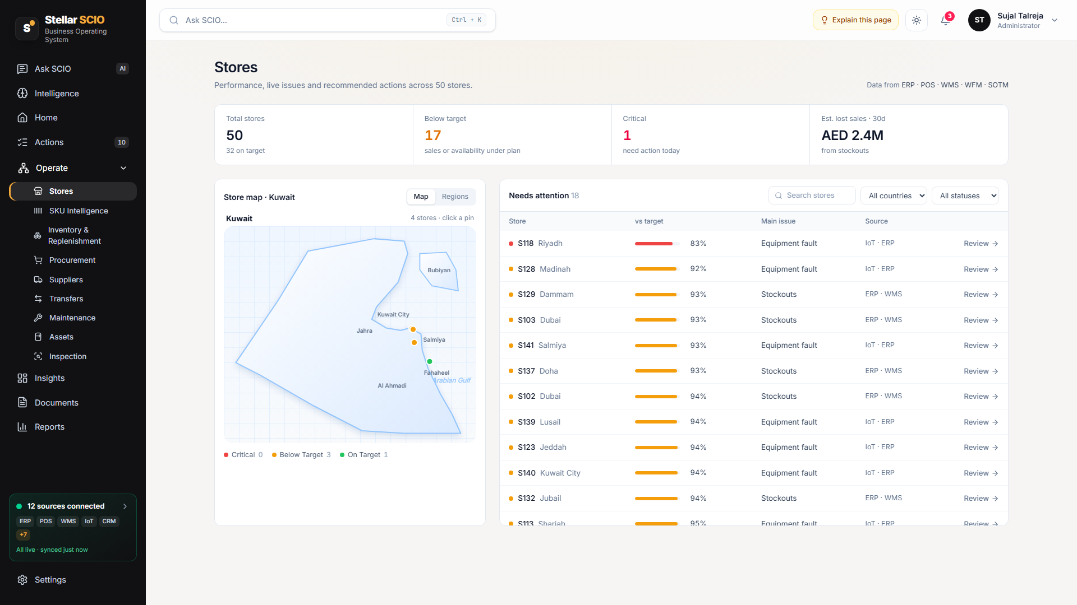
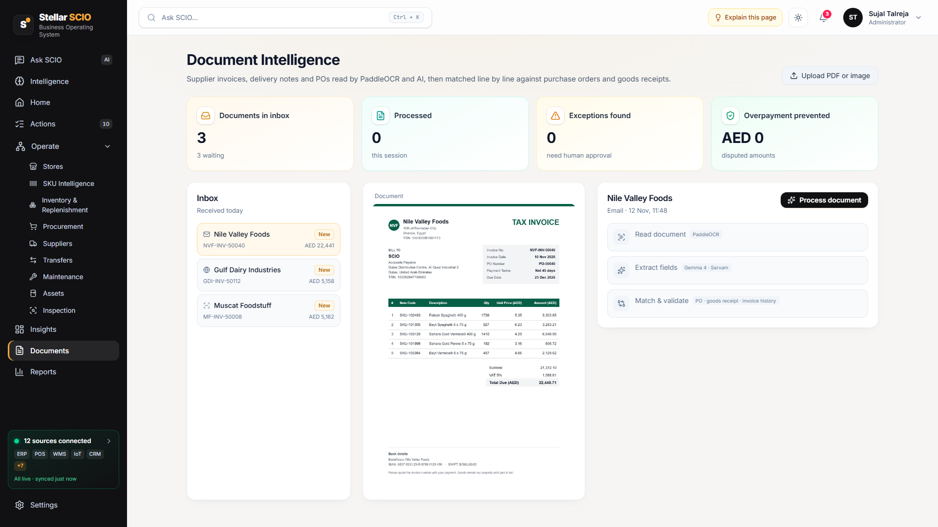
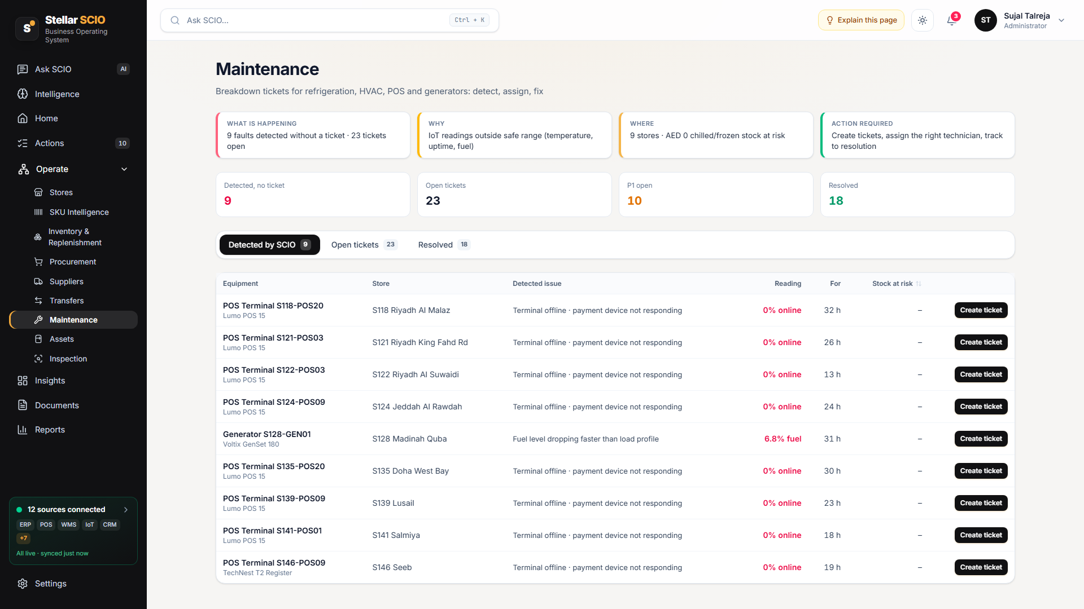
A look inside the prototype
Actions: every issue with its cost and owner
Locations: live map and performance
Documents: AI reads and checks invoices
Equipment: faults detected by sensors
Notes:
These are real screens from the working prototype, running on a sample retail business with 50 locations in six countries.

Slide 11




Built for any business that runs on data
Retail
Manufacturing
Logistics
“Which stores will run out of stock this week?”
“Which machine is slowing down the line?”
“Which deliveries are going to arrive late?”
Energy & Utilities
Fleet & Maritime
Services & Distribution
“Which sites are producing below plan today?”
“Which vessels need maintenance soon?”
“Which customers have not reordered this month?”
Notes:
The demo is retail, but the idea works anywhere: connect the data, ask questions, act on the answers. Here are examples from other industries.

Slide 12




What your business gains
Minutes, not days
Fewer surprises
Answer business questions instantly instead of waiting for a report.
Problems are flagged early, before they cost money or customers.
Less waste
One version of the truth
Catch expiring stock, idle inventory and overpayments in time.
Every team sees the same numbers, so meetings focus on decisions.
Notes:
The payoff is speed, fewer surprises, less waste and everyone working from the same facts.

Slide 13
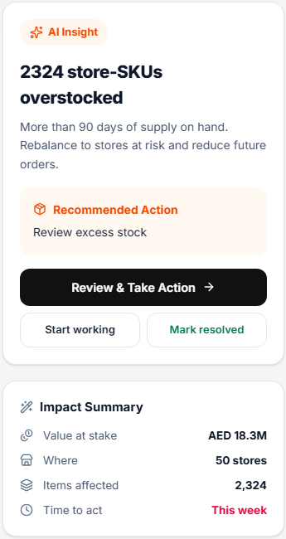



AI suggests. Your people decide.
Approval before action
SCIO drafts the fix; a person reviews and approves every step.
Every answer shows its sources
You can always see which system each number came from.
Works with what you have
No need to replace your current software. SCIO connects to it.
Right access for each role
Managers see their own area; leaders see the whole business.
Notes:
Trust matters. SCIO never acts on its own: it recommends, people approve. Every number is traceable, it plugs into existing tools, and access is controlled by role.

Slide 14
Getting started is simple
1
2
3
Connect your systems
See your first insights
Roll out to every team
We link SCIO to the tools you already use.
Within days, SCIO shows where time and money are leaking.
Each department asks its own questions and acts faster.
S
Stellar SCIO
Connect. Operate. Resolve.
www.stellarscio.app
Notes:
Start small: connect your systems, see the first insights quickly, then roll SCIO out across teams. Thank you.

