Slide 1
Implementation of Tomasulo’s Algorithm
Team #12
Mentor TA: Niranjan Ithal
SRN | Name
PES1UG22EC299 | Sujal Yatin Vaidya
PES1UG22EC319 | Thithikshaa S
PES1UG22EC320 | Thruptha Y
PES1UG22EC324 | Vanisri P

Slide 2
Implementation of Tomasulo’s Algorithm
Motivation:
Traditional processors execute instructions in-order, leading to pipeline stalls
Modern processors need higher instruction-level parallelism (ILP)
Memory access and long-latency operations create bottlenecks
Tomasulo's algorithm solves these by enabling out-of-order execution while maintaining correctness

Slide 3
Implementation of Tomasulo’s Algorithm
Theory Overview:
Dynamic scheduling algorithm that handles data hazards efficiently
Uses reservation stations to track and manage instruction dependencies
Maintains program order through in-order commitment

Slide 4
Implementation of Tomasulo’s Algorithm
3. Project Features:
Parameterized design (configurable number of instructions, registers)
Support for multiple instruction types with different latencies
Complete pipeline stage tracking (issue → execute → write → commit)
Hardware-efficient implementation using reservation stations

Slide 5
Implementation of Tomasulo’s Algorithm
4. Real-world Relevance:
Foundation of modern processor architectures
Critical for high-performance computing
Used in most contemporary superscalar processors
Enables efficient instruction-level parallelism

Slide 6
Block Diagram
Register Table
F0
F1
F2
F3
F4
F5
F6
F7
INSTRUCTION | ISSUE | EX-START | EX-COMP | WRITE | COMMIT
LD F0, 34 + R2 | 1 | 2 | 3 | 4 | 5
LD F2, 45 + R3 | 2 | 4 | 5 | 6 | 7
MUL F3, F2, F4 | 3 | 7 | 12 | 13 | 14
SUB F5, F1, F2 | 4 | 7 | 8 | 9 | 15
DIV F0, F3, F1 | 5 | 14 | 38 | 39 | 40
ADD F1, F5, F2 | 6 | 10 | 11 | 12 | 41
Instruction Queue
SUB F5, F1, F2
MUL F3, F2, F4
LD F2, 45 + R3
LD F0, 34 + R2
Operand Busses
Operation Busses
LOAD, ADD, SUB: 2 CYCLES
MUL: 6 CYCLES
DIV: 25 CYCLES
Reservation Stations
Reservation Stations
MEMORY UNIT
ADDER UNIT
MULTIPLIER UNIT
Common Data Bus

Slide 7
Contribution
What changes compared to base implementation?
Developed a fully original Verilog implementation tailored to the specific problem requirements, without relying on a pre-existing base implementation.

Slide 8
Individual Contribution
Sujal
Designed the main synthesizable algorithm with the help of others
Thithikshaa
Coded the testbench and testcases needed to cover the design
Helped in error correction and debugging

Slide 9
Individual Contribution
Thruptha
Assisted in the coding of the algorithm needed to make the design synthesizable
Helped optimize the design
Vanisri
Assisted in transitioning instruction loading logic from design to testbench
Helped in error correction and debugging

Slide 10
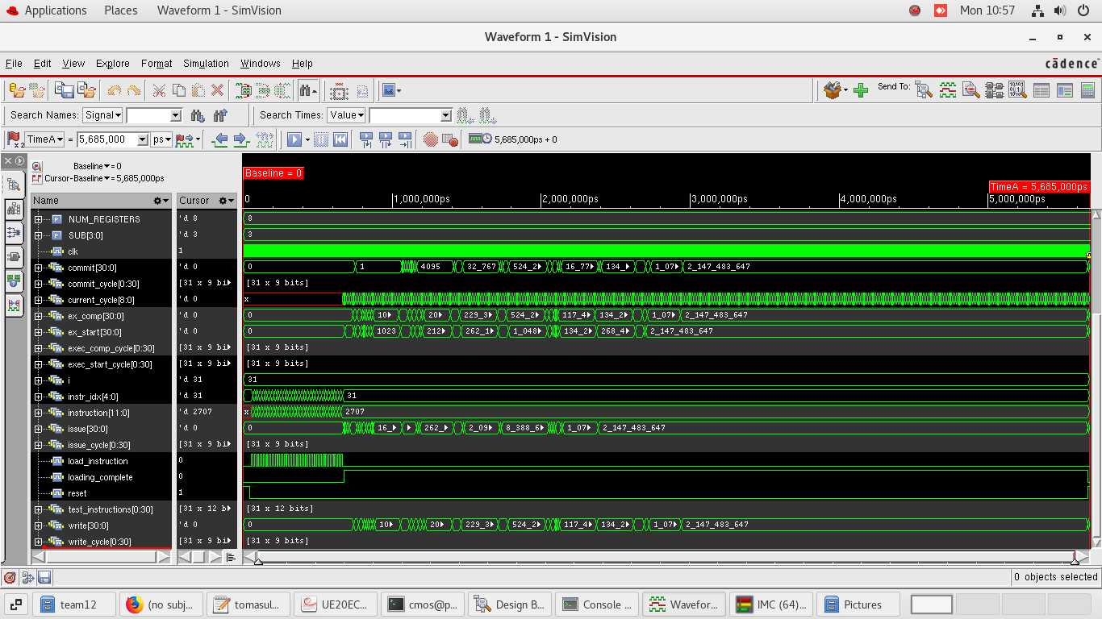
Waveforms (and explanation of design)
Waveform Screenshots only
No text

Slide 11
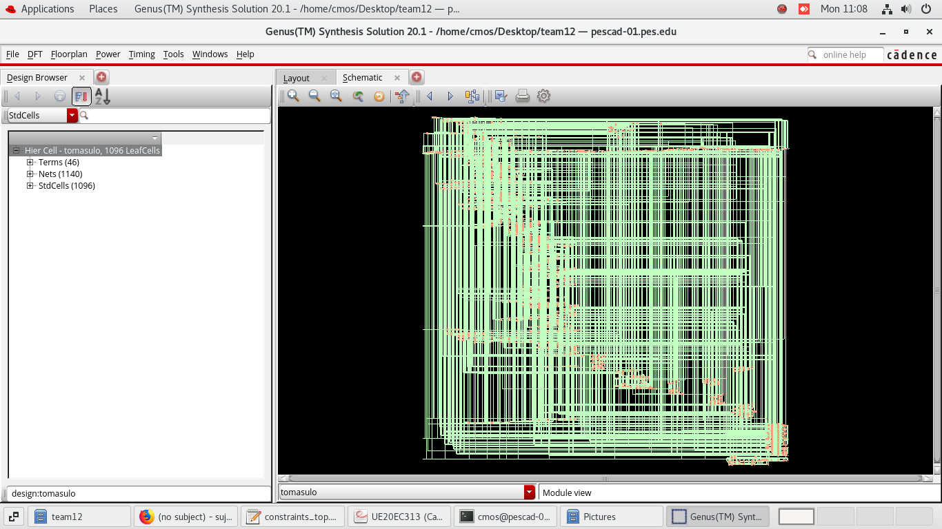
Waveforms (and explanation of design)
Waveform Screenshots only
No text

Slide 12
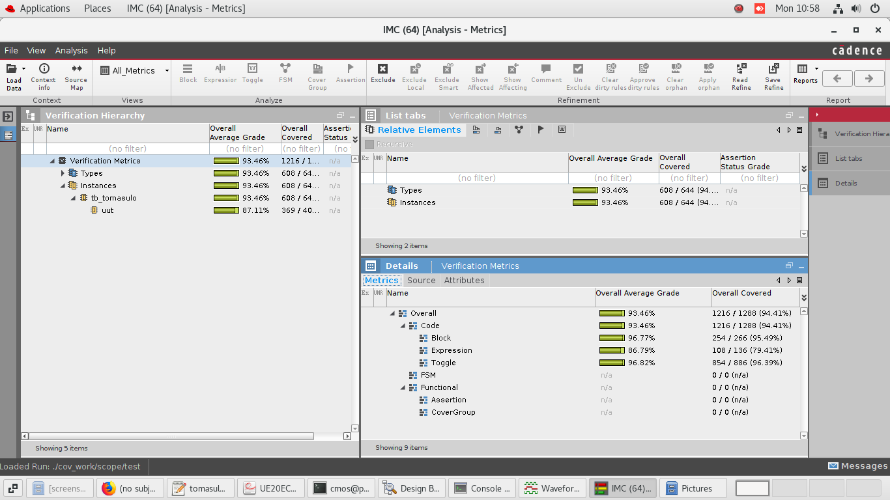
Coverage
Screenshots only
No text

Slide 13
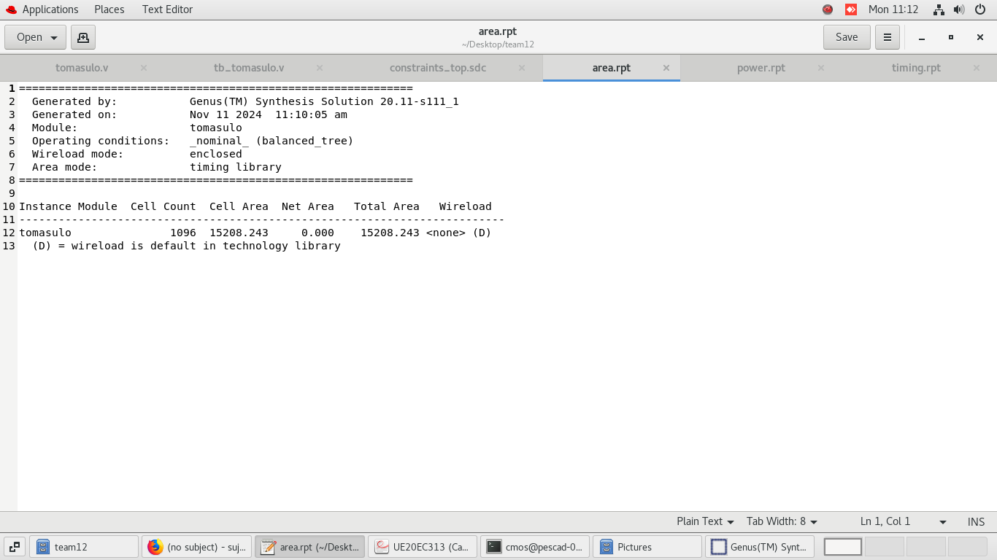
Area Report
Screenshot of Report at Max Freq
No Text

Slide 14
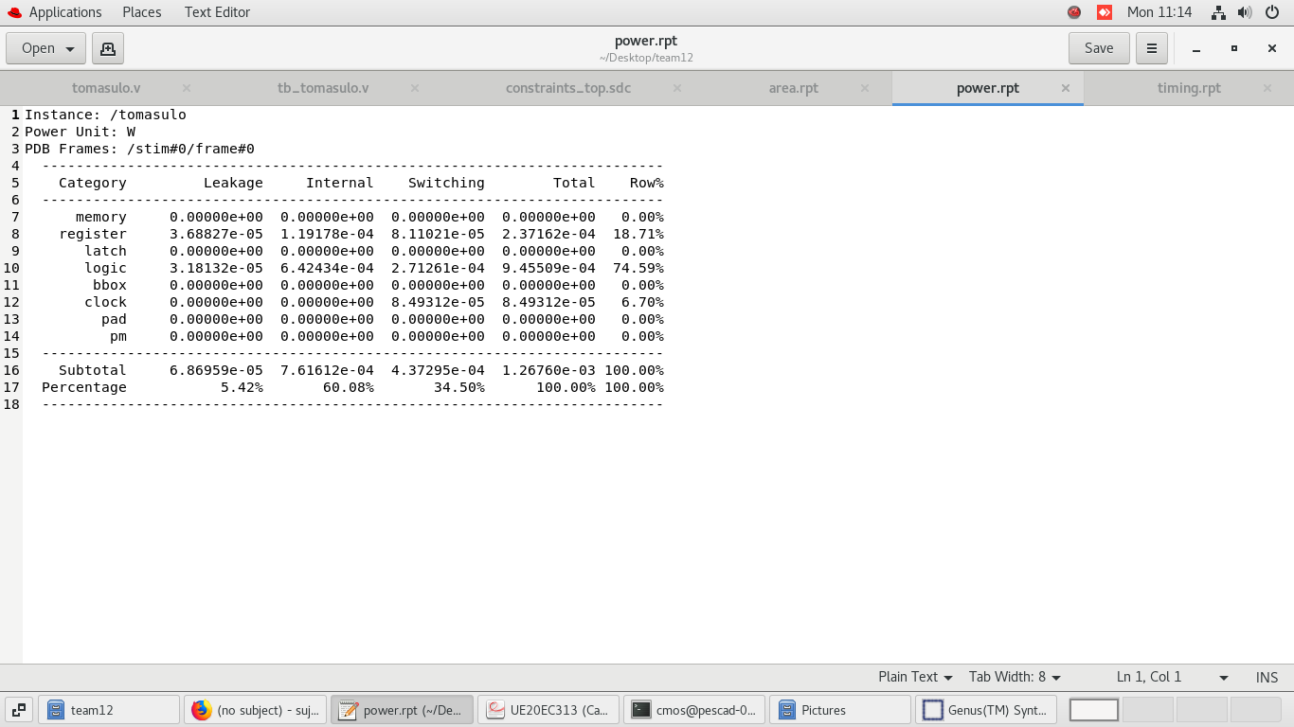
Power Report
Screenshot of Report at Max Freq
No Text

Slide 15
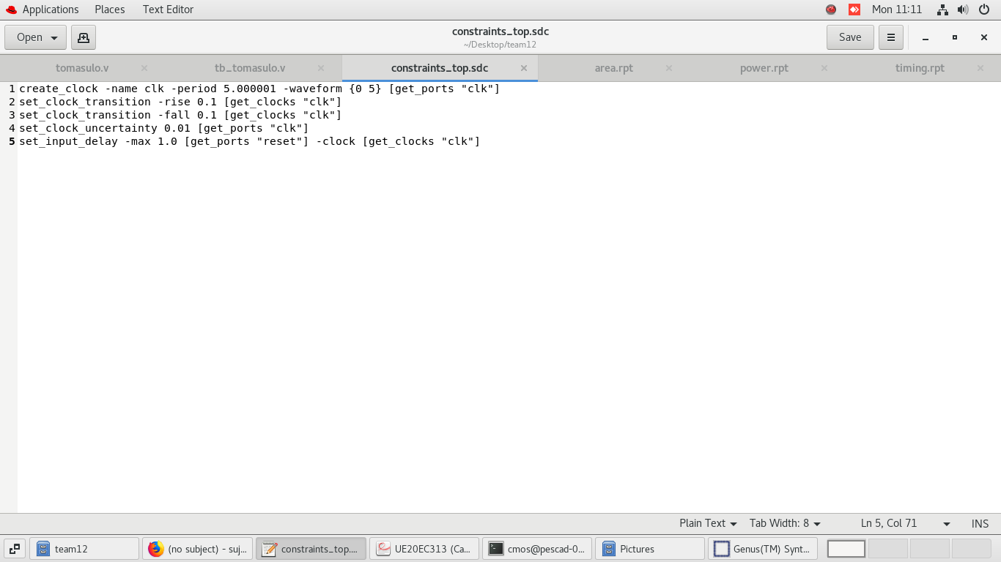
Timing Report
Max Freq of your design: 199.999 MHz
Screenshot of Report at Max Freq
No Text

Slide 16
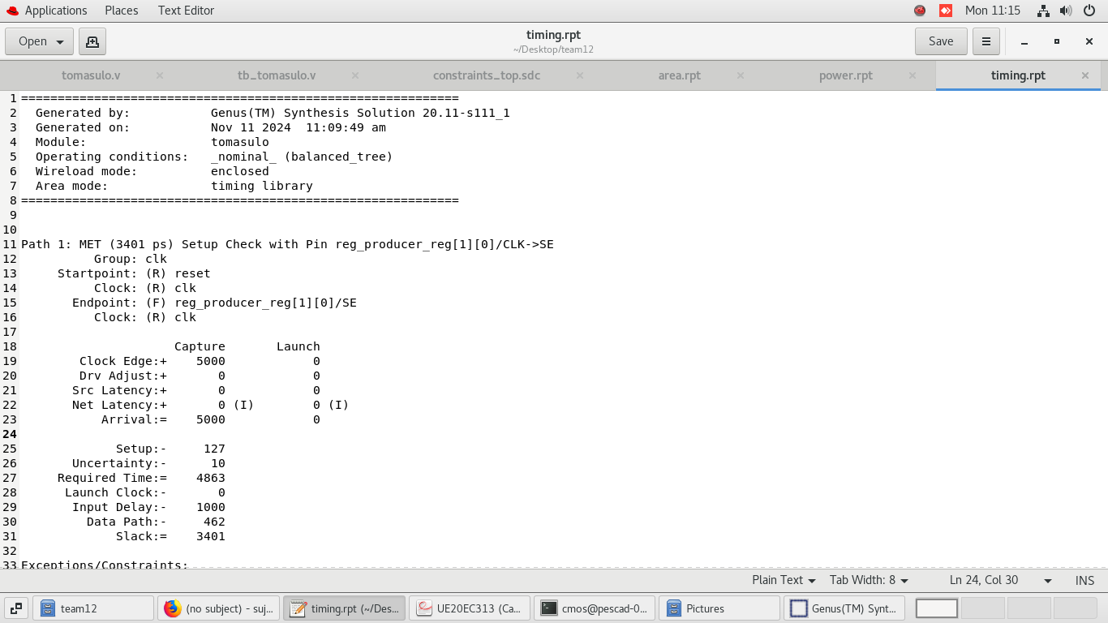
Timing Report
Max Freq of your design: 199.999 MHz
Screenshot of Report at Max Freq
No Text

Slide 17
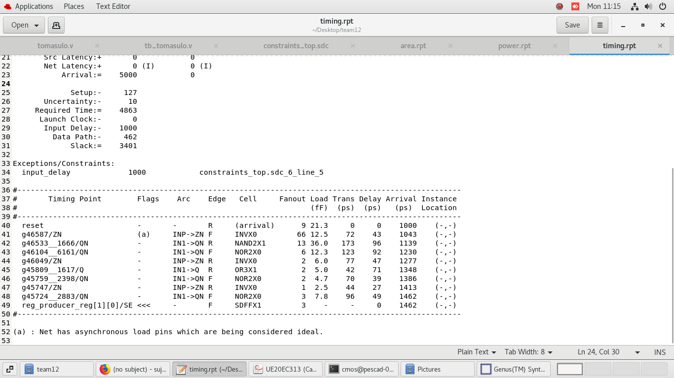
Timing Report
Max Freq of your design: 199.999 MHz
Screenshot of Report at Max Freq
No Text

Slide 18
References
Verilog Basics
https://www.chipverify.com
DSD course slides
Tomasulo’s algorithm
Computer Architecture course slides and notes provided by the TA
https://www.youtube.com/watch?v=zS9ngvUQPNM

