Slide 1

Layered Testbench of Tomasulo’s Algorithm
Team ID: 6

Slide 2

Introduction and Features
Introduction
Tomasulo's algorithm is a fundamental technique employed in modern microprocessors to enable dynamic instruction scheduling and improve overall performance. This project aims to thoroughly verify the implementation of Tomasulo's algorithm, ensuring its adherence to the expected behavioral and timing characteristics.
Features
Assertion-Based Validation
Coverage-Driven Optimization
Execution Monitoring
Modular Testbench Architecture

Slide 3
Block Diagram of the Design
Register Table
F0
F1
F2
F3
F4
F5
F6
F7
INSTRUCTION | ISSUE | EX-START | EX-COMP | WRITE | COMMIT
LD F0, 34 + R2 | 1 | 2 | 3 | 4 | 5
LD F2, 45 + R3 | 2 | 4 | 5 | 6 | 7
MUL F3, F2, F4 | 3 | 7 | 12 | 13 | 14
SUB F5, F1, F2 | 4 | 7 | 8 | 9 | 15
DIV F0, F3, F1 | 5 | 14 | 38 | 39 | 40
ADD F1, F5, F2 | 6 | 10 | 11 | 12 | 41
Instruction Queue
SUB F5, F1, F2
MUL F3, F2, F4
LD F2, 45 + R3
LD F0, 34 + R2
Operand Busses
Operation Busses
Reservation Stations
Reservation Stations
LOAD, ADD, SUB: 2 CYCLES
MUL: 6 CYCLES
DIV: 25 CYCLES
MEMORY UNIT
ADDER UNIT
MULTIPLIER UNIT
Common Data Bus

Slide 4
Block Diagram of Layered Testbench
Testbench Top
Test
Environment
DUT
Transaction
Inter
face
Generator
Driver
Transaction
Scoreboard
Monitor
Assertions
Assumptions
Coverpoints

Slide 5
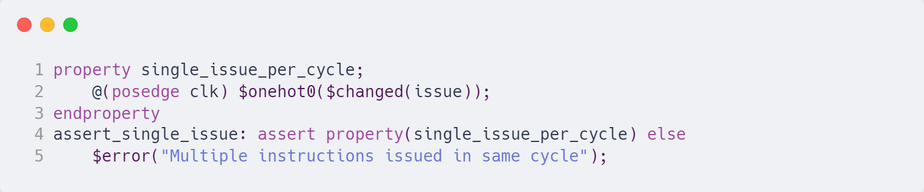
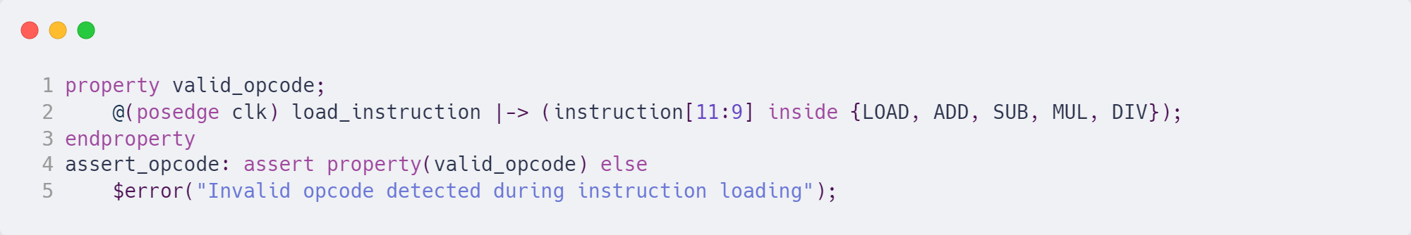
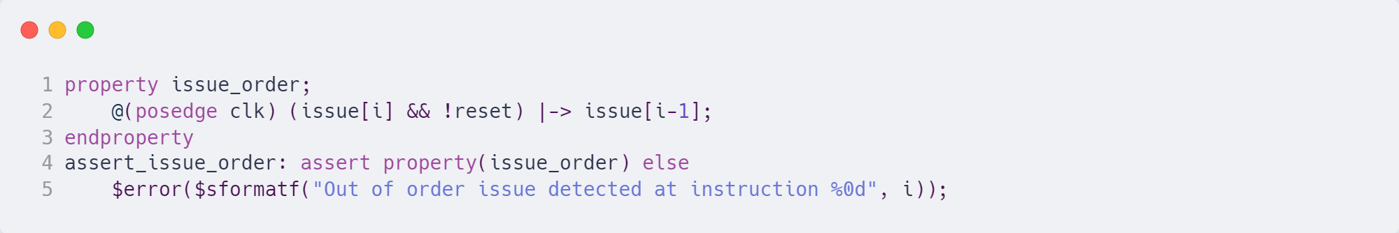
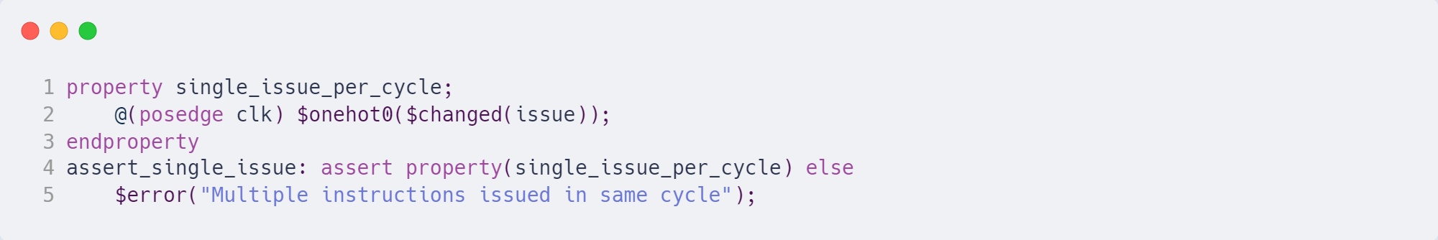
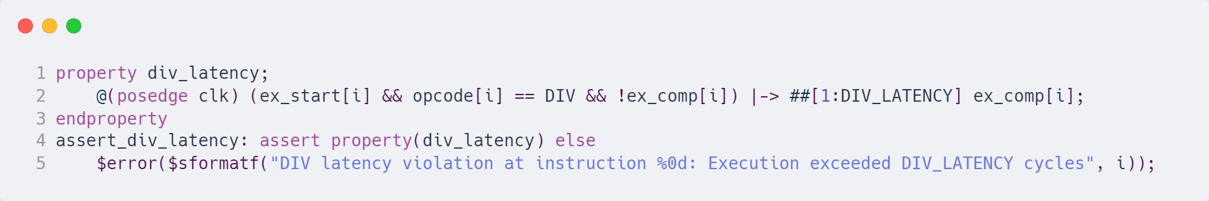
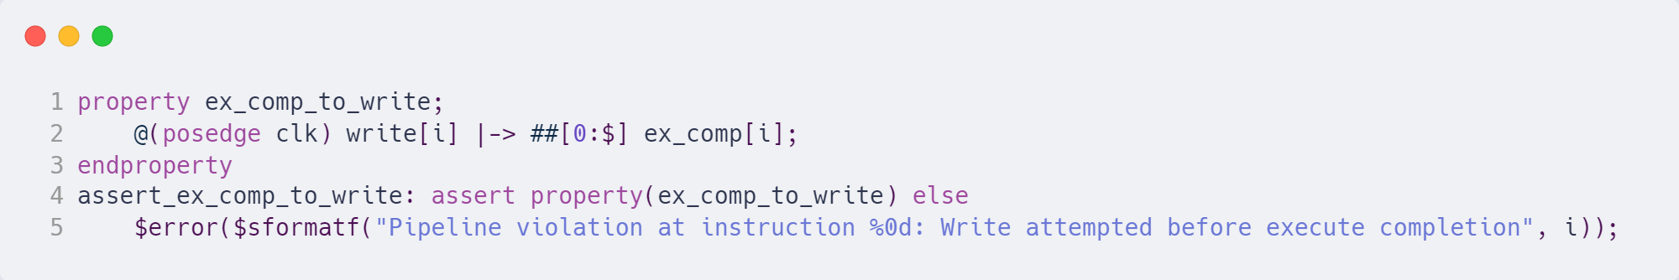
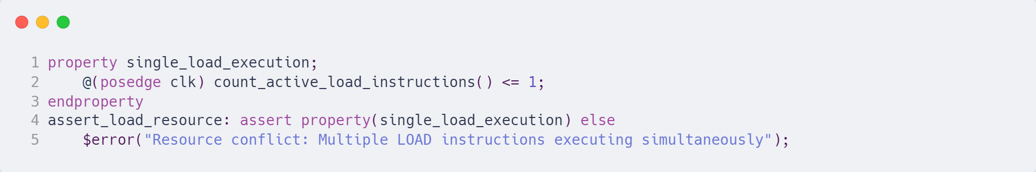
Assertions

Slide 6
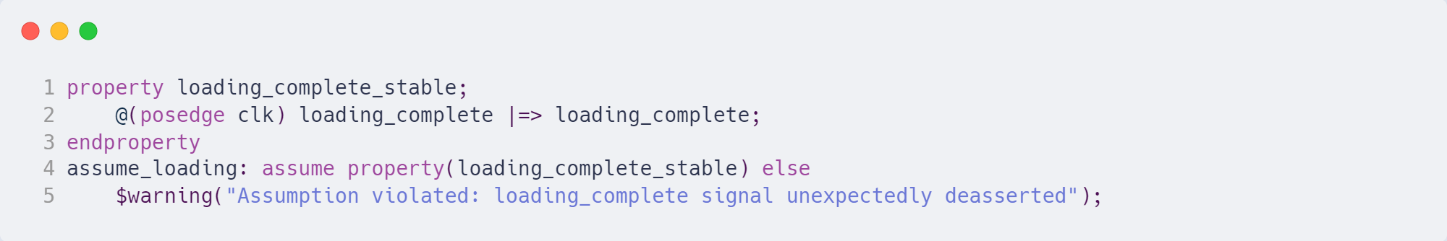
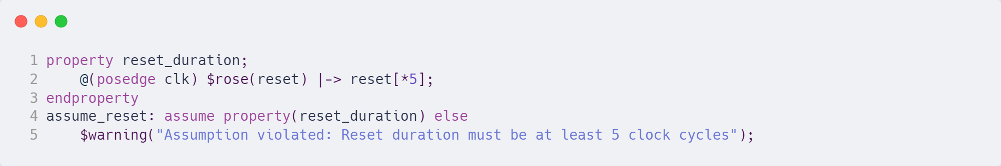
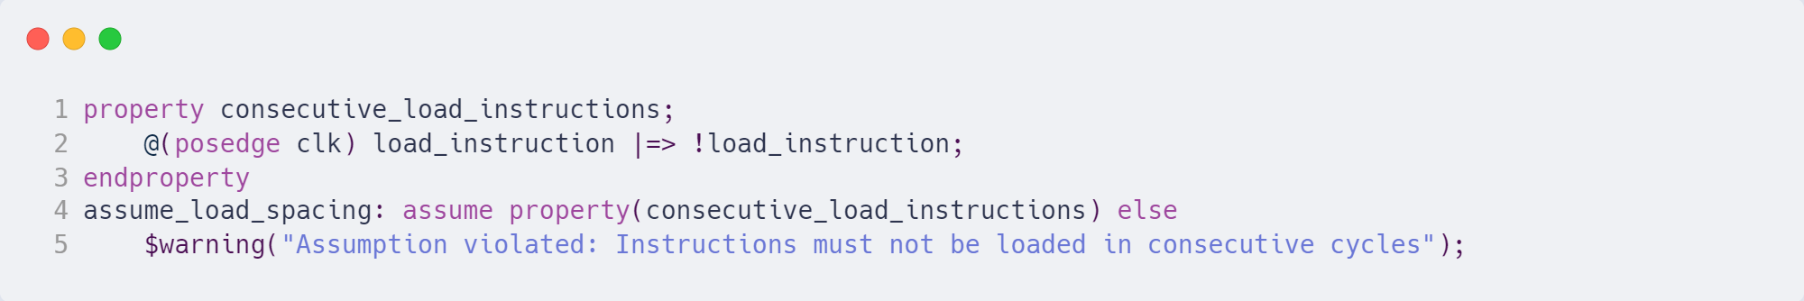
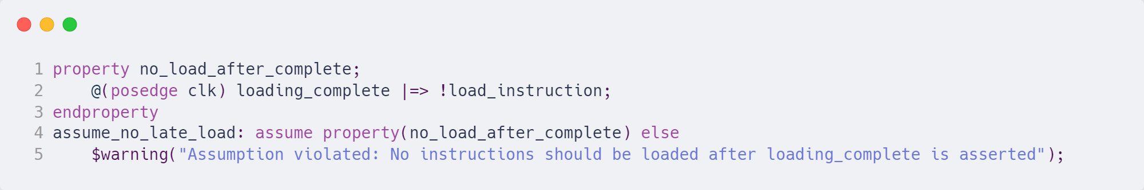
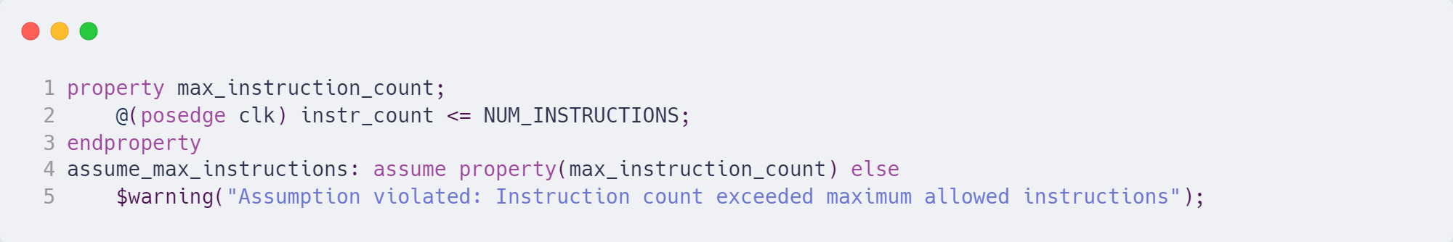
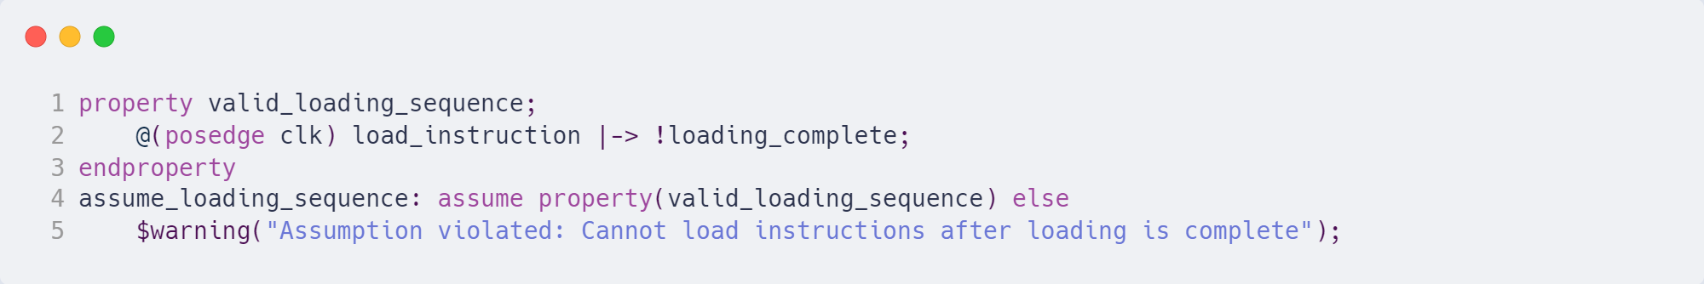
Assumptions

Slide 7
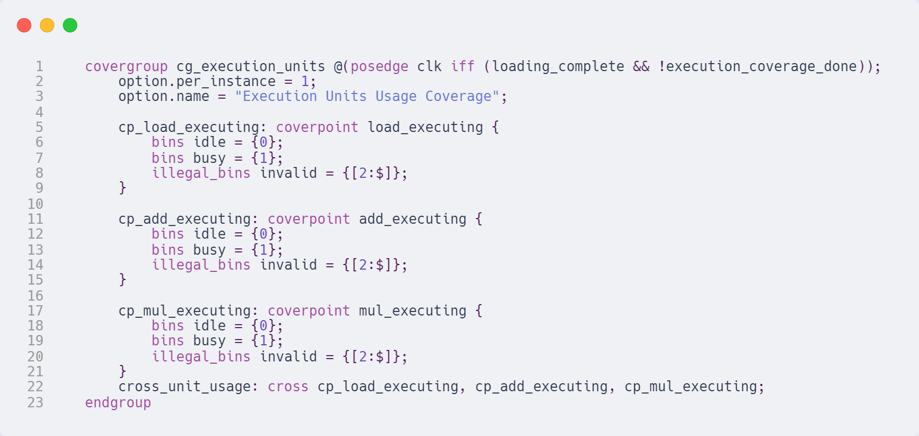
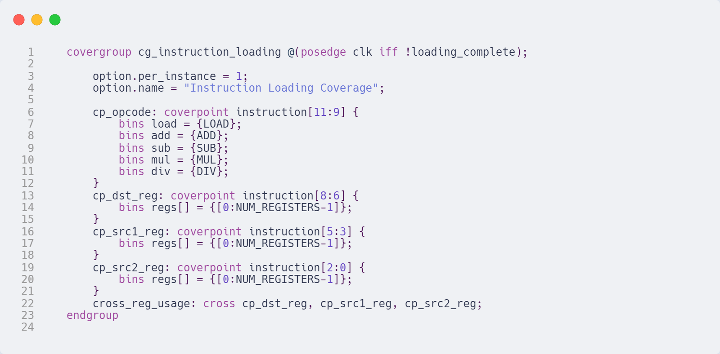
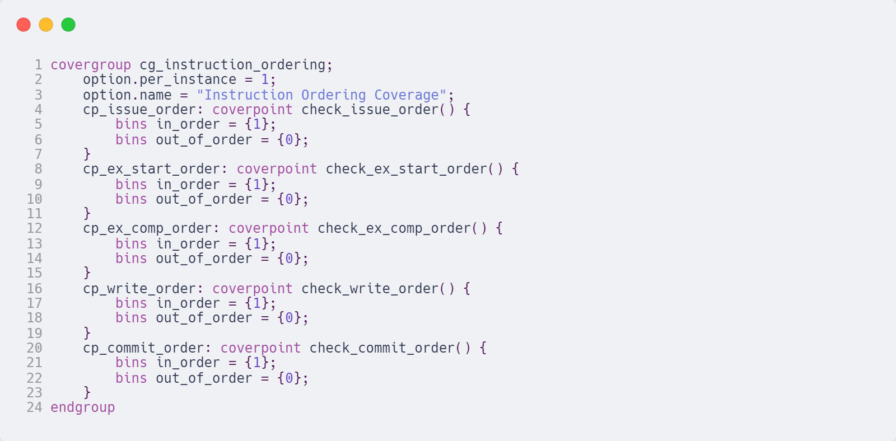
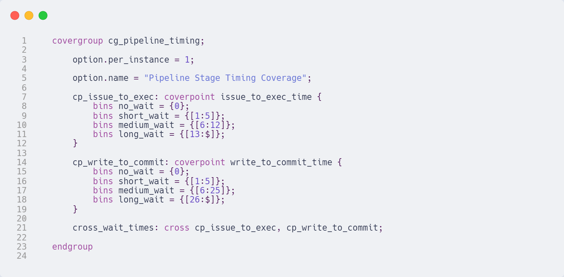
Covergroups

Slide 8
Coverage Report
Covergroup | Name | Coverage
Instruction Loading Coverage | cp_opcode | 5/5 (100%)
 | cp_dst_reg | 8/8 (100%)
 | cp_src1_reg | 8/8 (100%)
 | cp_src2_reg | 8/8 (100%)
 | cross_reg_usage | 26/512 (5.08%)
Covergroup | Name | Coverage
Instruction Ordering Coverage | cp_issue_order | 1/2 (50%)
 | cp_ex_start_ordder | 1/2 (50%)
 | cp_ex_start_order | 1/2 (50%)
 | cp_write_order | 1/2 (50%)
 | cp_commit_order | 1/2 (50%)
Covergroup | Name | Coverage
Executions units usage coverage | cp_load_executing | 2/2 (100%)
 | cp_add_executing | 2/2 (100%)
 | cp_mul_executing | 2/2 (100%)
 | cross_unit_usage | 6/8 (75%)
Covergroup | Name | Coverage
Pipeline Stage Timing Coverage | cp_issue_to_exec | 4/4 (100%)
 | cp_write_to_commit | 4/4 (100%)
 | cross_wait_times | 11/16 (68.75%)

Slide 9
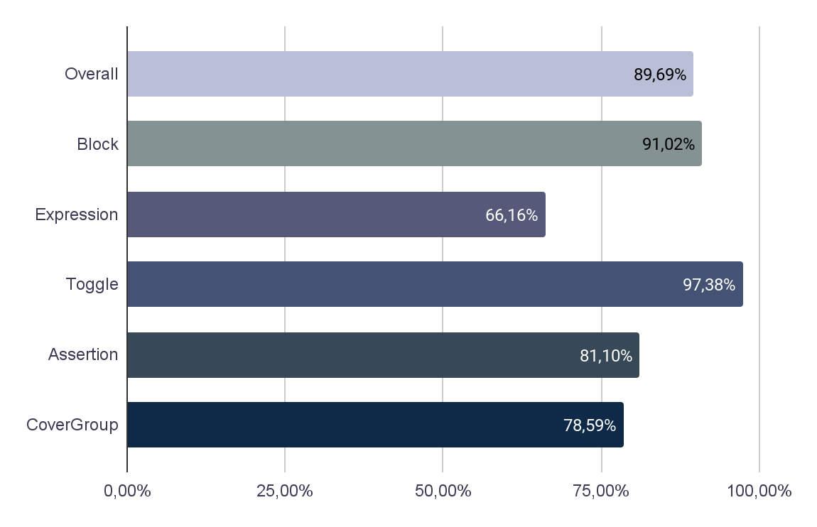

Code Coverage
*As obtained using Cadence Incisive Metrics Center

Slide 10
References
FFVDD Course Slides
[YouTube] System Verilog Testbench code for Full Adder
ChipVerify

