Slide 1
Optimal Selection of Crowdsourcing Workers Balancing their Utilities and Platform Profit
MS Thesis Defense
Presented By:
Sujan Sarker
Exam Roll: 1314 (2015 - 2016)
Supervised By:
Prof. Dr. Md. Abdur Razzaque
Dept. of Computer Science and Engineering
University of Dhaka
Notes:
Good afternoon my respected teachers and esteemed fellows.
Welcome to my Phd thesis defense presentation titled “ Dynamic Traffic Engineering for High Throughput Data Delivery in WMNs….”
First I’d like to introduce myself.
Me, Maheen Islam is a PhD candidate of CSE department at Dhaka University.
My supervisors are Dr. Md. Abdur Razzak Sir and Dr. Mamun Or Rashid sir.

Slide 2
Presentation Outline
Introduction
Research Challenges and Motivation
Related Work
Contribution
Proposed System
Performance evaluation
Summery of the thesis

Slide 3





Crowdsourcing
3
Distributed problem solving model
Outsources tasks to the crowd
Online community
Easy for human, difficult for computer
Innovation
Problem solving
Efficiency

Slide 4
Mobile Crowdsourcing
4
Smartphone
77 %
Smartphone
ubiquitous
seamless Internet connectivity
(e.g.,Wi-Fi, cellular, etc.)
multi sensing capabilities
Tablet
51 %
% of adults in USA (Nov 2016) [12]
Mixing smartphone based mobile technologies and crowdsourcing offers a new paradigm called Mobile Crowdsourcing (MCS)
[12] “Mobile technology fact sheet,” Available online: http://www.pewinternet.org/
fact-sheets/mobile technology-fact-sheet, accessed on 17 November 2017.

Slide 5
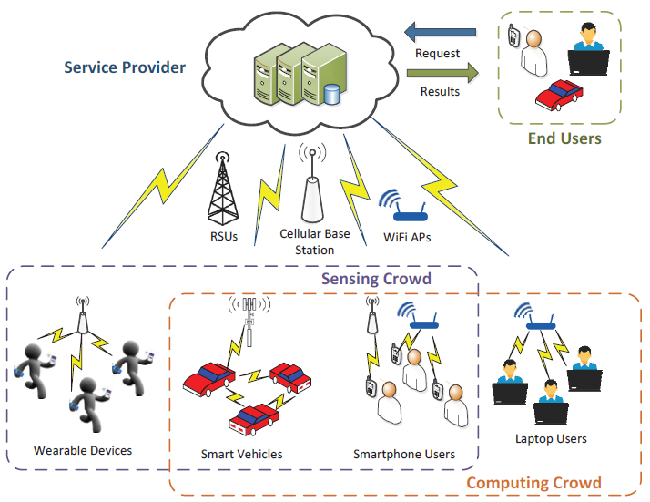
Players in MCS
5

Slide 6
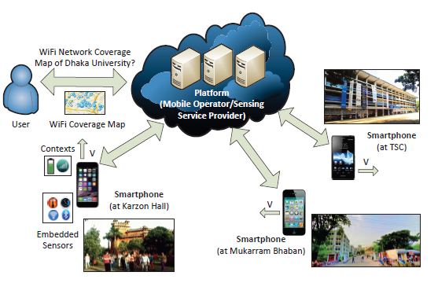
An Example of MCS System
6

Slide 7
Some MCS Applications
7
Traffic monitoring and smart navigation
Nericel[3], Vtrack[4]
Environmental monitoring
PIER[2], EarPhone[5]
Social networking
crowdSMILE[28]
Disaster Reporting
Project Jagriti[25]

Slide 8
Challenges in MCS
8
Decomposing service request into subtasks
Considering workers spatial and temporal availability
Controlling sensing quality
Making sufficient profit from the MCS system
Trade-off issues (e.g., profit quality trade-off)
Data quality assessment
Lucrative payment policy for the workers
Managing past sensing reputation

Slide 9
Research Questions
9
How to maximize quality of sensed data while fixing a profit margin of the platform?
How to maximize profit of a platform while keeping the required quality of sensed data for MCS applications?
How to make a reasonable trade-off in between the above two performance metrics?

Slide 10

State-of-the-Art-Works
10

Slide 11
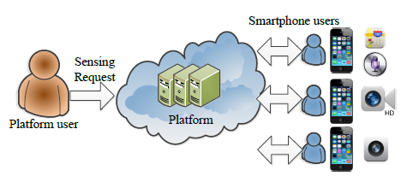
PROMOT Mechanism [39]
11
Greedily selects worker with a aim to maximize platform profit
Do not consider worker’s location or mobility
Tasks are considered atomic
Provide satisfactory reward to the winners
Do not consider worker past sensing reputation
[ 39] H. Shah-Mansouri and V. W. S. Wong, “Profit maximization in mobile crowdsourcing: A truthful auction mechanism,” in 2015 IEEE International Conference on Communications (ICC), June 2015, pp. 3216–3221.

Slide 12
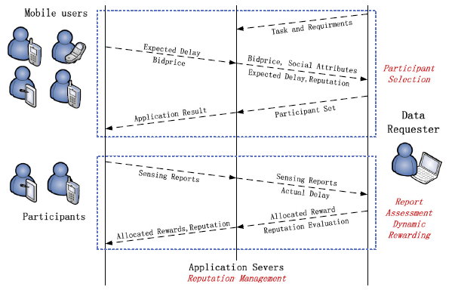
SACRM System [36]
12
Consider worker’s social attribute, task completion delay and reputation
Profit of the platform is not considered
Do not consider worker mobility or location
Report assessment and rewarding scheme
Can’t handle heterogeneous task request
[ 36] J. Ren, Y. Zhang, K. Zhang, and X. S. Shen, “Sacrm: Social aware crowdsourcing with reputation management in mobile sensing,” Computer Communications, vol. 65, pp. 55 – 65, 2015, mobile Ubiquitous Sensing from Social Network Viewpoint.

Slide 13
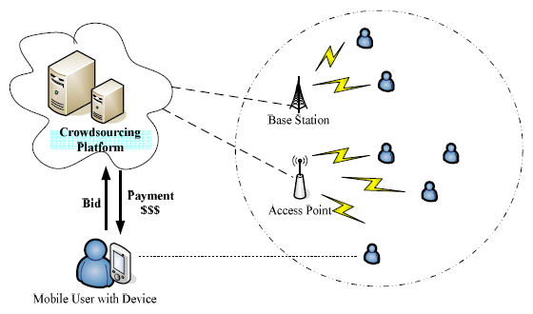
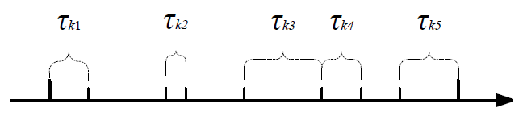
MSC System [46]
13
Worker location, mobility or past sensing reputation are not considered
Consider Two patterns : continuous and Discontinuous
Selects workers with a aim to minimize social cost
Can’t handle heterogeneous task request
[46 ] Z. Duan, M. Yan, Z. Cai, X. Wang, M. Han, and Y. Li, “Truthful incentive mechanisms for social cost minimization in mobile crowdsourcing systems,” Sensors, vol. 16, no. 4, 2016.

Slide 14
Thesis Contributions
14
Designed a workload allocation framework for MCS platform named PQ-Trade system.
Defined worker utility based on its mobility, current location and past sensing reputations.
Allocation problem is formulated as MONLP problem
Proven to be NP-Hard
Developed two greedy solutions
First fit utility maximization
First fit profit maximization
A payment policy for the selected worker
Performance evaluation of the algorithms and comparison with existing techniques

Slide 15
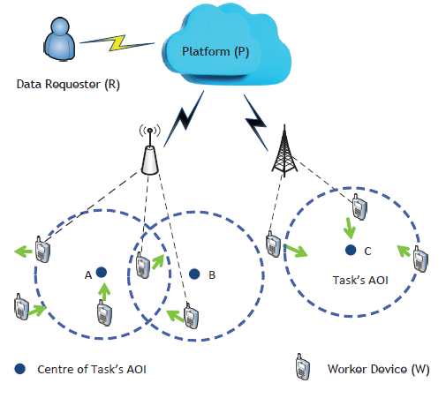

System Model
15
Sensing tasks set,
Each task is define by the tuple,
Set of workers,
Each bid is defined by the tuple,

Slide 16
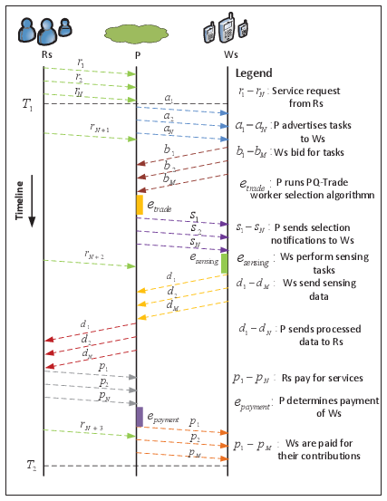
Interaction among Entities
16
Workload allocation
Perform tasks
Report assessment and payment

Slide 17
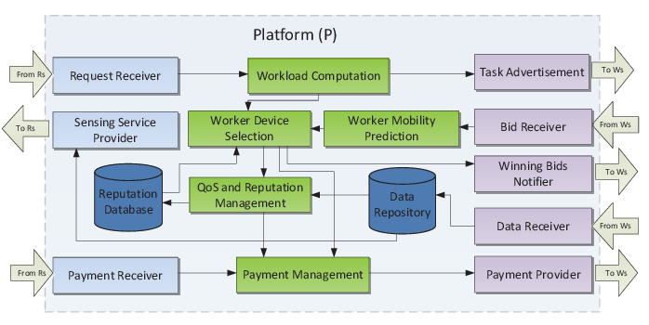
Computational Model of PQ – Trade Platform
17
Interact with Data Requesters
Core Computational Modules
Interact with Worker Devices

Slide 18
Receiving Sensing Task Request
18
Request Receiver
Workload Computation
Location
Type
Deadline
Budget

Slide 19

Workload Computation
19
Location
Type
Deadline
Budget
Workload
Request Receiver
Workload Computation
Location
Type
Deadline
Budget
Workload
Each task is divided into subtasks of uniform size.
Total number of subtasks is defined as workload of that task
Task Pool
Task volume
Size of uniform
subtask
For heterogeneous service request subtask definition can be more complex
- Introduces another research problem [62]
[62] S. Chen, M. Liu, and X. Chen, “A truthful double auction for two-sided heterogeneous mobile crowdsensing markets,” Computer Communications, vol. 81, no. Complete, pp. 31–42, 2016.

Slide 20



Calculation of Worker Sojourn Time in a Task’s AOI
20
Worker move at random direction with random velocity
Smooth Random mobility mode to predict expected velocity,
and sojourn time, [65]
Worker Mobility Predictor
[65] M. H. G. F. Asma Enayet, Md. Abdur Razzaque, “A mobility-aware optimal resource allocation architecture for big data task execution on mobile cloud in smart cities,”IEEE Communications Magazine, 2017.

Slide 21



Utility of a Worker
21
Distance Based Utility
Mobility Based Utility
Past Sensing Quality Based Utility

Slide 22

22
Mobility Based Utility Calculation
Worker Device Selection
Worker Mobility Prediction
is the completion delay of task t by worker m
is the delay deadline of task t
is the sojourn time of worker m in the AOI of task t
[36] J. Ren, Y. Zhang, K. Zhang, and X. S. Shen, “Sacrm: Social aware
crowdsourcing with reputation management in mobile sensing,” Computer
Communications, vol. 65, pp. 55 – 65, 2015.

Slide 23

23
Distance Based Utility Calculation
Worker Device Selection
Worker Mobility Prediction
Further away the user is, less sensing quality it can provide.
Temperature, Wi-Fi signal Strength, etc.
Can be modeled as:
Distance factor

Slide 24

24
Location Based Utility Calculation
Worker Device Selection
Worker Mobility Prediction
Combines and to define location based utility
Worker with longer remaining lifetime and closer to the task center gives higher utility

Slide 25


25
Past Quality Based Utility Calculation
Worker Device Selection
Reputation
Database
Quality Indicator,
Standard deviation of sensed data
For a new worker
Scaling factor
[37] B. Song, H. Shah-Mansouri, and V. W. S. Wong, “Quality of sensing aware budget
feasible mechanism for mobile crowdsensing,” IEEE Transactions on Wireless
Communications, vol. 16, no. 6, pp. 3619–3631, June 2017.

Slide 26

Combined Utility Calculation
26
Now we calculate the combined utility of a worker m for performing task t as,
weighting factor

Slide 27


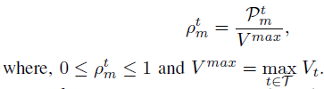
Profit of the Platform
27
Profit of the Cloud Platform can be calculated as:
Worker claimed cost
Monetary value of the task,,
Now we calculate normalized profit as:

Slide 28


MONLP Problem Formulation
28
where,
= 1
= 0
0 < < 1
Utility maximization problem
Profit maximization problem
Makes desired trade-off

Slide 29
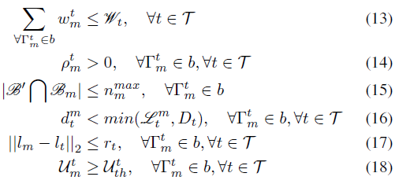
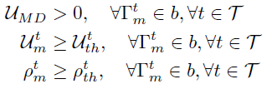
Constraints
29
Workload constraint
Maximum bid constraint
Worker availability constraint
Marginal utility constraint
Marginal profit constraint

Slide 30
Workload Allocation Problem is NP - Hard
30
MONLP selects a subset b from P(B), i.e., b ∈ P(B) that maximizes the objective function satisfying given constraints.
Same as maximum weight subset selection problem
NP-hard

Slide 31
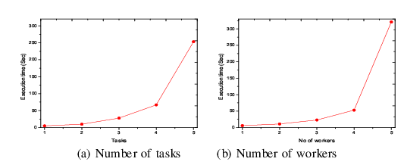
Execution Time
31
NEOS Optimization server (2x Intel
Xeon E5-2698 @ 2.3GHz CPU and 92GB RAM

Slide 32
First-Fit Greedy Solutions
32
First-Fit Utility Maximization (FFU): aims at maximizing utility while keeps profit in a marginal level.
First-Fit Profit Maximization (FFP): profit is maximized while utility is kept in a marginal level.

Slide 33
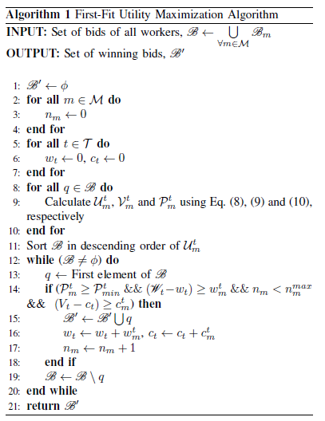
FFP Maximization Algorithm
33

Slide 34
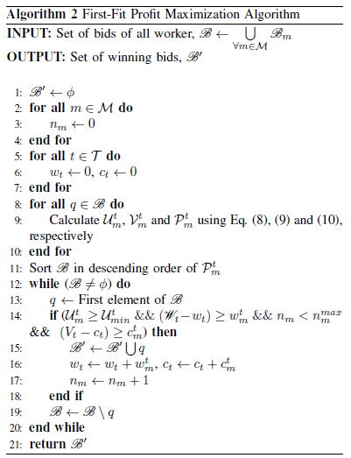
FFU Maximization Algorithm
34

Slide 35
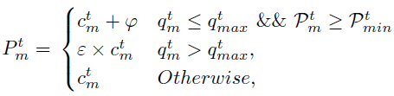


Worker Payment Policy
35
QoS and Reputation Management
Worker Device Selection
Payment
Management
Payment Provider
Penalty factor
Reward point
Weight factors

Slide 36
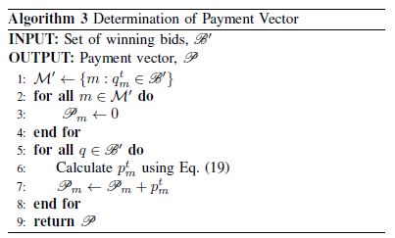
Worker Payment Determination Algorithm
36

Slide 37


Updating Quality Records
37
Reputation
Database
Data Repository
QoS and Reputation Management
Calculate SD of sensed data from the truth value
Truth value can be determined using methods proposed in [53]
Update qm using EWMA
[53] Y. Li, Q. Li, J. Gao, L. Su, B. Zhao, W. Fan, and J. Han, “Conflicts to harmony: A
framework for resolving conflicts in heterogeneous data by truth discovery,” IEEE
Transactions on Knowledge and Data Engineering, vol. 28, no. 8, pp. 1986–1999,Aug 2016.

Slide 38
Performance Evaluation
38
We carry out performance analysis of the proposed algorithms – PQ-Trade (ω = 0.6), FFP and FFU using MATLAB [67]
Present comparative results with state-of-the-art works SACRM [36] and MSC [46]
We hardly found any simulation tool for MCS system simulation
[36] J. Ren, Y. Zhang, K. Zhang, and X. S. Shen, “Sacrm: Social aware
crowdsourcing with reputation management in mobile sensing,” Computer
Communications, vol. 65, pp. 55 – 65, 2015.
[46] Z. Duan, M. Yan, Z. Cai, X. Wang, M. Han, and Y. Li, “Truthful incentive mechanisms for social cost minimization in mobile crowdsourcing systems,” Sensors,
vol. 16, no. 4, 2016.

Slide 39

Simulation Environment
39
Worker device
Sensing task
Arrival of sensing task requests and workers follow poison distribution [69]
Tasks and Workers distribution over simulation are is uniform random
[69] Y. Zhu, Q. Zhang, H. Zhu, J. Yu, J. Cao and L. M. Ni, "Towards Truthful Mechanisms for Mobile Crowdsourcing with Dynamic Smartphones," 2014 IEEE 34th International Conference on Distributed Computing Systems, Madrid, 2014, pp. 11-20.

Slide 40
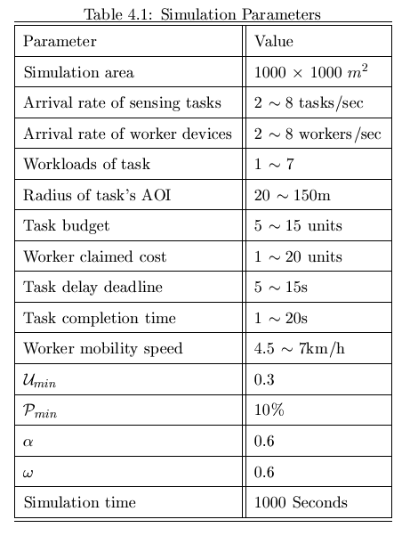
Simulation Parameters
40

Slide 41
Simulation Metrics
41
Profit of the platform
Total amount of revenue received by the platform
Average utility per worker
Ratio of total utility received from selected workers to total number of workers
Request service satisfaction
Ratio of total number of completed workloads to total number of requested workloads
Standard deviation of sensing quality
Average SD of quality of sensed data received from the selected workers
Average payment per worker
Ratio of total payment of selected workers to total number of workers
Execution time
Total time required to run worker selection and task allocation algorithms

Slide 42
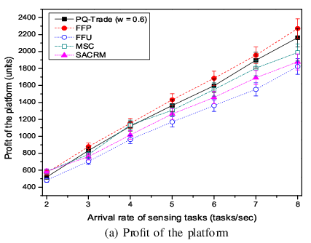
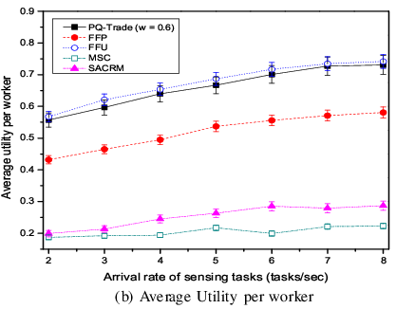
Impact of Varying Task Arrival Rates (1/3)
42
Highest profit
Gives more weight to utility
Sacrifices profit for utility
Sacrifices utility for profit
Worker mobility, location, past sensing quality
Arrival rate of workers
5 workers/sec

Slide 43
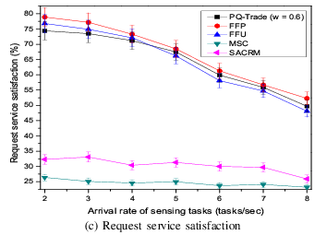
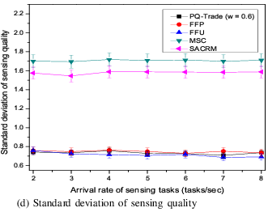
Impact of Varying Task Arrival Rates (2/3)
43
Worker sojourn time, location, Past sensing quality, marginal utility
High quality data with less standard deviation
Arrival rate of workers
5 workers/sec

Slide 44
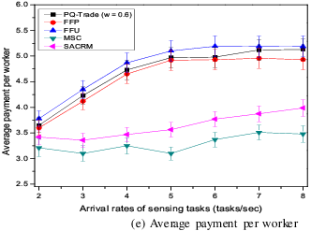
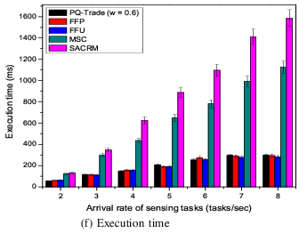
Impact of Varying Task Arrival Rates (3/3)
44
Runs in several milliseconds
Adaptive rewarding policy
Arrival rate of workers
5 workers/sec

Slide 45
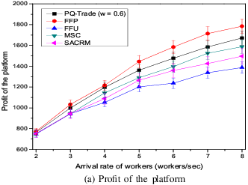
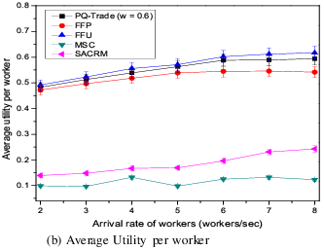
Impact of Varying Worker Arrival Rates (1/3)
45
Rate of increase is slower as the system gets saturated with large # of workers
Utility reaches to a saturation point
Arrival rate of tasks
5 tasks/sec

Slide 46
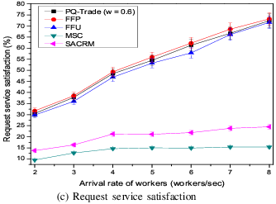
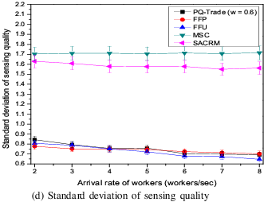
Impact of Varying Worker Arrival Rates (2/3)
46
Workload allocation opportunity increases
More high quality workers get selected
Arrival rate of workers
5 workers/sec

Slide 47
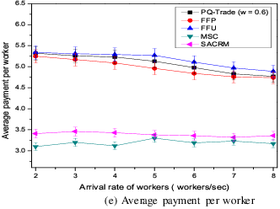
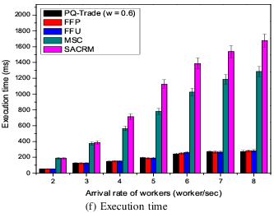
Impact of Varying Worker Arrival Rates (3/3)
47
Arrival rate of workers
5 workers/sec

Slide 48
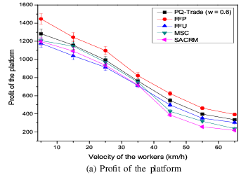
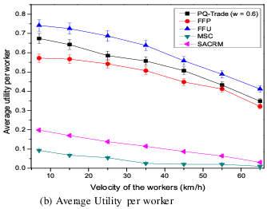
Impact of Varying Worker Velocities (1/2)
48
Unavailability of workers due to decreasing sojourn time
Arrival rate of tasks 5 tasks/sec
Arrival rate of workers 5 workers/sec

Slide 49
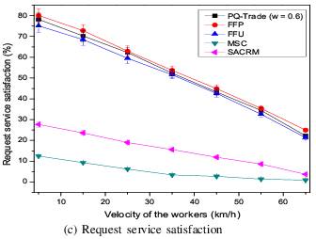
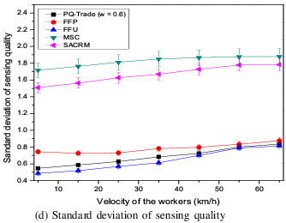
Impact of Varying Worker Velocities (2/2)
49
Unavailability of workers results in selecting poor quality workers
Arrival rate of tasks 5 tasks/sec
Arrival rate of workers 5 workers/sec

Slide 50
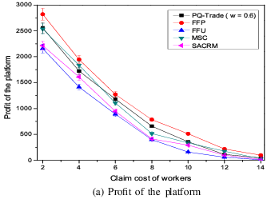
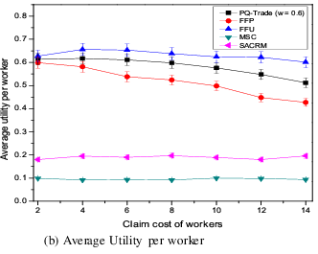
Impact of Varying Claimed Costs (1/2)
50
System fails to maintain minimum profit
Arrival rate of tasks 5 tasks/sec
Arrival rate of workers 5 workers/sec

Slide 51
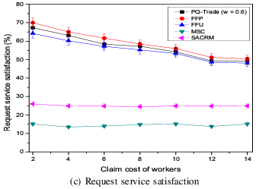
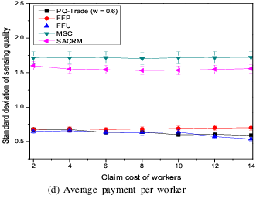
Impact of Varying Claimed Costs (2/2)
51
Arrival rate of tasks 5 tasks/sec
Arrival rate of workers 5 workers/sec

Slide 52
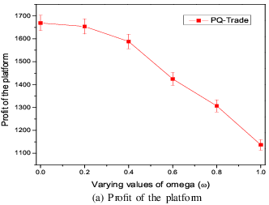
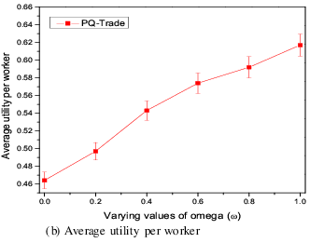
Impact of Varying ω
52
Platform gives more weight to worker utility than its profit

Slide 53
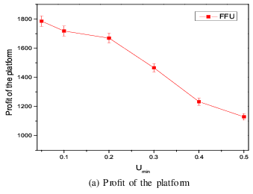
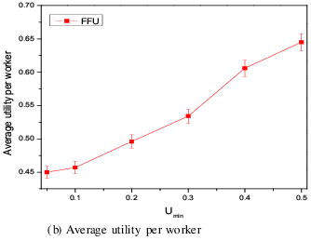
Impact of Varying Umin
53
Instead of profit, platform maximizes worker utility violating design principle

Slide 54
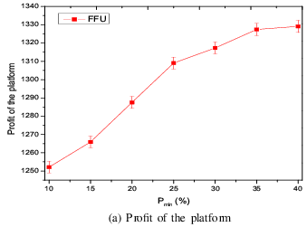
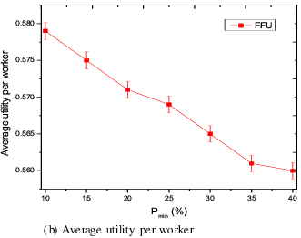
Impact of Varying Pmin
54
Instead of utility, platform maximizes its profit violating design principle

Slide 55
Summery of the Thesis (1/2)
55
Designed workload allocation framework for location aware MCS system.
Worker spacial and temporal availability aware utility model
A MONLP optimization formulation for allocating workload to maintain a reasonable trade-off between quality and profit, proven to NP-hard.

Slide 56
Summery of the Thesis (2/2)
56
Greedy solutions to avoid the complexity – FFP, FFU and PQ-Trade (ω)
FFP achieves profit as higher as 23.8%
FFU achieves average utility gain 2.29x
System’s service satisfaction is 1.6x
PQ-Trade (ω = 0.6) achieves profit as high as 17.21% and utility gain 2.22x
Success of the system highly depends on the system parameter setup

Slide 57
57
References
[1] N. D. Lane, E. Miluzzo, H. Lu, D. Peebles, T. Choudhury, and A. T. Campbell,
“A survey of mobile phone sensing,” Comm. Mag., vol. 48, no. 9, pp. 140–150, Sep 2010.
[2] M. Mun, S. Reddy, K. Shilton, N. Yau, J. Burke, D. Estrin, M. Hansen, E. Howard,
R. West, and P. Boda, “Peir: the personal environmental impact report, as a platform
for participatory sensing systems research,” in in Proc. ACM/USENIX Int.
Conf. Mobile Systems, Applications, and Services (MobiSys) Krakow, 2009.
[3] P. Mohan, V. N. Padmanabhan, and R. Ramjee, “Nericell: Rich monitoring of road
and traffic conditions using mobile smartphones,” in Proceedings of the 6th ACM
Conference on Embedded Network Sensor Systems, ser. SenSys ’08. New York, NY,
USA: ACM, 2008, pp. 323–336.
[4] A. Thiagarajan, L. Ravindranath, K. LaCurts, S. Madden, H. Balakrishnan,
S. Toledo, and J. Eriksson, “Vtrack: Accurate, energy-aware road traffic delay
estimation using mobile phones,” in Proceedings of the 7th ACM Conference on
Embedded Networked Sensor Systems, ser. SenSys ’09. ACM, 2009, pp. 85–98.
[5] R. K. Rana, C. T. Chou, S. S. Kanhere, N. Bulusu, and W. Hu, “Ear-phone: An
end-to-end participatory urban noise mapping system,” in Proceedings of the 9th
ACM/IEEE International Conference on Information Processing in Sensor Networks,
ser. IPSN ’10. New York, NY, USA: ACM, 2010, pp. 105–116

Slide 58
58
[6] G. Chatzimilioudis, A. Konstantinidis, C. Laoudias, and D. Zeinalipour-Yazti,
“Crowdsourcing with smartphones,” IEEE Internet Computing, vol. 16, no. 5, pp.
36–44, Sept 2012.
[7] R. K. Ganti, F. Ye, and H. Lei, “Mobile crowdsensing: current state and future
challenges,” IEEE Communications Magazine, vol. 49, no. 11, pp. 32–39, November
2011.
[8] Z. Feng, Y. Zhu, Q. Zhang, L. M. Ni, and A. V. Vasilakos, “Trac: Truthful auction for
location-aware collaborative sensing in mobile crowdsourcing,” in IEEE INFOCOM
2014 - IEEE Conference on Computer Communications, April 2014, pp. 1231–1239.
[9] D. Yang, G. Xue, X. Fang, and J. Tang, “Crowdsourcing to smartphones: Incentive
mechanism design for mobile phone sensing,” in Proceedings of the 18th Annual
International Conference on Mobile Computing and Networking, ser. Mobicom ’12.
New York, NY, USA: ACM, 2012, pp. 173–184.
[10] S. Sarker, A. K. Nath, and A. Razzaque, “Tradeoffs between sensing quality and
energy efficiency for context monitoring applications,” in 2016 International Conference
on Networking Systems and Security (NSysS), Jan 2016, pp. 1–7.
[11] C. Laoudias, A. Konstantinidis, G. Chatzimilioudis, and D. Zeinalipour-Yazti,
“Crowdsourcing with smartphones,” IEEE Internet Computing, vol. 16, pp. 36–44,
2012.

Slide 59
59
[13] Y. Wang, X. Jia, Q. Jin, and J. Ma, “Mobile crowdsourcing: Architecture, applications,
and challenges,” in 2015 IEEE 12th Intl Conf on Ubiquitous Intelligence and Computing and 2015 IEEE 12th Intl Conf on Autonomic and Trusted Computing and 2015 IEEE 15th Intl Conf on Scalable Computing and Communications and Its Associated Workshops (UIC-ATC-ScalCom), Aug 2015, pp. 1127–1132.
[14] J. Howe, “The rise of crowdsourcing,” Wired Magazine, vol. 14, no. 6, 06 2006.
[Online]. Available: http://www.wired.com/wired/archive/14.06/crowds.html
[15] K. Yang, K. Zhang, J. Ren, and X. Shen, “Security and privacy in mobile crowdsourcing
networks: challenges and opportunities,” IEEE Communications Magazine,
vol. 53, no. 8, pp. 75–81, August 2015.
[16] M. Stevens, “Crowdsourcing of pollution data using smartphones.”
[17] K. Frkas, . Z. Nagy, T. Toms, and R. Szab, “Participatory sensing based real-time
public transport information service,” in 2014 IEEE International Conference on
Pervasive Computing and Communication Workshops (PERCOM WORKSHOPS),
March 2014, pp. 141–144.
[18] J. Eriksson, L. Girod, B. Hull, R. Newton, S. Madden, and H. Balakrishnan, “The
pothole patrol: Using a mobile sensor network for road surface monitoring,” in
Proceedings of the 6th International Conference on Mobile Systems, Applications,
and Services, ser. MobiSys ’08. New York, NY, USA: ACM, 2008, pp. 29–39.
[Online]. Available: http://doi.acm.org/10.1145/1378600.1378605

Slide 60
[19] D. Kwak, D. Kim, R. Liu, L. Iftode, and B. Nath, “Tweeting traffic image reports
on the road,” in 6th International Conference on Mobile Computing, Applications
and Services, Nov 2014, pp. 40–48.
[20] Y. C. Fan, C. T. Iam, G. H. Syu, and W. H. Lee, “Teleeye: Enabling real-time
geospatial query answering with mobile crowd,” in 2013 IEEE International Conference
on Distributed Computing in Sensor Systems, May 2013, pp. 323–324.
[21] A. Grazioli, M. Picone, F. Zanichelli, and M. Amoretti, “Collaborative mobile application
and advanced services for smart parking,” in 2013 IEEE 14th International
Conference on Mobile Data Management, vol. 2, June 2013, pp. 39–44.
[22] E. Koukoumidis, L.-S. Peh, and M. R. Martonosi, “Signalguru: Leveraging mobile
phones for collaborative traffic signal schedule advisory,” in Proceedings of the
9th International Conference on Mobile Systems, Applications, and Services, ser.
MobiSys ’11. New York, NY, USA: ACM, 2011, pp. 127–140. [Online]. Available:
http://doi.acm.org/10.1145/1999995.2000008
[23] J. N. C. Victorino and M. R. J. E. Estuar, “Profiling flood risk through crowdsourced
flood level reports,” in 2014 International Conference on IT Convergence
and Security (ICITCS), Oct 2014, pp. 1–4.
[24] Y. Yang, M. Sherman, and J. Lindqvist, “Disaster mitigation by crowdsourcing hazard
documentation,” in IEEE Global Humanitarian Technology Conference (GHTC
2014), Oct 2014, pp. 93–98.

Slide 61
[25] D. C. M, S. Sankaranarayanan, and C. Sharma, “Project jagriti: Crowdsourced child
abuse reporting,” in IEEE Global Humanitarian Technology Conference (GHTC
2014), Oct 2014, pp. 609–613.
[26] J. Reilly, S. Dashti, M. Ervasti, J. D. Bray, S. D. Glaser, and A. M. Bayen, “Mobile
phones as seismologic sensors: Automating data extraction for the ishake system,”
IEEE Transactions on Automation Science and Engineering, vol. 10, no. 2, pp. 242–
251, April 2013.
[27] L. I. Besaleva and A. C. Weaver, “Crowdhelp: M-health application for emergency
response improvement through crowdsourced and sensor-detected information,” in
2014 Wireless Telecommunications Symposium, April 2014, pp. 1–5.
[28] D. M. Punjabi, L. P. Tung, and B. S. P. Lin, “Crowdsmile: A crowdsourcing-based
social and mobile integrated system for learning by exploration,” in 2013 IEEE 10th
International Conference on Ubiquitous Intelligence and Computing and 2013 IEEE
10th International Conference on Autonomic and Trusted Computing, Dec 2013, pp.
521–526.
[29] K. Gimpel, N. Schneider, B. O’Connor, D. Das, D. Mills, J. Eisenstein,
M. Heilman, D. Yogatama, J. Flanigan, and N. A. Smith, “Part-of-speech tagging
for twitter: Annotation, features, and experiments,” in Proceedings of the 49th
Annual Meeting of the Association for Computational Linguistics: Human Language
Technologies: Short Papers - Volume 2, ser. HLT ’11. Stroudsburg, PA, USA:
Association for Computational Linguistics, 2011, pp. 42–47. [Online]. Available:
http://dl.acm.org/citation.cfm?id=2002736.2002747

Slide 62
62
[30] T. Eaglin, K. Subramanian, and J. Payton, “3d modeling by the masses: A mobile
app for modeling buildings,” in 2013 IEEE International Conference on Pervasive
Computing and Communications Workshops (PERCOM Workshops), March 2013,
pp. 315–317.
[31] S. Chen, M. Li, and K. Ren, “The power of indoor crowd: Indoor 3d maps from
the crowd,” in 2014 IEEE Conference on Computer Communications Workshops
(INFOCOM WKSHPS), April 2014, pp. 217–218.
[32] K. Farkas, A. Zsolt Nagy, T. Tomas, and R. Szabo, “Participatory sensing based
real-time public transport information service,” pp. 141–144, 03 2014.
[33] M. S. S. Tan and R. O. Atienza, “Librorum: A crowdsourcing filipino-english dictionary
mobile application,” in TENCON 2014 - 2014 IEEE Region 10 Conference,
Oct 2014, pp. 1–6.
[34] Y. Liu, T. Alexandrova, T. Nakajima, and V. Lehdonvirta, “Mobile image search
via local crowd: A user study,” in 2011 IEEE 17th International Conference on
Embedded and Real-Time Computing Systems and Applications, vol. 2, Aug 2011,
pp. 109–112.
[35] C. Laoudias, G. Constantinou, M. Constantinides, S. Nicolaou, D. Zeinalipour-Yazti,
and C. G. Panayiotou, “The airplace indoor positioning platform for android smartphones,”
in 2012 IEEE 13th International Conference on Mobile Data Management,
July 2012, pp. 312–315.

Slide 63
63
[36] J. Ren, Y. Zhang, K. Zhang, and X. S. Shen, “Sacrm: Social aware
crowdsourcing with reputation management in mobile sensing,” Computer
Communications, vol. 65, pp. 55 – 65, 2015, mobile Ubiquitous Sensing from Social
Network Viewpoint. [Online]. Available: //www.sciencedirect.com/science/article/
pii/S014036641500050X
[37] B. Song, H. Shah-Mansouri, and V. W. S. Wong, “Quality of sensing aware budget
feasible mechanism for mobile crowdsensing,” IEEE Transactions on Wireless
Communications, vol. 16, no. 6, pp. 3619–3631, June 2017.
[38] I. Koutsopoulos, “Optimal incentive-driven design of participatory sensing systems,”
in 2013 Proceedings IEEE INFOCOM, April 2013, pp. 1402–1410.
[39] H. Shah-Mansouri and V. W. S. Wong, “Profit maximization in mobile crowdsourcing:
A truthful auction mechanism,” in 2015 IEEE International Conference on
Communications (ICC), June 2015, pp. 3216–3221.
[40] L. G. Jaimes, I. Vergara-Laurens, and M. A. Labrador, “A location-based incentive
mechanism for participatory sensing systems with budget constraints,” in 2012 IEEE
International Conference on Pervasive Computing and Communications, March
2012, pp. 103–108.
[41] S. Ji and T. Chen, “Incentive mechanisms for discretized mobile crowdsensings,”
IEEE Transactions on Wireless Communications, vol. 15, no. 1, pp. 146–161, Jan
2016.

Slide 64
64
[42] T. Luo, H. P. Tan, and L. Xia, “Profit-maximizing incentive for participatory sensing,”
in IEEE INFOCOM 2014 - IEEE Conference on Computer Communications,
April 2014, pp. 127–135.
[43] A. Subramanian, G. S. Kanth, S. Moharir, and R. Vaze, “Online incentive mechanism
design for smartphone crowd-sourcing,” in 2015 13th International Symposium
on Modeling and Optimization in Mobile, Ad Hoc, and Wireless Networks (WiOpt),
May 2015, pp. 403–410.
[44] X. Zhang, G. Xue, R. Yu, D. Yang, and J. Tang, “Truthful incentive mechanisms
for crowdsourcing,” in 2015 IEEE Conference on Computer Communications (INFOCOM),
April 2015, pp. 2830–2838.
[45] L. Gao, F. Hou, and J. Huang, “Providing long-term participation incentive in
participatory sensing,” in 2015 IEEE Conference on Computer Communications
(INFOCOM), April 2015, pp. 2803–2811.
[46] Z. Duan, M. Yan, Z. Cai, X. Wang, M. Han, and Y. Li, “Truthful incentive mechanisms
for social cost minimization in mobile crowdsourcing systems,” Sensors,
vol. 16, no. 4, 2016.
[47] D. Zhao, X. Y. Li, and H. Ma, “How to crowdsource tasks truthfully without sacrificing
utility: Online incentive mechanisms with budget constraint,” in IEEE INFOCOM
2014 - IEEE Conference on Computer Communications, April 2014, pp.
1213–1221.

Slide 65
65
[48] L. Tran-Thanh, M. Venanzi, A. Rogers, and N. R. Jennings, “Efficient budget
allocation with accuracy guarantees for crowdsourcing classification tasks,” in Proceedings of the 2013 International Conference on Autonomous Agents and
Multi-agent Systems, ser. AAMAS ’13. Richland, SC: International Foundation
for Autonomous Agents and Multiagent Systems, 2013, pp. 901–908. [Online].
Available: http://dl.acm.org/citation.cfm?id=2484920.2485063
[49] Q. Zhang, Y. Wen, X. Tian, X. Gan, and X. Wang, “Incentivize crowd labeling
under budget constraint,” in 2015 IEEE Conference on Computer Communications
(INFOCOM), April 2015, pp. 2812–2820.
[50] H. Jin, L. Su, D. Chen, K. Nahrstedt, and J. Xu, “Quality of information aware
incentive mechanisms for mobile crowd sensing systems,” in Proceedings of the 16th
ACM International Symposium on Mobile Ad Hoc Networking and Computing, ser.
MobiHoc ’15. New York, NY, USA: ACM, 2015, pp. 167–176. [Online]. Available:
http://doi.acm.org/10.1145/2746285.2746310
[51] M. Zhang, P. Yang, C. Tian, S. Tang, X. Gao, B. Wang, and F. Xiao, “Qualityaware
sensing coverage in budget-constrained mobile crowdsensing networks,” IEEE
Transactions on Vehicular Technology, vol. 65, no. 9, pp. 7698–7707, Sept 2016.
[52] D. Peng, F. Wu, and G. Chen, “Pay as how well you do: A quality based incentive
mechanism for crowdsensing,” in Proceedings of the 16th ACM International Symposium
on Mobile Ad Hoc Networking and Computing, ser. MobiHoc ’15. New York,
NY, USA: ACM, 2015, pp. 177–186.

Slide 66
66
[53] Y. Li, Q. Li, J. Gao, L. Su, B. Zhao, W. Fan, and J. Han, “Conflicts to harmony: A
framework for resolving conflicts in heterogeneous data by truth discovery,” IEEE
Transactions on Knowledge and Data Engineering, vol. 28, no. 8, pp. 1986–1999,
Aug 2016.
[54] S. Reddy, D. Estrin, and M. Srivastava, “Recruitment framework for participatory
sensing data collectionvasive Computing, ser. Pervasive’10. Berlin, Heidelberg: Springer-Verlag, 2010, pp.138–155.
[55] H. Amintoosi and S. S. Kanhere, “A trust-based recruitment framework for multihop
social participatory sensing,” in 2013 IEEE International Conference on Distributed
Computing in Sensor Systems, May 2013, pp. 266–273.
[56] X. Zhang, Z. Yang, C. Wu, W. Sun, Y. Liu, and K. Xing, “Robust trajectory estimation
for crowdsourcing-based mobile applications,” IEEE Transactions on Parallel
and Distributed Systems, vol. 25, no. 7, pp. 1876–1885, July 2014.
[57] X. Wang, W. Cheng, P. Mohapatra, and T. F. Abdelzaher, “Artsense: Anonymous
reputation and trust in participatory sensing,” in INFOCOM, 2013.
[58] D. Christin, C. Rokopf, M. Hollick, L. A. Martucci, and S. S. Kanhere, “Incognisense:
An anonymity-preserving reputation framework for participatory sensing
applications,” in 2012 IEEE International Conference on Pervasive Computing and
Communications, March 2012, pp. 135–143.

Slide 67
67
[59] H. Amintoosi and S. S. Kanhere, “A reputation framework for social participatory
sensing systems,” Mob. Netw. Appl., vol. 19, no. 1, pp. 88–100, Feb. 2014. [Online].
Available: http://dx.doi.org/10.1007/s11036-013-0455-x
[60] K. L. Huang, S. S. Kanhere, and W. Hu, “Are you contributing trustworthy
data?: The case for a reputation system in participatory sensing,” in Proceedings
of the 13th ACM International Conference on Modeling, Analysis, and Simulation
of Wireless and Mobile Systems, ser. MSWIM ’10. New York, NY, USA: ACM,
2010, pp. 14–22. [Online]. Available: http://doi.acm.org/10.1145/1868521.1868526
[61] A. R. Johnsen, P. J. Binning, J. Aamand, N. Badawi, and A. E. Rosenbom,
“The gompertz function can coherently describe microbial mineralization of growthBIBLIOGRAPHY 86 sustaining pesticides,” Environmental Science & Technology, vol. 47, no. 15, pp. 8508–8514, 2013, pMID: 23796023.
[62] S. Chen, M. Liu, and X. Chen, “A truthful double auction for two-sided heterogeneous
mobile crowdsensing markets,” Computer Communications, vol. 81, no.
Complete, pp. 31–42, 2016.
[63] J. Paek, J. Kim, and R. Govindan, “Energy-efficient rate-adaptive gps-based positioning for smartphones,” in Proceedings of the 8th International Conference on
Mobile Systems, Applications, and Services, ser. MobiSys ’10. New York, NY,
USA: ACM, 2010, pp. 299–314.

Slide 68
68
[64] C. Bettstetter, “Smooth is better than sharp: A random mobility model for simulation
of wireless networks,” in Proceedings of the 4th ACM International Workshop
on Modeling, Analysis and Simulation of Wireless and Mobile Systems, ser. MSWIM
’01. ACM, 2001, pp. 19–27.
[65] M. H. G. F. Asma Enayet, Md. Abdur Razzaque, “A mobility-aware optimal resource
allocation architecture for big data task execution on mobile cloud in smart cities,”
IEEE Communications Magazine, 2017.
[66] M. R. Garey and D. S. Johnson, Computers and Intractability; A Guide to the
Theory of NP-Completeness. New York, NY, USA: W. H. Freeman & Co., 1990.
[67] Natick, “Matlab, version 7.10.0 (r2010a),” The MathWorks Inc., Massachusetts,
Tech. Rep., 2010.
[68] Z. Duan, M. Yan, Z. Cai, X. Wang, M. Han, and Y. Li, “Truthful incentive mechanisms
for social cost minimization in mobile crowdsourcing systems,” vol. 16, no. 4,
2016.
[69] Y. Zhu, Q. Zhang, H. Zhu, J. Yu, J. Cao and L. M. Ni, "Towards Truthful Mechanisms for Mobile Crowdsourcing with Dynamic Smartphones," 2014 IEEE 34th International Conference on Distributed Computing Systems, Madrid, 2014, pp. 11-20.

Slide 69

Thank you for your patience
69

Slide 70
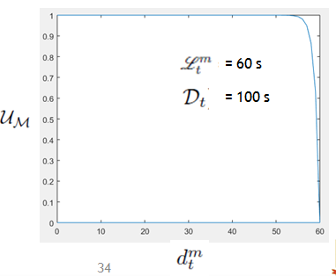

Slide 71
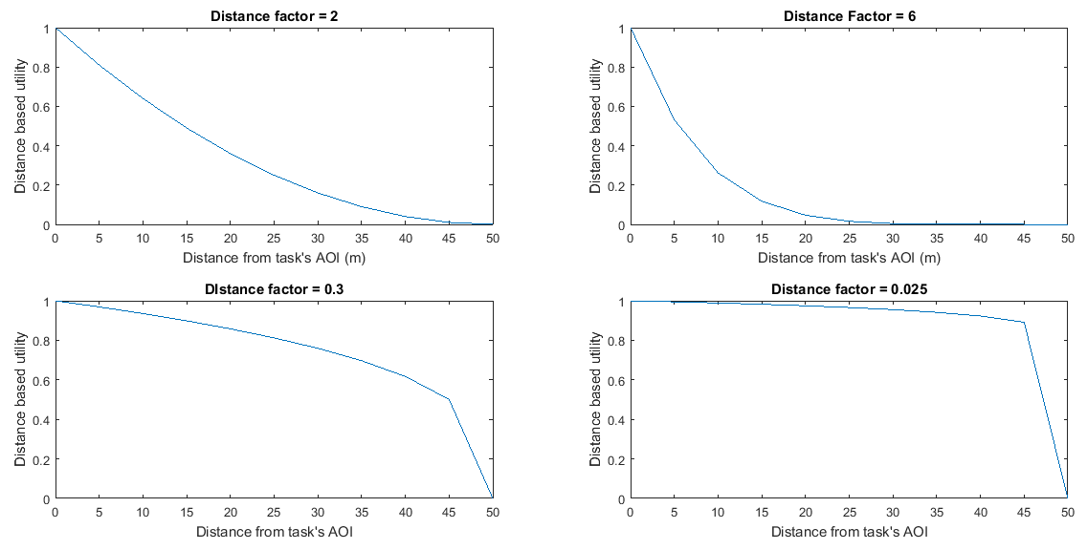

Slide 72
