Slide 1
MINI PROJECT PRESENTATION
ONLINE QUIZ
APPLICATION
A web application where users can attend quizzes
and view their scores.
HTML
CSS
JavaScript
Node.js
Express.js
Roll No.: 24KT1A0521
GitHub: https://github.com/sujan11nayak-dot/onlinequiz.git

Slide 2
01 • OVERVIEW
Problem Statement & Proposed Solution
Why an online quiz application is useful
The Problem
Proposed Solution
• Paper-based quizzes take time to conduct and check.
• Manual score calculation may lead to mistakes.
• Participants need a simple way to see their results.
• A web page displays multiple-choice questions.
• Users select answers and submit the quiz.
• The server calculates the score and displays results.
Problem statement: Users can attend quizzes and view their scores.
2

Slide 3
02 • PLANNING
Aim, Objectives & Requirements
Main goals and tools used in the project
Aim
Objectives
Software Requirements
• To develop a simple online quiz application using RESTful APIs.
• Allow users to answer questions and view their scores.
• Display quiz questions.
• Accept and submit answers.
• Calculate the score automatically.
• Show individual and all users' results.
• VS Code
• Node.js and Express.js
• HTML, CSS and JavaScript
• Web browser
Storage used in this demonstration: in-memory JavaScript arrays; data resets when the server restarts.
3

Slide 4
03 • DESIGN
System Architecture & Workflow
A simple client–server design
FRONTEND
BACKEND
QUIZ DATA
index.html
style.css
script.js
Node.js
Express.js
server.js
Questions
Answers
Results
Workflow
• User opens the quiz webpage and views the questions.
• JavaScript sends answers to Express using fetch().
• The server checks answers, calculates the score and returns JSON.
• The webpage displays the score and saved results.
4

Slide 5
04 • REST API
REST API Methods & Endpoints
Routes used by the frontend to communicate with Express
METHOD | ENDPOINT | PURPOSE
GET | /api/quiz | Display quiz questions
POST | /api/submit | Submit answers and calculate score
GET | /api/results | View all quiz results
GET | /api/results/:id | View an individual result
The frontend uses fetch() and JSON to send requests and receive responses.
5

Slide 6
IMPLEMENTATION
Backend Code – server.js (Part 1)
Server setup, quiz questions and GET API
const express = require("express");
const cors = require("cors");
const app = express();
app.use(cors());
app.use(express.json());
app.use(express.static("public"));
const questions = [
{id:1, q:"Capital of India?", o:["Delhi","Mumbai","Chennai"], a:"Delhi"},
{id:2, q:"Which is a programming language?", o:["HTML","JavaScript","CSS"], a:"JavaScript"},
{id:3, q:"CPU stands for?", o:["Central Processing Unit","Computer Unit","Control Unit"], a:"Central Processing Unit"}
];
let results = [], id = 1;
// Display questions without answers
app.get("/api/quiz", (req,res) => {
res.json(questions.map(({a,...q}) => q));
});
6

Slide 7
IMPLEMENTATION
Backend Code – server.js (Part 2)
Submit answers, calculate score and retrieve results
// Submit quiz and calculate score
app.post("/api/submit", (req,res) => {
const {name, answers} = req.body;
if(!name || !Array.isArray(answers))
return res.status(400).json({message:"Enter valid details"});
let score = questions.filter((q,i) => q.a === answers[i]).length;
let result = {id:id++, name, score, total:questions.length};
results.push(result);
res.json(result);
});
// View all results
app.get("/api/results", (req,res) => res.json(results));
// View individual result
app.get("/api/results/:id", (req,res) => {
const user = results.find(u => u.id == req.params.id);
res.json(user || {message:"Result not found"});
});
app.listen(3000, () => console.log("Server running on port 3000"));
7

Slide 8
IMPLEMENTATION
Frontend Code – index.html
Page structure and controls
<!DOCTYPE html>
<html>
<head>
<title>Online Quiz</title>
<link rel="stylesheet" href="style.css">
</head>
<body>
<h1>Online Quiz Application</h1>
<input id="name" placeholder="Enter your name">
<div id="quiz"></div>
<button onclick="submitQuiz()">Submit Quiz</button>
<h2 id="result"></h2>
<button onclick="loadResults()">View Scores</button>
<div id="scores"></div>
<script src="script.js"></script>
</body>
</html>
8

Slide 9
IMPLEMENTATION
Frontend Code – script.js
Load questions, submit answers and display scores
const API = "/api";
let questions = [];
async function loadQuiz() {
questions = await (await fetch(API+"/quiz")).json();
document.getElementById("quiz").innerHTML =
questions.map((q,i) => `<h3>${q.q}</h3>` +
q.o.map(a => `<label><input type="radio" name="q${i}" value="${a}">${a}</label><br>`).join("")
).join("");
}
async function submitQuiz() {
const name = document.getElementById("name").value.trim();
if(!name) return alert("Enter name");
const answers = questions.map((q,i) =>
document.querySelector(`input[name="q${i}"]:checked`)?.value || "");
const res = await fetch(API+"/submit", {
method:"POST", headers:{"Content-Type":"application/json"},
body:JSON.stringify({name,answers})
});
const data = await res.json();
document.getElementById("result").innerText =
`Score: ${data.score}/${data.total}`;
loadResults();
}
async function loadResults() {
const data = await (await fetch(API+"/results")).json();
document.getElementById("scores").innerHTML =
data.map(u => `<p>${u.id}. ${u.name} - ${u.score}/${u.total}</p>`).join("") || "No results";
}
loadQuiz();
9

Slide 10
IMPLEMENTATION
Styling – style.css
Simple and clean quiz interface
body {
font-family: Arial;
margin: 30px;
background: #f2f5ff;
}
h1 { color: blue; }
button {
padding: 10px;
background: blue;
color: white;
border: none;
cursor: pointer;
}
#quiz {
background: white;
padding: 15px;
margin: 15px 0;
}
10

Slide 11
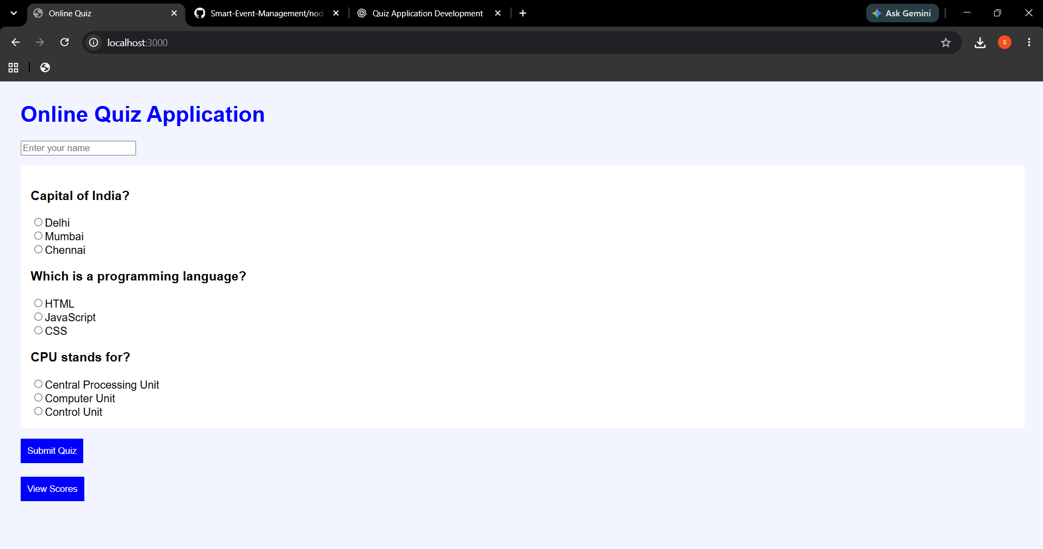
05 • TESTING
Execution, Testing & Output
Run the application and attach your own screenshots in the spaces below
1. Install packages
2. Start server
3. Open browser
• npm init -y
• npm install express cors
• node server.js
• http://localhost:3000
11

Slide 12
06 • PROJECT SUMMARY
Conclusion & Repository
The Online Quiz Application demonstrates how a frontend can communicate with an Express.js backend through RESTful APIs.
ATTEND
CALCULATE
VIEW
Users can answer multiple-choice questions.
The server checks answers and calculates scores.
Users can view their scores and quiz results.
GITHUB REPOSITORY
https://github.com/sujan11nayak-dot/onlinequiz.git
Roll No.: 24KT1A0521
THANK YOU

