Slide 1

By: Sujan Shrestha and Nishant Balami
Professor: Shafqat shad

Slide 2
Introduction
Desktop application
Developed using Java and JavaFX.
Data are stored in JSON data structure in .json file.
Keeps track of past and upcoming events.
Used by the event managers.

Slide 3
Event
Could be on campus or off campus
Is funded by the university
Report can be generated for past events
Has location and schedule
Has five associated entities (next slide)

Slide 4
Entities
Event managers
Students
Resources
Transports (with drivers)
Expenses

Slide 5
Features
Plan new events
Modify or cancel upcoming events
Generate report for past events
Manage resources and transportations for an event
Register students for an event
Assign event managers for an event
Record list of expenses of an event

Slide 6
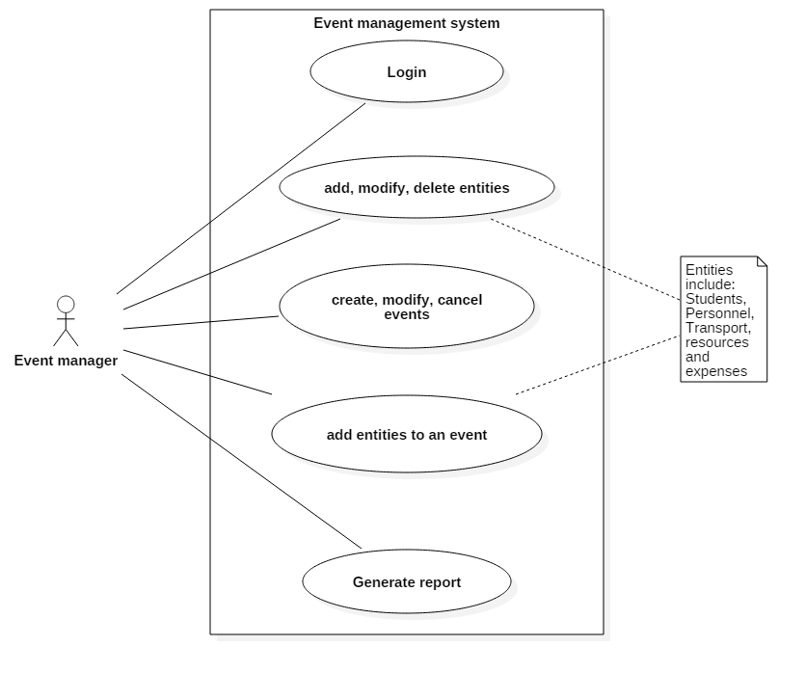
Use case diagram

Slide 7
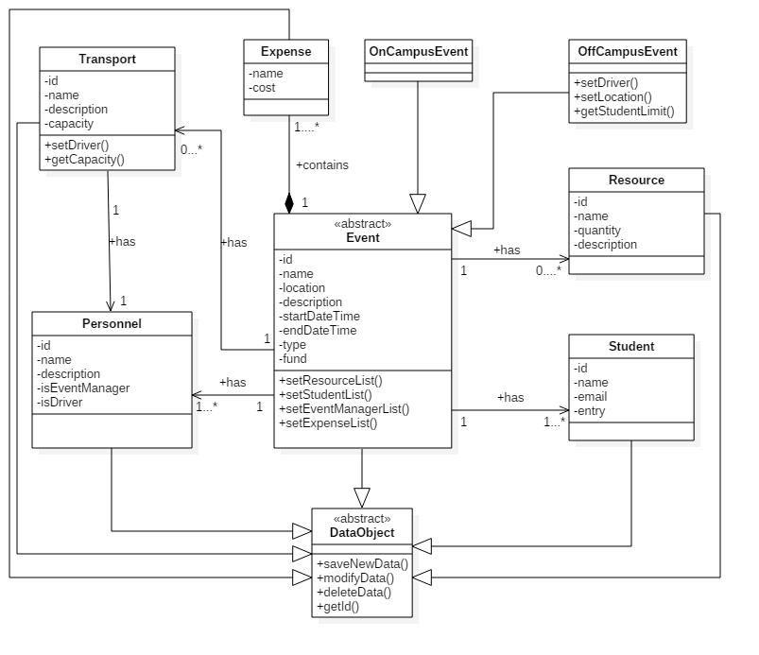
Class diagram

Slide 8
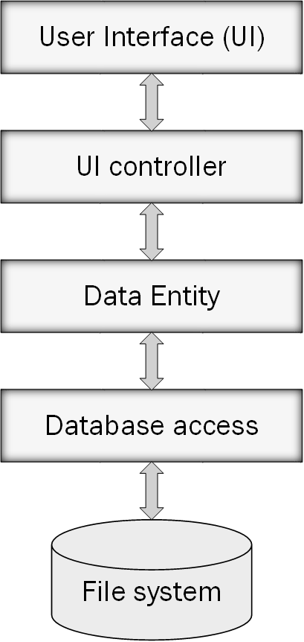
System architecture

Slide 9
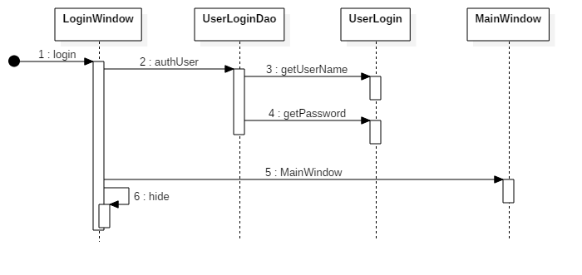
Login sequence diagram

Slide 10
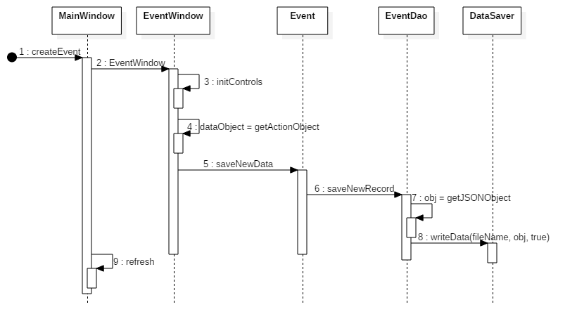
Create event sequence diagram

Slide 11
THANK YOU

