Slide 1
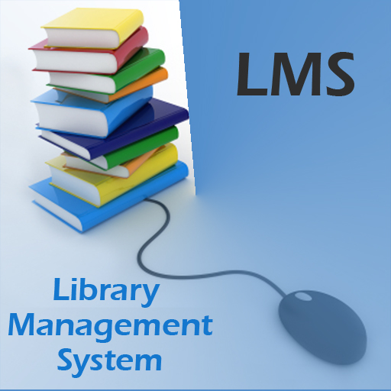
Members:
Nisha Karanjit
Sadiksha Dhakal
Nisha Basnet
Nidina Shrestha
Hadiqa Afzal
Reference: (FPP and MPP) Professor Paul Corazza

Slide 2
Introduction
Desktop application of Library Management System
Data is accessed from file using object serialization
Contains three main modules :
i. User Management
ii. Member Management
iii. Book Management

Slide 3
User Management
Deals with three types of users
Admin
Librarian
Both
Features:
System Login
Add New User
Update Existing User
Delete Existing User

Slide 4
Member Management
Deals with the members who use Library
Each member have a unique Member Id
Checkout History of each member can be known
Features
Add New Member
Update Existing Member
Delete Existing Member

Slide 5
Book Management
Deals with the different books available in the library
Each book has unique Book ID and 10-13 digit ISBN number
The selected book can be Checkout if there is any available copy left
After a book is returned the number of copy is increased and book is available for new checkout

Slide 6
Book Management
Features
Add New Book
Update Existing Book
Add New Book Copy
Checkout Book
Return Book

Slide 7
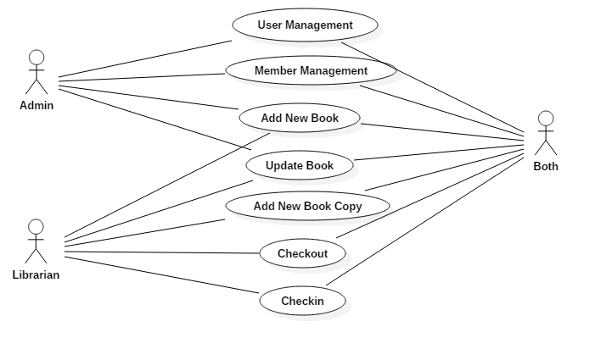
Use Case Diagram

Slide 8
System Architecture
User Interface (Password Encryption)
System Controllers
Logical Layer
File Repository

Slide 9
Additional Features
Password encryption is done using SHA(Secure Hashing Algorithm)
Check in functionality
Fine for overdue books

Slide 10
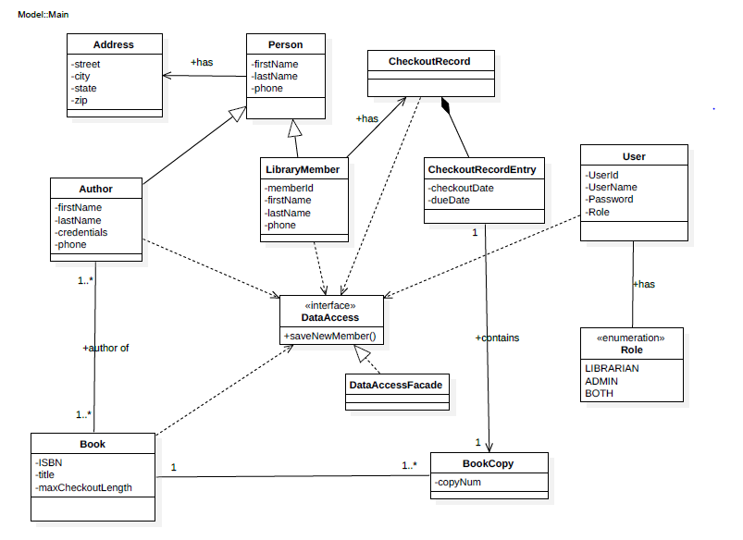
Class Diagram

Slide 11
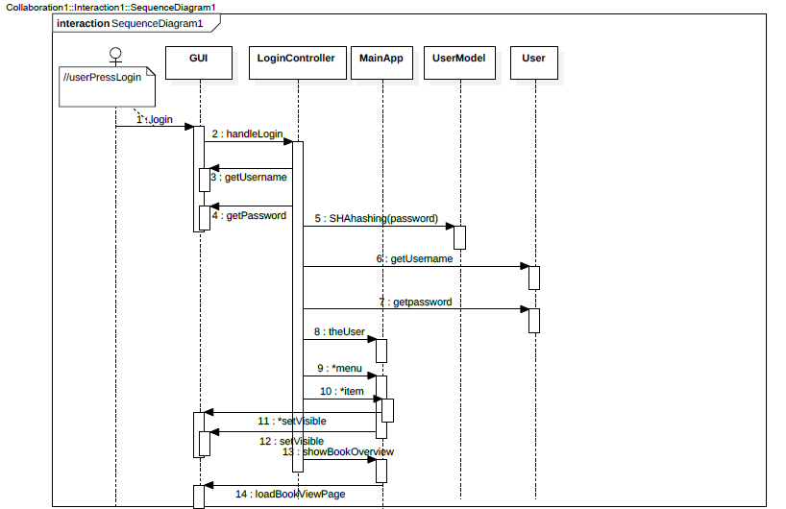
Login Sequence Diagram

Slide 12
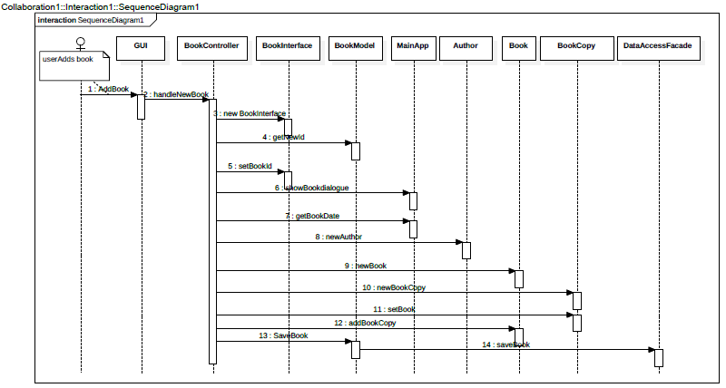
Add New Book Sequence Diagram

Slide 13

Demo

Slide 14

Questions????

