Slide 1

B.Tech (CSE) – BCSE497J Project-I
DermInsight AI: An Automated Deep Learning Framework for Early Detection of Skin Cancer
Team members:
Sujan M (23BCE2002)
Ramachandran Sivasankar (23BCE2107)
Alan John Anand (23BCB0165)
Faculty guide :
Dr. Krishna Rani Samal, Associate Professor, SCOPE

Slide 2
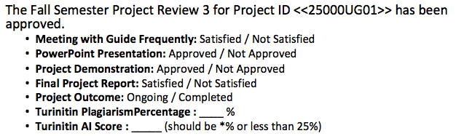
Approval Mail From Guide
Get the approval for the following points from your guide through mail before 21-10-2026.(sample attached below)
All the above aspects are addressed and updated by the project team.

Slide 3
Aim
To build an image-only deep learning pipeline that classifies dermoscopic skin-lesion images as benign or malignant (melanoma), and to find which class-imbalance strategy gives the most useful balance between cancers found and false alarms on patients the model has never seen.
The comparison is controlled: one DenseNet201 backbone, one patient-level split of SIIM-ISIC 2020, one test protocol – only the imbalance strategy changes.
33,126
dermoscopic images (ISIC 2020)
2,056
patients, split patient-wise
1.76%
malignant – about 56 : 1 imbalance
5
imbalance strategies compared

Slide 4
Abstract
Melanoma is ~1% of skin cancers but causes most skin-cancer deaths; 5-year survival falls from >99% (localised) to 36% (distant spread), so early detection matters.
Screening data are highly imbalanced: only 584 of 33,126 SIIM-ISIC 2020 images are malignant – a model that calls everything benign is 98.24% accurate and finds no cancer.
DermInsight AI fine-tunes an ImageNet-pretrained DenseNet201 and compares five imbalance strategies: weighted BCE (frozen backbone), weighted BCE (full fine-tuning), WeightedRandomSampler, focal loss and random oversampling.
All runs share one patient-level split (1,439 / 307 / 310 patients, no overlap); epochs and thresholds are chosen on validation only and each model is scored once on 4,920 test images.
Test ROC-AUC: 0.800 – 0.871 (random oversampling highest). The weighted sampler gave the most useful balance: 36.76% sensitivity at 96.85% specificity.
Key finding: the decision threshold, not the ROC-AUC, decides how many cancers are missed – so the confusion matrix and threshold rule must always be reported.

Slide 5
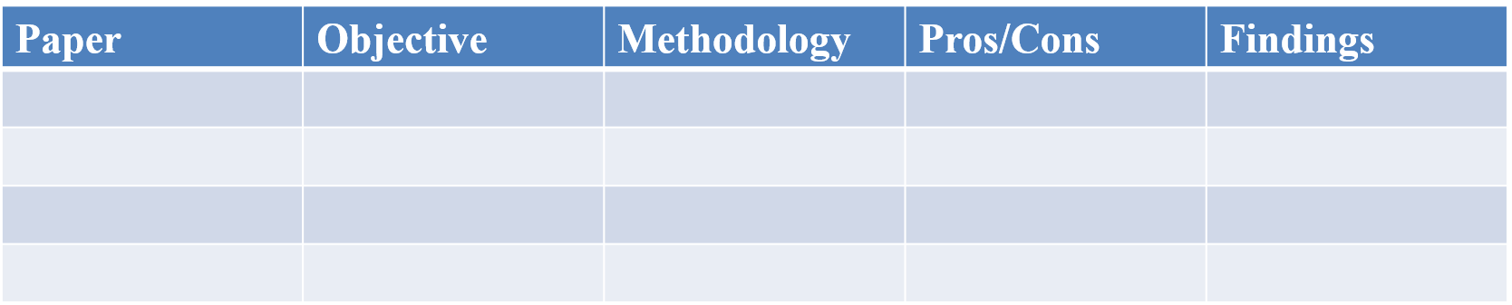

Literature Review
Paper | Objective | Methodology | Pros / Cons | Findings
Esteva et al., 2017 (Nature) | Dermatologist-level skin cancer classification | Inception-v3 fine-tuned from ImageNet on ~129k clinical images | + Biopsy-proven test set − Curated images, not screening data | Matched board-certified dermatologists
Haenssle et al., 2018 (Ann. Oncol.) | CNN vs 58 dermatologists on dermoscopy | Pretrained CNN in a reader study on dermoscopic images | + Direct human comparison − Small, fixed test set | CNN performed better than most dermatologists
Brinker et al., 2019 (Eur. J. Cancer) | Head-to-head melanoma classification | CNN trained on ISIC images vs 157 dermatologists | + Large reader panel − Threshold choice not the focus | CNN outperformed 136 of 157 dermatologists
Tschandl et al., 2019 (Lancet Oncol.) | Human readers vs ML algorithms | Open, web-based international diagnostic study | + Many algorithms and readers − Curated image set | Best algorithms beat most human readers
Huang et al., 2017 (CVPR) | Improve feature reuse in deep CNNs | DenseNet: each layer receives all earlier feature maps | + Fewer parameters than ResNet − Higher memory use | Strong features; our DenseNet201 backbone

Slide 6
Literature Review (contd.)
Paper | Objective | Methodology | Pros / Cons | Findings
Rotemberg et al., 2021 (Sci. Data) | Patient-centric melanoma dataset | ISIC 2020: 33,126 images from 2,056 patients with metadata | + Screening-like prevalence, patient IDs − 1.76% malignant | Our dataset; enables patient-level split
Cassidy et al., 2022 (Med. Image Anal.) | Audit of ISIC datasets | Duplicate and overlap analysis across ISIC archives | + Exposes data leakage − No fixed protocol proposed | Duplicates incl. train/test overlap
Buda et al., 2018 (Neural Netw.) | Class imbalance in CNNs | Systematic study of over-/under-sampling and thresholding | + Controlled comparison − Not on medical screening data | Oversampling best in most settings
Lin et al., 2017 (ICCV) | Train under extreme imbalance | Focal loss down-weights easy examples (α, γ) | + Simple loss change − Compresses scores; threshold-sensitive | Better learning on hard examples; basis of Exp 4
Saito & Rehmsmeier, 2015 (PLoS ONE) | Evaluation with rare positives | Compared ROC and precision-recall plots on imbalanced data | + Clear reporting guidance − Not a model | PR analysis more informative → we report AP

Slide 7
Research Gap
Threshold-blind reporting: most studies give accuracy or ROC-AUC at τ = 0.5 on balanced data and do not show how many cancers are missed when malignant cases are < 2%.
Data leakage: patient-level separation of train and test data is rarely stated, though ISIC has many images per patient and known duplicates.
No like-for-like comparison: imbalance methods are reported one at a time, on different splits and evaluation rules.
Unclear threshold selection: papers rarely say whether τ was tuned on validation or on test data.
What DermInsight AI does
• Five imbalance strategies on one DenseNet201 backbone
• One patient-level split, checked in code for overlap
• Epoch and threshold chosen on validation only; test set used once
• Full confusion matrix and 95% Wilson interval on sensitivity for every model

Slide 8
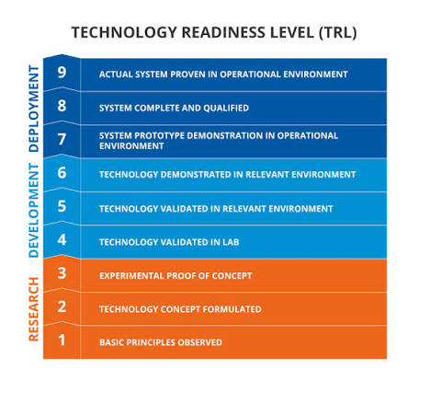

Objectives
Create a patient-level train / validation / test split of SIIM-ISIC 2020 and verify in code that no patient is shared.
Build a reproducible PyTorch pipeline with a DenseNet201 binary classifier.
Compare loss weighting, weighted sampling, focal loss and random oversampling under the same split and test protocol.
Select checkpoints and thresholds on the 5,419 validation images only; score the 4,920 test images once per model.
Report ROC-AUC, AP, sensitivity, specificity, precision, F1 and the confusion matrix, cross-checked with saved metric files.
Document what did not work or could not be confirmed, and use it to plan Project-II.
SDG 3
TRL 3
Identified SDG: SDG 3 – Good Health and Well-being (early cancer detection)
TRL: Level 3 – experimental proof of concept on public data
Outcome: International Conference (Scopus) – IEEE-format paper prepared

Slide 9
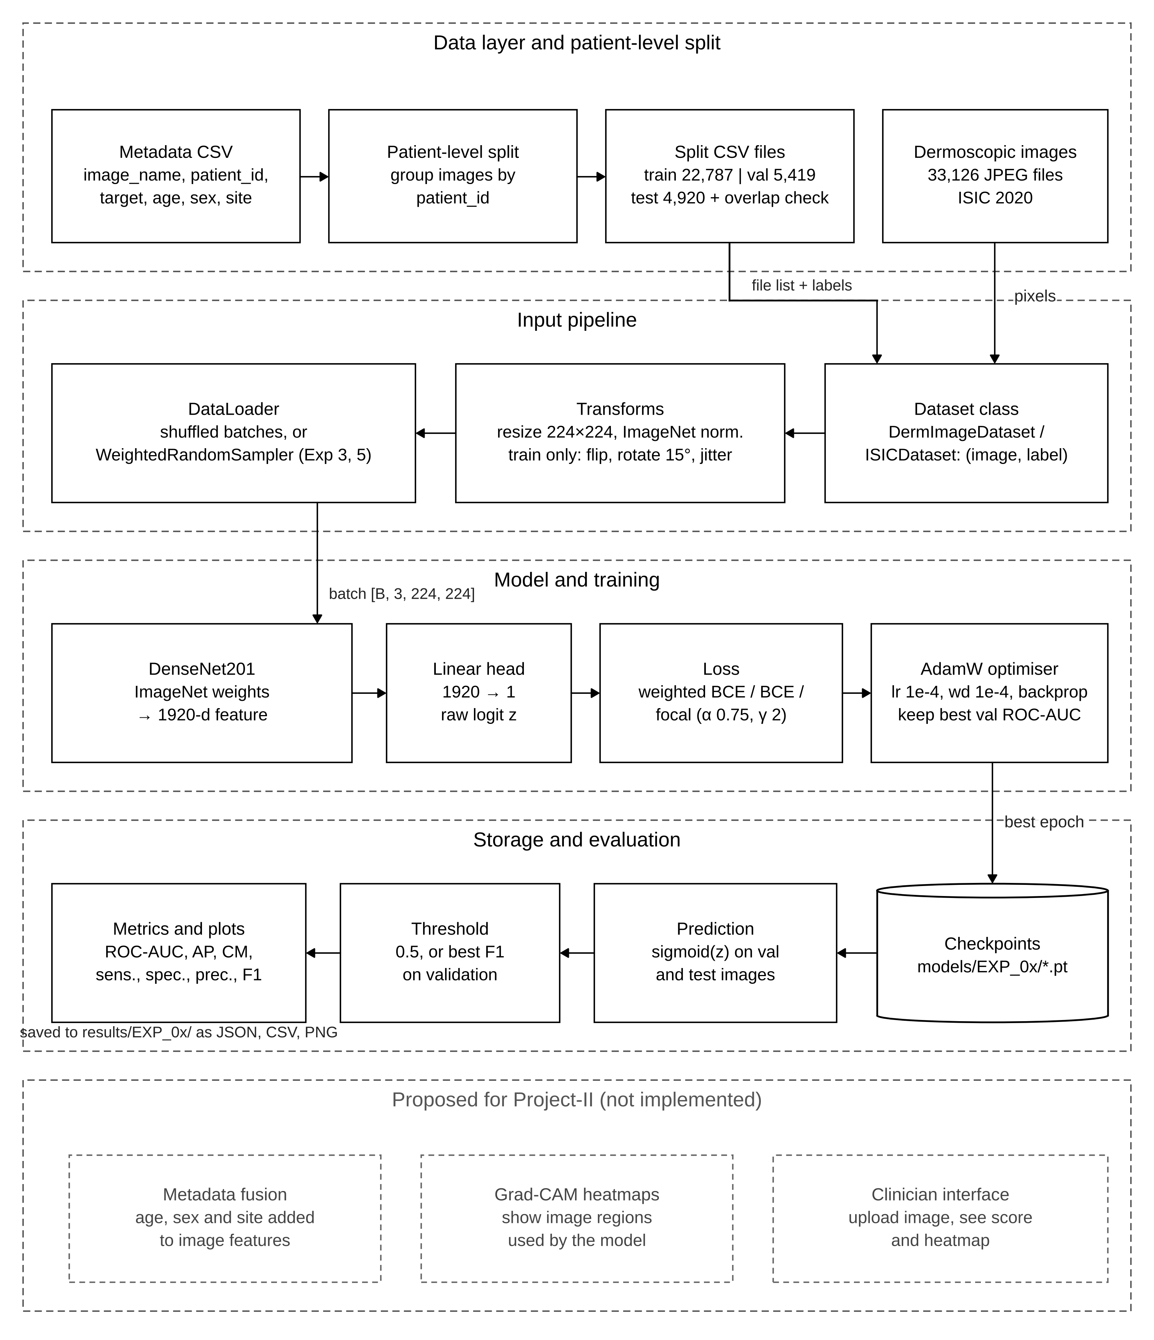
Framework/Architecture/Block Diagram
Data layer: ISIC 2020 metadata grouped by patient_id → train 22,787 | val 5,419 | test 4,920 images, overlap assert.
Input pipeline: Dataset class → resize 224×224, ImageNet normalisation; flip, ±15° rotation, light colour jitter on training images only.
Model & training: DenseNet201 (ImageNet) → 1920-d feature → linear head (1 logit); weighted BCE / BCE / focal loss; AdamW (lr 1e-4).
Evaluation: best-val-ROC-AUC checkpoint → sigmoid scores → threshold (0.5 or best-F1 on validation) → metrics and plots.
Project-II (proposed): metadata fusion, Grad-CAM, clinician interface.

Slide 10
Functional Requirements
ID | Requirement | Implemented in
FR1 | Read split CSVs and load each image with its target label | DermImageDataset, ISICDataset
FR2 | Stop the run if any patient ID appears in more than one split | assert checks in train_model()
FR3 | Resize to 224×224, ImageNet-normalise; augment training images only | build_transform()
FR4 | Produce one logit per image: DenseNet201 + 1920 → 1 linear head | DermInsightDenseNet201
FR5 | Train with the selected imbalance strategy (weight, sampler, focal, oversampling) | Experiment scripts and settings
FR6 | Evaluate on validation each epoch; keep best-ROC-AUC checkpoint | Training loops; saved checkpoints
FR7 | Select decision threshold on validation (best F1 over 0.01 – 0.99) when needed | stage2b_final_evaluation.py
FR8 | Compute ROC-AUC, AP, accuracy, precision, sensitivity, specificity, F1, confusion matrix | calculate_binary_metrics()
FR9 | Save metrics (JSON/CSV), predictions (CSV) and plots (PNG) per experiment | results/EXP_0x folders

Slide 11
Modules
1. Dataset & patient-level split
• 33,126 images, 584 malignant, 2,056 patients
• Grouped by patient_id; zero shared patients
• 1.95% / 1.31% / 1.38% malignant
2. Preprocessing & augmentation
• Resize 224×224, ImageNet mean/std
• Train only: h-flip, ±15° rotation, jitter 0.1
• Kept light to preserve colour/texture
3. Model
• torchvision DenseNet201, ImageNet-1K
• Classifier → identity; 1920 → 1 linear head
• p̂ = σ(z); malignant if p̂ ≥ τ
4. Imbalance strategies
• Exp 1/2: weighted BCE (w₊ = 50.21)
• Exp 3: WeightedRandomSampler
• Exp 4: focal loss · Exp 5: oversampling
5. Threshold selection
• Best epoch by validation ROC-AUC
• τ = 0.5, or best-F1 on validation
• Exp 2: τ = 0.86 · Exp 5: τ = 0.7296
6. Evaluation & reporting
• Sens., spec., precision, F1, accuracy
• ROC-AUC and AP (scikit-learn)
• 95% Wilson CI on sensitivity

Slide 12
Experiments and Results
Exp | Strategy | τ | Test ROC-AUC | AP | Sens. % | Spec. % | Cancers found | False alarms
1 | Weighted BCE, frozen backbone | 0.50 | 0.800 | 0.063 | 91.18 | 41.90 | 62 / 68 | 2,819
2 | Weighted BCE, full fine-tuning | 0.86 | 0.830 | 0.129 | 22.06 | 98.31 | 15 / 68 | 82
3 | WeightedRandomSampler | 0.50 | 0.822 | 0.129 | 36.76 | 96.85 | 25 / 68 | 153
4 | Focal loss (α 0.75, γ 2) | 0.50 | 0.860 | 0.140 | 14.71 | 99.24 | 10 / 68 | 37
5 | Random oversampling | 0.73 | 0.871 | 0.104 | 19.12 | 98.25 | 13 / 68 | 85
Test set: 4,920 images from 310 unseen patients (68 malignant). Full fine-tuning lifted validation ROC-AUC from 0.847 to 0.906 – 0.919.
Exp 1 finds 62/68 cancers but raises 2,819 false alarms; Exps 2, 4, 5 keep false alarms < 90 but find only 10 – 15 cancers.
Best balance – Exp 3 (sampler): 36.76% sensitivity at 96.85% specificity, highest F1 (20.33%).
Accuracy misleads: Exp 4 has 98.07% accuracy yet misses 58 of 68 melanomas.

Slide 13
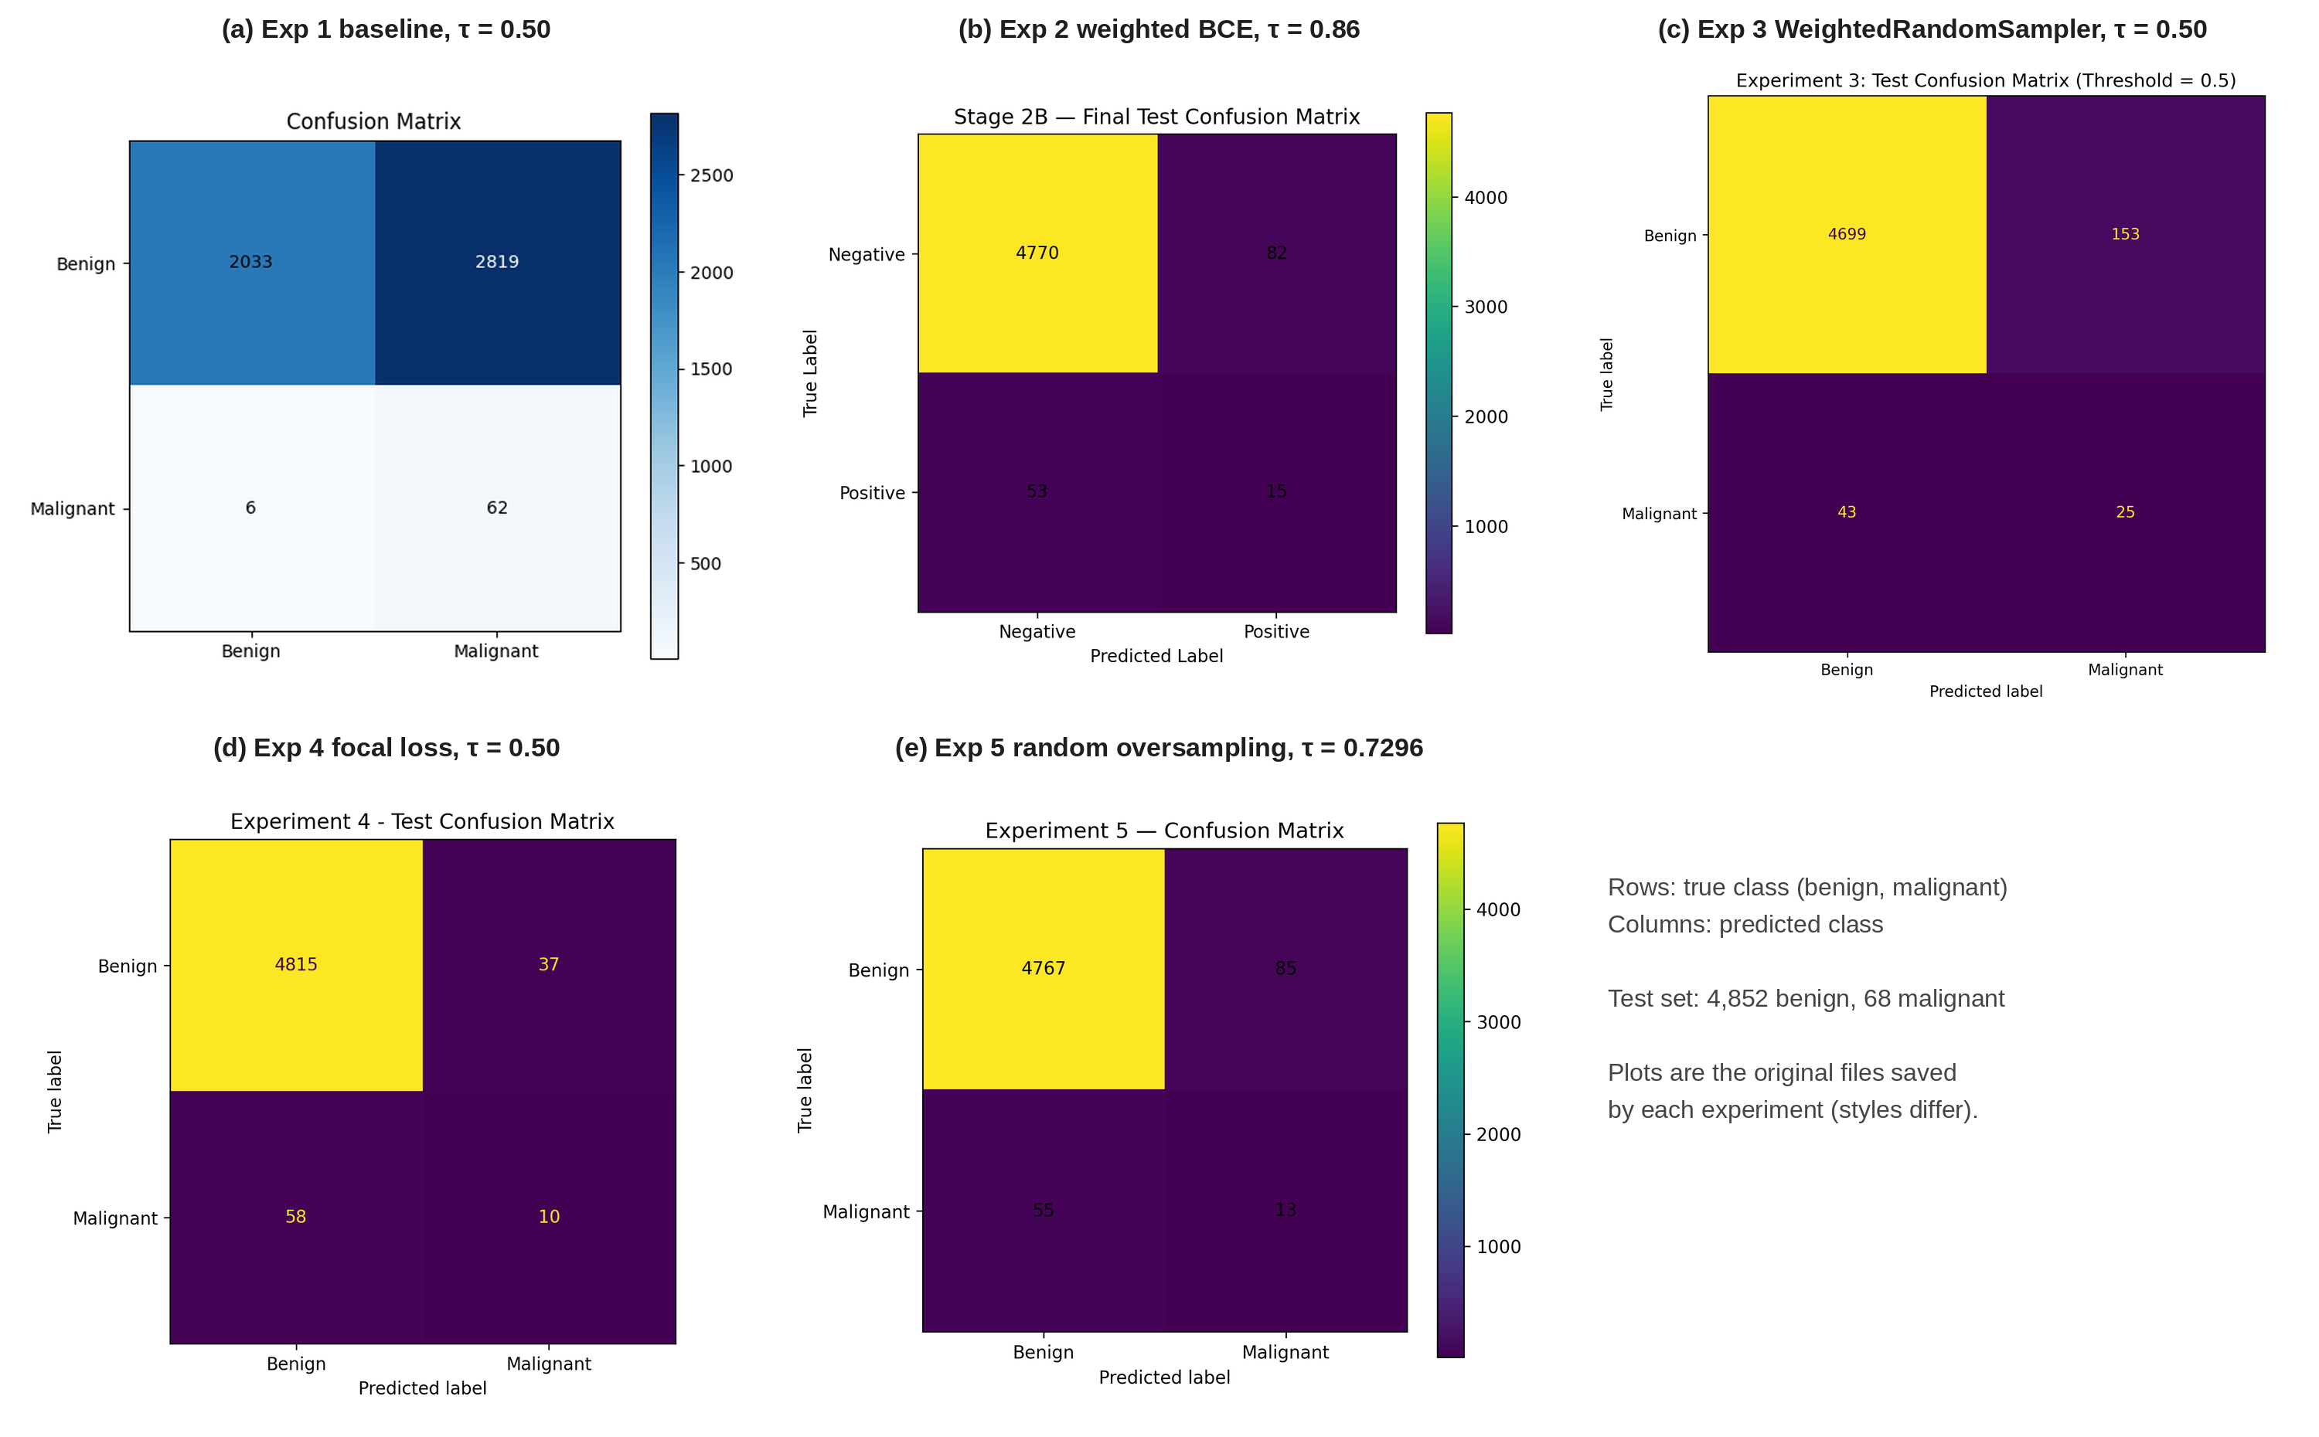
Experiments and Results (contd.)
Threshold drives the trade-off more than the method: Exp 4 at τ = 0.3 would find 46/68 at 87.35% specificity.
Exp 5's validation-tuned τ = 0.7296 transferred poorly: at 0.5 it would find 18 instead of 13 cancers.
95% Wilson intervals on sensitivity are ~±10 points (only 68 test melanomas), so Exps 2, 4, 5 cannot be ranked reliably.
Test confusion matrices of all five experiments (rows: true class, columns: predicted)

Slide 14
Conclusion and Future Work
Conclusion
• Built DermInsight AI, an image-only DenseNet201 pipeline, and compared five imbalance strategies on a leak-free patient-level split of ISIC 2020.
• Full fine-tuning with any strategy raised validation ROC-AUC from 0.847 to 0.906 – 0.919; best test ROC-AUC 0.871.
• At the thresholds used, models either found most cancers with thousands of false alarms, or few cancers (10 – 25 of 68) with low false alarms.
• Weighted sampler gave the best balance (36.76% sens., 96.85% spec.).
• A good ROC-AUC or accuracy can hide many missed cancers – always report the threshold rule and confusion matrix.
Future Work (Project-II)
• Choose thresholds against a sensitivity target (e.g. ≥ 80% on validation) with patient-wise cross-validation.
• Fuse patient metadata (age, sex, anatomical site) with image features.
• Grad-CAM heatmaps to check the model looks at the lesion, not rulers or hair.
• Calibrate outputs with temperature scaling.
• External testing on HAM10000; remove duplicate images before splitting.
• Clinician-facing interface: upload image, see score and heatmap.

Slide 15
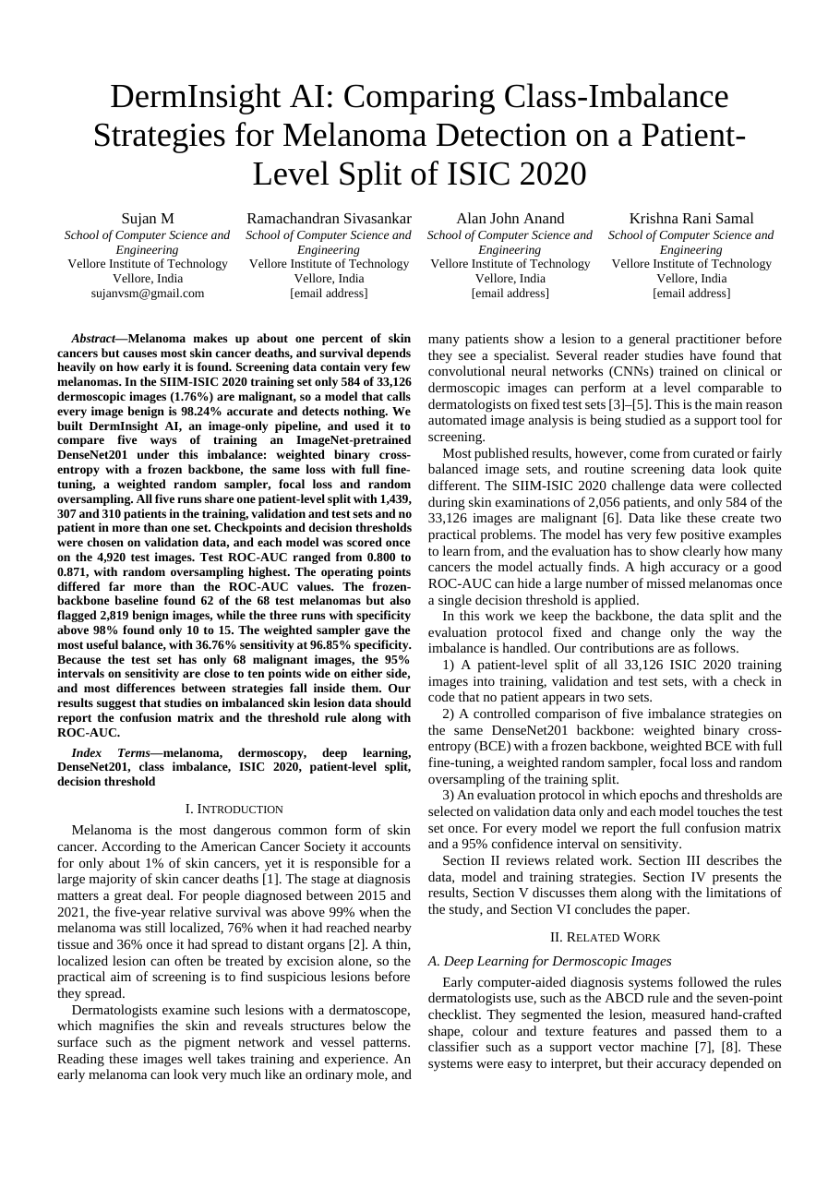
Outcome Achieved
Outcome type: International Conference Proceedings (Scopus-indexed venue targeted)
Paper: “DermInsight AI: Comparing Class-Imbalance Strategies for Melanoma Detection on a Patient-Level Split of ISIC 2020”
Authors: Sujan M, Ramachandran Sivasankar, Alan John Anand, Dr. Krishna Rani Samal (SCOPE, VIT Vellore)
Format: IEEE conference template, 32 references
Status: Manuscript prepared – submission details to be updated

Slide 16
References
[1] American Cancer Society, "Key statistics for melanoma skin cancer," 2026. [Online]. Available: https://www.cancer.org/cancer/types/melanoma-skin-cancer/about/key-statistics.html
[2] American Cancer Society, "Survival rates for melanoma skin cancer by stage," 2026. [Online]. Available: https://www.cancer.org/cancer/types/melanoma-skin-cancer/detection-diagnosis-staging/survival-rates-for-melanoma-skin-cancer-by-stage.html
[3] A. Esteva, B. Kuprel, R. A. Novoa, J. Ko, S. M. Swetter, H. M. Blau, and S. Thrun, "Dermatologist-level classification of skin cancer with deep neural networks," Nature, vol. 542, no. 7639, pp. 115-118, 2017.
[4] H. A. Haenssle, C. Fink, R. Schneiderbauer, et al., "Man against machine: Diagnostic performance of a deep learning convolutional neural network for dermoscopic melanoma recognition in comparison to 58 dermatologists," Ann. Oncol., vol. 29, no. 8, pp. 1836-1842, 2018.
[5] T. J. Brinker, A. Hekler, A. H. Enk, et al., "Deep learning outperformed 136 of 157 dermatologists in a head-to-head dermoscopic melanoma image classification task," Eur. J. Cancer, vol. 113, pp. 47-54, 2019.
[6] V. Rotemberg, N. Kurtansky, B. Betz-Stablein, et al., "A patient-centric dataset of images and metadata for identifying melanomas using clinical context," Sci. Data, vol. 8, no. 1, p. 34, 2021.
[7] M. E. Celebi, N. Codella, and A. Halpern, "Dermoscopy image analysis: Overview and future directions," IEEE J. Biomed. Health Inform., vol. 23, no. 2, pp. 474-478, 2019.
[8] A. Adegun and S. Viriri, "Deep learning techniques for skin lesion analysis and melanoma cancer detection: A survey of state-of-the-art," Artif. Intell. Rev., vol. 54, no. 2, pp. 811-841, 2021.
[9] P. Tschandl, N. Codella, B. N. Akay, et al., "Comparison of the accuracy of human readers versus machine-learning algorithms for pigmented skin lesion classification: An open, web-based, international, diagnostic study," Lancet Oncol., vol. 20, no. 7, pp. 938-947, 2019.
[10] J. Deng, W. Dong, R. Socher, L.-J. Li, K. Li, and L. Fei-Fei, "ImageNet: A large-scale hierarchical image database," in Proc. IEEE Conf. Comput. Vis. Pattern Recognit. (CVPR), 2009, pp. 248-255.
[11] J. Yosinski, J. Clune, Y. Bengio, and H. Lipson, "How transferable are features in deep neural networks?" in Adv. Neural Inf. Process. Syst. (NeurIPS), vol. 27, 2014, pp. 3320-3328.
[12] G. Huang, Z. Liu, L. van der Maaten, and K. Q. Weinberger, "Densely connected convolutional networks," in Proc. IEEE Conf. Comput. Vis. Pattern Recognit. (CVPR), 2017, pp. 4700-4708.
[13] K. He, X. Zhang, S. Ren, and J. Sun, "Deep residual learning for image recognition," in Proc. IEEE Conf. Comput. Vis. Pattern Recognit. (CVPR), 2016, pp. 770-778.
[14] N. C. F. Codella, D. Gutman, M. E. Celebi, et al., "Skin lesion analysis toward melanoma detection: A challenge at the 2017 International Symposium on Biomedical Imaging (ISBI), hosted by the International Skin Imaging Collaboration (ISIC)," in Proc. IEEE 15th Int. Symp. Biomed. Imaging (ISBI), 2018, pp. 168-172.
[15] P. Tschandl, C. Rosendahl, and H. Kittler, "The HAM10000 dataset, a large collection of multi-source dermatoscopic images of common pigmented skin lesions," Sci. Data, vol. 5, p. 180161, 2018.
[16] B. Cassidy, C. Kendrick, A. Brodzicki, J. Jaworek-Korjakowska, and M. H. Yap, "Analysis of the ISIC image datasets: Usage, benchmarks and recommendations," Med. Image Anal., vol. 75, p. 102305, 2022.

Slide 17
References (contd.)
[17] J. M. Johnson and T. M. Khoshgoftaar, "Survey on deep learning with class imbalance," J. Big Data, vol. 6, no. 1, p. 27, 2019.
[18] M. Buda, A. Maki, and M. A. Mazurowski, "A systematic study of the class imbalance problem in convolutional neural networks," Neural Netw., vol. 106, pp. 249-259, 2018.
[19] N. V. Chawla, K. W. Bowyer, L. O. Hall, and W. P. Kegelmeyer, "SMOTE: Synthetic minority over-sampling technique," J. Artif. Intell. Res., vol. 16, pp. 321-357, 2002.
[20] T.-Y. Lin, P. Goyal, R. Girshick, K. He, and P. Dollár, "Focal loss for dense object detection," in Proc. IEEE Int. Conf. Comput. Vis. (ICCV), 2017, pp. 2980-2988.
[21] T. Saito and M. Rehmsmeier, "The precision-recall plot is more informative than the ROC plot when evaluating binary classifiers on imbalanced datasets," PLoS ONE, vol. 10, no. 3, p. e0118432, 2015.
[22] J. Davis and M. Goadrich, "The relationship between precision-recall and ROC curves," in Proc. 23rd Int. Conf. Mach. Learn. (ICML), 2006, pp. 233-240.
[23] C. Guo, G. Pleiss, Y. Sun, and K. Q. Weinberger, "On calibration of modern neural networks," in Proc. 34th Int. Conf. Mach. Learn. (ICML), 2017, pp. 1321-1330.
[24] I. Loshchilov and F. Hutter, "Decoupled weight decay regularization," in Proc. Int. Conf. Learn. Represent. (ICLR), 2019.
[25] F. Pedregosa, G. Varoquaux, A. Gramfort, et al., "Scikit-learn: Machine learning in Python," J. Mach. Learn. Res., vol. 12, pp. 2825-2830, 2011.
[26] E. B. Wilson, "Probable inference, the law of succession, and statistical inference," J. Amer. Statist. Assoc., vol. 22, no. 158, pp. 209-212, 1927.
[27] A. Paszke, S. Gross, F. Massa, et al., "PyTorch: An imperative style, high-performance deep learning library," in Adv. Neural Inf. Process. Syst. (NeurIPS), vol. 32, 2019, pp. 8024-8035.
[28] R. Daneshjou, K. Vodrahalli, R. A. Novoa, et al., "Disparities in dermatology AI performance on a diverse, curated clinical image set," Sci. Adv., vol. 8, no. 32, p. eabq6147, 2022.
[29] M. Groh, C. Harris, L. Soenksen, et al., "Evaluating deep neural networks trained on clinical images in dermatology with the Fitzpatrick 17k dataset," in Proc. IEEE/CVF Conf. Comput. Vis. Pattern Recognit. Workshops (CVPRW), 2021, pp. 1820-1828.
[30] A. G. C. Pacheco and R. A. Krohling, "An attention-based mechanism to combine images and metadata in deep learning models applied to skin cancer classification," IEEE J. Biomed. Health Inform., vol. 25, no. 9, pp. 3554-3563, 2021.
[31] J. Kawahara, S. Daneshvar, G. Argenziano, and G. Hamarneh, "Seven-point checklist and skin lesion classification using multitask multimodal neural nets," IEEE J. Biomed. Health Inform., vol. 23, no. 2, pp. 538-546, 2019.
[32] R. R. Selvaraju, M. Cogswell, A. Das, R. Vedantam, D. Parikh, and D. Batra, "Grad-CAM: Visual explanations from deep networks via gradient-based localization," in Proc. IEEE Int. Conf. Comput. Vis. (ICCV), 2017, pp. 618-626.

