Slide 2
Line Organization
Oldest and traditional form
Direct line of authority from the superior to subordinate level.
Also known as simple and military organization
Follows the chain of command and scalar chain
Types of Line Organization
Pure line Organization: individuals perform same type of work Line is divided into effective control and supervision
Department line Organization: Organization is divided into different departments.

Slide 3
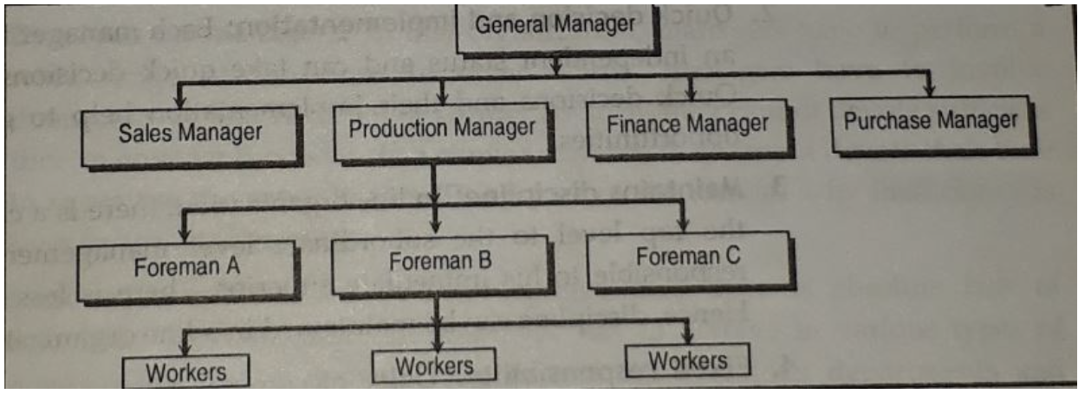

Slide 4
Advantages
Simple and Easy To understand
Quick Decision And Implementation
Maintain Discipline
Fixed Responsibility
Flexibility
Effective Management
Economical

Slide 5
Disadvantages
Overload on Managers
Lack of specialization
Autocratic Leadership
Problems of coordination
Inefficiency
Lack of stability
https://tyonote.com/line_organization/

Slide 6
Functional Organization
Divides entire functions into major functional groups
Each function is entrusted to a specialist-functional specialist
Functional manger can exercise functional authority to overall subordinates
Functional specialist communicate through chief executive

Slide 7
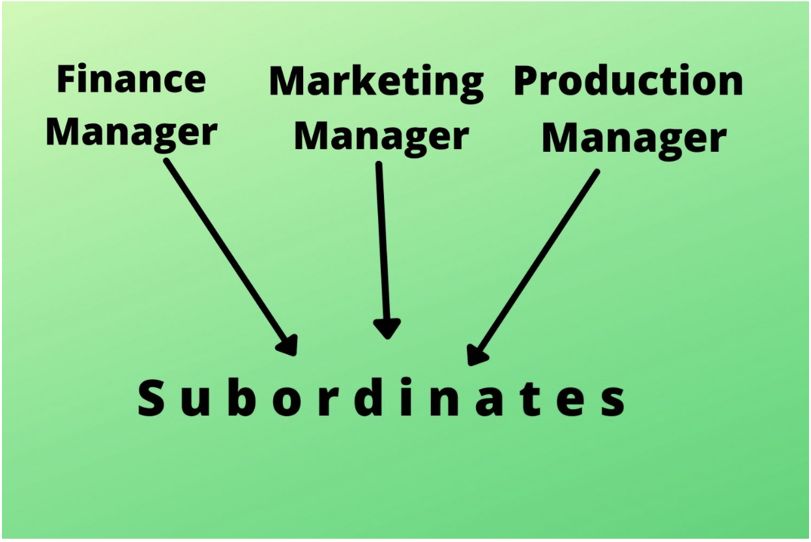

Slide 8
Advantages
Benefits of Specialists
Increase Efficiency
Healthy Competition Among Experts
Relief To Executives
Mass Production
Facilitates Growth and Expansion

Slide 9
Disadvantages
Multiple Command System
Lack of Coordination
High Administrative Cost
Delay in Decision-Making
Spoils Human Relations
Narrow Outlooks of Specialists

