Slide 2
Line Organization
Oldest and traditional form
Direct line of authority from the superior to subordinate level.
Also known as simple and military organization
Follows the chain of command and scalar chain
Types of Line Organization
Pure line Organization: individuals perform same type of work Line is divided into effective control and supervision
Department line Organization: Organization is divided into different departments.

Slide 3
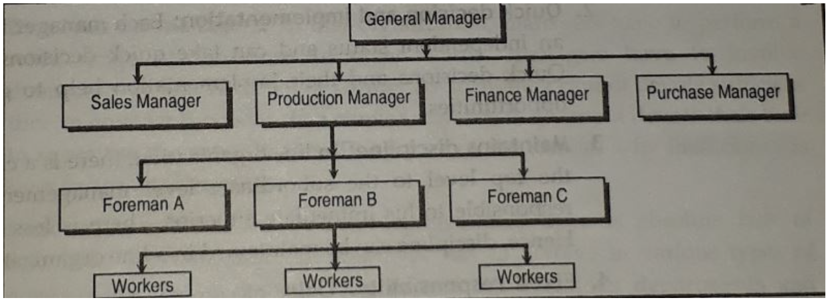

Slide 4
Advantages
Simple and Easy To understand
Quick Decision And Implementation
Maintain Discipline
Fixed Responsibility
Flexibility
Effective Management
Economical

Slide 5
Disadvantages
Overload on Managers
Lack of specialization
Autocratic Leadership
Problems of coordination
Inefficiency
Lack of stability
https://tyonote.com/line_organization/

Slide 6
Functional Organization
Divides entire functions into major functional groups
Each function is entrusted to a specialist-functional specialist
Functional manger can exercise functional authority to overall subordinates
Functional specialist communicate through chief executive

Slide 7
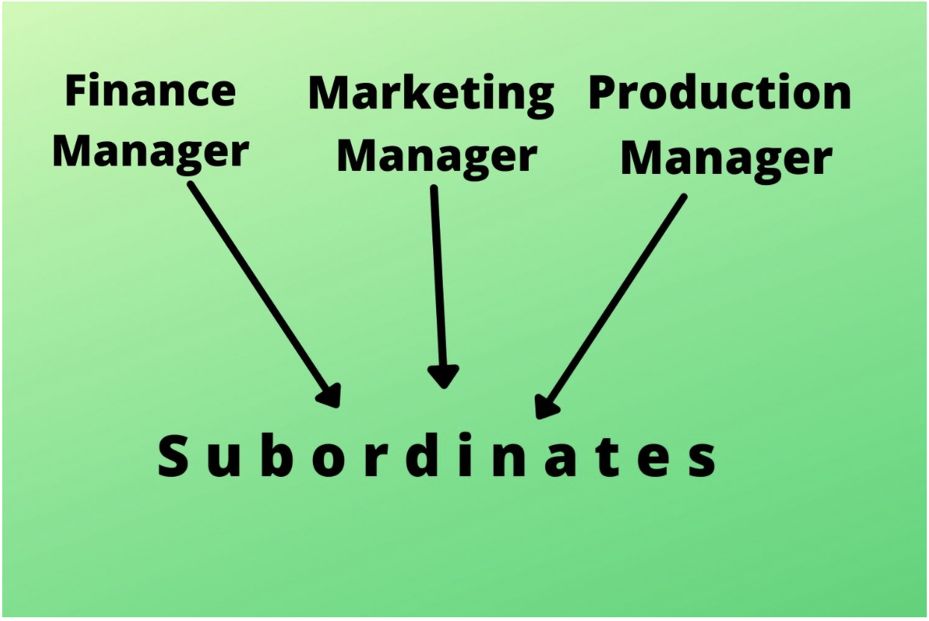

Slide 8
Advantages
Benefits of Specialists
Increase Efficiency
Healthy Competition Among Experts
Relief To Executives
Mass Production
Facilitates Growth and Expansion

Slide 9
Disadvantages
Multiple Command System
Lack of Coordination
High Administrative Cost
Delay in Decision-Making
Spoils Human Relations
Narrow Outlooks of Specialists

Slide 10
Line and Staff Organization
Line-staff organization, in management, approach in which authorities (e.g., managers) establish goals and directives that are then fulfilled by staff and other workers.
Line groups are engaged in tasks that constitute the technical core of the firm or the subunit of a larger enterprise.
Staff groups are engaged in tasks that provide support for line groups. They consist of advisory (legal), service (human resources), or control (accounting) groups.
The staff are thinkers while the line are doers.

Slide 11
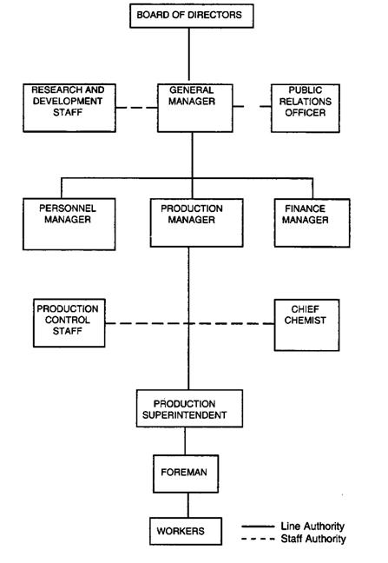

Slide 12
Advantages
Expert advice
Benefit of Specialization
Better co-ordination
Balanced decisions
Improved quality
Well defined authority and responsibility
Less wastage

Slide 13
Disadvantages
Chances of mis-interpretation
Ineffective staff in the absence of authority
Line and staff conflicts
Staffs steals the show
Costly
Lack of sound advice

Slide 14
Committee Organization
A committee organization is an association of people set up to arrive at solutions to common problems.
Committee organizational structure provides integrated ideas of various related people of the company.
It is a very good example of democratic management wherein every member has an equal opportunity to raise his voice and come to a common solution.
A committee may be of two types:
Executive Committee (Permanent Committee)
It is formed when the nature of the work is of repetitive type.
Advisory Committee (Ad Hoc Committee)
It is formed temporarily for some specific temporary function only.

Slide 15
Advantages
Quality of decision
Participative management
Reduce Bias and Conflicts
Setting Objectives, Plans and Policies
Co-ordination
Promotes united actions

Slide 16
Disadvantages
Delay in decision
Probability of diversion
Lack of Secrecy
Costly
Compromise

