Slide 1
A FINAL YEAR MAJOR PROJECT ON REAL ESTATE REGISTRATION SYSTEM USING BLOCKCHAIN TECHNOLOGY [CT 707] SUBMITTED TO: DEPARTMENT OF ELECTRONICS AND COMPUTER ENGINEERING
SUBMITTED BY:
AJAY MAHARJAN (HCE075BCT006) ASHISH RAI (HCE075BCT042) NIBENDRA BAJRACHARYA (HCE075BCT015) SUJAN MAHARJAN (HCE075BCT037)

Slide 2
INTRODUCTION
Current process involves a lot of vulnerabilities
People in the authority can easily cheat the common people and government
Blockchain – a shared, immutable, decentralized, digital ledger
Transactions of real estate to be stored as blocks
System makes the authority decentralized, transparent and secured
System works on the basis of majority consensus – Use of Consensus algorithm

Slide 3
PROBLEM STATEMENT
Corruption
Lack of Transparency
Slow process in transfer of real estate
Bad Record Keeping

Slide 4
OBJECTIVES
To decentralize the record keeping system and increase data transparency
To digitize the land records
To mitigate corruption by real-time accounting

Slide 5
REQUIREMENTS ANALYSIS
Functional Requirements
Register Land
Make Property Available
Check Records
Validate Transactions
Response the Request
Request Land
Buy Land

Slide 6
Non Functional Requirements
Reliability
Availability
Performance
Scalability
Maintainability
Security

Slide 7
FEASIBILITY STUDY
Technical Feasibility - Hardware and software tools are within accessible boundaries.
Operational Feasibility - Simple and interactive interface and data drive.
Economic Feasibility - Only a computer is required to access the web application

Slide 8
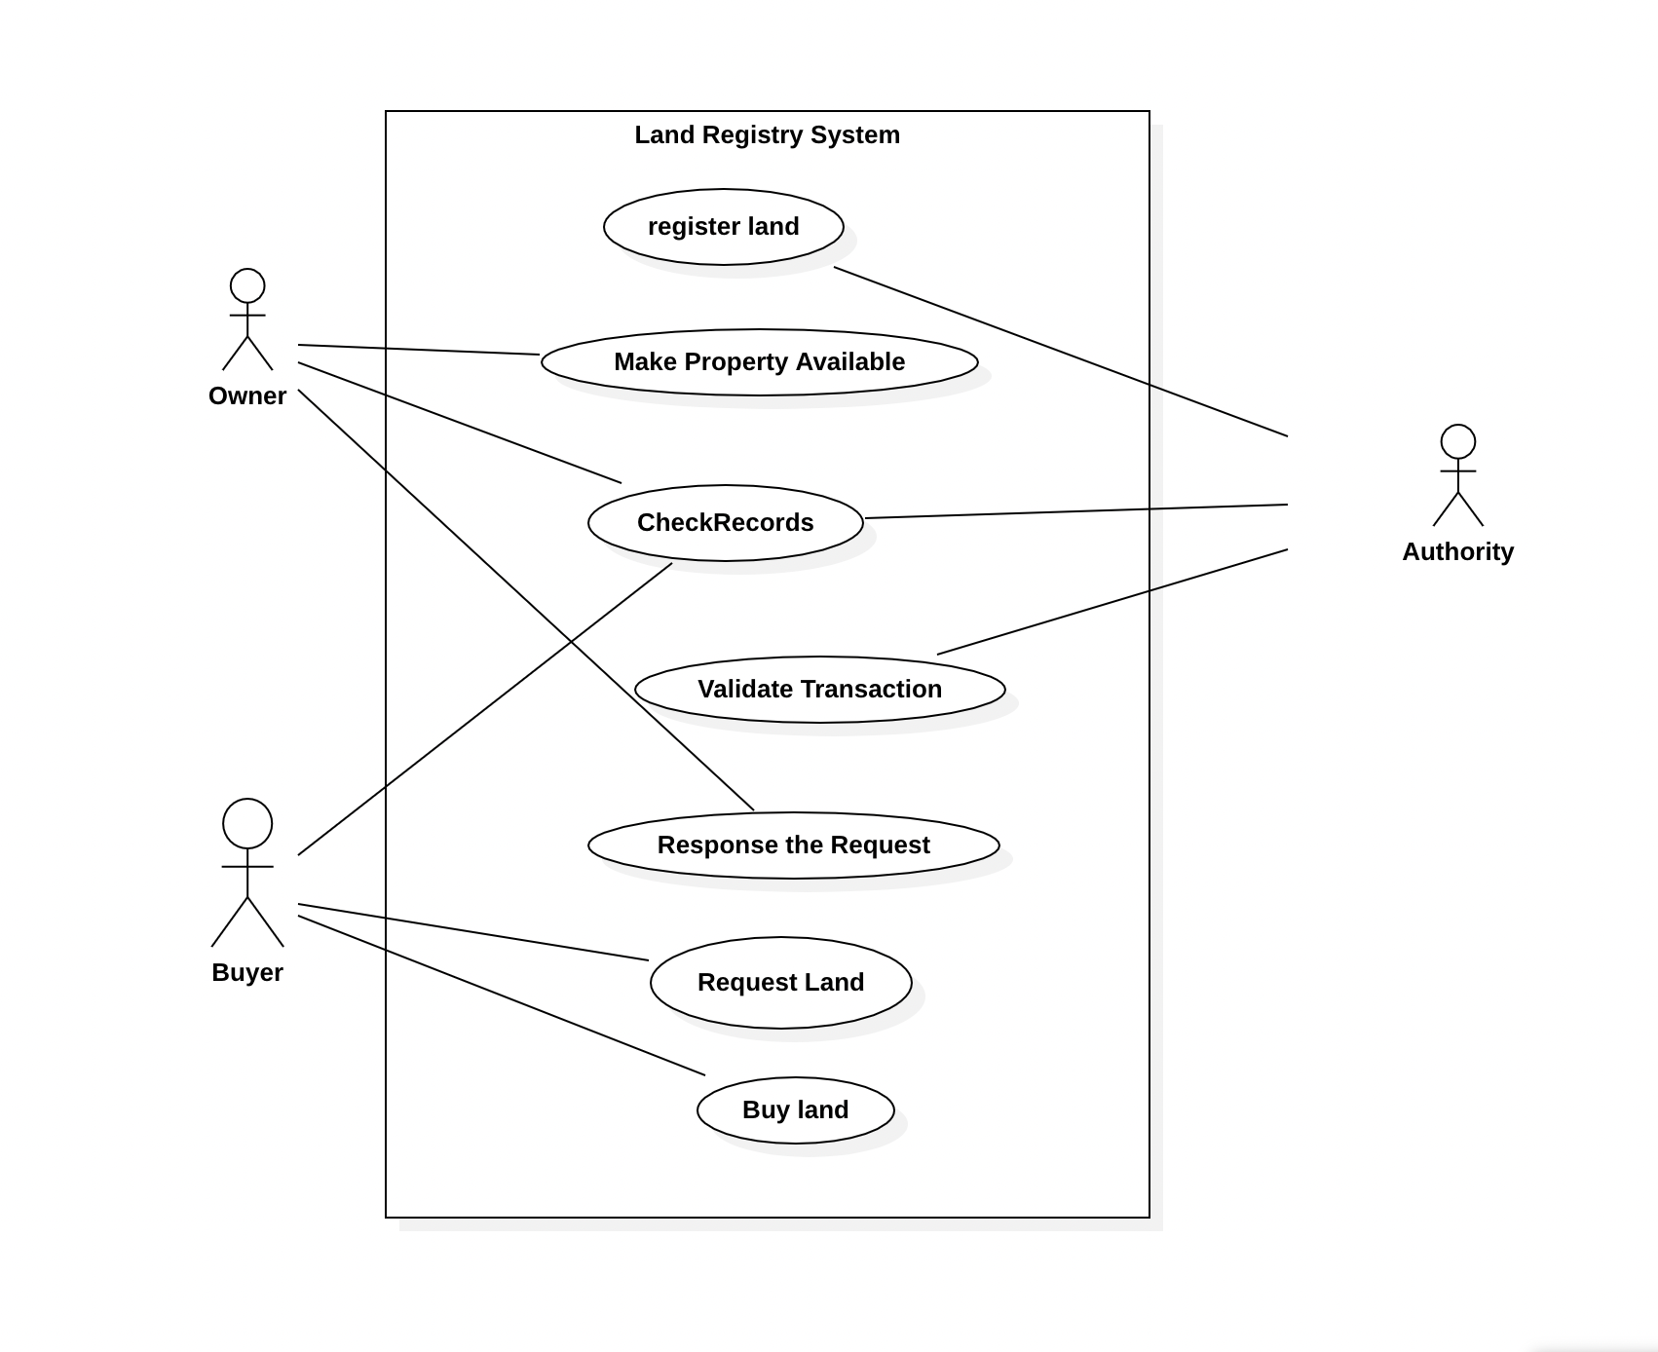
SYSTEM DESIGN
Use Case Diagram

Slide 9
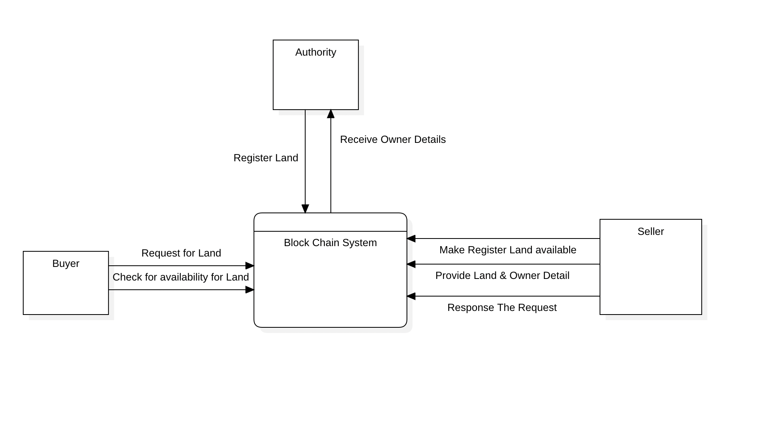
Data Flow Diagram – Level 0

Slide 10
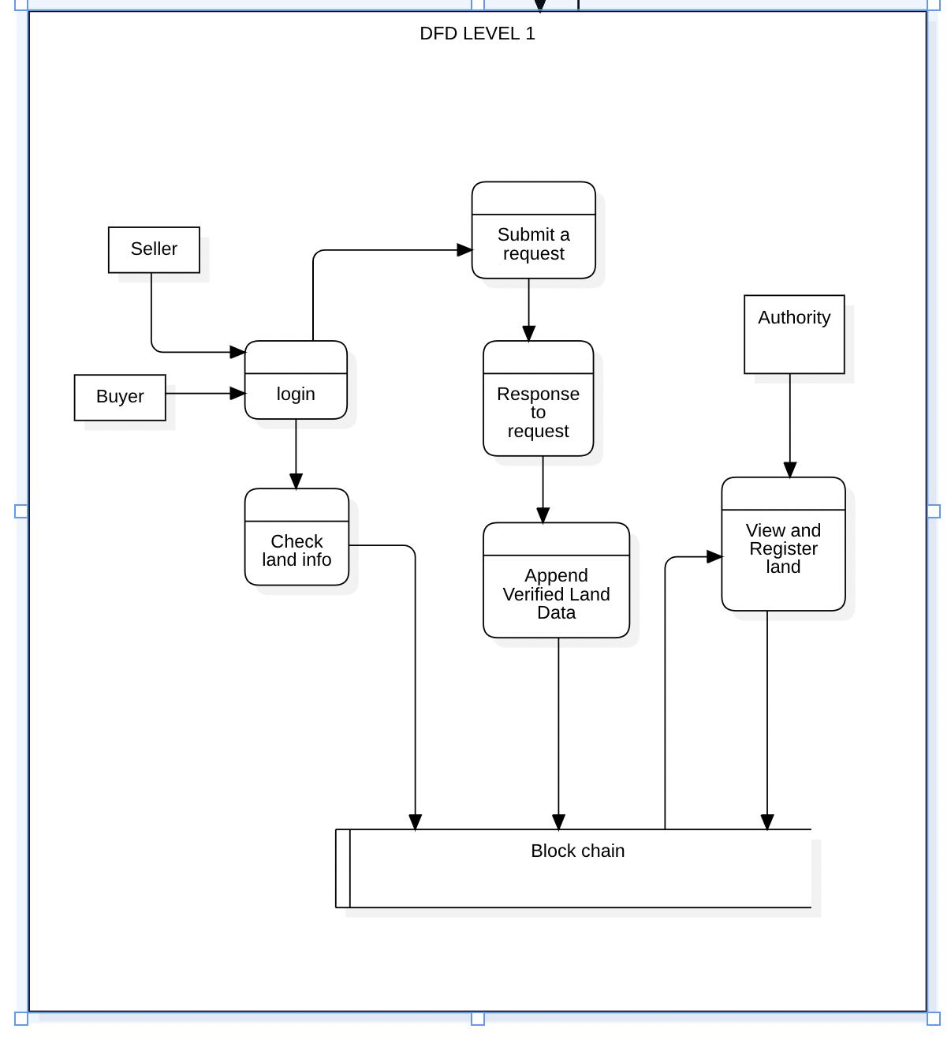
Data Flow Diagram – Level 1

Slide 11
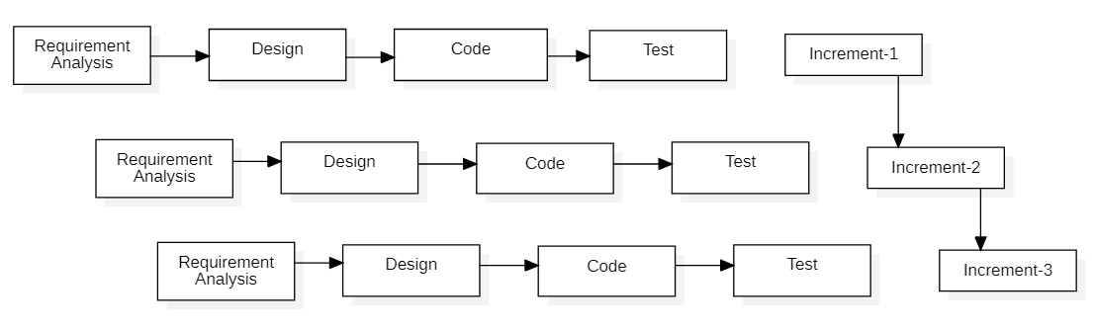
METHODOLOGY
Figure: Block diagram of incremental model

Slide 12
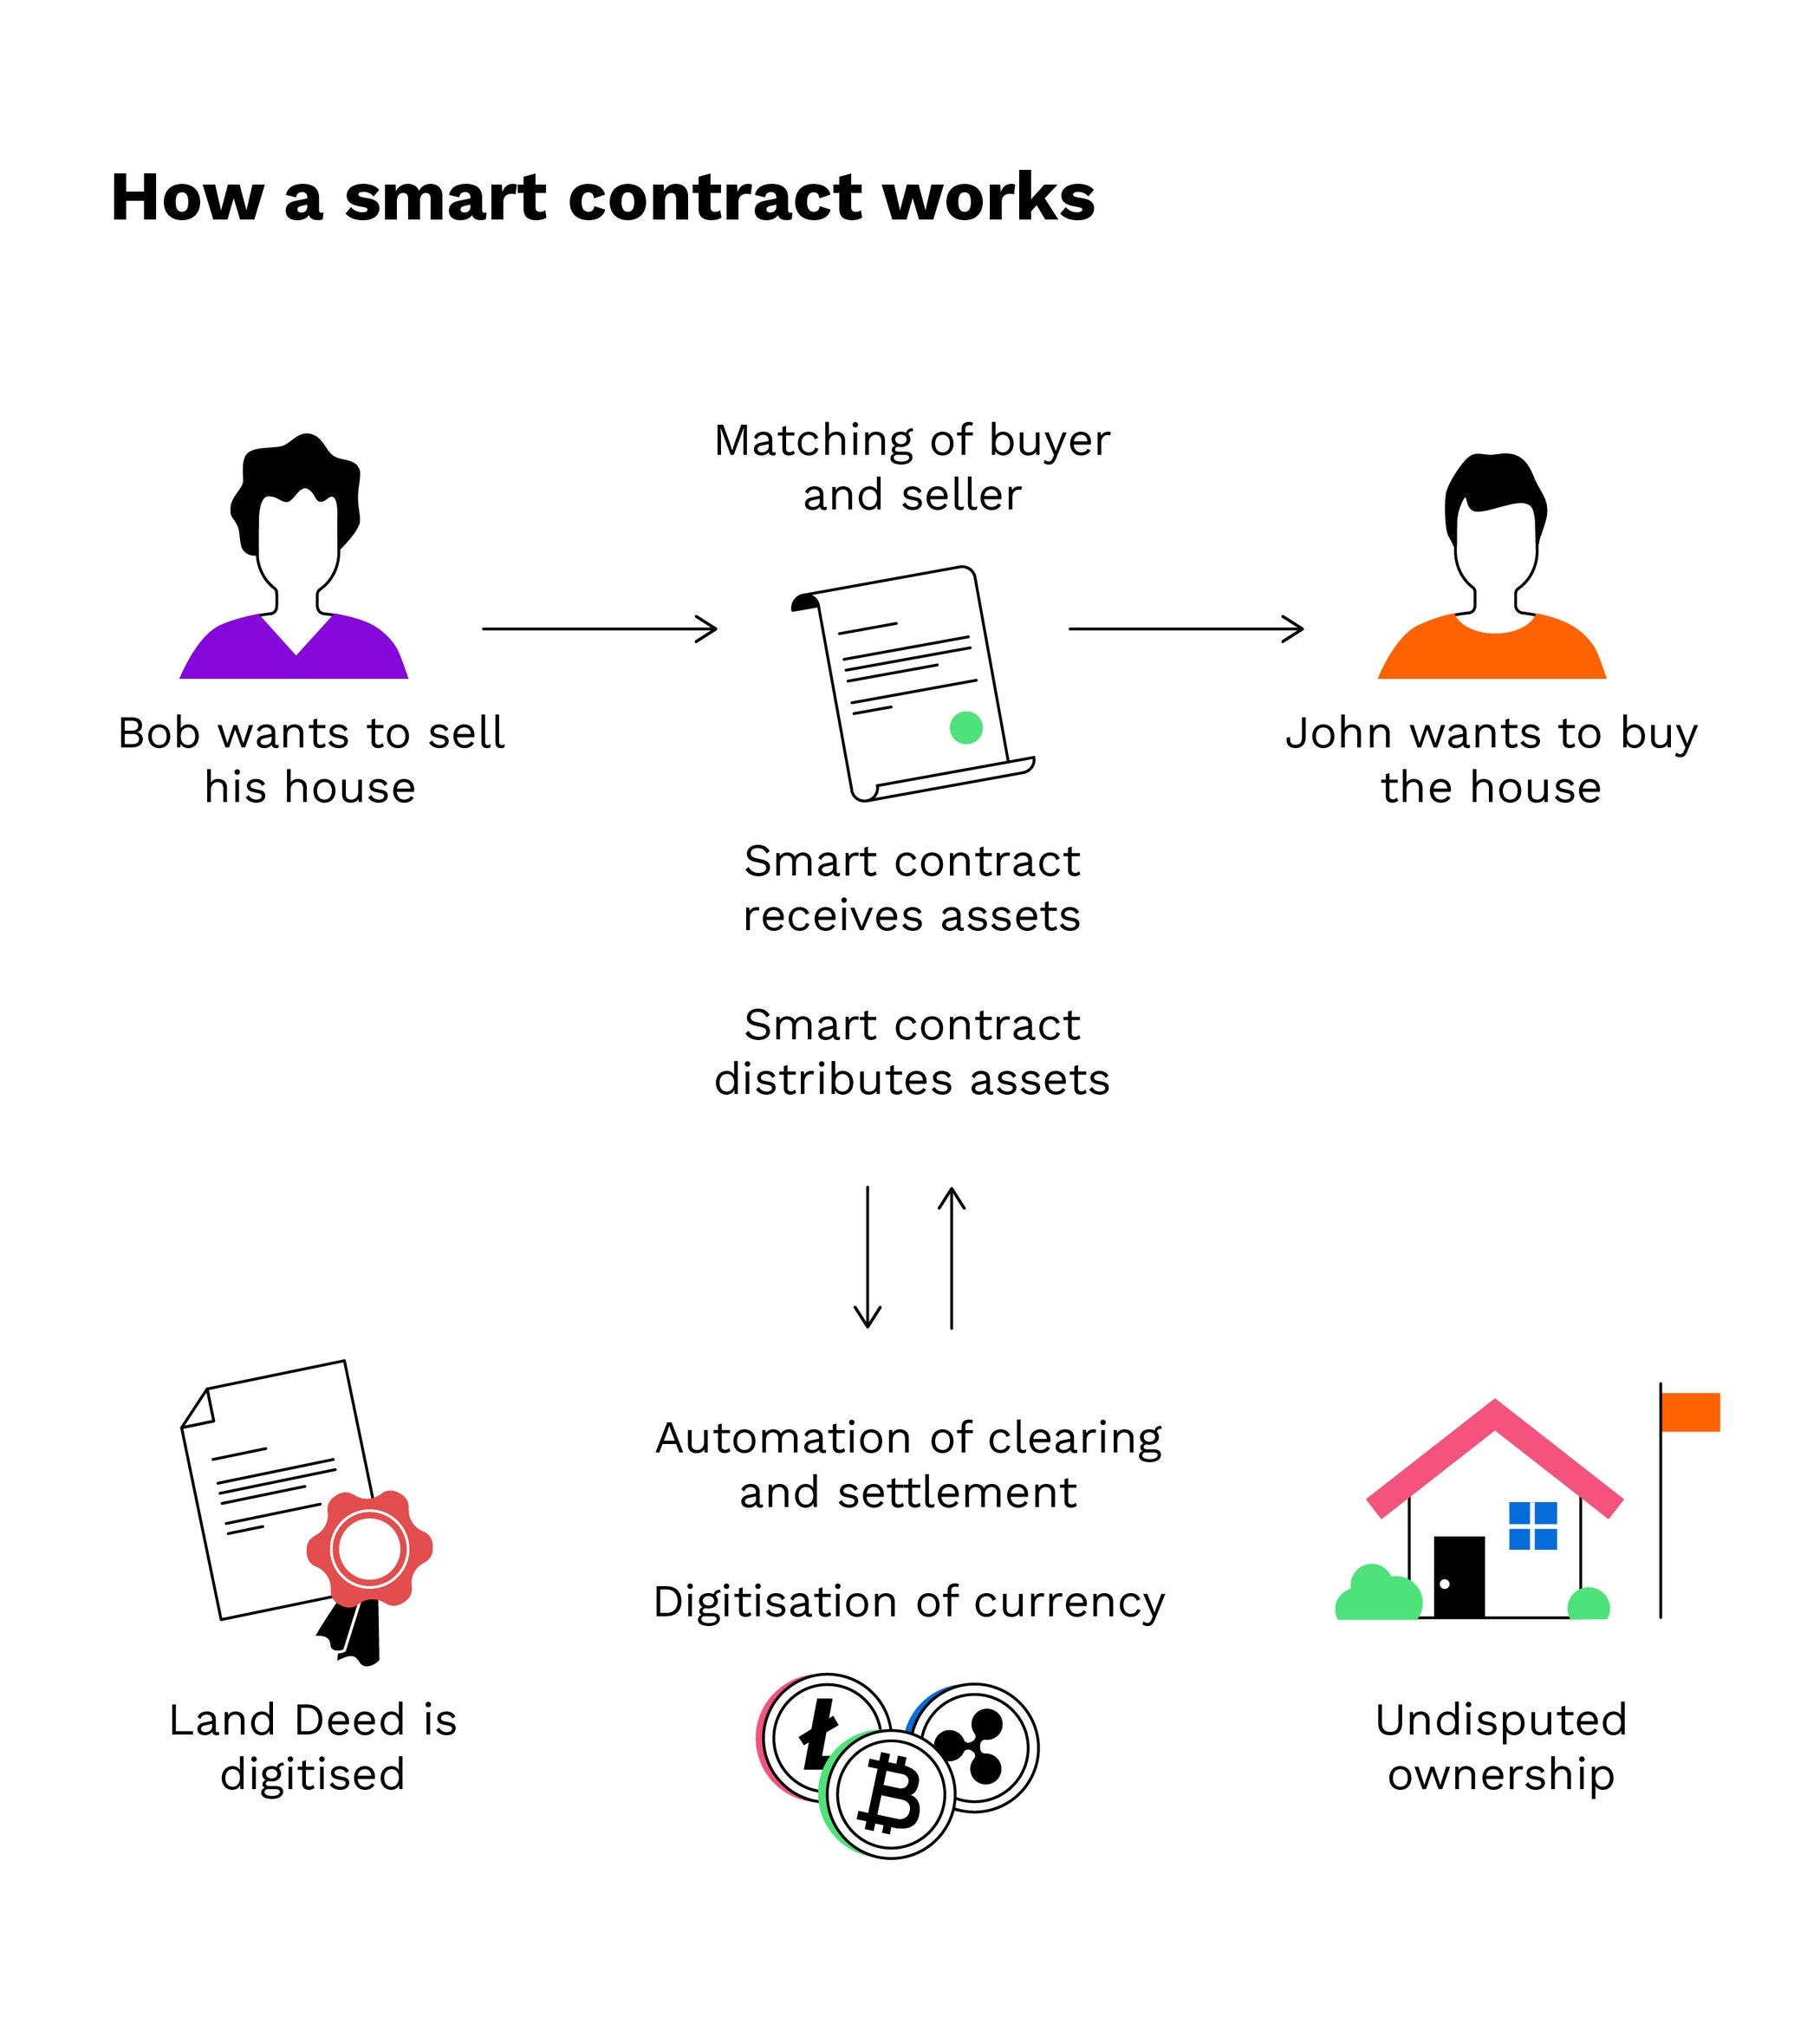

Slide 13
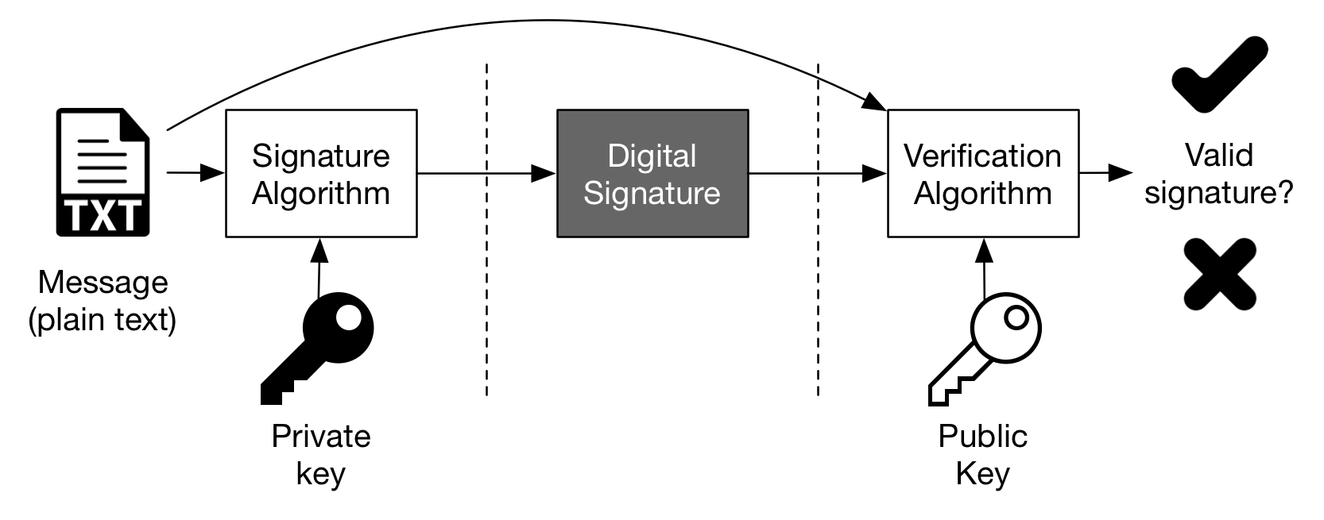
Digital Signature

Slide 14
Frontend development:
JavaScript – React
CSS
Backend development:
Node JS
Mango DB
Solidity
IPFS

Slide 15
REFERENCES
[1] V. Marinkovic, "E-commerce proposal," pp. 2-3, 2020.
[2] D. S. A. Bhat, "A Review Paper on E-Commerce," pp. 2-4, 2016.
[3] V. Jain, "An Overview of Electronic Commerce (e-Commerce)," Contemporary Issues in Business and Government, vol. 27, no. 3, pp. 666-669, 2021.
[4] C. W. Steinfield, "Electronic Commerce and the Local Merchant: Opportunities for Synergy Between Physical and Web," Electronic Markets, vol. 9, pp. 51-57, 1999.
[5] B. Schafer, "E-Commerce Recommendation Applications," 2000.

Slide 16
THANK YOU

