Slide 1
A FINAL YEAR MAJOR PROJECT ON REAL ESTATE REGISTRATION SYSTEM USING BLOCKCHAIN TECHNOLOGY [CT 707] SUBMITTED TO: DEPARTMENT OF ELECTRONICS AND COMPUTER ENGINEERING
SUBMITTED BY:
AJAY MAHARJAN (HCE075BCT006) ASHISH RAI (HCE075BCT042) NIBENDRA BAJRACHARYA (HCE075BCT015) SUJAN MAHARJAN (HCE075BCT037)

Slide 2
INTRODUCTION
Current process involves a lot of vulnerabilities
People in the authority can easily cheat the common people and government
Blockchain – a shared, immutable, decentralized, digital ledger
Transactions of real estate to be stored as blocks
System makes the authority decentralized, transparent and secured
System works on the basis of majority consensus – Use of Consensus algorithm

Slide 3
PROBLEM STATEMENT
Corruption
Lack of Transparency
Slow process in transfer of real estate
Bad record keeping

Slide 4
OBJECTIVES
To decentralize the record keeping system and increase data transparency
To digitize the land records
To mitigate corruption by real-time accounting

Slide 5
REQUIREMENTS ANALYSIS
Functional Requirements
Register Land
Make Property Available
Check Records
Validate Transactions
Response the Request
Request Land
Buy Land

Slide 6
Non Functional Requirements
Reliability
Availability
Performance
Scalability
Maintainability
Security

Slide 7
FEASIBILITY STUDY
Technical Feasibility - Hardware and software tools are within accessible boundaries.
Operational Feasibility - Simple and interactive interface and data drive.
Economic Feasibility - Only a computer is required to access the web application

Slide 8
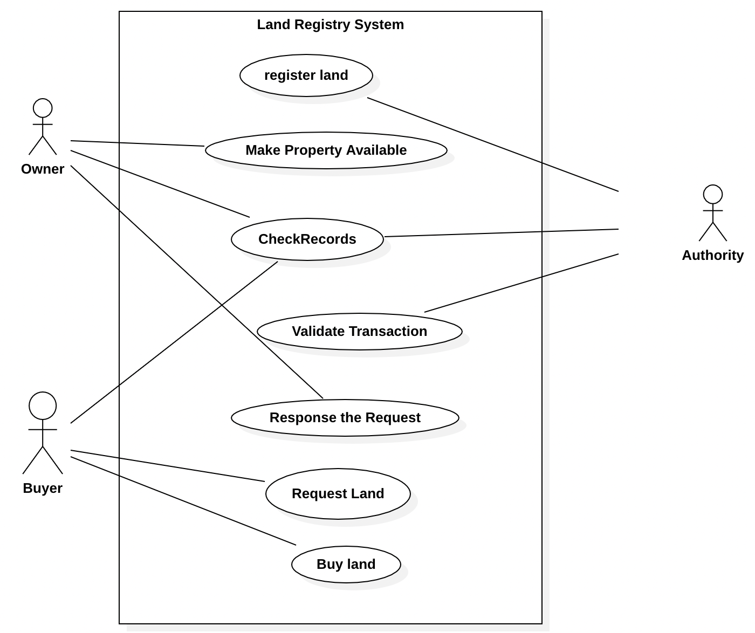
SYSTEM DESIGN
Use Case Diagram

Slide 9
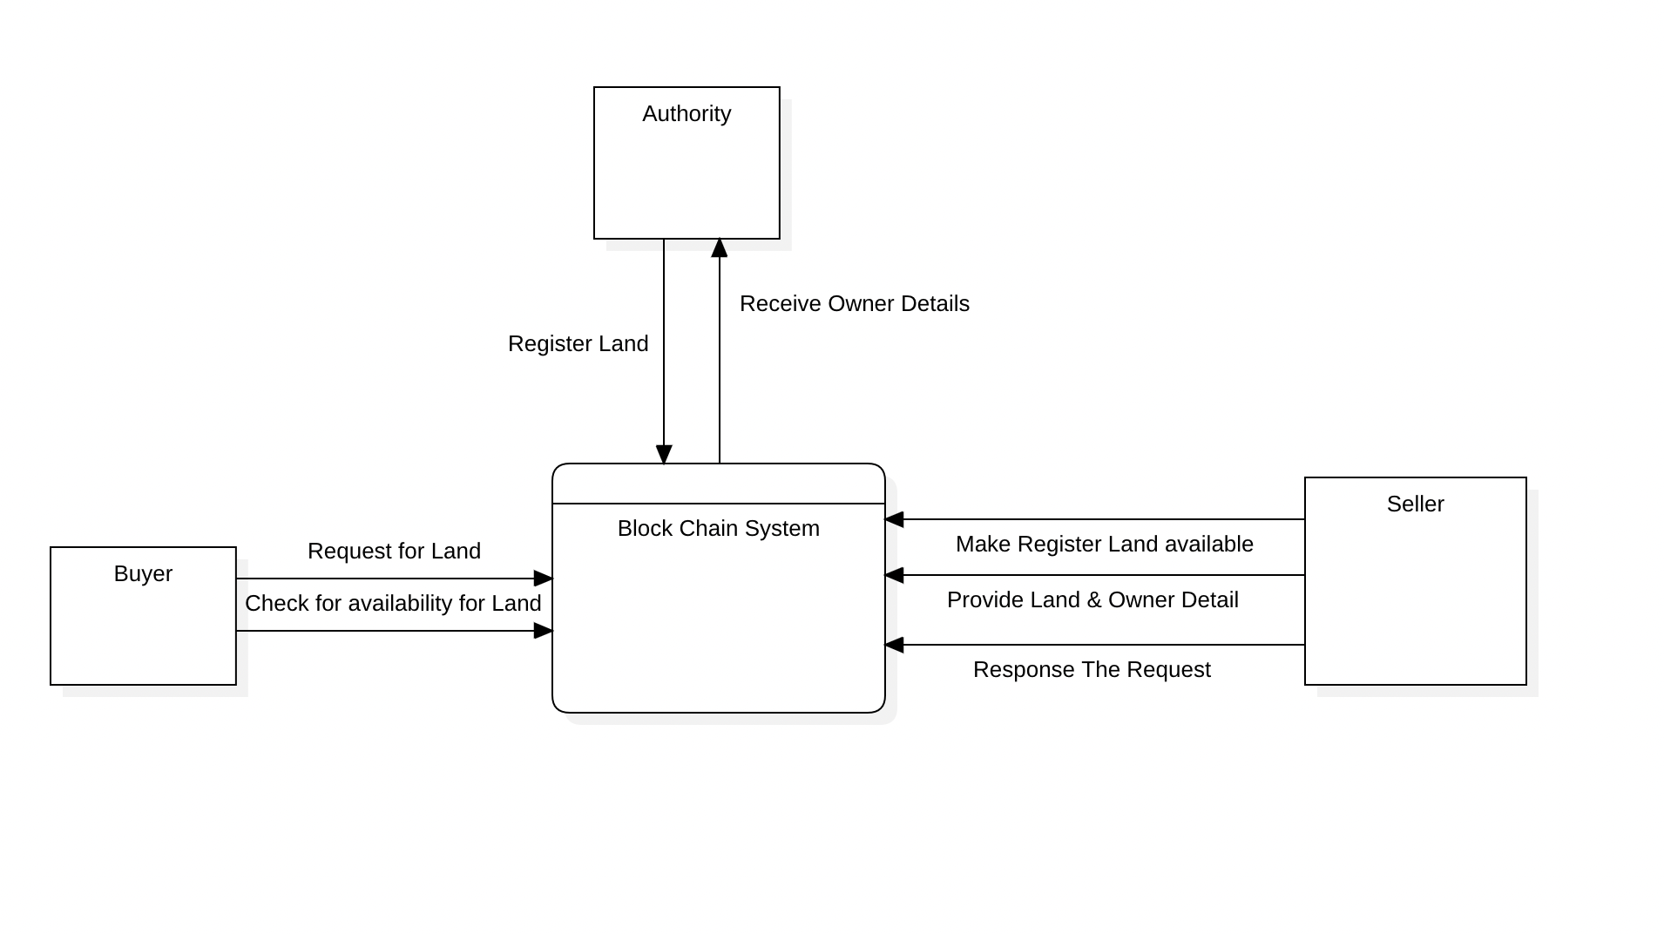
Data Flow Diagram – Level 0

Slide 10
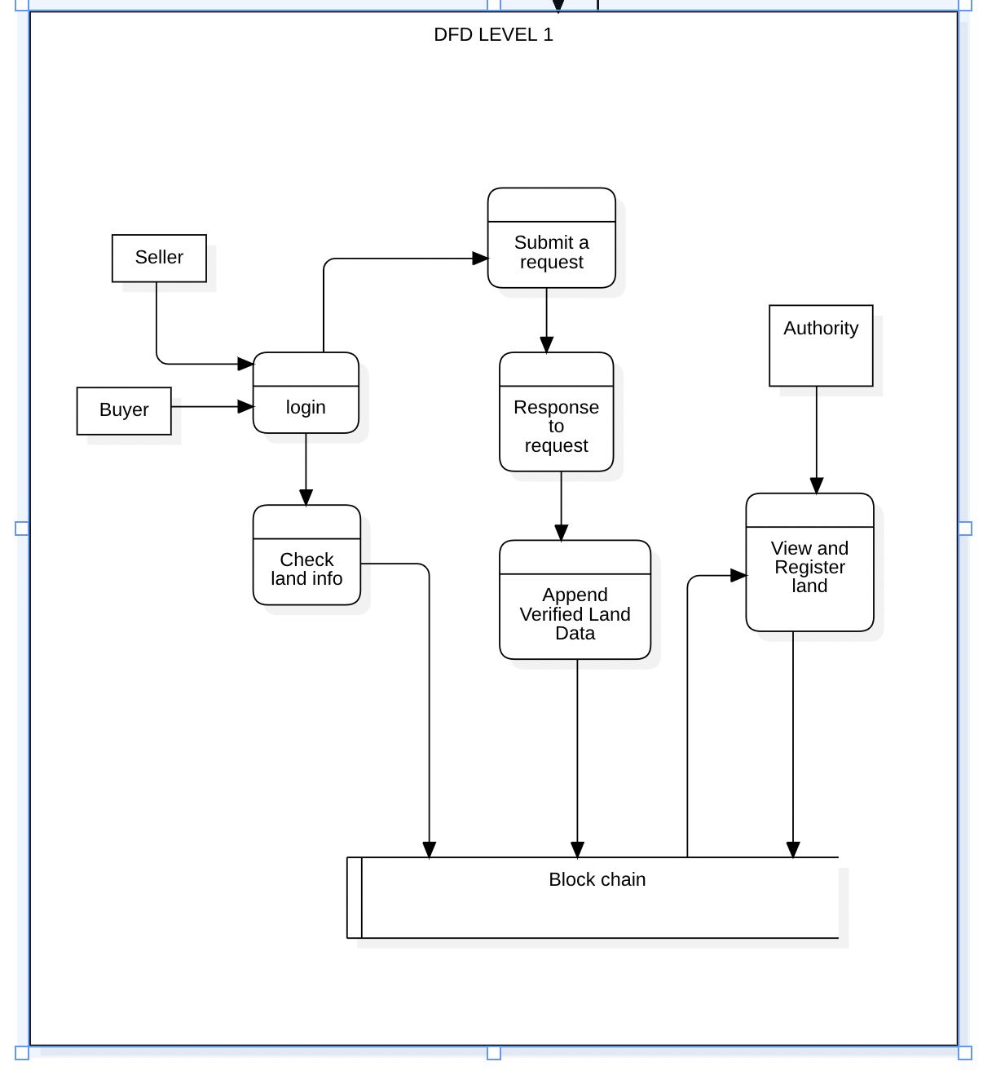
Data Flow Diagram – Level 1

Slide 11
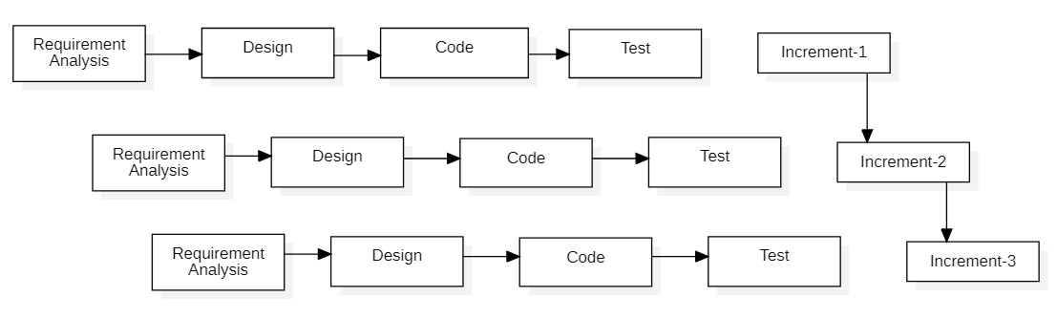
METHODOLOGY
Figure: Block diagram of incremental model

Slide 12
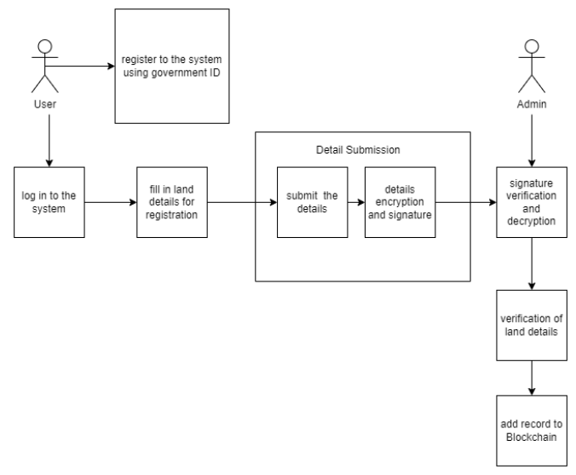
Block diagram

Slide 13
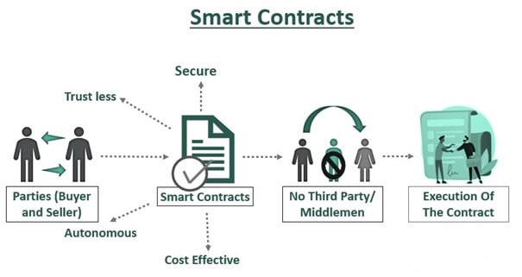

Slide 14
Ethereum Blockchain
KECCAK – 256
Elliptic Curve Digital Signature Algorithm
Ethereum Virtual Machine

Slide 15
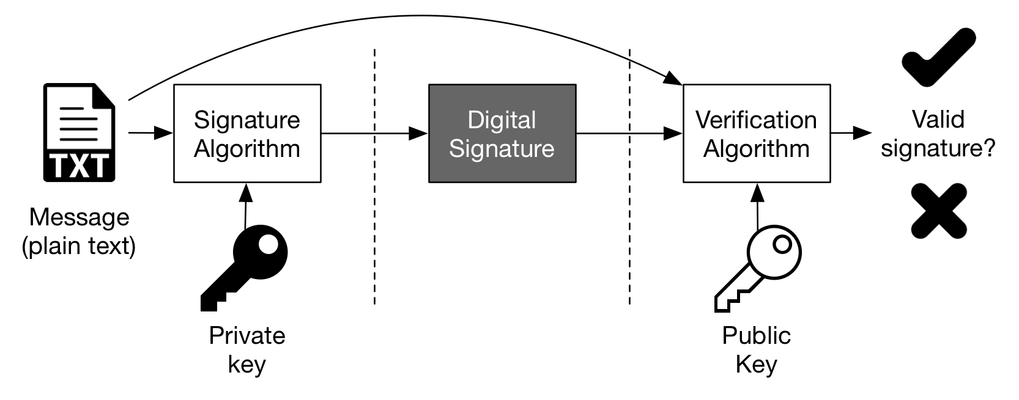
Digital Signature

Slide 16
Proof of Work
One of the consensus algorithms used worldwide
PoW algorithm is used to verify a transaction, mine the block, distribute the mined block to every node, and add the block to block chain.

Slide 17
PROJECT TOOLS
Frontend development:
JavaScript – React
CSS
Backend development:
Node JS
Mongo DB
Solidity
InterPlanetary File System (IPFS)

Slide 18
REFERENCES
[1] I. Karamitsos, M. Papadaki, N. B. Al Barghuthi et al., “Design of the blockchain smart contract: A use case for real estate,” Journal of Information Security, vol. 9, no. 03, p. 177, 2018.
[2] V. Chavan and C. Patel, “A study of tokenization of real estate using blockchain technology,” VIVA-Tech International Journal for Research and Innovation, vol. 1,
no. 4, pp. 1–8, 2021.
[3] B. Wigley and N. Cary, “The future is decentralised,” United Nations Development Progamme.[Electronic Resource]. URL: https://www.undp.org/content/dam/undp/library/innovation/The-Future-is-Decentralised. pdf/(date of access: 09.04. 2020), 2016.
[4] R. Khan, S. Ansari, S. Jain, and S. Sachdeva, “Blockchain based land registry system using ethereum blockchain,” J. Xi’an Univ. Archit. Technol, pp. 3640–3648,
2020.
[5] A. Lymbouras, “A shallow dive into bitcoin’s blockchain part 2 - transactions,” https://towardsdatascience.com/a-shallow-dive-into-bitcoins-blockchain-part-2-transactions-d4ee83067bae, accessed: 2022-03-08.

Slide 19
THANK YOU

