Slide 1
Pharmacy Medicine Supply Management System

Slide 2
POD MEMBERS AND THEIR RESPONSIBILITIES
SAI SUJANA MARUVADA(POD LEADER) - 851375
PHARAMACY MEDICINE SUPPLY MICROSERVICE
MEGHANA MATTA - 851362
MEDICINE STOCK MICROSERVICE
DHARANI SRI PENUMACHA - 851363
MEDICAL REPRESENTATIVE SCHEDULE MICROSERVICE
WASIM RAZA MOHAMMAD - 851373
AUTHORIZATION MICROSERVICE AND CLIENT UI

Slide 3
ACKNOWLEDGEMENT
We did the project- Pharmacy Medicine Supply Management System for our MFPE under the continuous guidance of
Mentor:- Kalyan
Trainer:- Shrivalli Maheshwaran
We would like to thank them for the continuous support and inputs

Slide 4
HARDWARE AND SOFTWARE REQUIREMENTS
Software Requirements:
Visual studio 2019 community edition
SQL Server 2014
Postman Client in Chrome
Azure cloud access
Hardware Requirement:
Developer laptop with at least 8GB RAM.

Slide 5
PROJECT OVERVIEW
The main objective of this project is for a pharmaceutical company to automate the logic of forming a schedule for their medical representatives to meet the targeted doctors to explain their medicines and its nature for prescription. Based on the response from doctors, the medicine demand will be determined. This should be fed into the system to determine the medicine supply detail to its Pharmacists. The application developed will target this requirement

Slide 6
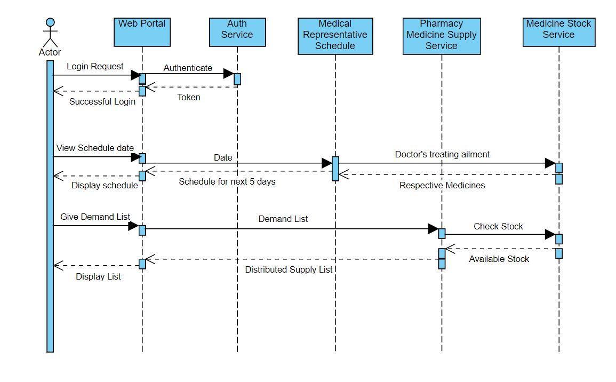
SEQUENCE DIAGRAM

Slide 7
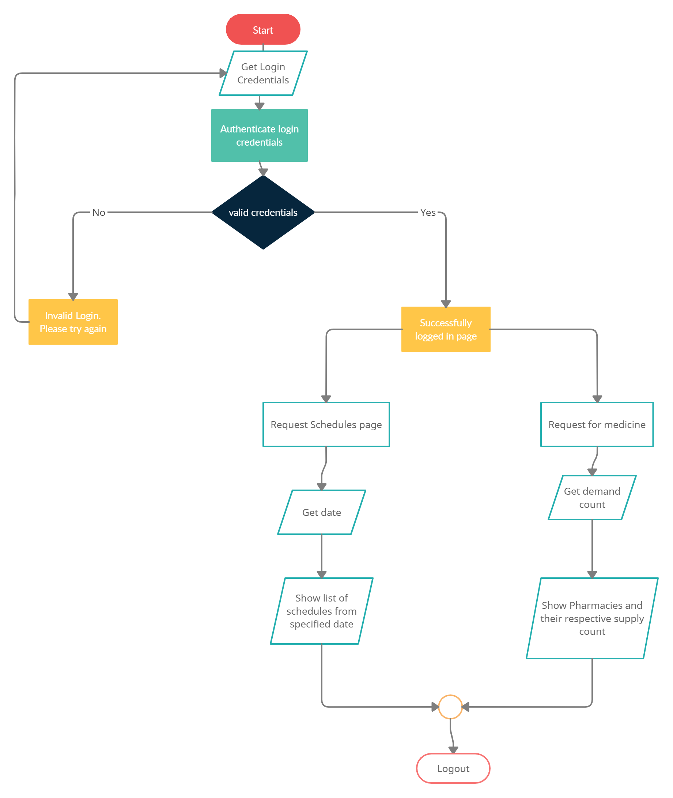
WORKFLOW DIAGRAM

Slide 8
MODULES
This application consists of four microservices and an MVC Client.
The four microservices include:
Authorization Service
Medicine Stock Information Service
Medical Representative Schedule Service
Pharmacy Medicine Supply Service

Slide 9
Authorization Service:
This service authenticates the user based on the credentials entered during login. This service returns a JWT Token on successful login which is then used for further authorization of requests.
Medicine Stock Service :
This service retrieves details of available medicines from the godown. The details retrieved include: Medicine Name, Chemical Composition, Target Ailment, Date Of Expiry and Number of medicines in stock. These details are used by the other two services.

Slide 10
Medical Representative Schedule Service:
The intent of this Microservice is to provide a doctor meet schedule for the Representatives of the company. Based on pre-defined doctor information, the microservice maps the available representatives for a period of 5 days. The start date of the schedule
should be sent as input from the web portal. This module interacts with the medicine stock module to find the medicine stock to be explained to the targeted doctors.

Slide 11
Pharmacy Medicine Supply Service:
This service maintains a list of pharmacies that the company does business with. It receives input from the web portal for the medicine count needed. Upon receiving this, this
Microservice interacts with Medicine Stock service to get the current stock. This count is split among all the pharmacists and returned to the web portal. If the stock count is lesser than the demand, then the stock count is considered.

Slide 12
PROJECT FLOW

Slide 13
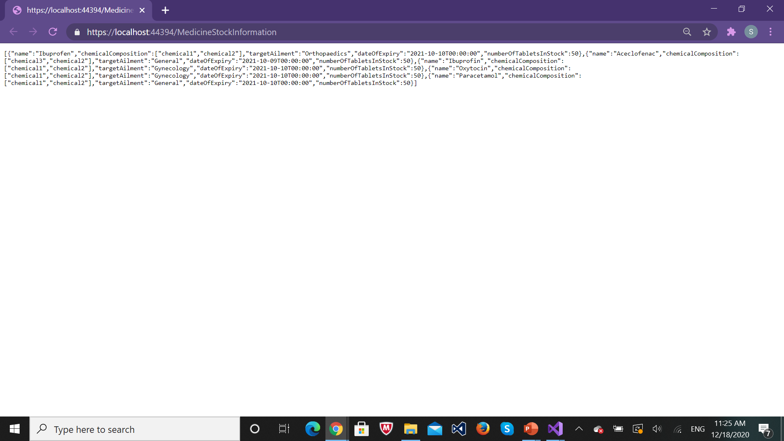
MEDICINE STOCK SERVICE
Data returned from the API

Slide 14
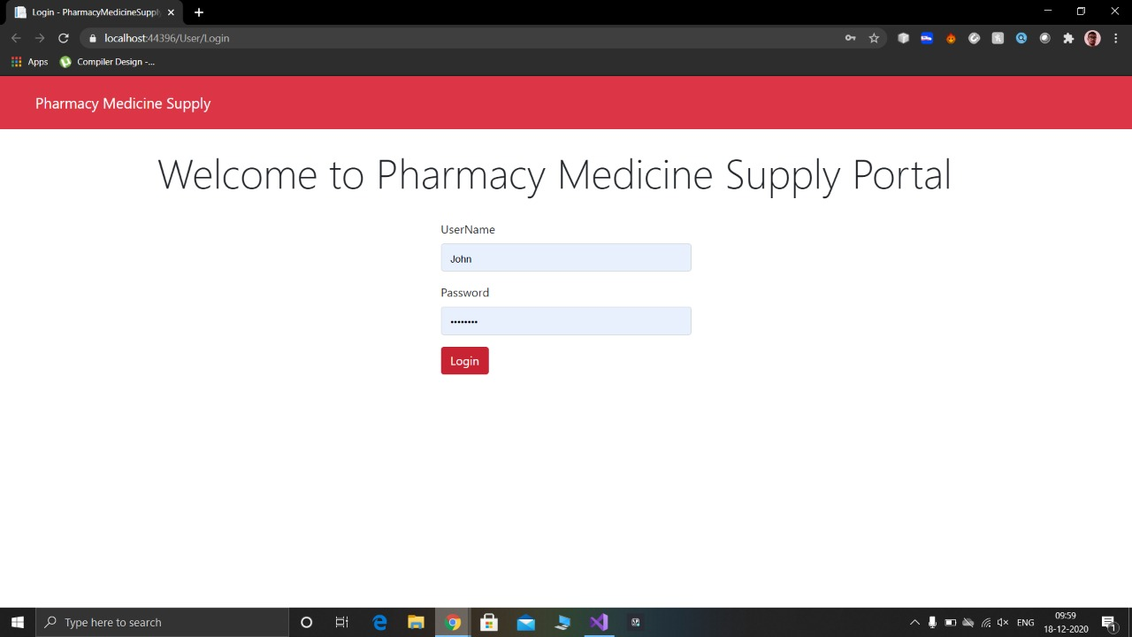
LOGIN
Login page

Slide 15
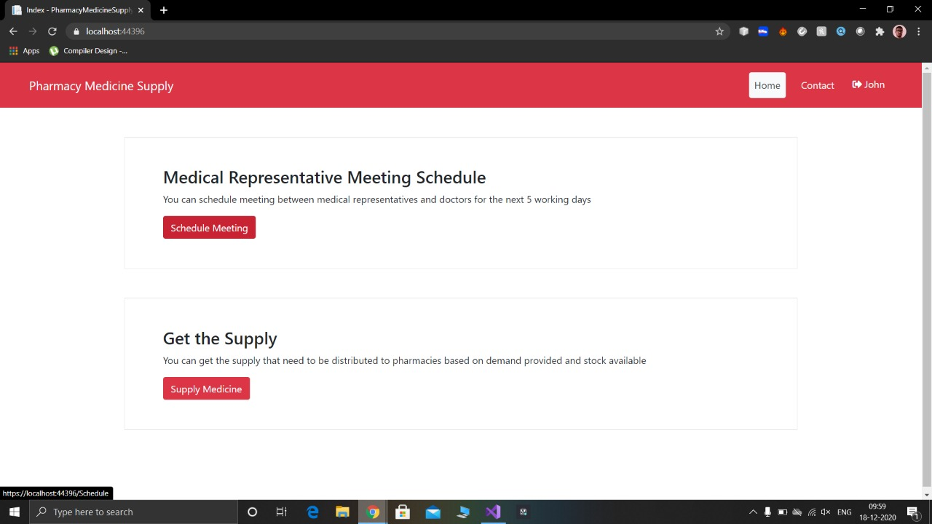
After successful login:

Slide 16
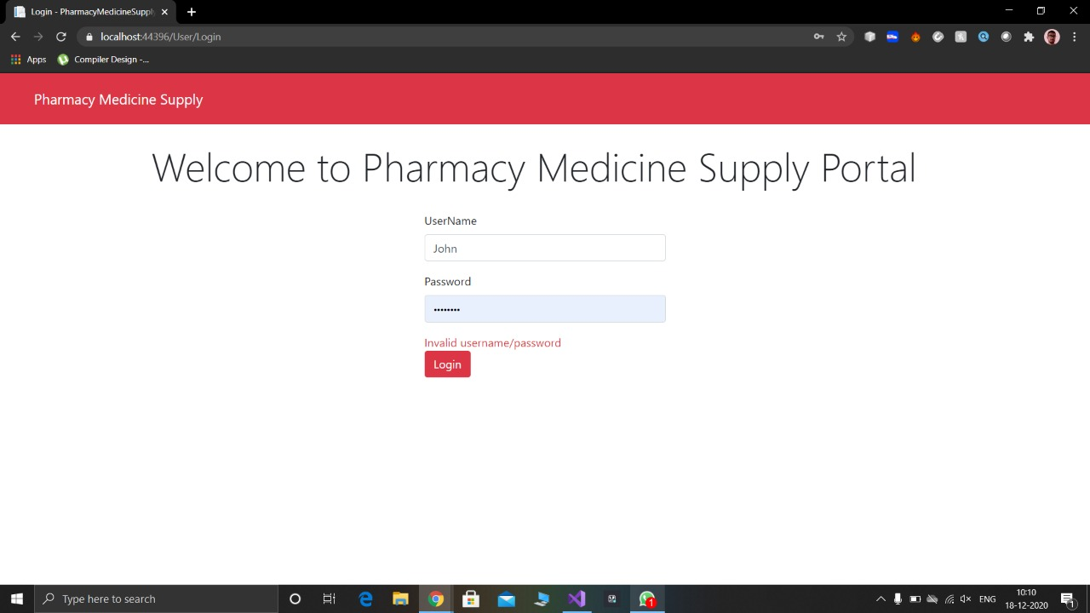
When wrong credentials are entered:

Slide 17
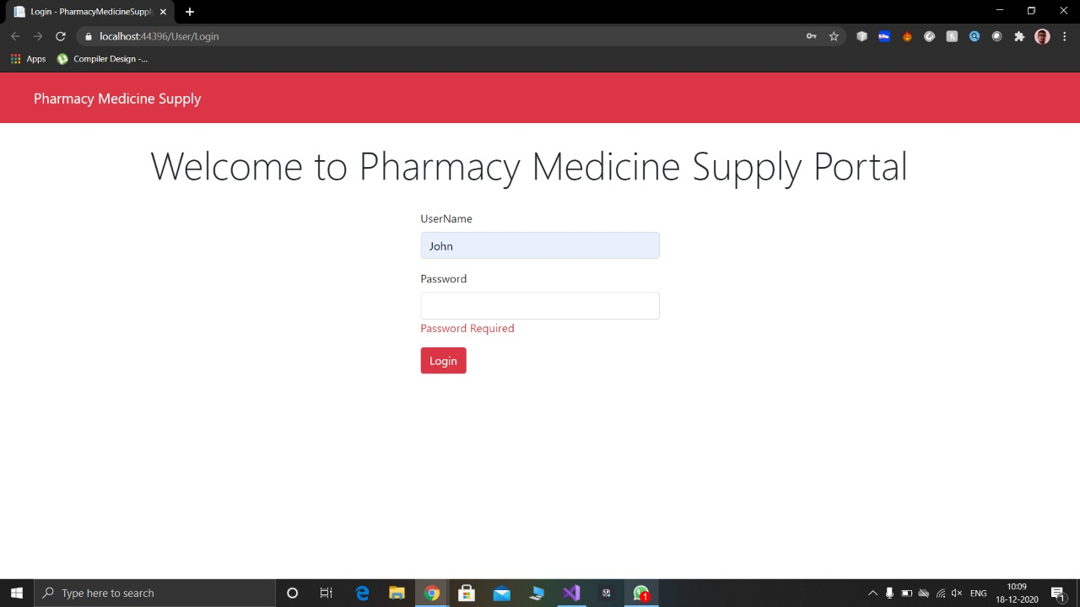
When password is not entered:

Slide 18
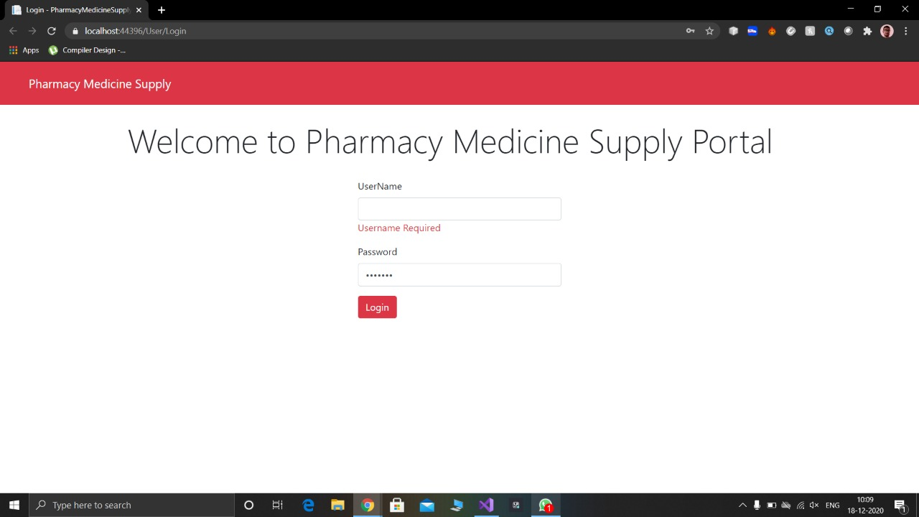
When username is not entered:

Slide 19
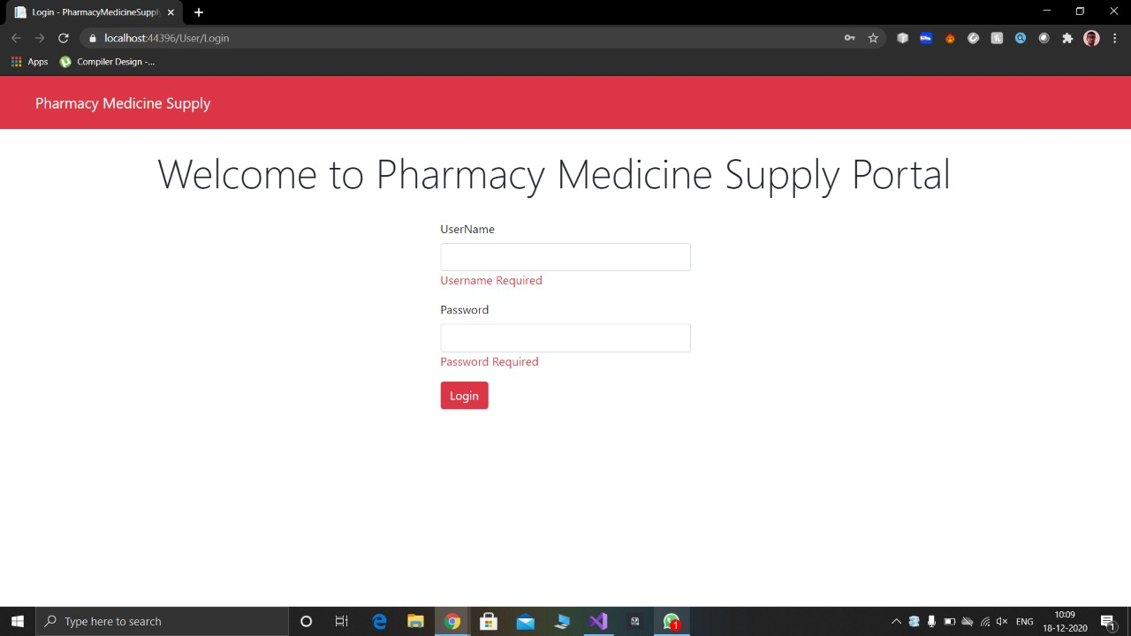
When both fields are left empty:

Slide 20
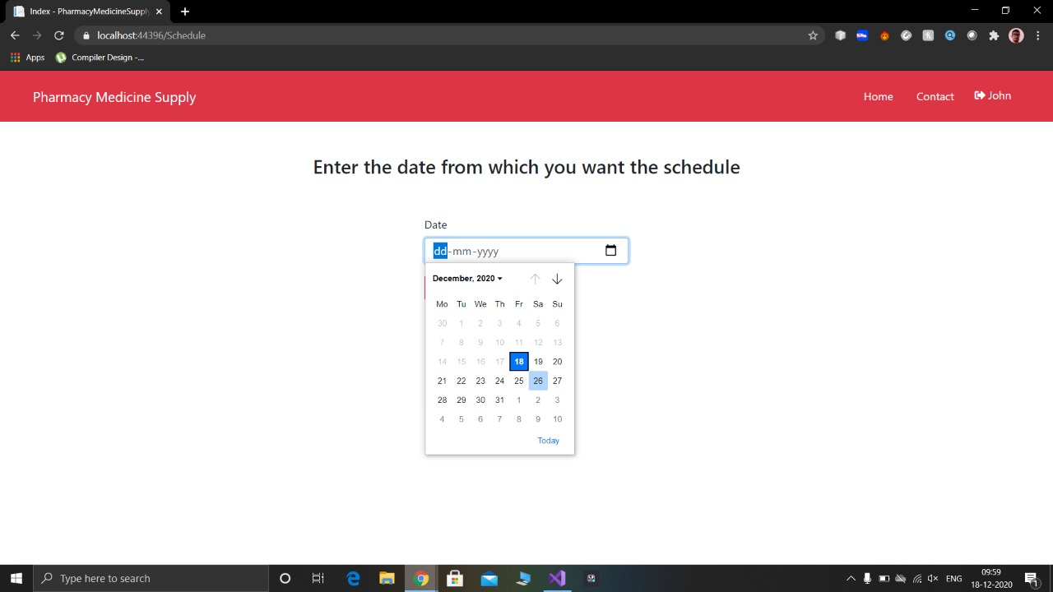
MEDICAL REPRESENTATIVE SCHEDULE
Schedule Page:

Slide 21
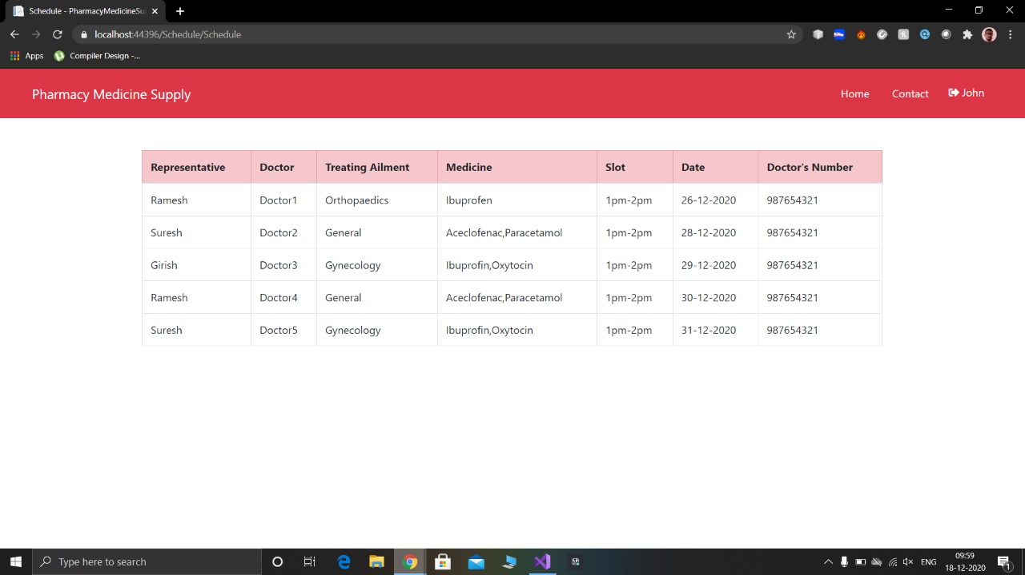
Retrieved Schedule:

Slide 22
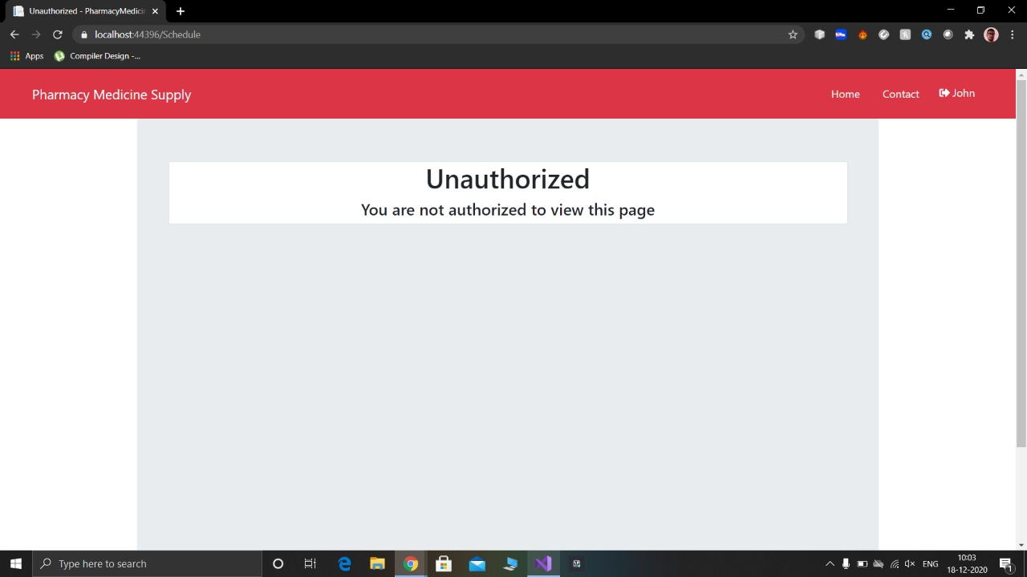
When an unauthorized request is made to schedule service:

Slide 23
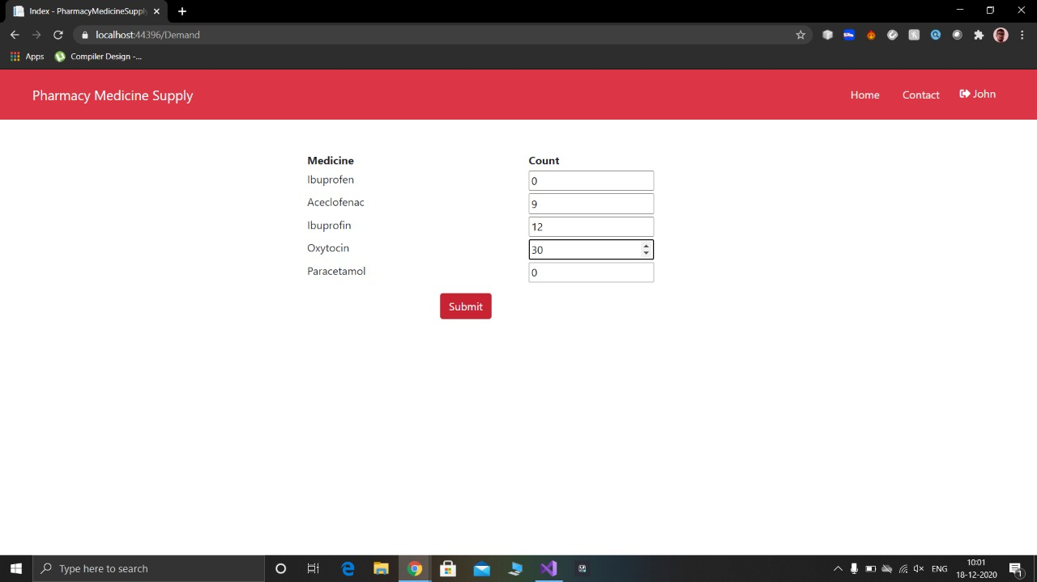
PHARMACY MEDICINE SUPPLY
Supply page :

Slide 24
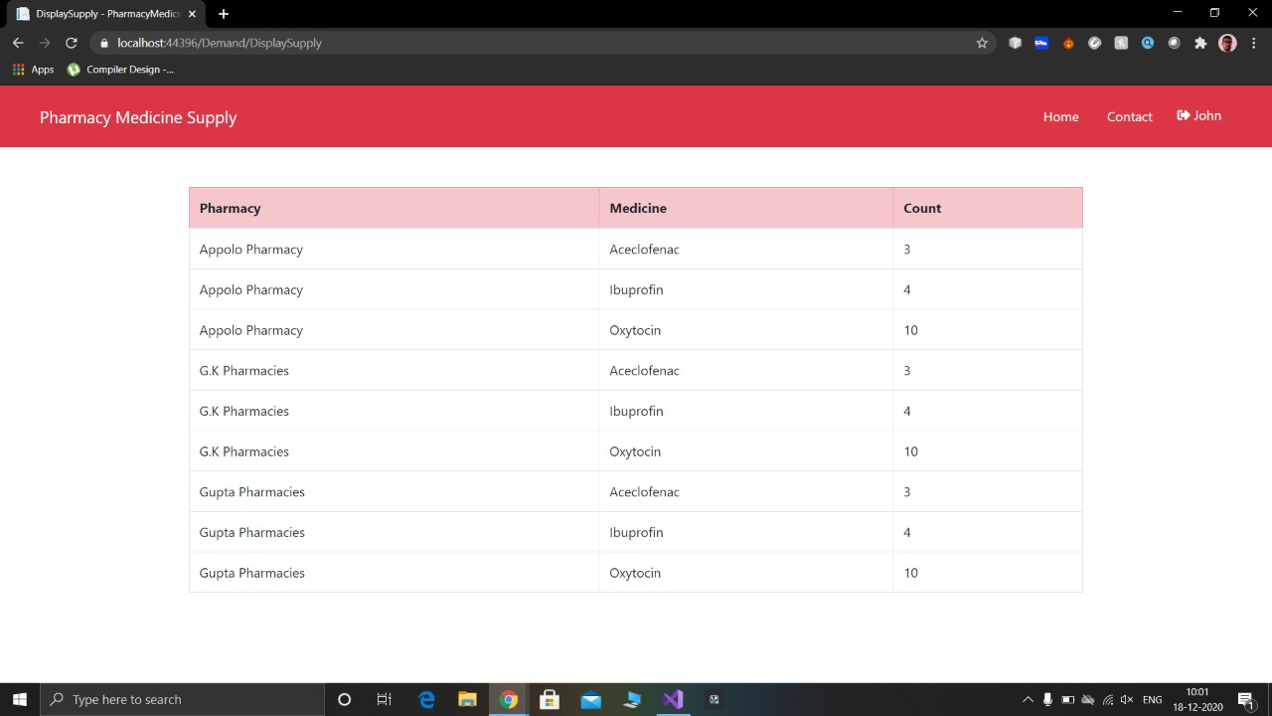
Retrieved supply list:

Slide 25
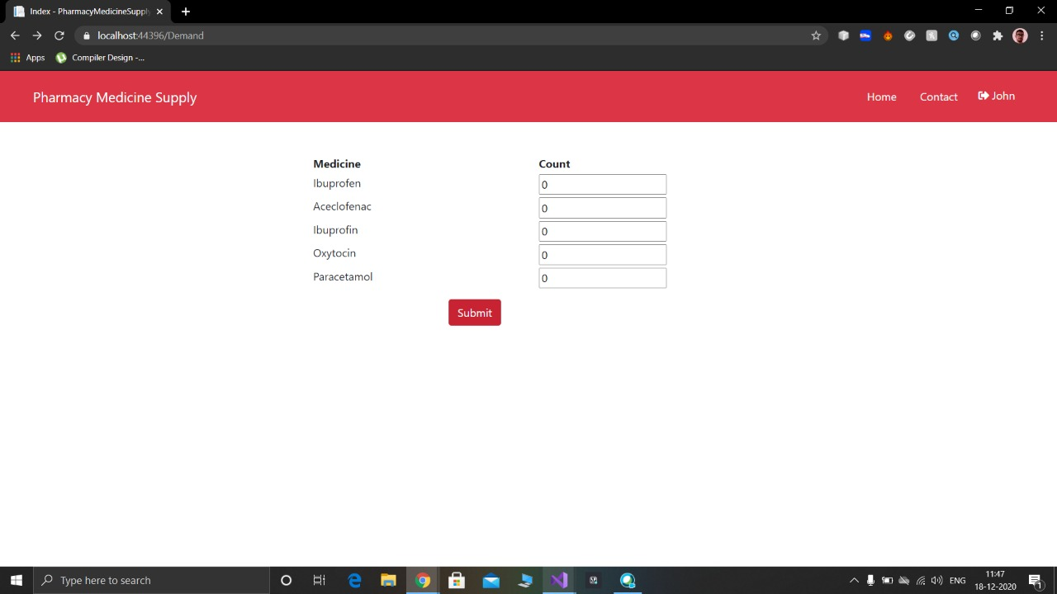
When demand entered is 0

Slide 26
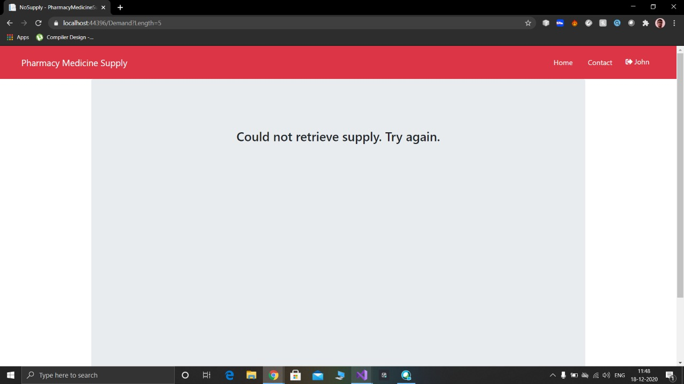

Slide 27
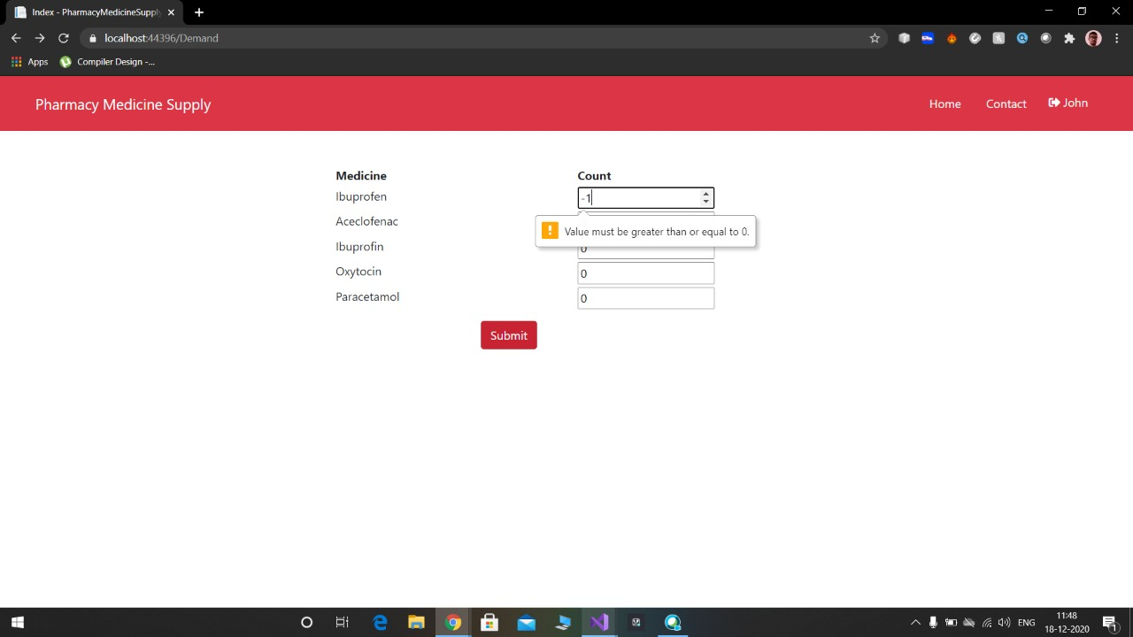
When negative demand is entered:

Slide 28
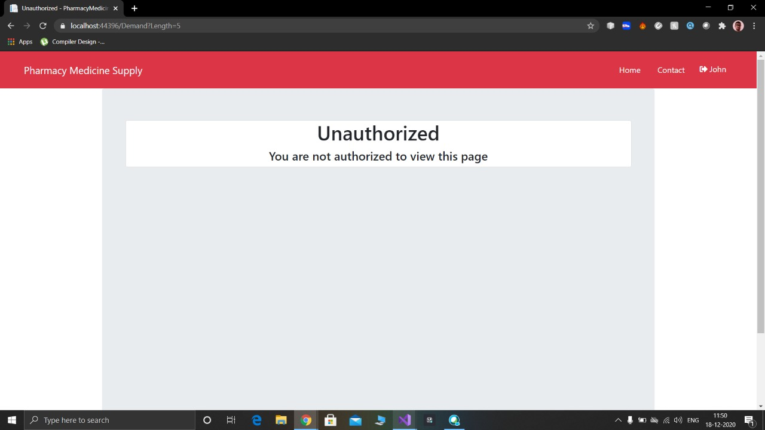
When an unauthorized request is made to the service

Slide 29
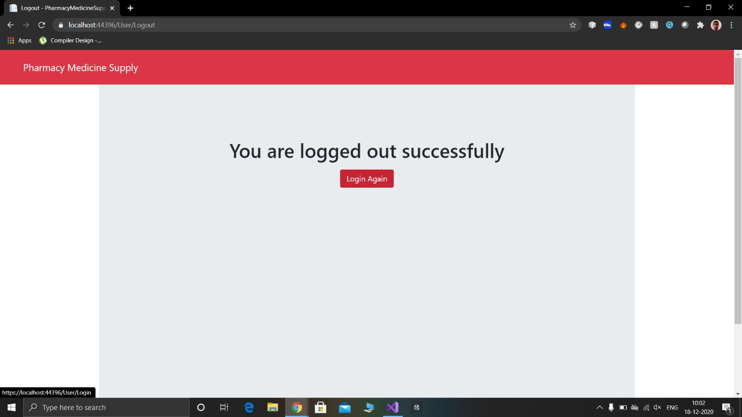
LOGOUT

Slide 30
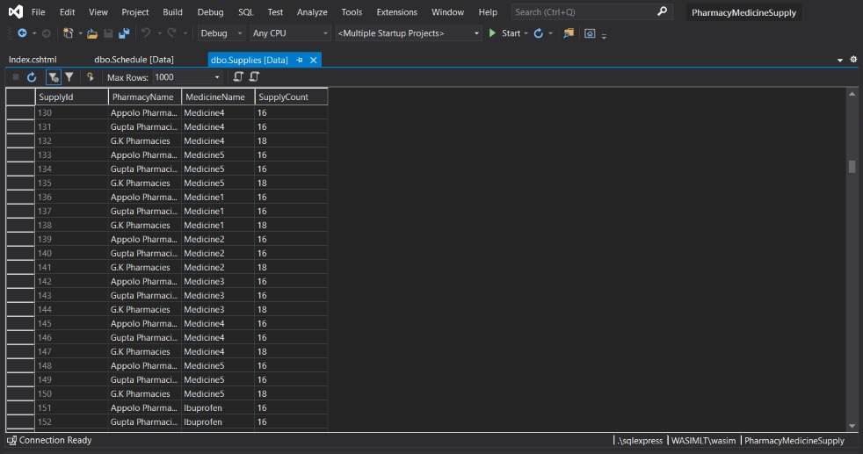
The responses from services are stored in a database
Responses from pharmacy supply service :

Slide 31
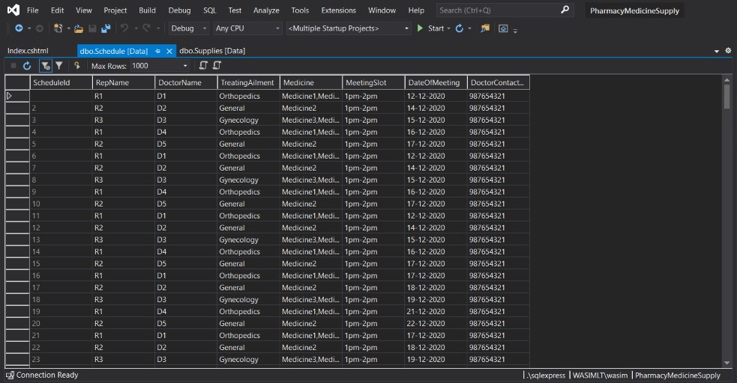
Responses from Schedule Service :

Slide 32
CONCLUSION
By doing this project we learnt how to study use case document , how to divide works in groups and help each other in their problems.
It also improved our knowledge of Microservices , C# concepts, EF core, coding standards and naming conventions, .NET Core Web API , MVC core and Nunit testing.
We also learnt deploy microservices on cloud using Microsoft Azure and how to edit the CI/CD pipeline.
We had a great learning experience while doing this project which will help us greatly in the future

Slide 33
THANK YOU

