Slide 1
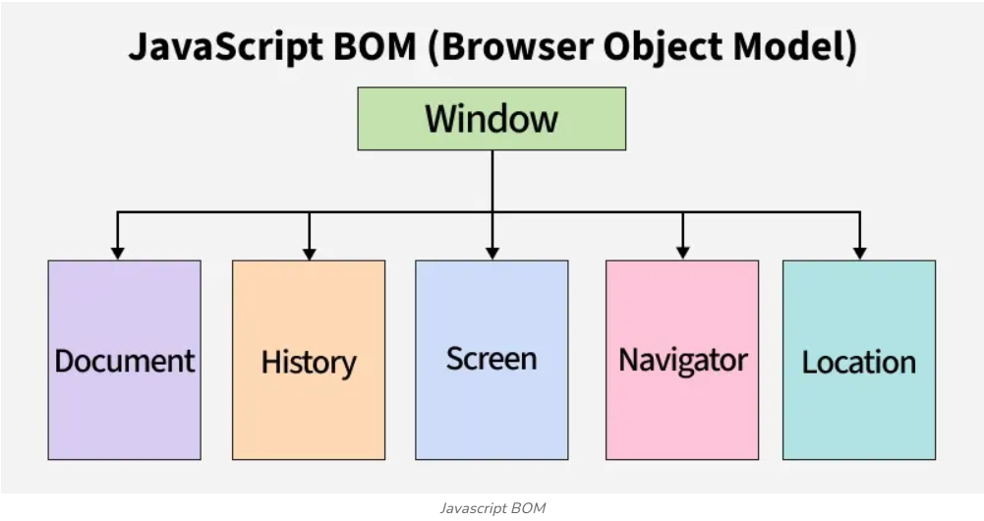
What is BOM?
• BOM (Browser Object Model)
• It allows JavaScript to interact with the browser itself
• Not limited to webpage content (unlike DOM)
• Controls browser features like window size, navigation, history, screen info

Slide 2
Why BOM Exists?
• Webpages need to access browser functionalities
• Example: Check window size for responsive design
• Redirect user to another webpage
• Show alerts, confirmation, and input dialogs
• Access browser history for navigation

Slide 3
Where Do We Use BOM?
• Creating popup messages (alert, prompt, confirm)
• Understanding screen size for UI adjustments
• Opening or closing browser windows
• Navigating between pages
• Getting information about browser & system

Slide 4
BOM vs DOM (Very Important)
• DOM → Document Object Model → Deals with HTML elements
• BOM → Browser Object Model → Deals with browser window
DOM Example: document.getElementById()
BOM Example: window.location.href

Slide 5
Window Object (Heart of BOM)
• window is the top-most object in BOM
• Represents the entire browser window
• All global variables & functions become part of window
• Example:
window.alert('Hi')
window.innerWidth
window.document

Slide 6
Window Object Properties
Some commonly used properties of window:
• innerWidth → Width of browser window
• innerHeight → Height of browser window
• outerWidth → Full width (including toolbar)
• outerHeight → Full height (including toolbar)

Slide 7
Screen Object
• Gives information about user's screen
• screen.width → Screen width
• screen.height → Screen height
• screen.colorDepth → Color quality
Used for responsive layouts & display adjustments

Slide 8
Location Object
• Helps control and access browser URL
• window.location.href → Get current URL
• window.location.reload() → Reload page
• window.location.assign('site') → Navigate to new page
• Useful for redirects and changing pages dynamically

Slide 9
History Object
• Allows navigation through browser history
• history.back() → Go to previous page
• history.forward() → Go to next page
• history.length → Number of pages in history
Useful in SPA & custom navigation systems

Slide 10
Navigator Object
• Contains information about browser & OS
• navigator.userAgent
• navigator.language
• navigator.onLine → Check internet connection
Used for browser compatibility & environment checking

Slide 11
Popup Methods
• alert('message') → Simple message popup
• confirm('Are you sure?') → Returns true/false
• prompt('Your name?') → Takes user input
Commonly used for quick interactions

Slide 12
Opening & Closing Browser Windows
• window.open('https://google.com') → Opens new tab/window
• window.close() → Closes current tab (if opened via script)
Used for controlled navigation

Slide 13
Real‑Life Uses of BOM
• Showing warning popups
• Checking if user is online
• Detecting screen size for responsive content
• Automatically redirecting users
• Custom back/forward navigation

Slide 14
Summary of BOM
• BOM = Browser level interactions using JavaScript
• window object is the root
• DOM = webpage content | BOM = browser control
• Useful for: navigation, screen info, popups, history control, window sizing

