Slide 1
Enterprise Accounting System
Sujan CR
PES1201801286

Slide 2
Description
The project is a accounting system an enterprise can use in its day-to-day working.
Enabled to store all employees’ details and addresses, the firm’s transactions of everyday, account balances of all the internal and external accounts alongside each journal entry’s supporting documents.
Designed to show Ledger balances of the firm.
A real-time database workflow is ensured using a number of triggers.
Resembles a small real-life accounting system

Slide 3
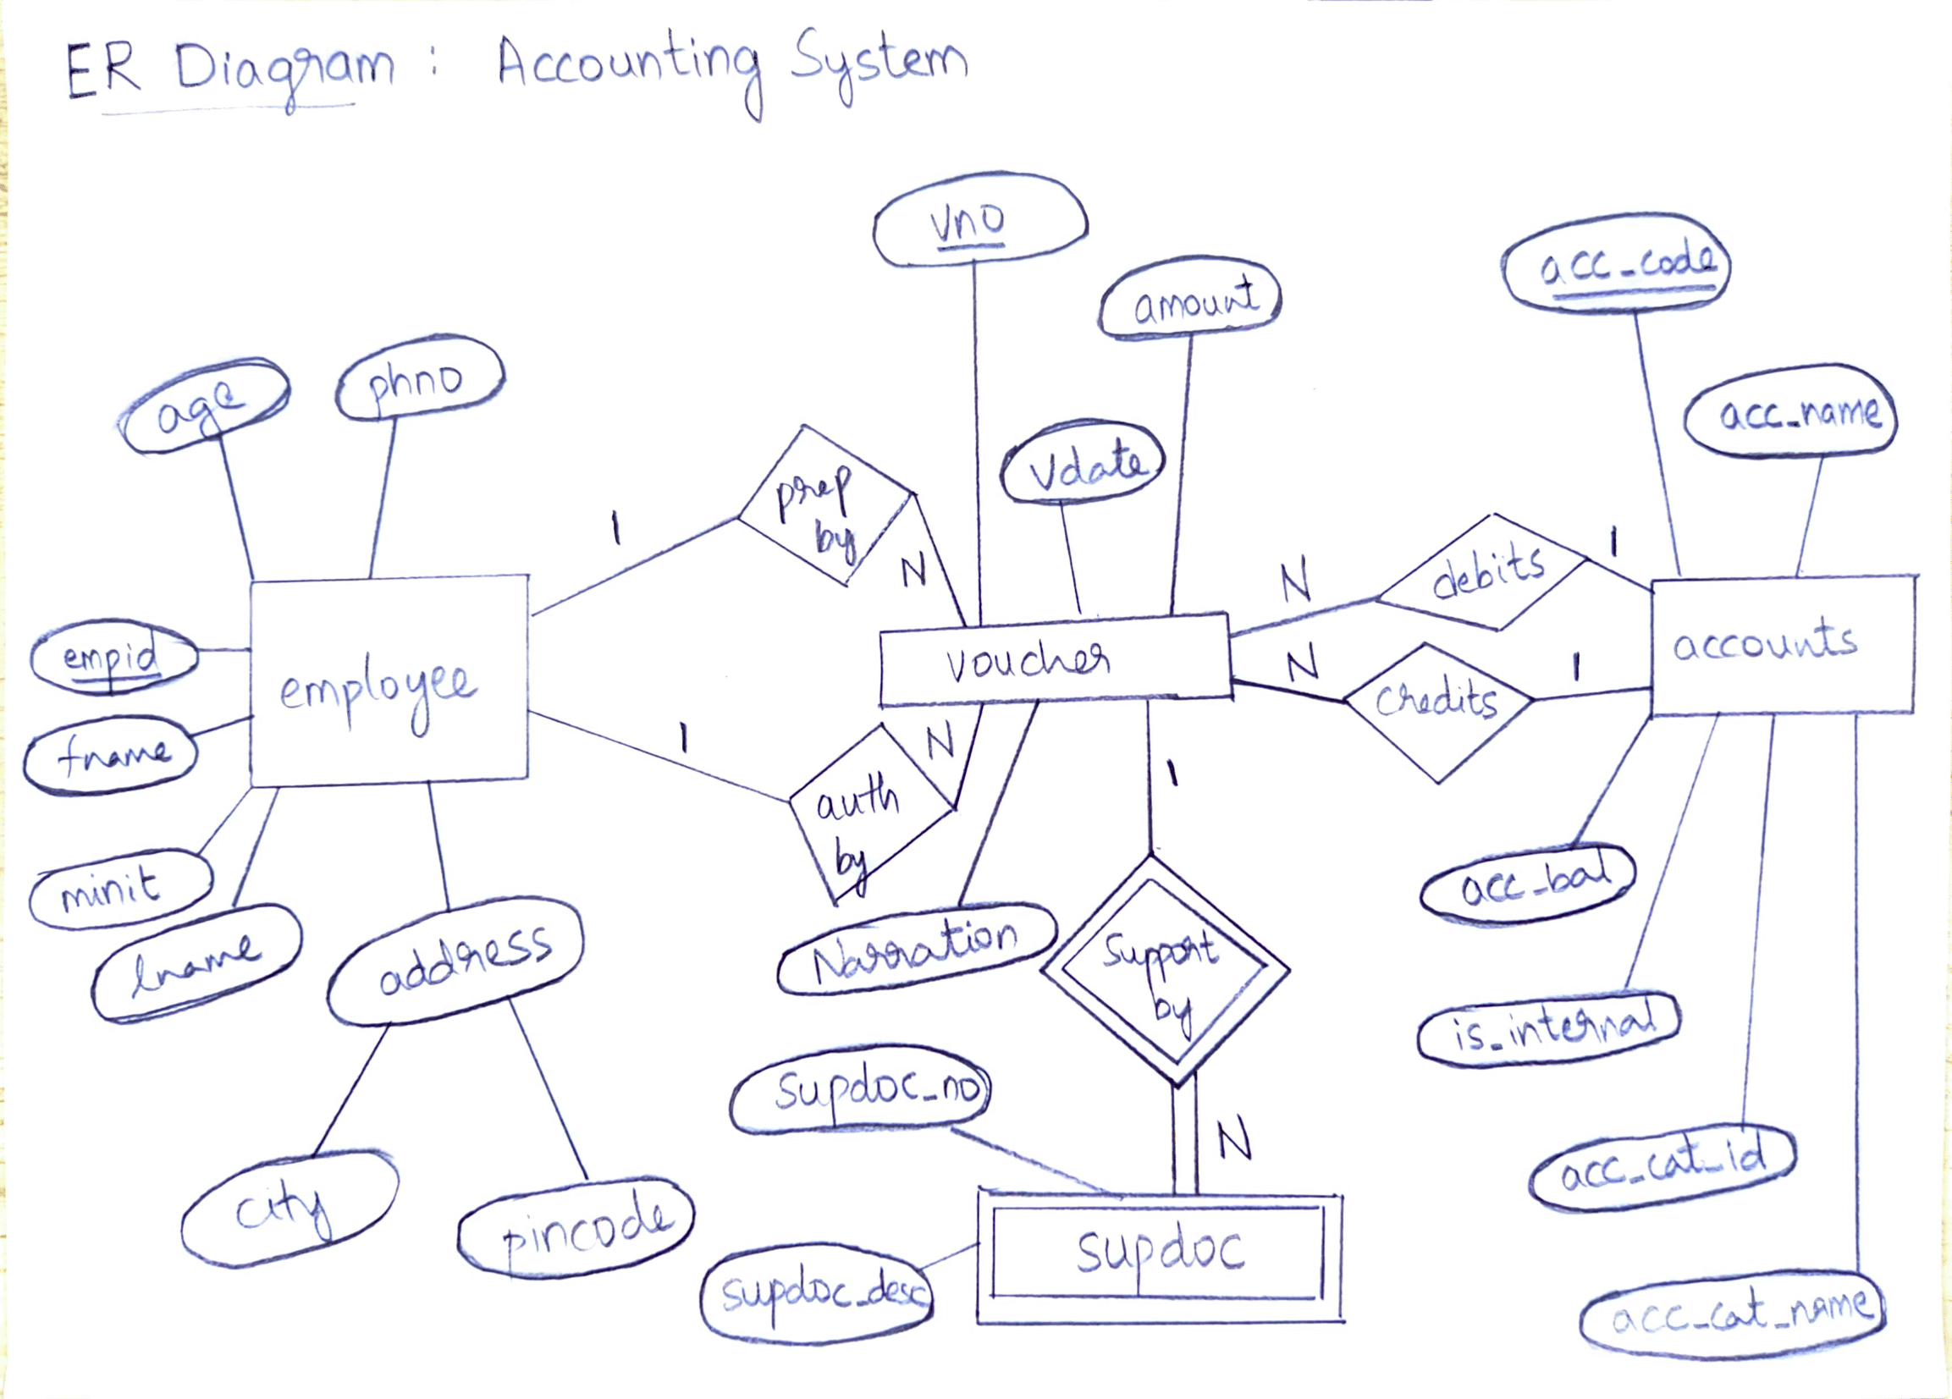
ER Diagram with constriants

Slide 4
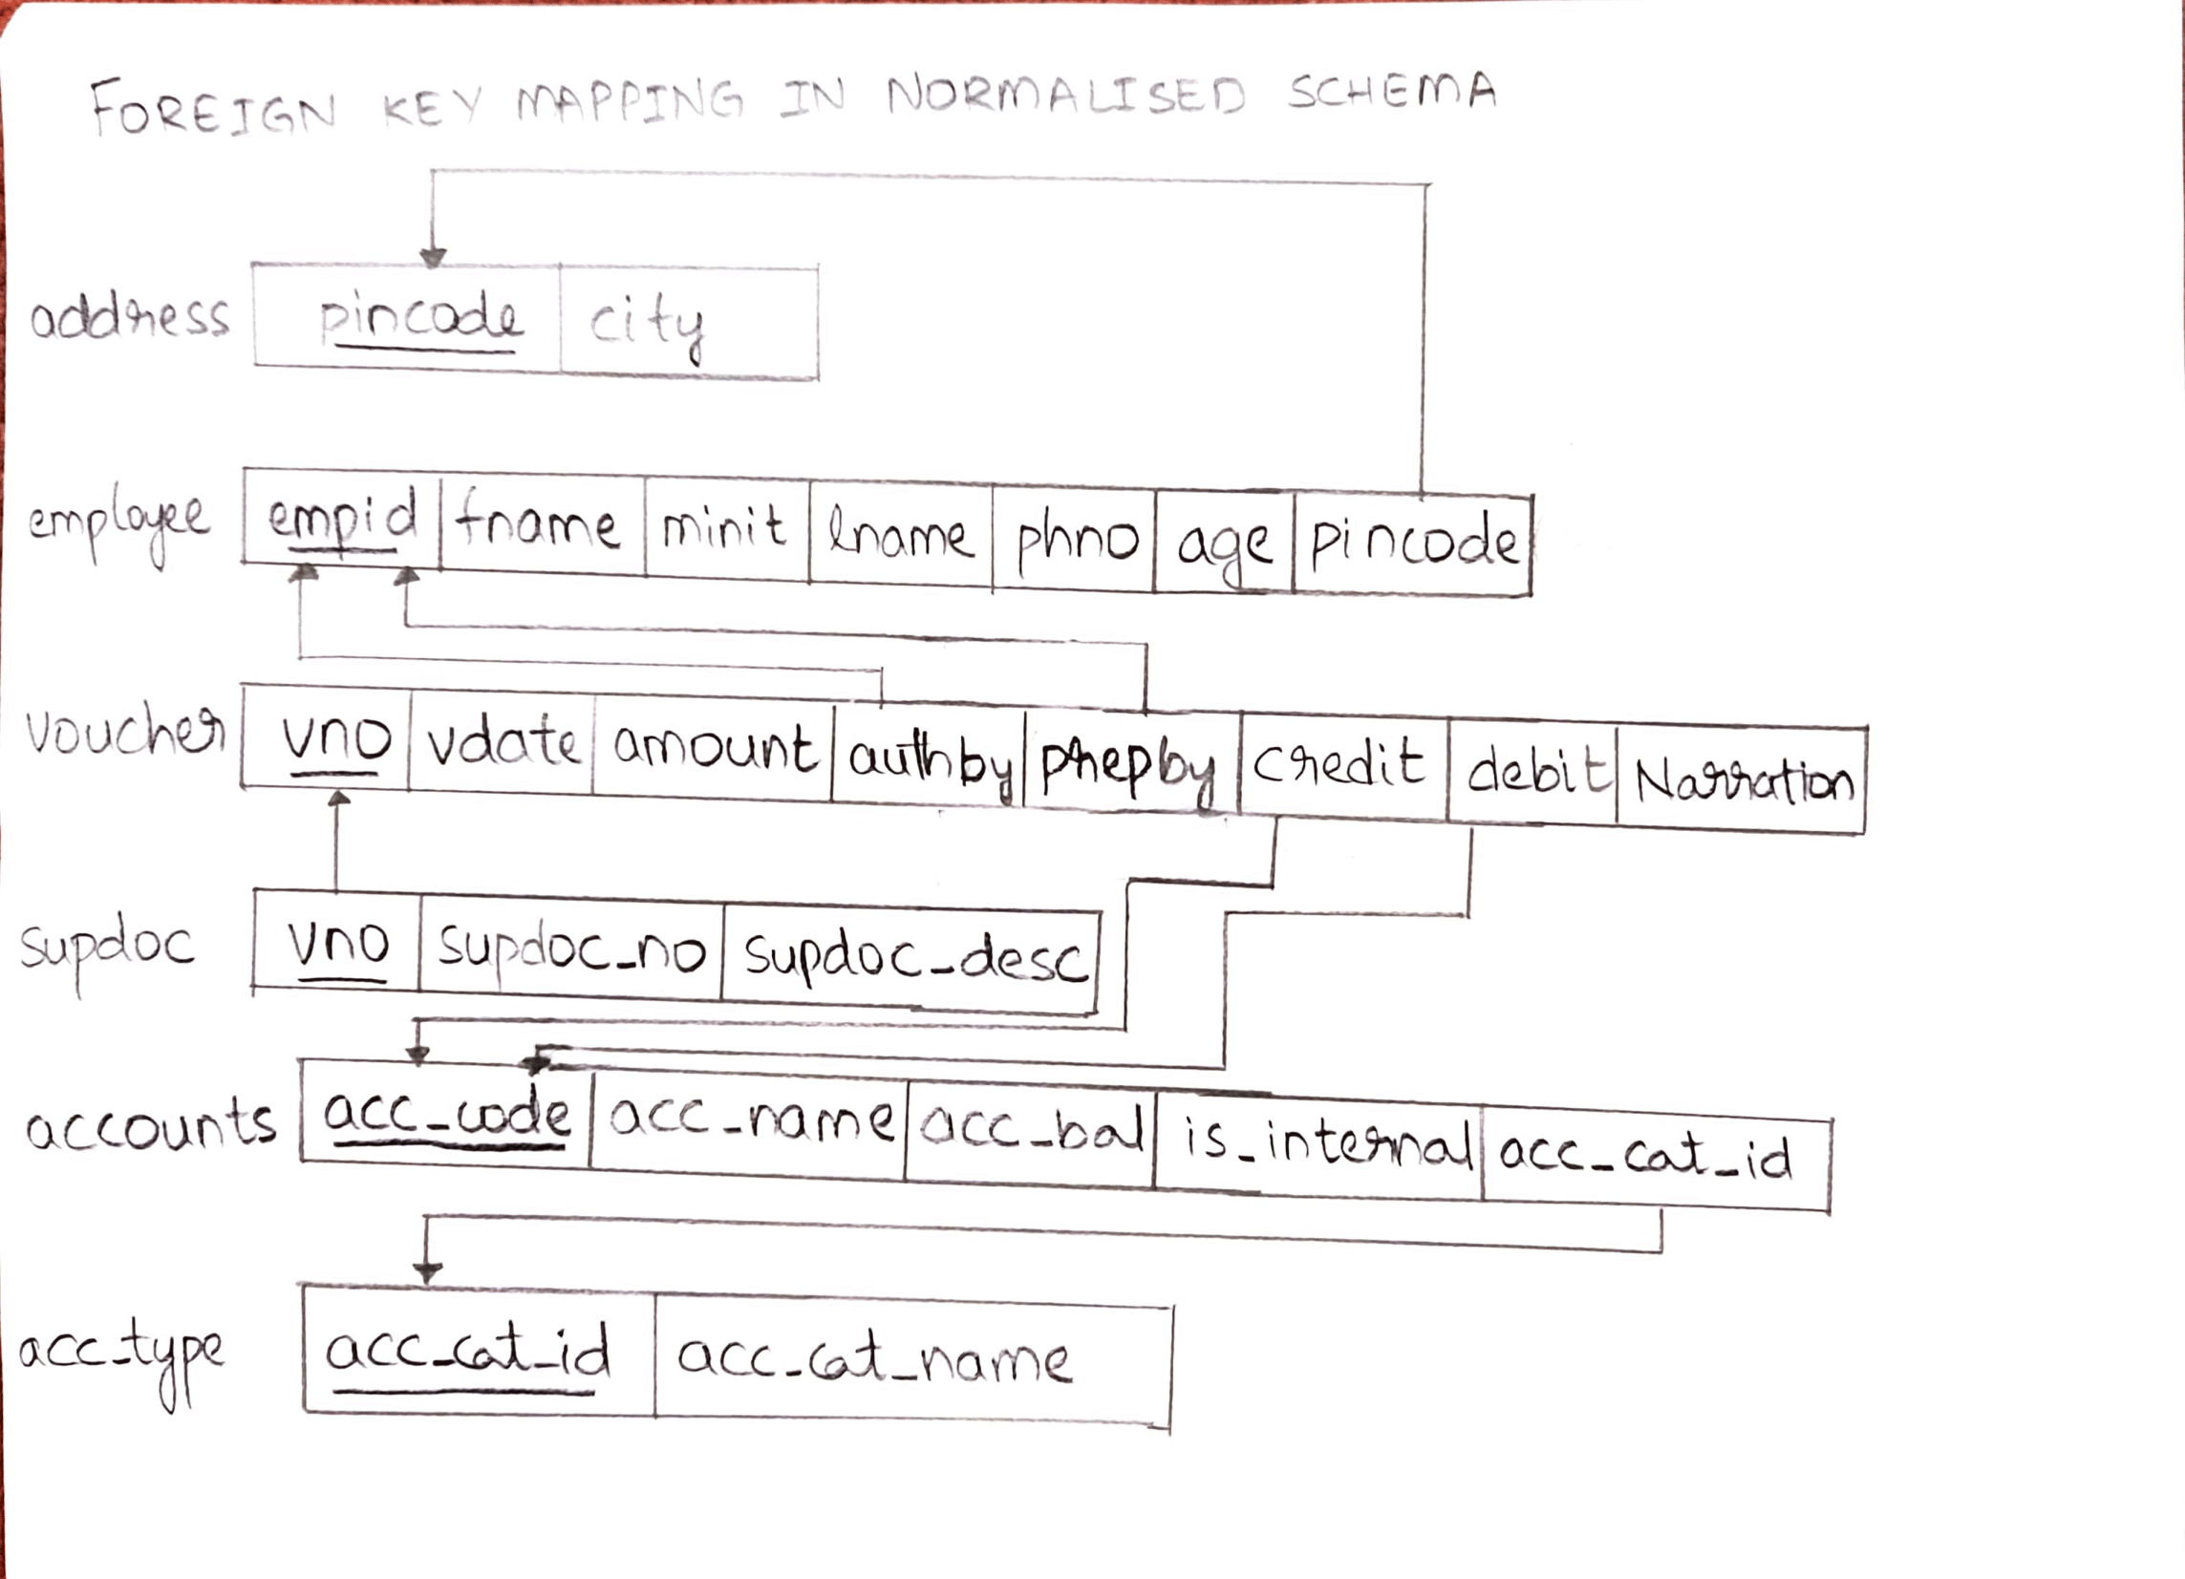
Normalized Schema & FK Mapping

Slide 5
Tech Stack
Front End | Back End
HTML CSS (very minimal use) | Host : Linux Server Language : PHP Server : PHP inbuilt quick server DB : MySQL (v 8.0.20)

