Slide 1
IDS Project Analysis of Loans
Team Members:
Akhil Eppa (PES1201802026)
Varun Tirthani (PES1201802027)
Sujan CR (PES1201801286)

Slide 2
Objective:
To clean and analyse the loan.csv dataset for understanding the various aspects of loan lending.
Overview:
Our dataset contains the details of all the loans disbursed in a 7 year period from 2011-2018 by one of the world's top lending companies.
Apart from the traditional fields such as amount lended, rate of lending, period of loan, our dataset also contains additional informative and insightful fields such as annual income of borrower, mode of ownership of current residence, details of employment,etc

Slide 3
Steps Done
Reducing Dataset Size
Checking for missing values
Filling numerical missing values with mean
Filling Categorical missing values using ffill
Plotting Graphs
Drawing Inferences
Finding Correlations
Hypothesis Testing

Slide 4
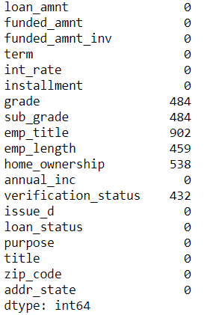
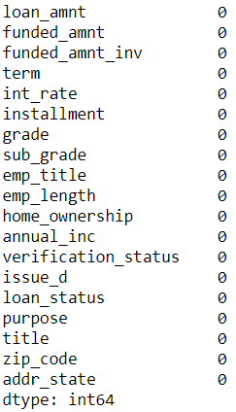
Filling missing values
Before and after cleaning

Slide 5
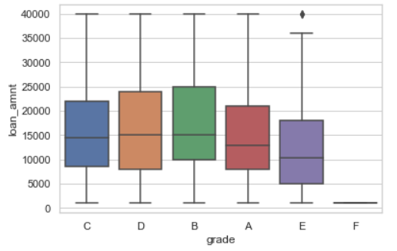
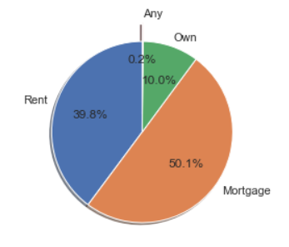
Loan Amount vs Grade & Loan Categories

Slide 6
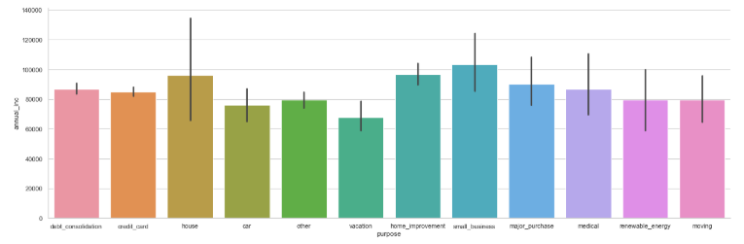
Purpose VS Annual Income

Slide 7
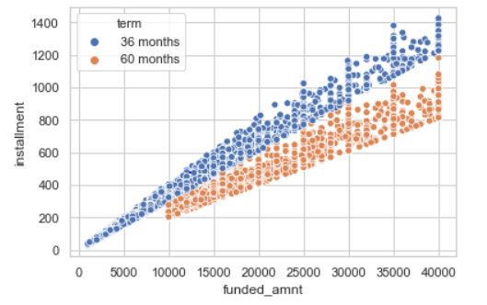
Funded Amount vs Installments

Slide 8
Inferences from Graphs
Annual Income is highest for people applying for small business among all people applying for loans
Bank does not lend F Grade Citizens
Bank Lends highest amount for B Grade Citizens
F4,F5 – Loans lent for people belonging to these categories is zero

Slide 9
Inferences (continued)
In general, it is found that number of people who were not verified were more than those verified
Mortage Loans constitute 50% of all loans

Slide 10



Correlations
Loan Amount VS Employment Length
Interest Rates VS Grades
Loan Amount VS Installment

Slide 11
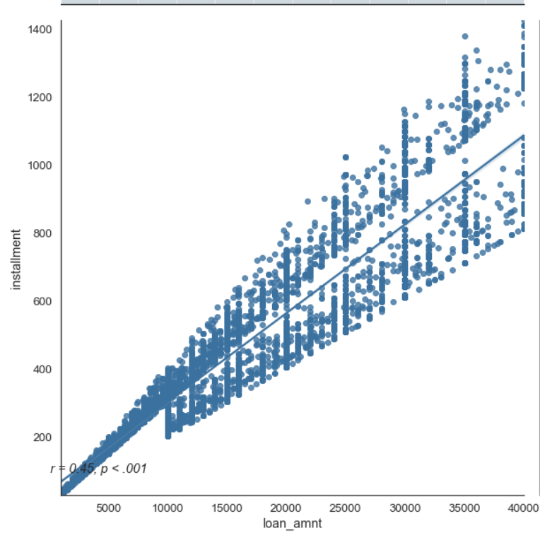
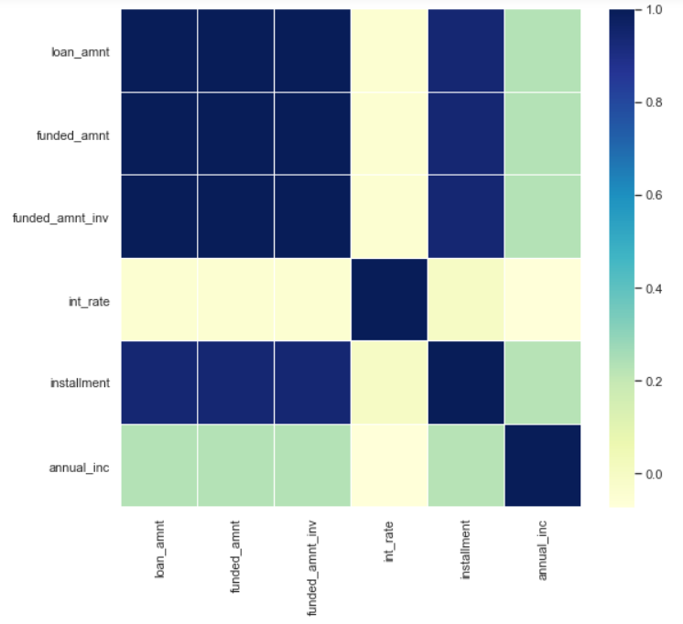
Plots related to correlations

Slide 12
Correlations
No correlation between grades and employment lengths
No correlation between employment lengths and interest rates
No correlation between funded amount and annual income
High correlation between loan amount and instalment
High correlation between interest rates and grades

