Slide 1
Tableau Training
Day 1
Agenda
Introduction of BI tools
Introduction of Tableau
Products of Tableau
Tableau Desktop Installation
Building a basic Report

Slide 2
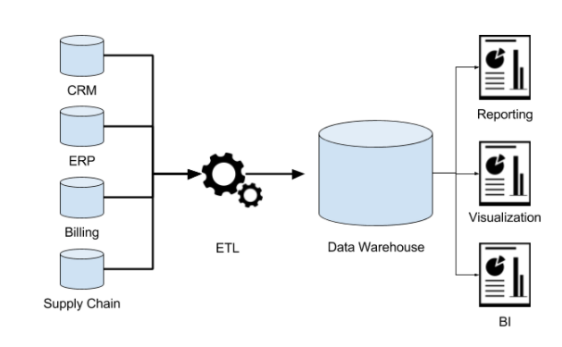
Dataware housing Architecture

Slide 3
Data Warehouse
Used to analyze data
Support decision making and reporting for users
Create a single, unified system
A single point of access for all data
An assurance of data quality

Slide 4
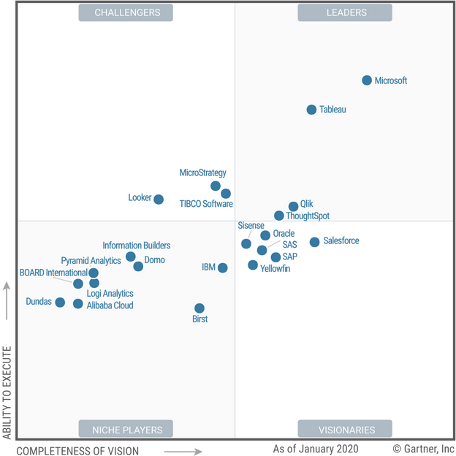
BI Tools
Helps you understand trends and deriving insights from your data so that you can make tactical and strategic business decisions

Slide 5
Tableau Products
Developer Tools
Tableau Desktop
Tableau Prep
Tableau Public
Interactor Tools
Tableau Server
Tableau Online
Tableau Reader
Tableau Mobile

Slide 6
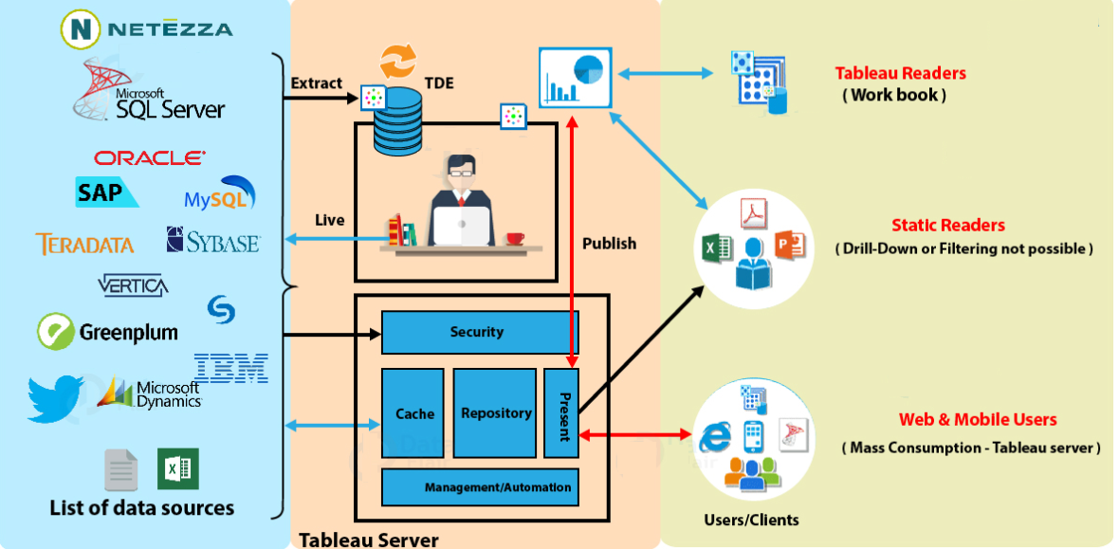
Tableau Architecture

Slide 7
Tableau Installation
Version 2020.1
https://www.tableau.com/support/releases/desktop/2020.1.14#esdalt
Git Repository
https://github.com/sujankumar215/Tableau-Training_WF/tree/main/Day1

Slide 8

Q&A

