Slide 1
Obtaining Gage height for NWM from USGS using corresponding discharge values
Supervisor: Dr. Bong Chul Seo
Presented by: Sujan Maharjan

Slide 2
National Water Model Forecasts
CONUS Short-Range 18h deterministic forecast
CONUS Medium-Range 10day ensemble forecast
CONUS Long-Range 30day ensemble forecast

Slide 3
Ensembles in the NWM
Ensemble 1
Ensemble 2
Ensemble 3
Ensemble 4
Ensemble mean

Slide 4
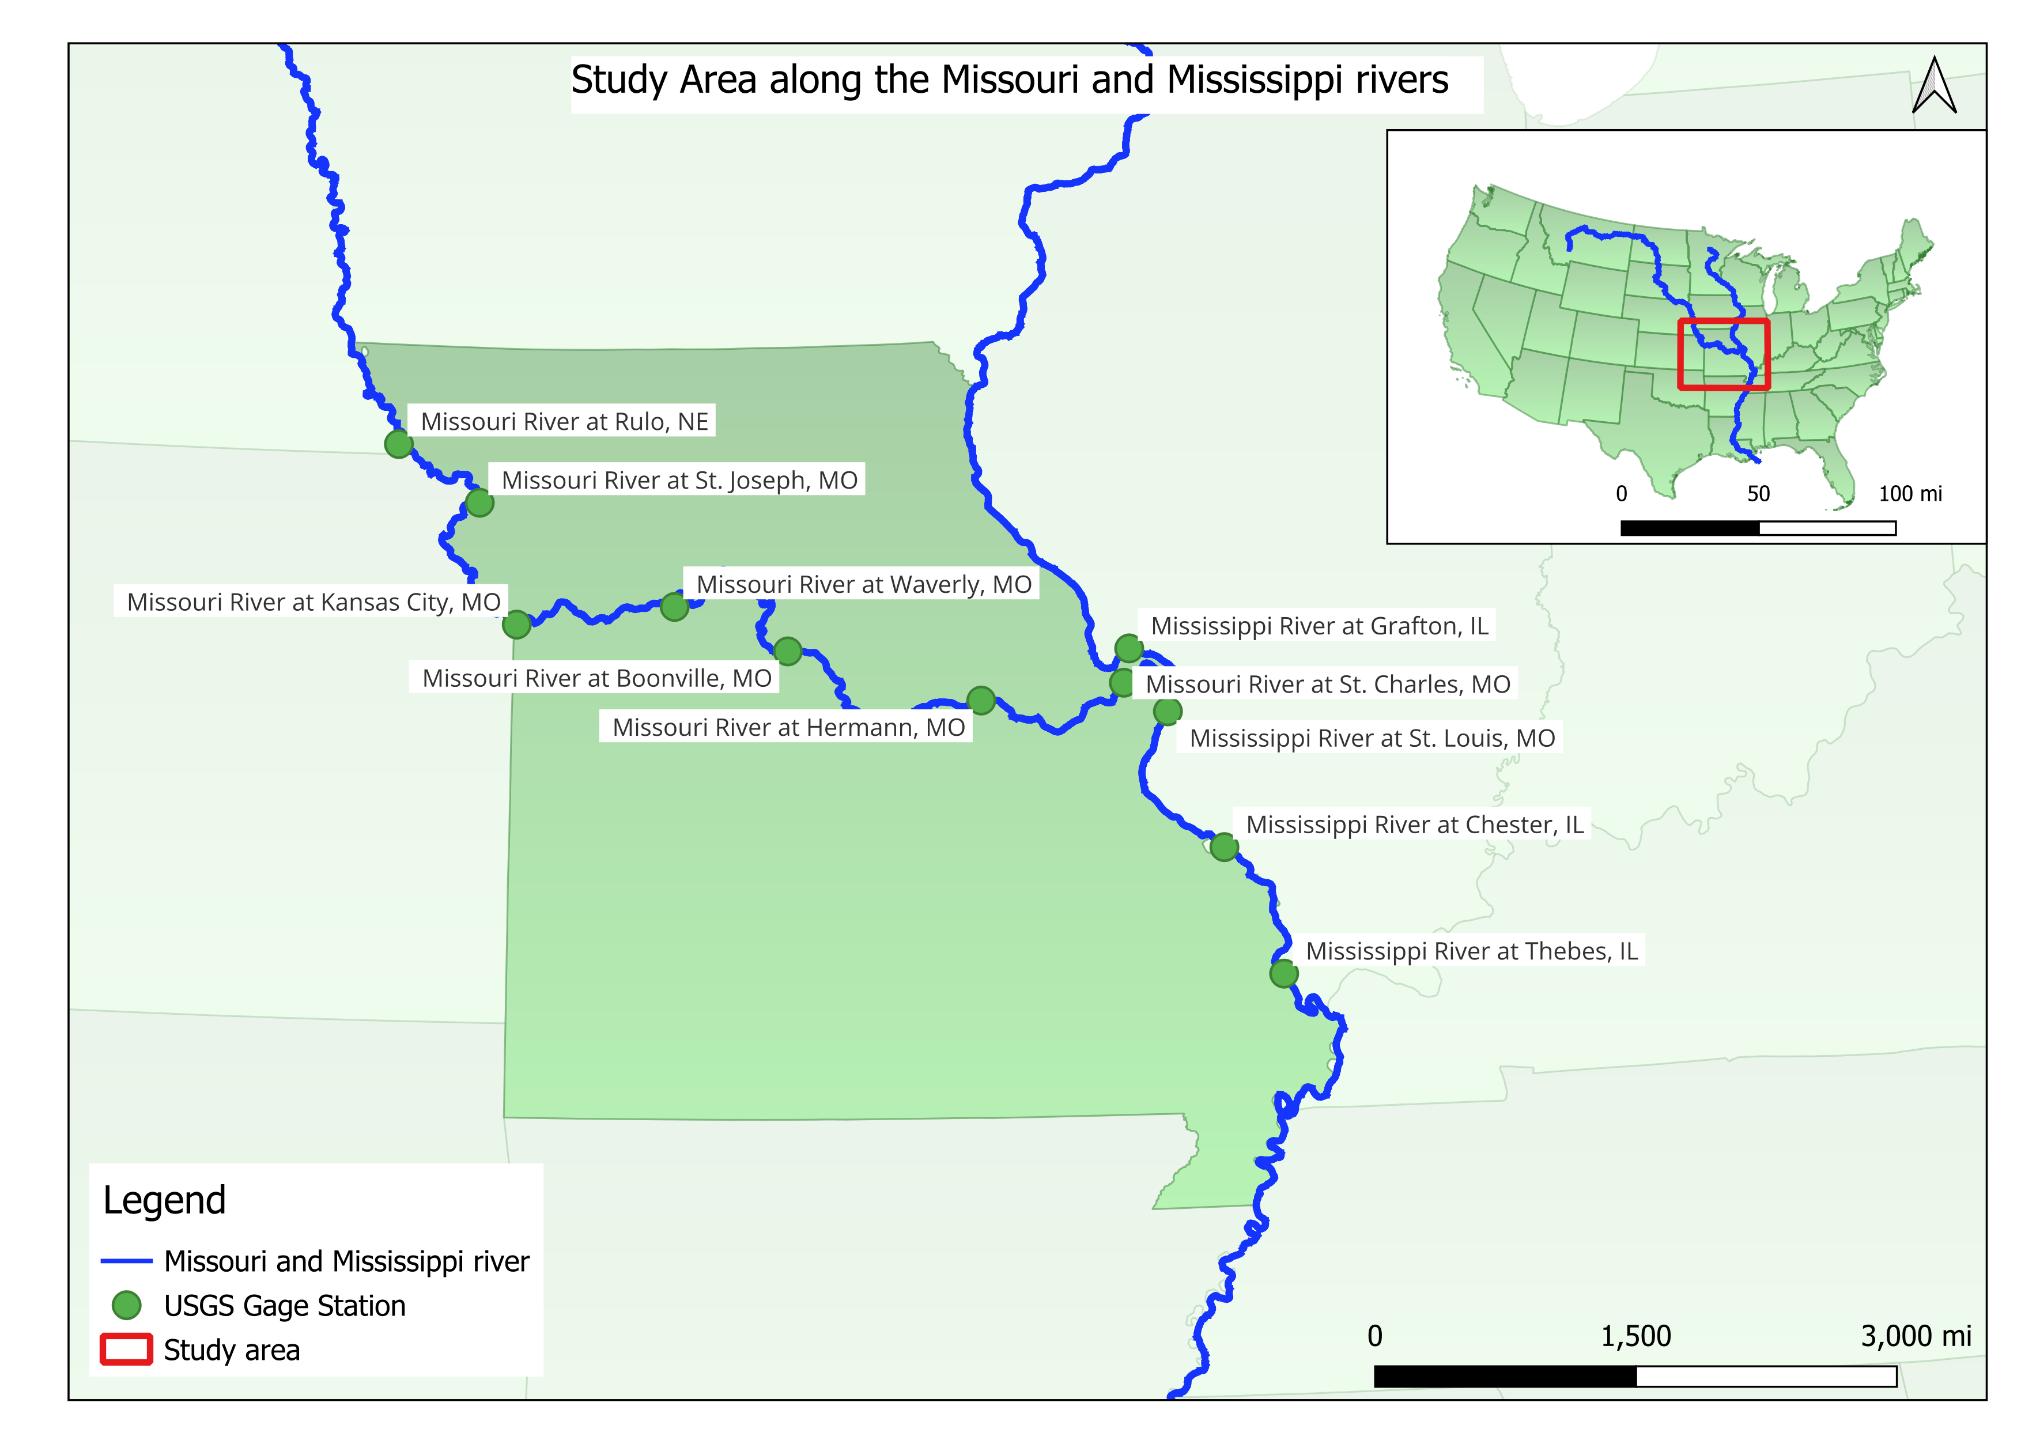
Study area

Slide 5











Methodology
1. Take the USGS and NWM Discharge
3. Find the USGS discharge corresponding to NWM Discharge and time bracket and take the closest Gage Height
2. Introduce a discharge bracket and time window
USGS Discharge
NWM Discharge
Discharge
Discharge
$$t_{1}$$
$$t_{2}$$
$$t_{3}$$
Time
$$t_{4}$$
$$t_{5}$$
$$t_{6}$$
$$t_{1}−∆t$$
$$t_{1}+∆t$$
Time
$$t_{5}$$
$$t_{6}$$
$$t_{1}$$
$$t_{2}$$
$$t_{3}$$
$$t_{4}$$

Slide 6
Methodology
1. Take the USGS and NWM Discharge
3. Find the USGS discharge corresponding to NWM Discharge and time bracket and take the closest Gage Height
2. Introduce a discharge bracket and time window
USGS Discharge
NWM Discharge
Discharge
Discharge
$$t_{1}$$
$$t_{2}$$
$$t_{3}$$
Time
$$t_{4}$$
$$t_{5}$$
$$t_{6}$$
$$t_{1}−∆t$$
$$t_{1}+∆t$$
Time
$$t_{5}$$
$$t_{6}$$
$$t_{1}$$
$$t_{2}$$
$$t_{3}$$
$$t_{4}$$

Slide 7
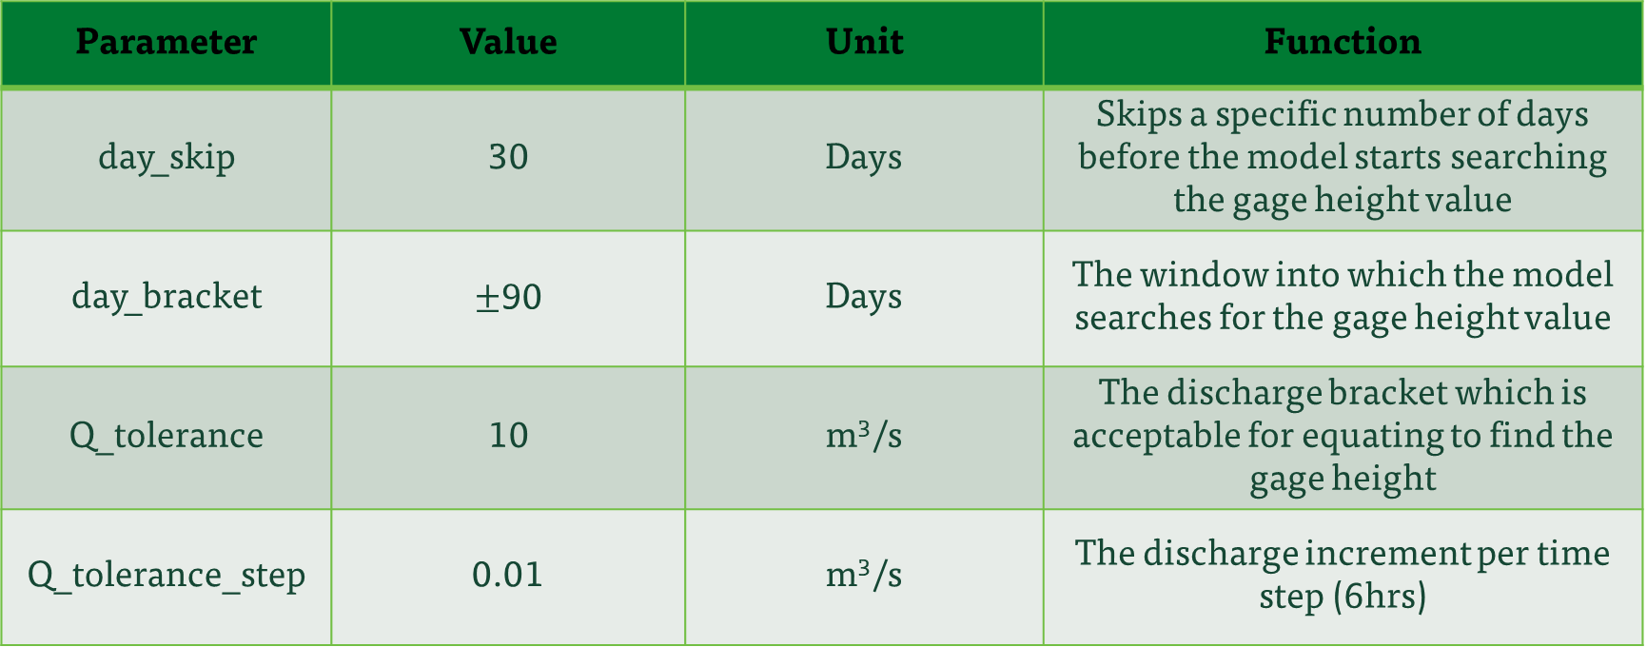
Model Parameters
Parameter | Value | Unit | Function
day_skip | 30 | Days | Skips a specific number of days before the model starts searching the gage height value
day_bracket | $±$90 | Days | The window into which the model searches for the gage height value
Q_tolerance | 10 | m³/s | The discharge bracket which is acceptable for equating to find the gage height
Q_tolerance_step | 0.01 | m³/s | The discharge increment per time step (6hrs)

Slide 8
Resulting graphs

Slide 9
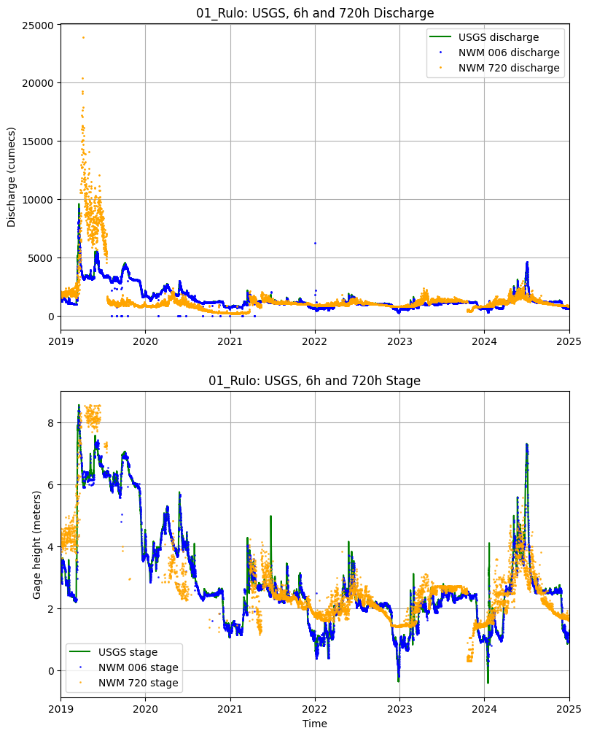
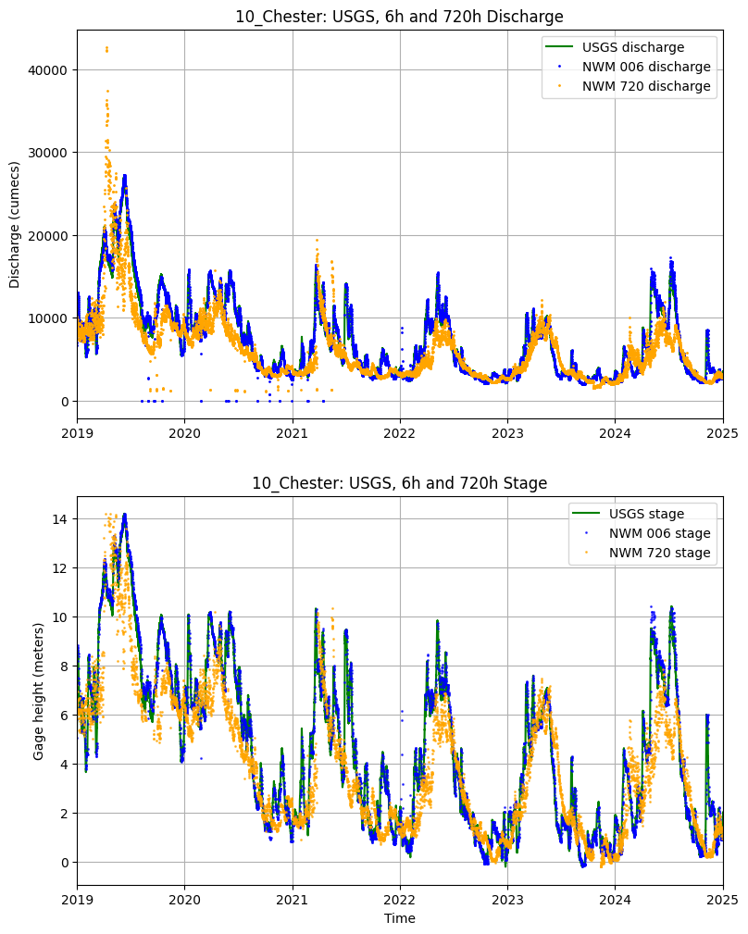
Areas where NWM discharge lies outside the brackets
Areas where NWM discharge lies outside the brackets

Slide 10
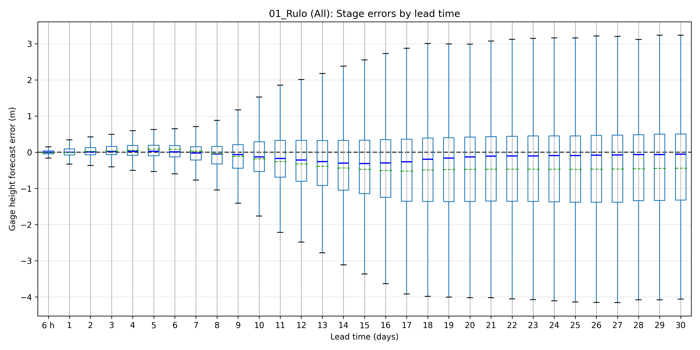
Rulo error box plot

Slide 11
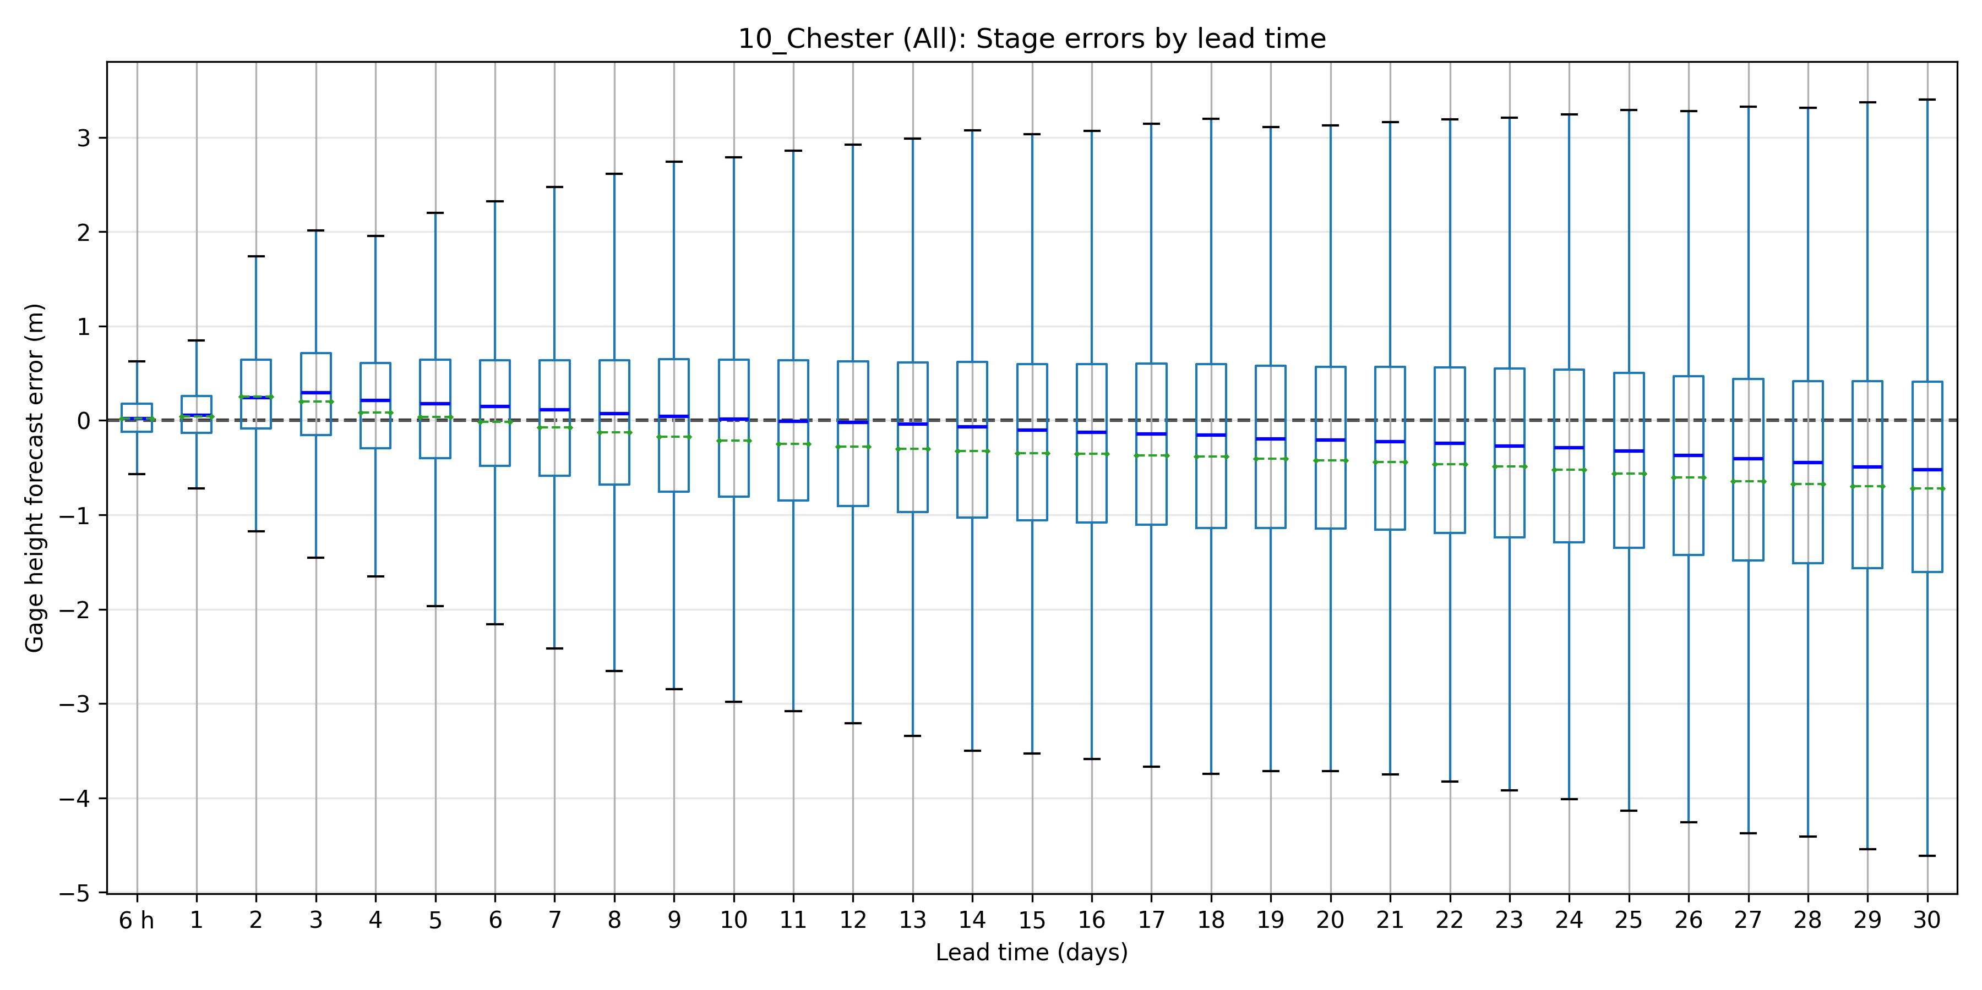
Chester error box plot

Slide 12
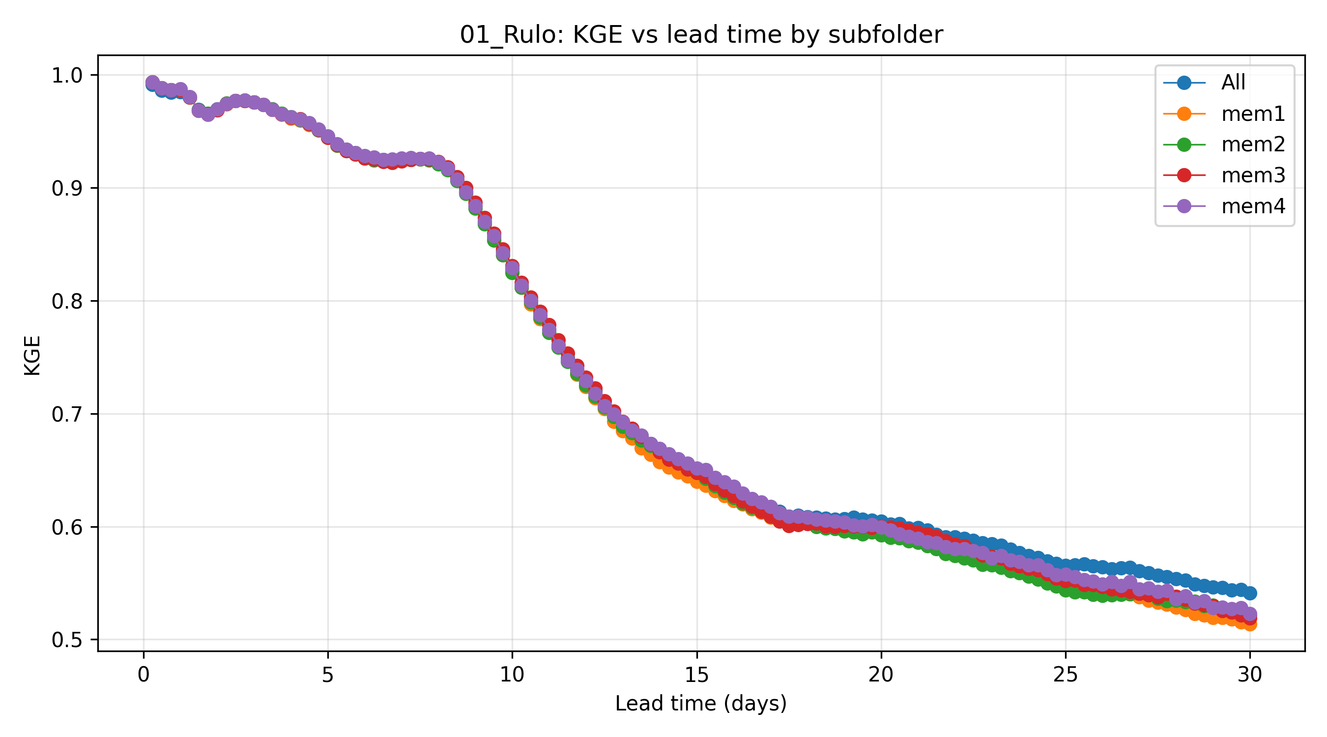
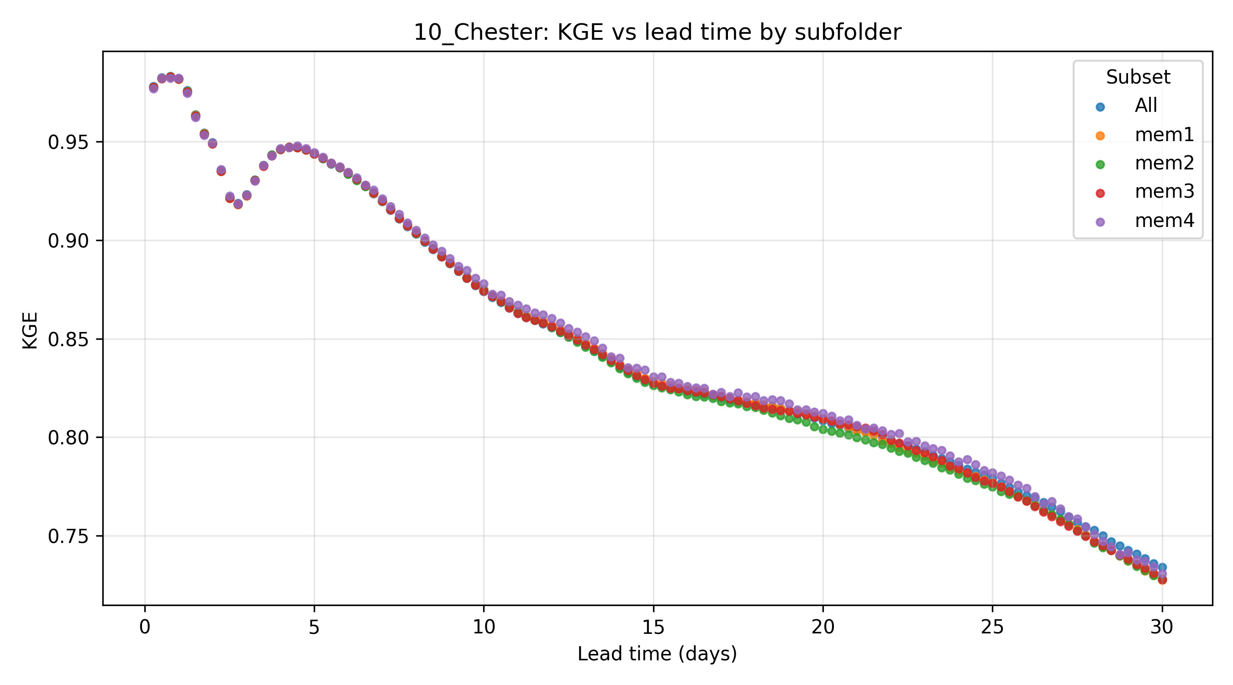
Ensemble KGE comparison

Slide 13
Future works
Compare and contrast the results from all the stations within the area of interest
Evaluate the forecast and determine suitable and trustable lead times for the waterways administration

