Slide 1

Automatic Car Parking System
An IoT-based solution for automated vehicle parking management.
Designed to make the vehicle parking process easier, faster, and more secure by using simple electronic components and a microcontroller.
Developed by B-Tech Semester 6 (EC) students Sujan Patel and Nisarg Patel.

Slide 2
The Parking Management Crisis
Manual Management
Long Waiting Times
In many places such as shopping malls, offices, and residential apartments, parking management is usually done manually.
Manual management often leads to long waiting times and traffic near the entrance.
Unauthorized Access
Time Wasted
Sometimes, unauthorized vehicles can enter the parking area due to human error or lack of strict barriers.
People often waste a lot of time in busy cities searching for an empty parking spot.

Slide 3
What is the Automatic Car Parking System?
This project proposes an automated parking system using an Arduino Uno, IR sensors, an RFID module, and a servo motor to overcome manual parking problems.
Primary Purpose
To reduce manual work, improve parking management, and allow entry only to authorized users.
Scope
It demonstrates how sensors and identification technologies like RFID can be combined with a microcontroller to create an efficient and reliable automated parking system.

Slide 4



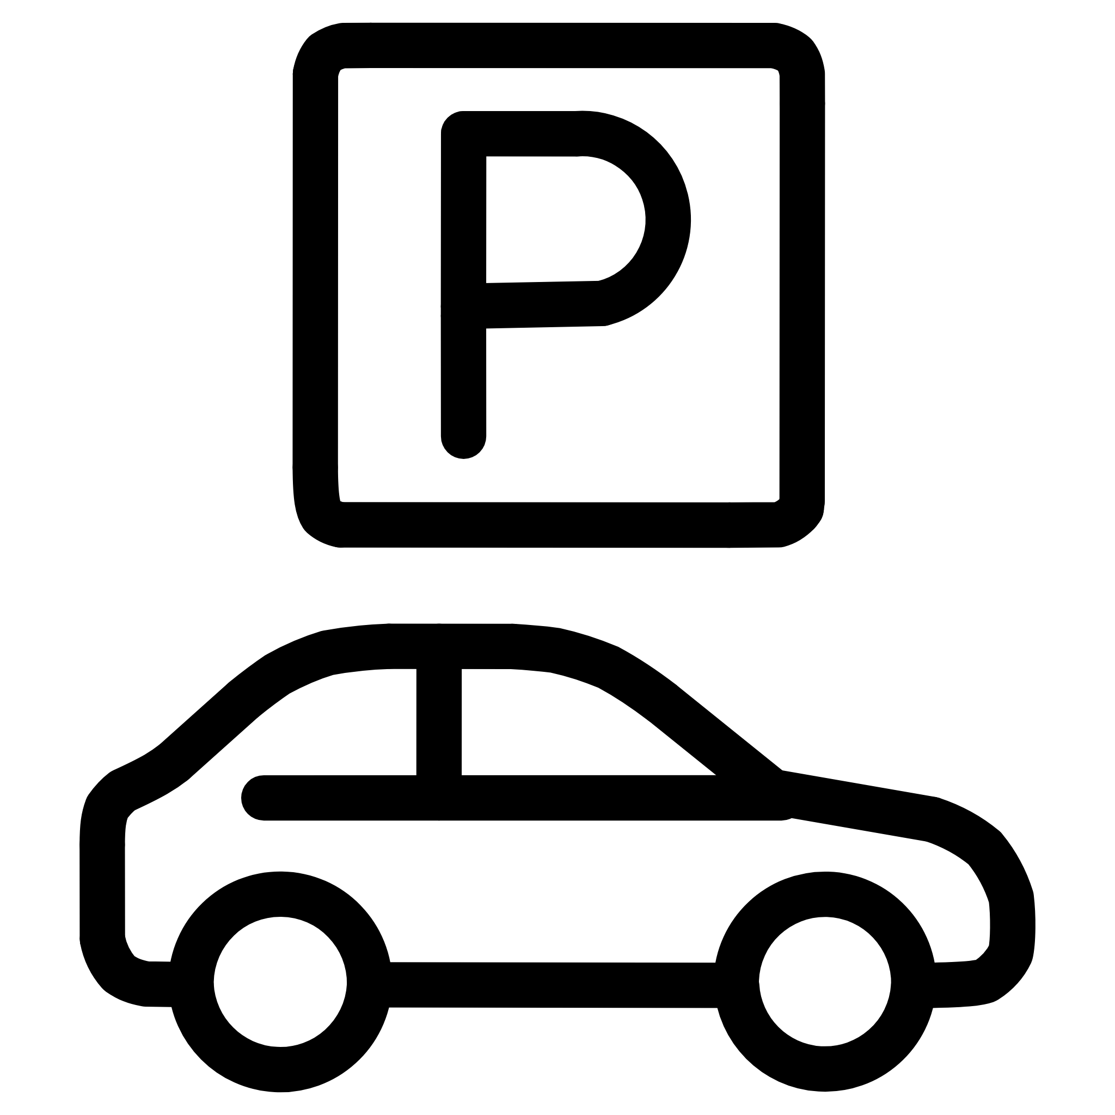
Core Objectives
Automated Entry Verification
Automated Gate Control
Use RFID technology to check the authorization of the user.
Control the opening and closing of the gate automatically using a servo motor.
Vehicle Detection
Availability Tracking
Continuously monitor vehicle movement at the entrance and inside the parking area using IR sensors.
Help users know which parking slots are free and which ones are already occupied by cars.

Slide 5
Traditional Manual Parking vs. Smart Car Parking System
Traditional Manual Parking
Smart Car Parking System
Parking management is usually done manually.
Often leads to long waiting times and traffic near the entrance.
Vulnerable to unauthorized vehicles entering the parking area.
People waste a lot of time searching for empty spots.
Automated gate control requiring no manual intervention.
Makes parking faster and easier, reducing traffic inside parking zones.
Allows entry only to authorized users via RFID scanning.
Detects if a slot is empty or occupied and displays the information.

Slide 6
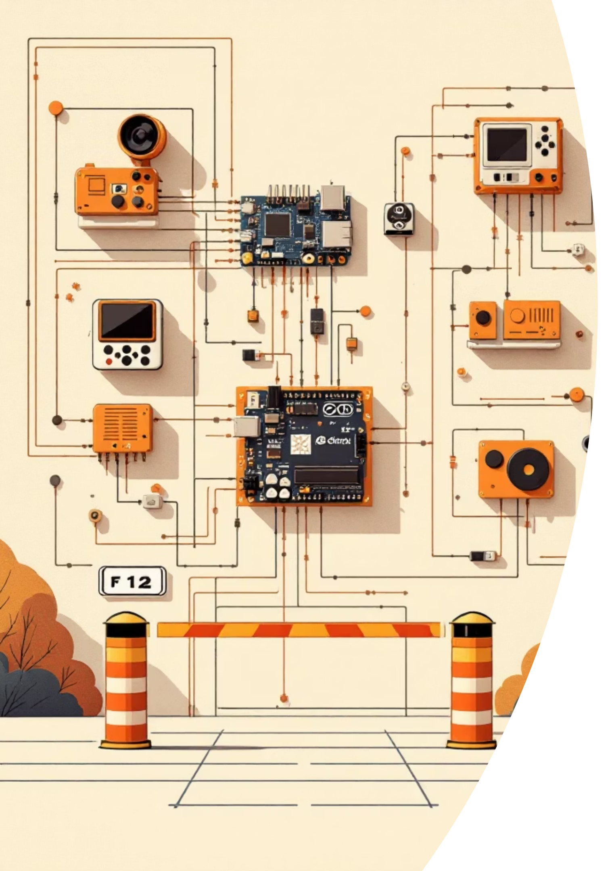
How the System Integrates
01
The Arduino Uno acts as the main controller that manages all operations.
02
All hardware components, sensors, and modules are connected to the Arduino.
03
The microcontroller processes the signals received from the sensors and RFID module to control the gate.
04
The setup is designed to be simple, secure, and efficient.

Slide 7
Core Electronics
Arduino UNO R3 SMD
16x2 Character LCD Display Module
Power Supply Components
Acts as the main microcontroller and development board to manage the entire process.
Equipped with an I2C Interface to display parking slot availability.
Includes an Electrolytic Capacitor (2200 µF, 25 V) to control voltage, along with male-to-male and female-to-female jumper wire cables for connections.

Slide 8
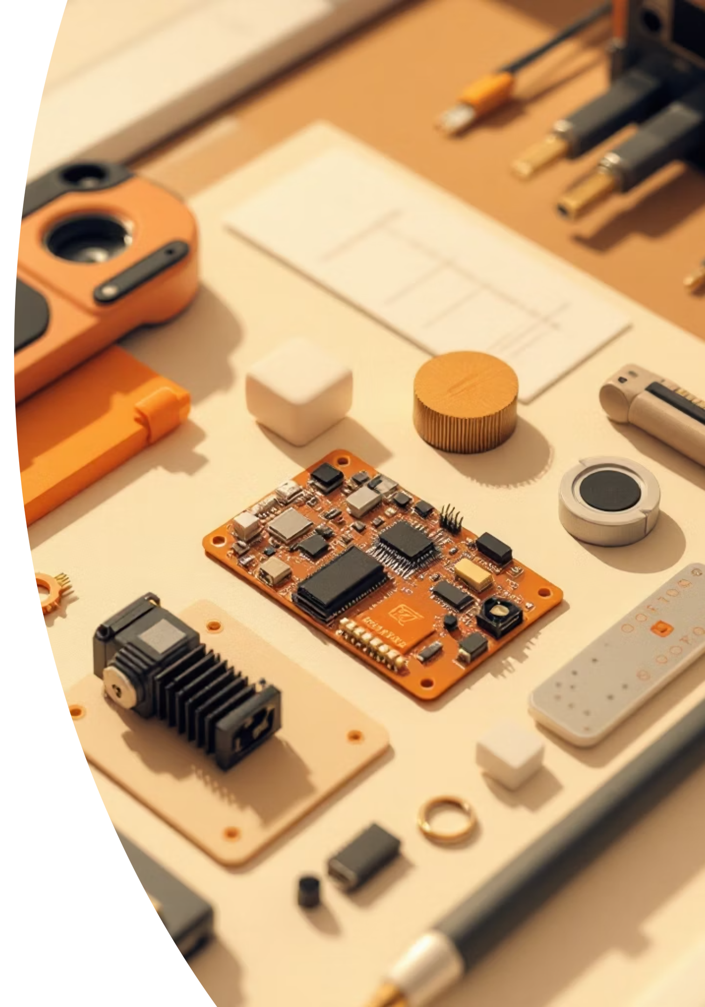



Detection and Movement
Infrared (IR) Obstacle Detection Sensors
Two modules are used to detect the presence and movement of cars.
RFID Reader Module
Used for scanning authorization cards.
MG90S Metal Gear Micro Servo Motor
Used to rotate and physically open or close the entry gate.

Slide 9

Programming the System
Arduino IDE
Open-source software utilized for programming the Arduino microcontroller.
The program stores authorized RFID data so the Arduino can compare it against scanned cards.
The software logic allows the system to run automatically without any manual control.

Slide 10
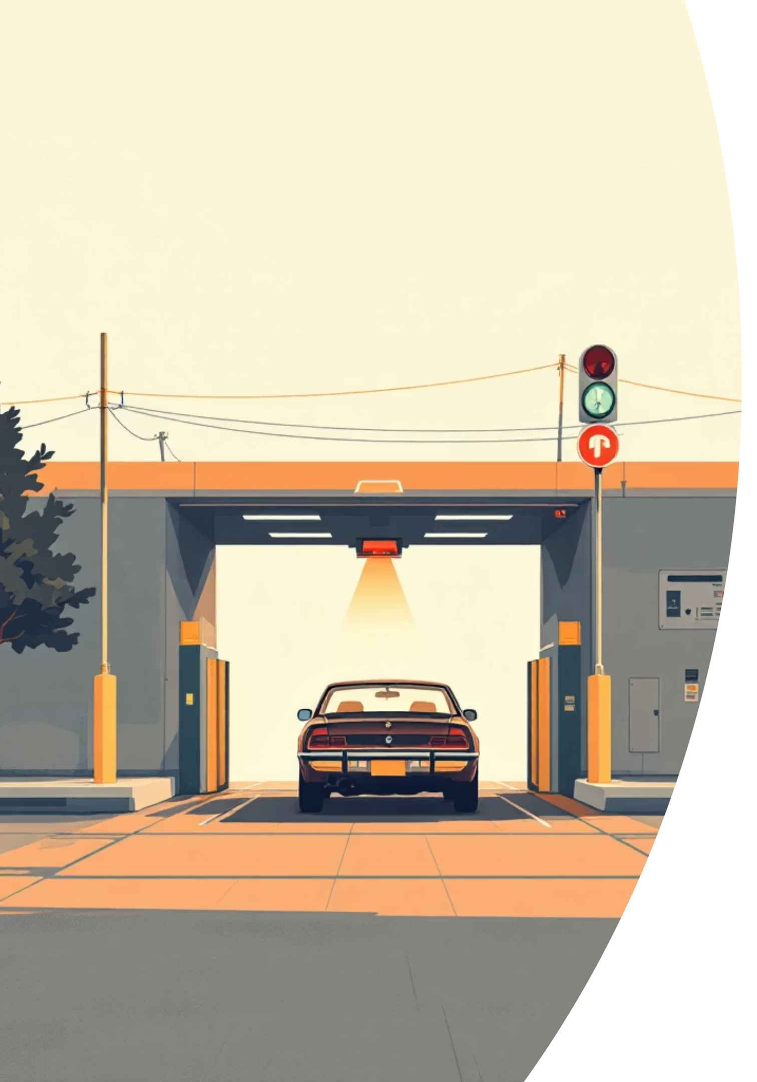




Detecting the Car
Phase 1 - Vehicle Arrival
One IR sensor is placed near the entrance gate to detect an arriving car.
When a vehicle arrives at the entrance, the first IR sensor detects the vehicle.
As soon as the sensor detects the car, it sends a signal to the Arduino Uno.
Once detected, the system indicates that the driver should scan their RFID card.

