Slide 1

Phishing Email Detector Using DevSecOps Principles
ICT932 – Cybersecurity Project Implementation
Crown Institute of Higher Education, Canberra
Team Members:
Kinley Choden (CIHE240377)
Karma Choden (CIHE240402)
Tashi Phuntsho (CIHE240355)
Namkha Gyeltshen (CIHE240180)
Sujan Mongar (CIHE240181)

Slide 2

Executive Summary
Phishing remains one of the top causes of breaches globally. Our project designed a GUI-based phishing email analyzer using heuristic detection, integrated security controls, and DevSecOps practices to ensure reliability and resilience.
Notes:
“This slide gives a quick overview of what our project is about. Phishing is still one of the biggest causes of cyber attacks and data breaches worldwide. So, in this project, our team created a phishing email detector — a tool that can analyze emails and decide whether they are safe or suspicious. We built it with a graphical interface, meaning users can easily upload or paste emails to check. We also followed DevSecOps practices, which means we included security checks and automation throughout the development process to make the system more reliable and secure.”

Slide 3

Background and Context
Phishing manipulates human trust via fake emails imitating legitimate organizations. The project explores countermeasures and detection using heuristic-based analysis.
Notes:
“This slide explains the background of our project. Phishing attacks work by tricking people into trusting fake emails that look like they come from real companies, like banks or delivery services. Attackers use these fake messages to steal information such as passwords or account details. Our project focuses on finding ways to detect these fake emails using heuristic-based analysis — which means we use certain patterns or rules, like suspicious words or unusual links, to identify phishing attempts.”

Slide 4
Importance of Cybersecurity in Software Development
Security must be embedded early in the SDLC to avoid costly post-release fixes. DevSecOps helps integrate automated testing, threat modeling, and secure coding practices.
Notes:
“This slide explains why cybersecurity is important in every stage of software development. If we only think about security at the end, it can be very expensive and difficult to fix problems. That’s why we follow DevSecOps — it makes sure security is included right from the start. It helps us run automated security tests, check for threats early, and write safer code. This approach saves time, reduces risks, and makes the final software more secure.”

Slide 5
DevSecOps Relevance to Project
Implemented continuous integration (CI), automated security scans, and enforced quality gates. Adopted NIST SP 800-61 for incident response alignment.
Notes:
“This slide shows how we used DevSecOps in our project. We used continuous integration, which means every time we updated the code, the system automatically tested and scanned it for security issues. We added automated tools that checked for vulnerabilities before allowing new code to go live — these are called quality gates. We also followed the NIST SP 800-61 framework, which helped us plan how to detect, respond to, and recover from any security incidents in an organized way.”

Slide 6
Project Objectives
Build GUI phishing detector
Integrate RBAC and 2FA.
Automate SAST, DAST, and dependency scanning.
Test with synthetic dataset.
Document via report and presentation.
Notes:
“This slide lists the main goals of our project. First, we wanted to build a phishing detector with a simple GUI where users can paste or upload emails for analysis. Second, we added RBAC — which means role-based access control — and 2FA, or two-factor authentication, to make login more secure. Third, we automated different security testing tools like SAST and DAST so the system checks code automatically. Fourth, we tested our detector using a synthetic dataset with both phishing and legitimate emails. Finally, we documented everything in a detailed report and this presentation.”

Slide 7
Threat Modelling (STRIDE)
Used STRIDE to identify Spoofing, Tampering, Repudiation, Information Disclosure, DoS, and Elevation of Privilege. Implemented controls like 2FA, RBAC, logging, and request throttling.
Notes:
“This slide explains how we used the STRIDE model to identify possible threats in our system. STRIDE stands for six types of security threats — Spoofing, Tampering, Repudiation, Information Disclosure, Denial of Service, and Elevation of Privilege. For example, spoofing could happen if someone pretends to be an admin, and denial of service could occur if someone sends too many requests to crash the system. To reduce these risks, we added controls like two-factor authentication, role-based access control, activity logging, and request limits to protect the system.”

Slide 8
Tooling and Methodology
SAST: Bandit, SonarQube
DAST: OWASP ZAP, Nikto
Dependency Scanning: pip-audit
Monitoring: ELK Stack
CI/CD: GitHub Actions
Notes:
“This slide shows the main tools and methods we used to secure and develop our project. For static analysis, we used Bandit and SonarQube — these tools check the code for security issues before running it. For dynamic testing, we used OWASP ZAP and Nikto, which test the running application for vulnerabilities. We also used pip-audit to check our libraries for known security problems, and the ELK Stack to monitor logs and system activity. All of this was managed through GitHub Actions, which automatically ran these tools in our CI/CD pipeline every time we made updates.”

Slide 9
Roles and Responsibilities
Kinley – Documentation & Compliance
Karma – Core heuristics & dependency checks
Tashi – DAST & performance testing
Namkha – GUI & UX
Sujan – CI/CD & Monitoring
Notes:
“This slide shows how our team divided the work for the project. Each member had a specific responsibility to make sure all parts of the project were covered. Kinley focused on documentation and compliance — making sure our report and policies followed standards. I, Karma, worked on the main phishing detection logic and fixing dependency issues. Tashi handled dynamic testing, like OWASP ZAP scans, and performance testing. Namkha designed the GUI and focused on making it user-friendly. Sujan worked on the CI/CD pipeline and the monitoring setup using the ELK dashboard. This teamwork helped us apply DevSecOps principles effectively.”

Slide 10
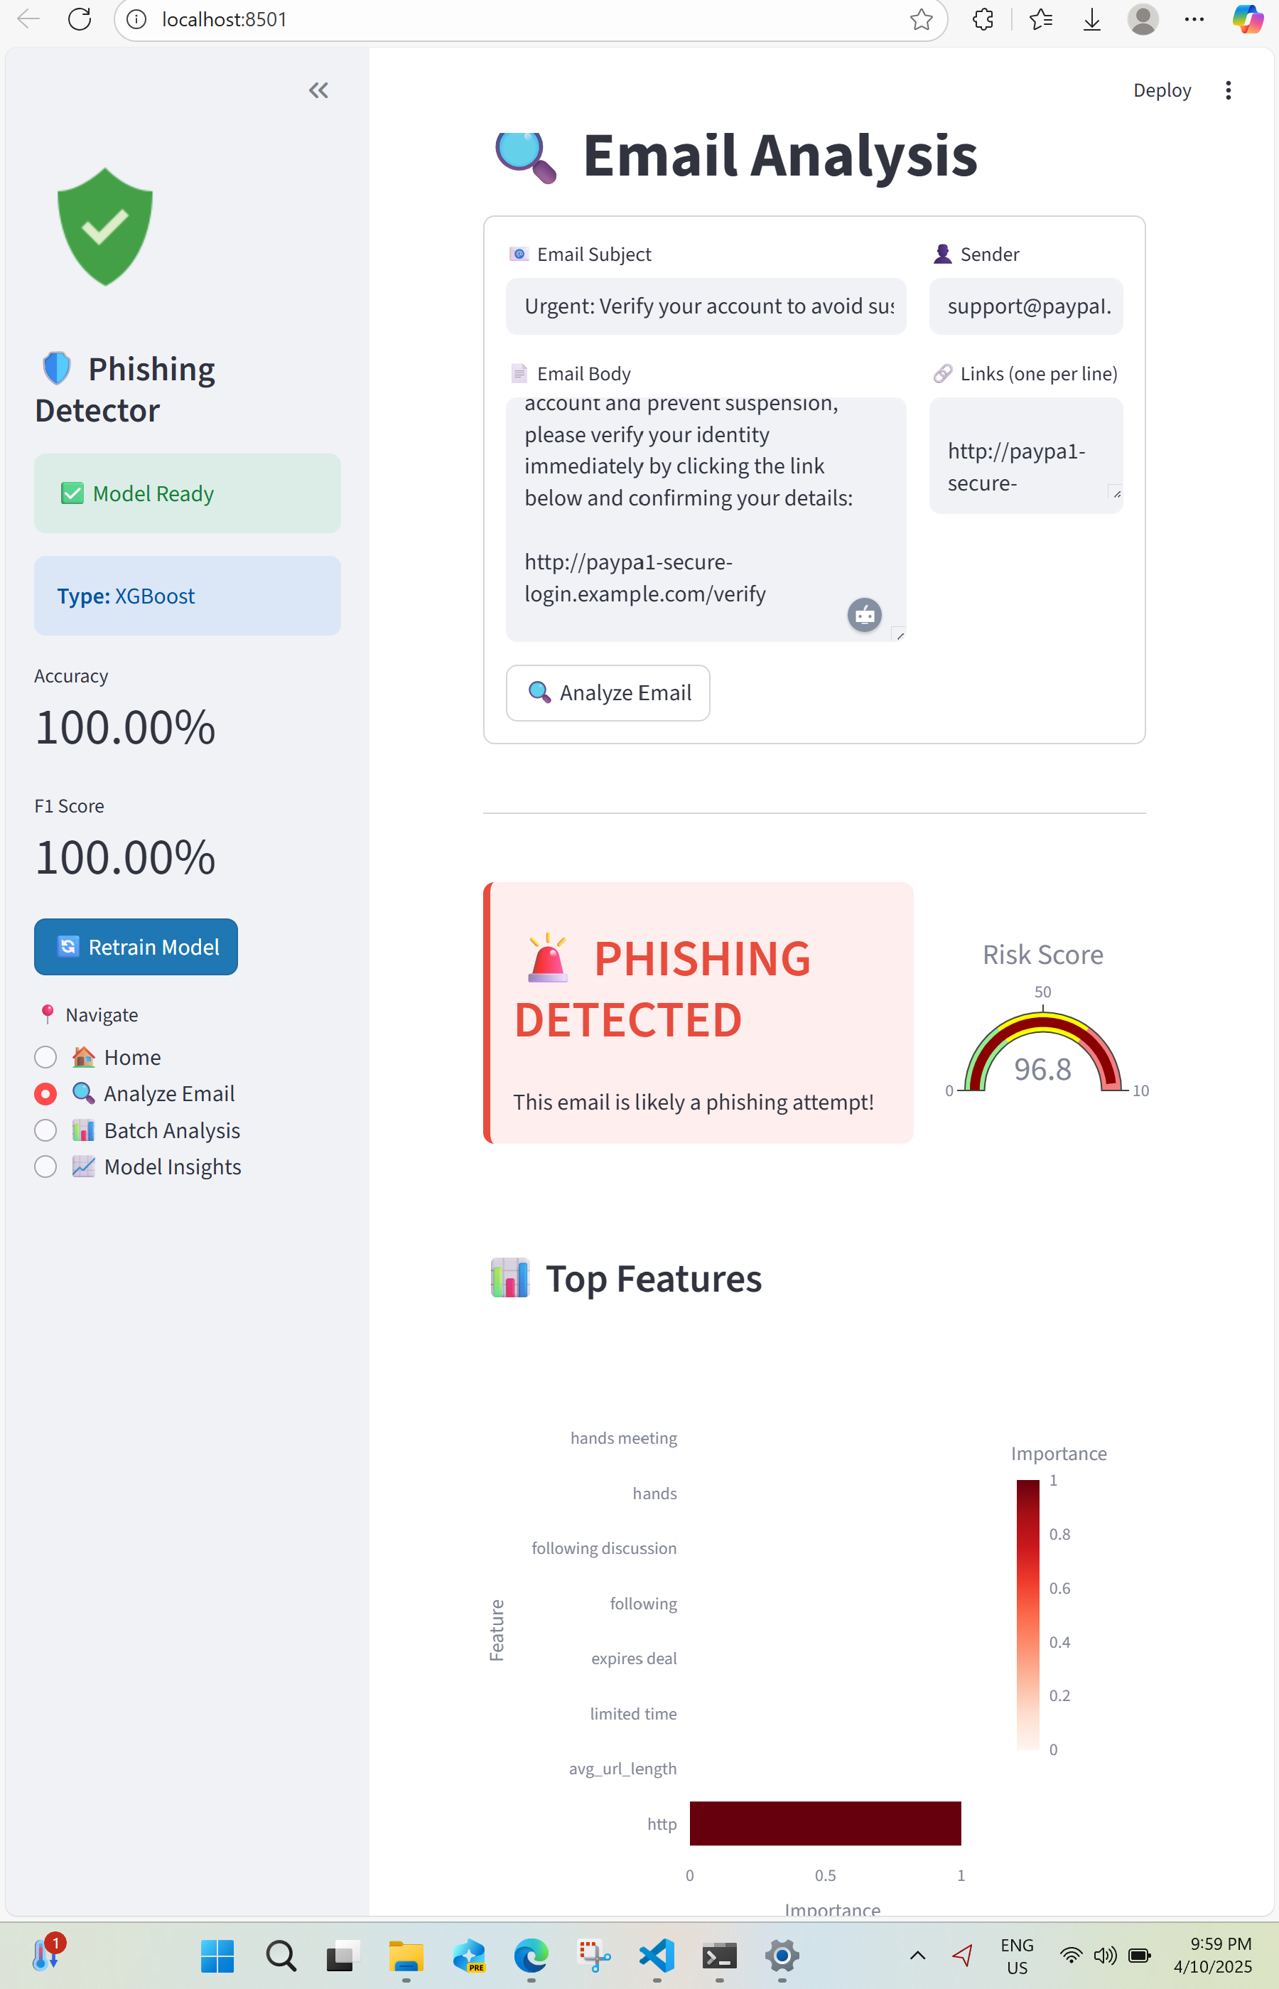
Project Management

Slide 11
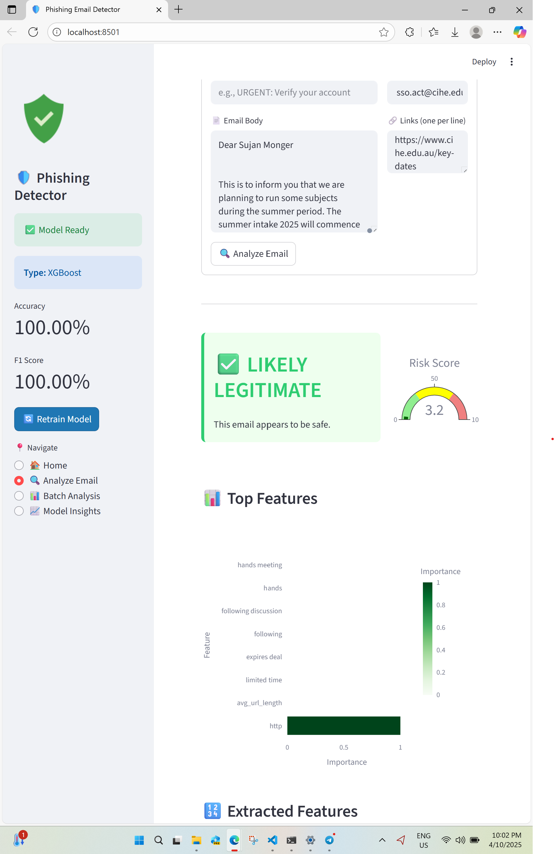
System Architecture
The modular system includes a GUI for input, analyzer for keyword and URL detection, RBAC-based authentication, and ELK-based monitoring dashboard.

Slide 12
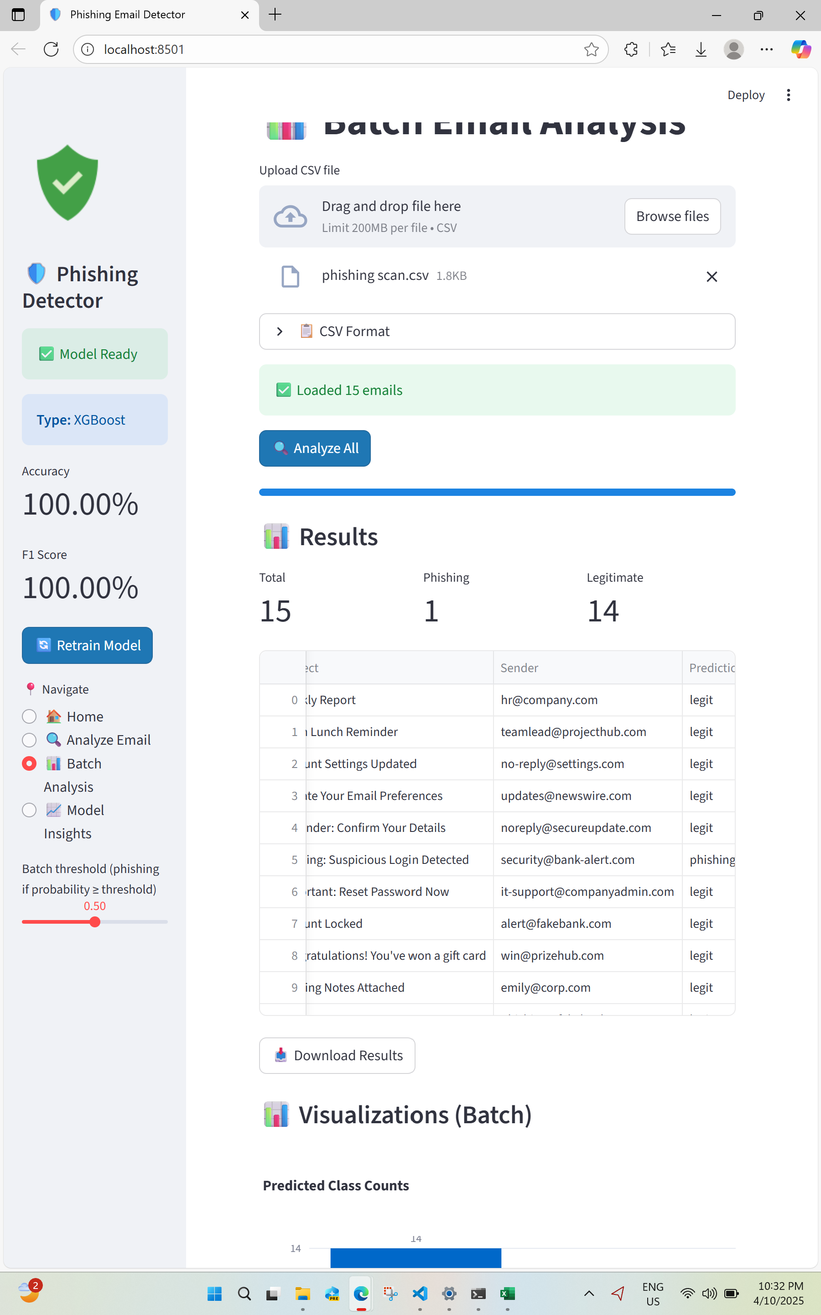
Application Interface (GUI)
The GUI allows users to paste email content or upload files. It classifies messages as legitimate or phishing using heuristic rules.

Slide 13
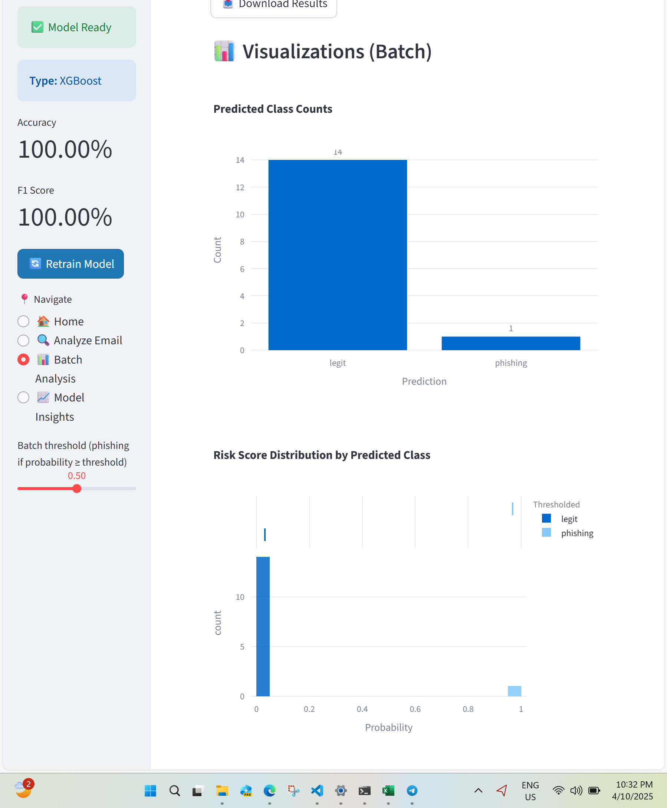
CI/CD Pipeline
Pipeline included build, test, SAST, dependency scan, DAST, and deploy stages. Security gates prevent insecure code from merging.

Slide 14
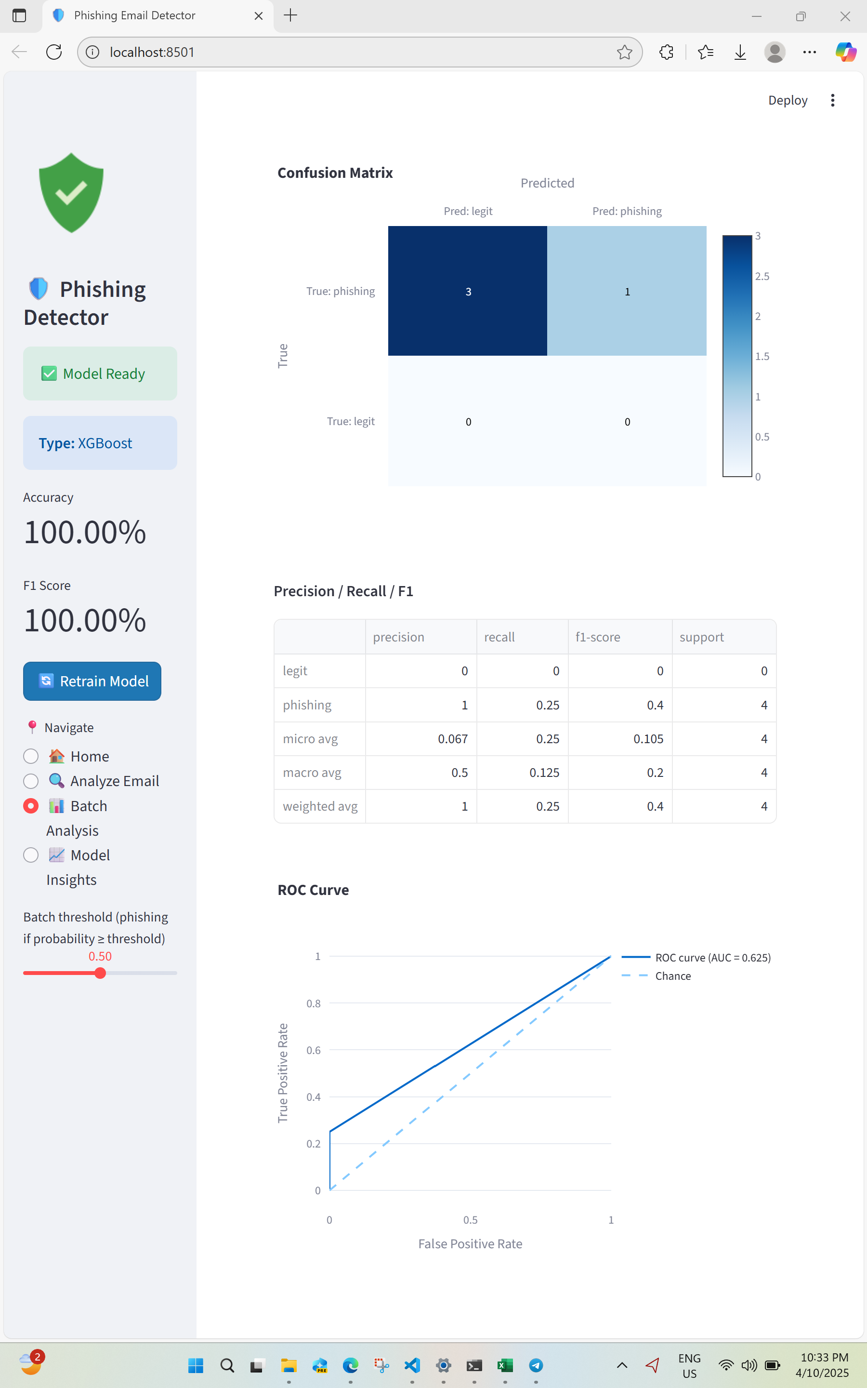
Testing and Validation
Dataset: 200 emails (100 phishing, 100 benign). Validated precision (0.86), recall (0.83), and F1 (0.845).

Slide 15

Results and Discussion
Heuristic detection achieved solid baseline accuracy. DevSecOps reduced risk by embedding automated controls and monitoring.

Slide 16
Challenges and Solutions
False Positives – Adjusted keyword rules.
Dependency Issues – Weekly updates and smoke tests.
Slow DAST – Separated baseline and full scans.
Secrets Logging – Middleware redaction.
Notes:
“This slide explains some of the main challenges we faced and how we solved them. One problem was false positives, where safe emails were sometimes flagged as phishing — we fixed this by adjusting the keyword rules. Another issue was dependency conflicts when updating libraries — we handled this by doing weekly updates and quick smoke tests. The DAST scans also took too long during builds, so we changed to run smaller scans for each update and full scans overnight. We also improved secrets management by adding middleware that hides tokens or passwords from the logs. These fixes made the system more stable, faster, and safer.”

Slide 17
Incident Response and Monitoring
Adopted NIST SP 800-61 IRP with phases: preparation, detection, containment, recovery, and post-incident review.
Notes:
“This slide explains how we handled monitoring and incident response in our project. We followed the NIST SP 800-61 framework, which includes steps like preparation, detection, containment, recovery, and post-incident review. Our system collects logs in JSON format and sends them through Filebeat and Logstash to Elasticsearch, where they can be viewed in Kibana dashboards. This setup helps us detect any suspicious activity, like repeated failed logins or phishing submissions. If an incident happens, we can quickly investigate, block harmful actions, and restore normal operations. This process ensures our system stays secure and any problems are handled effectively.”

Slide 18

Future Work
Integrate NLP/ML models
Add URL intelligence checks
Create Chrome/Outlook extensions
Deploy in enterprise with SIEM integration
Notes:
“This slide talks about what we plan to improve in the future. First, we want to add machine learning and NLP models to make phishing detection more accurate and intelligent. Next, we plan to include URL intelligence checks, such as WHOIS data, domain age, and SPF or DKIM verification, to better identify fake websites. We also want to build browser and email extensions, so users can check messages directly in Gmail or Chrome. Finally, we aim to make the system enterprise-ready by using containers, adding SIEM integration, and connecting it with automated response systems. These upgrades will make our tool faster, smarter, and suitable for real-world use.”

Slide 19
Conclusion
The prototype achieved high accuracy with secure design practices. DevSecOps integration ensured a secure and maintainable lifecycle.
Notes:
“This slide wraps up our project. We successfully built a phishing email detector that works using heuristic rules and follows DevSecOps principles. The tool includes strong security features like RBAC, 2FA, and secret management, and it automates security checks through CI/CD pipelines. We also used monitoring dashboards and incident response planning to handle threats in real time. Overall, the project showed how adding security at every stage of development makes the system more reliable, safe, and professional. It also gave us valuable hands-on experience with DevSecOps tools and real-world cybersecurity practices.”

Slide 20
References
Key Sources:
Aleroud & Zhou (2017)
Akbar et al. (2022)
Goenka et al. (2024)
Saeed et al. (2025)
Sinan et al. (2025)
Rajapakse et al. (2022)
NIST SP 800-61 Rev.2 (2018)
Notes:
Remind audience all research references are academic.

