Slide 1

Keystroke Dynamics Authentication System Using Machine Learning
By Namkha Gyeltshen,
Tashi Phuntsho & Sujan Monger
Crown Institute of Higher Education

Slide 2
Table of Contents
Introduction
Problem Statement / Objectives
Project Planning
Background and Related Work
Methodology
Implementation and Results
Testing and Deployment
Conclusion and Future Work
Live Demonstration

Slide 3
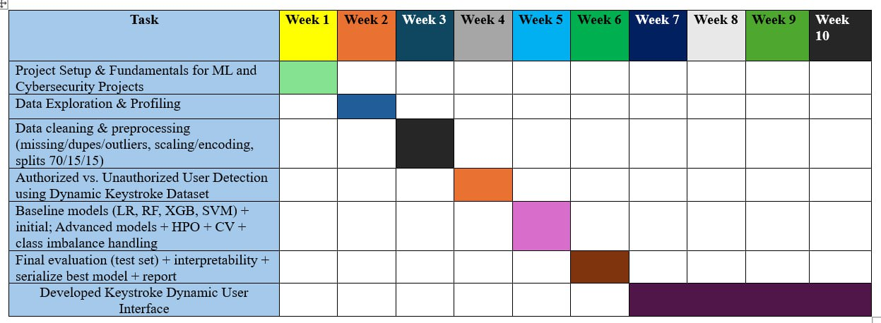
Project Planning and Timeline
https://app.clickup.com/90161284303/v/g/2kz0g16f-556

Slide 4
Problem Statement
Traditional password-based authentication is increasingly vulnerable to phishing, credential theft, and password reuse attacks.
• Multi-factor authentication improves security but often reduces usability and adds complexity.
• Behavioral biometrics such as keystroke dynamics offer continuous, non-intrusive user authentication.

Slide 5
Project Objectives
• Build scalable keystroke data collection systems
• Develop Random Forest, LightGBM, XGBoost models
• Evaluate model accuracy, precision, recall, and ROC
• Ensure privacy and ethics compliance (GDPR, Australian Privacy Act)
• Explore scalability for enterprise applications

Slide 6
Background & Related Work
Behavioral biometrics foundations (Revett, 2019; Banerjee & Woodard, 2020).
Machine learning advances in keystroke dynamics (Killourhy & Maxion, 2021; Ahmed et al., 2023).
Existing tools: CMU Keystroke Dataset, IKDD Dataset, XGBoost frameworks.

Slide 7
Research Methodology
Functional Requirements: Keystroke capture, feature extraction (dwell & flight times), ML model training.
Non-Functional: Data privacy, security, maintainability, real-time response.
Architecture: ML pipeline diagram (data → preprocessing → model → evaluation → deployment).
Dataset Analysis: IKDD Dataset; normalization (Z-score, min–max), missing-value imputation, outlier filtering.

Slide 8
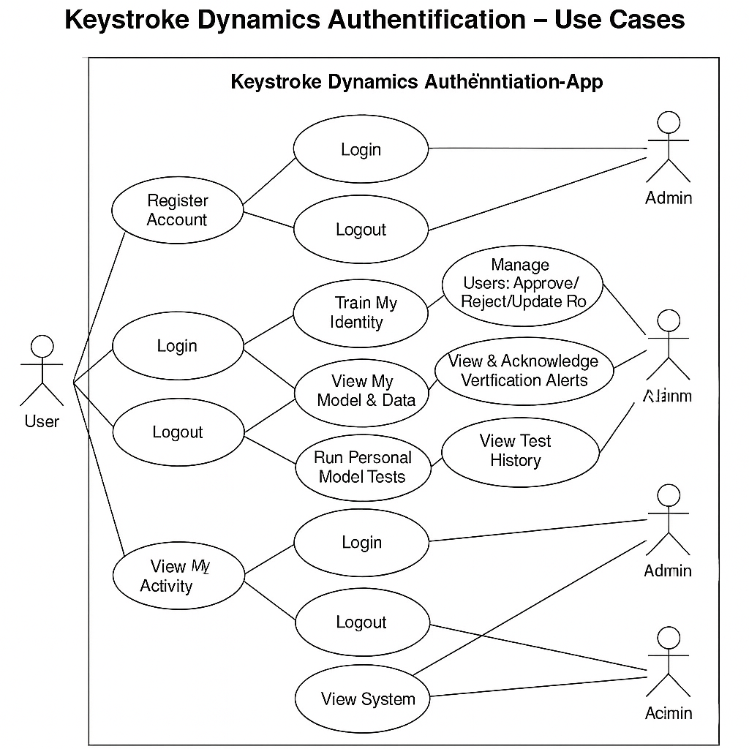
User case Diagram
The system involves three main actors: User, Analyst, and Admin.
Users can register, log in, train typing patterns, and test personal models.
Analysts access testing history, analyze model performance, and review verification data.
Admins manage users, monitor alerts, approve/reject accounts, and oversee system logs.
Each role interacts through the Keystroke Dynamics Authentication App, ensuring a secure and role-specific workflow.

Slide 9
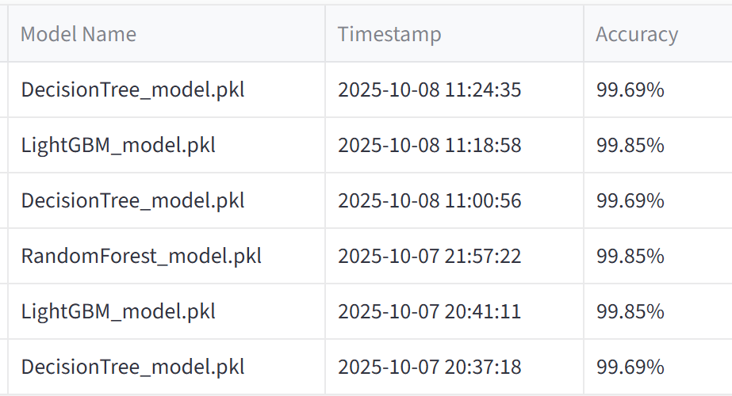
Implementation & Results
Tools: Python, Scikit-learn, LightGBM, DecisionTree, Streamlit.
Performance metrics (Accuracy, Precision, Recall, F1, AUC, EER).
Graphs: Confusion matrix, ROC curve.
Result Summary Table:
Random Forest – 99.85%
LightGBM – 99.85%
DecisionTree – 99.69%

Slide 10
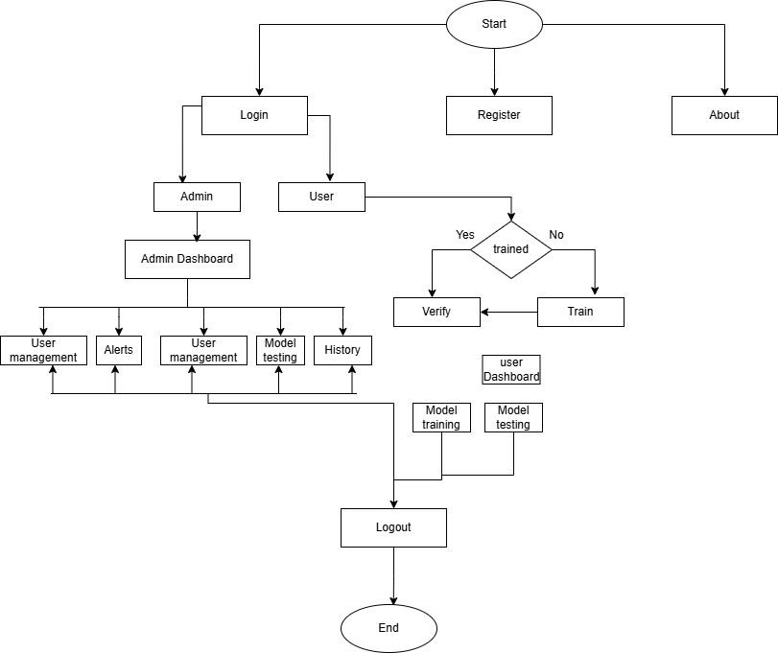
Application GUI

Slide 11
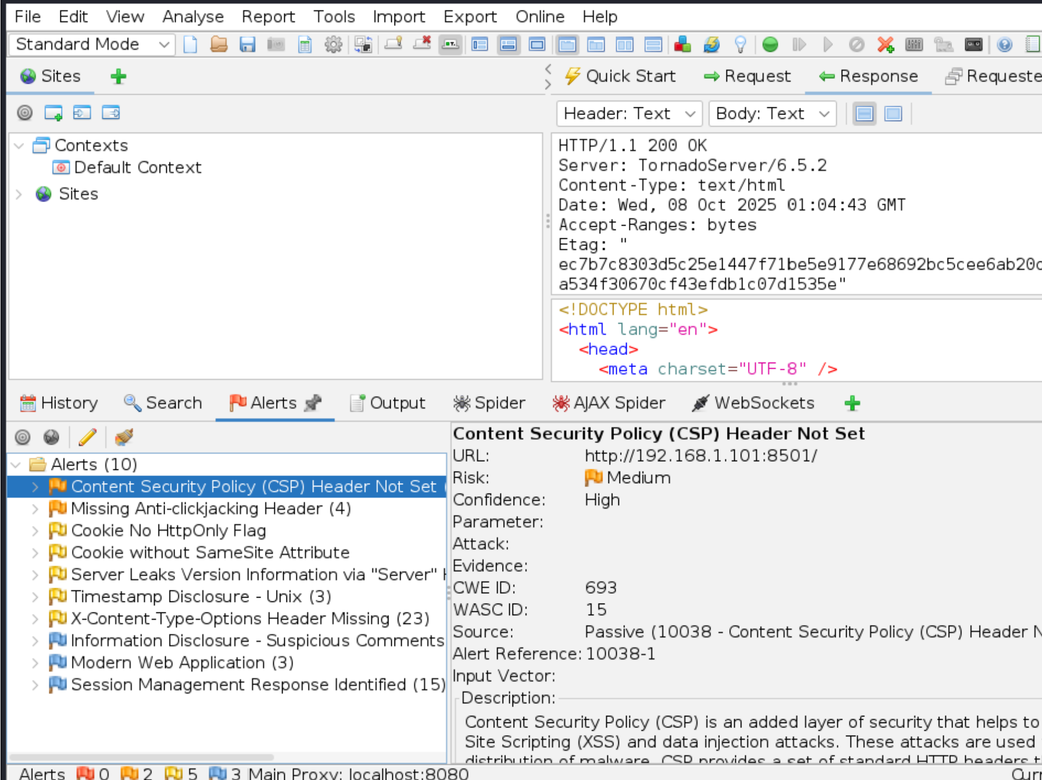
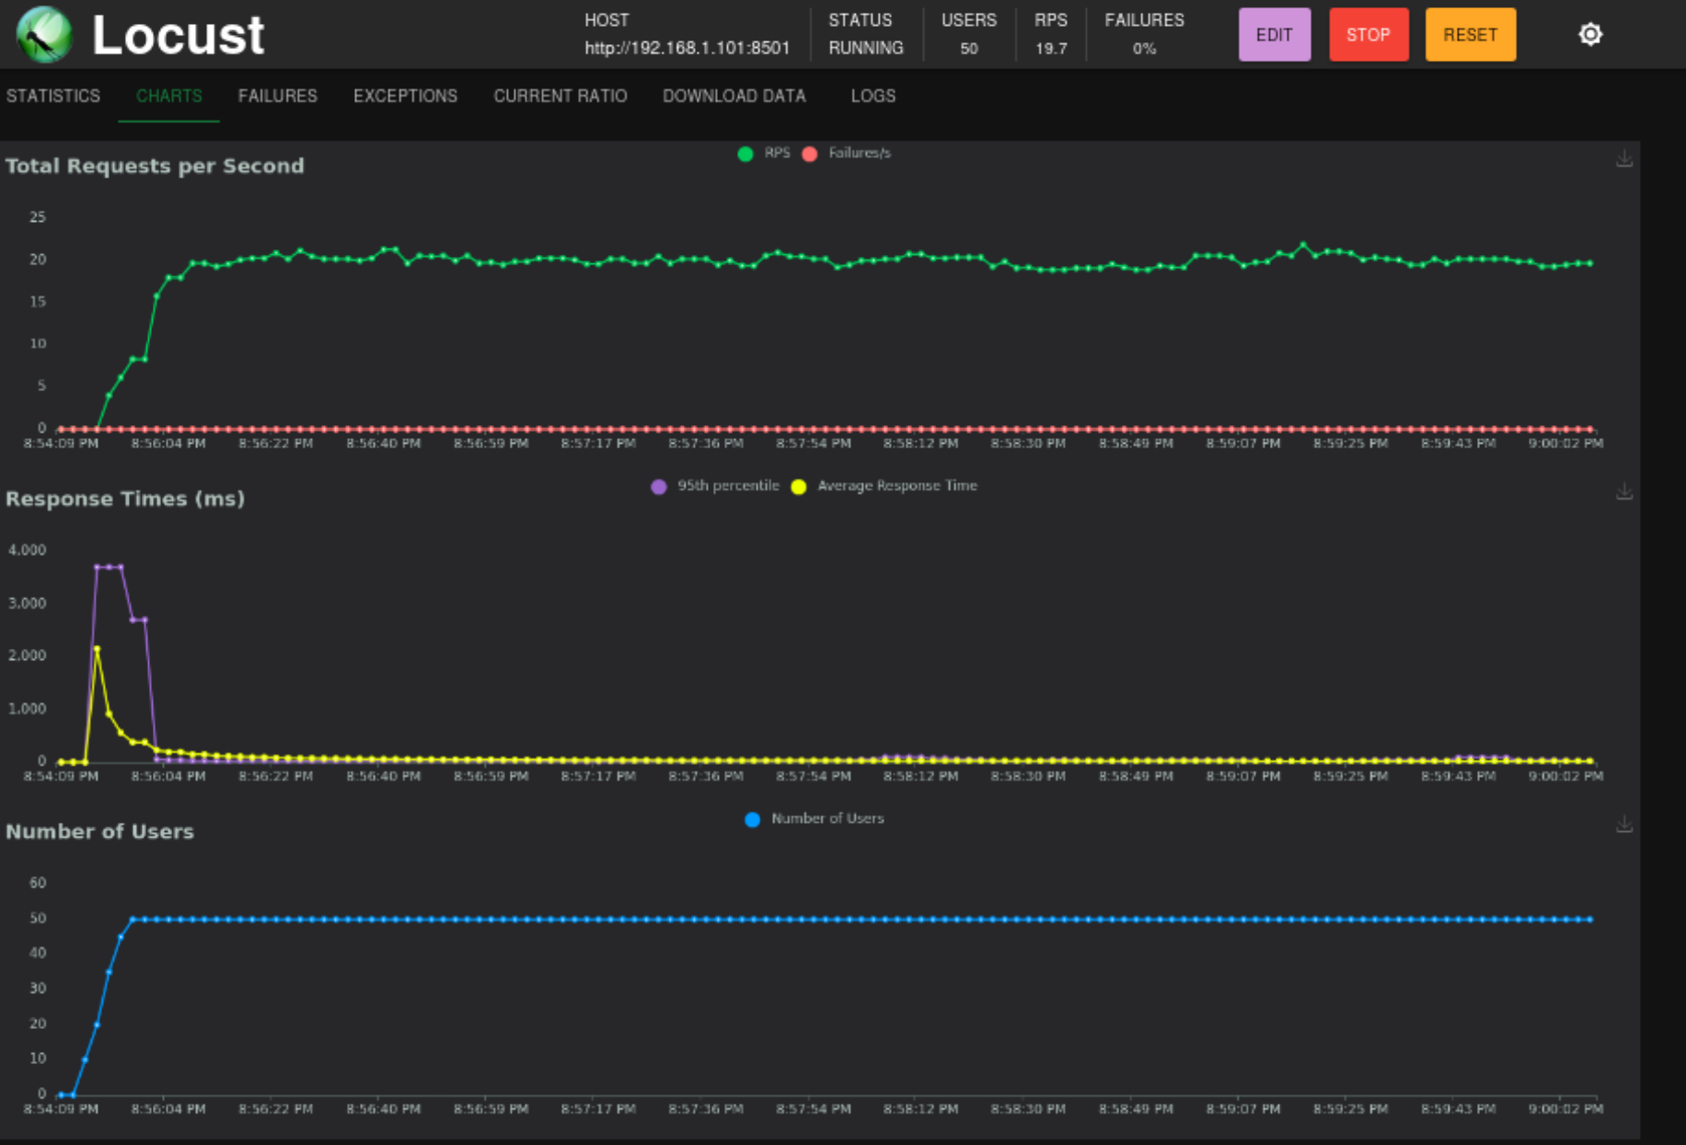
Implementation and Testing
The ZAP scan identified several medium-risk issues including missing Content Security Policy (CSP), anti-clickjacking headers, and cookie misconfigurations. These vulnerabilities were analyzed and mitigated to strengthen the web application’s security posture.
The system was tested with 50 concurrent users, maintaining an average of 19.7 requests per second (RPS) and stable response times under 4 ms. Results confirm the application can handle moderate traffic loads efficiently without performance degradation

Slide 12
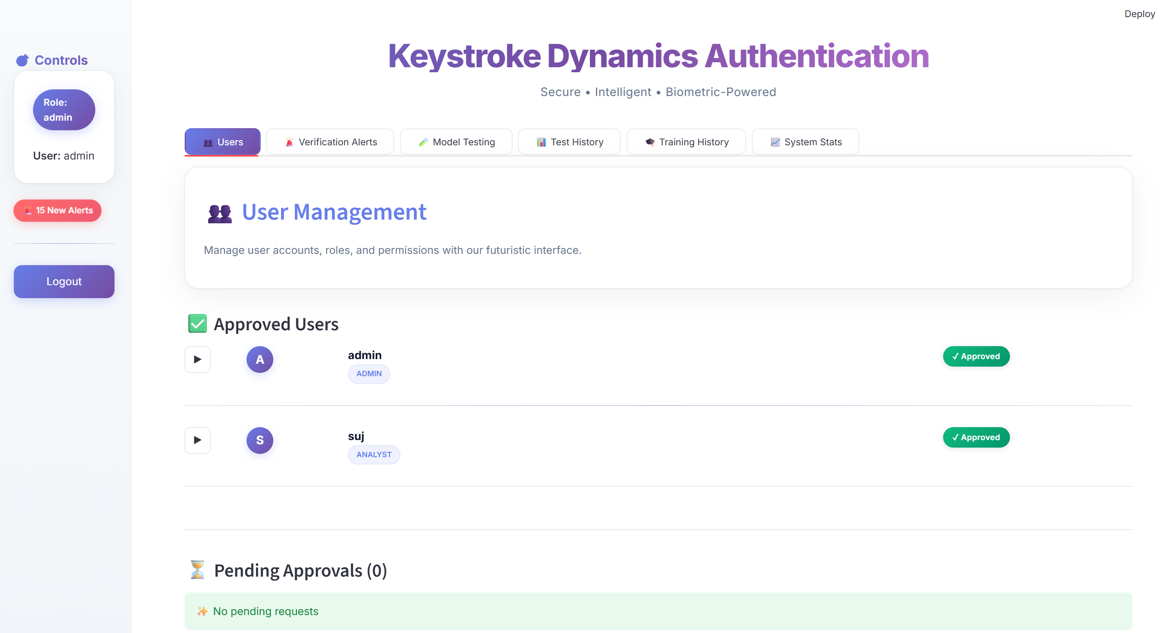
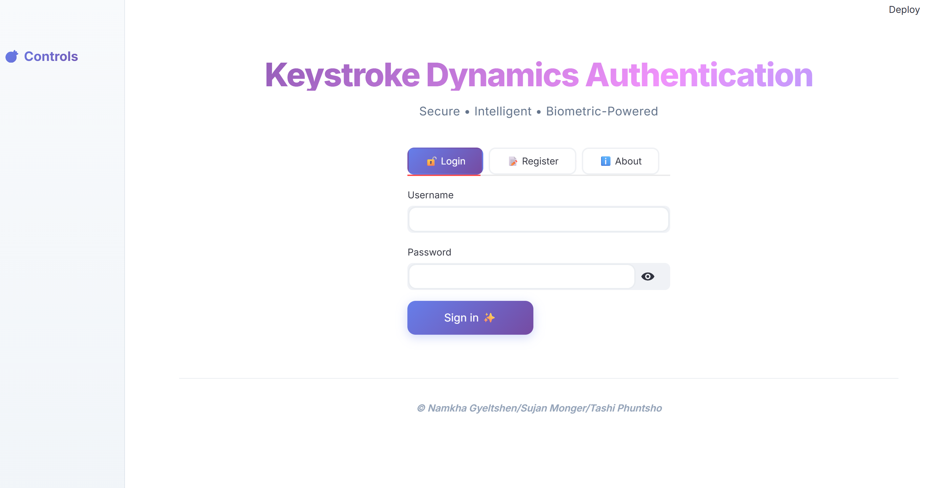
Application GUI
Users log in through a secure authentication portal that supports multi-role access (Admin, Analyst, User). Once logged in, the dashboard provides personalized access to system features

Slide 13
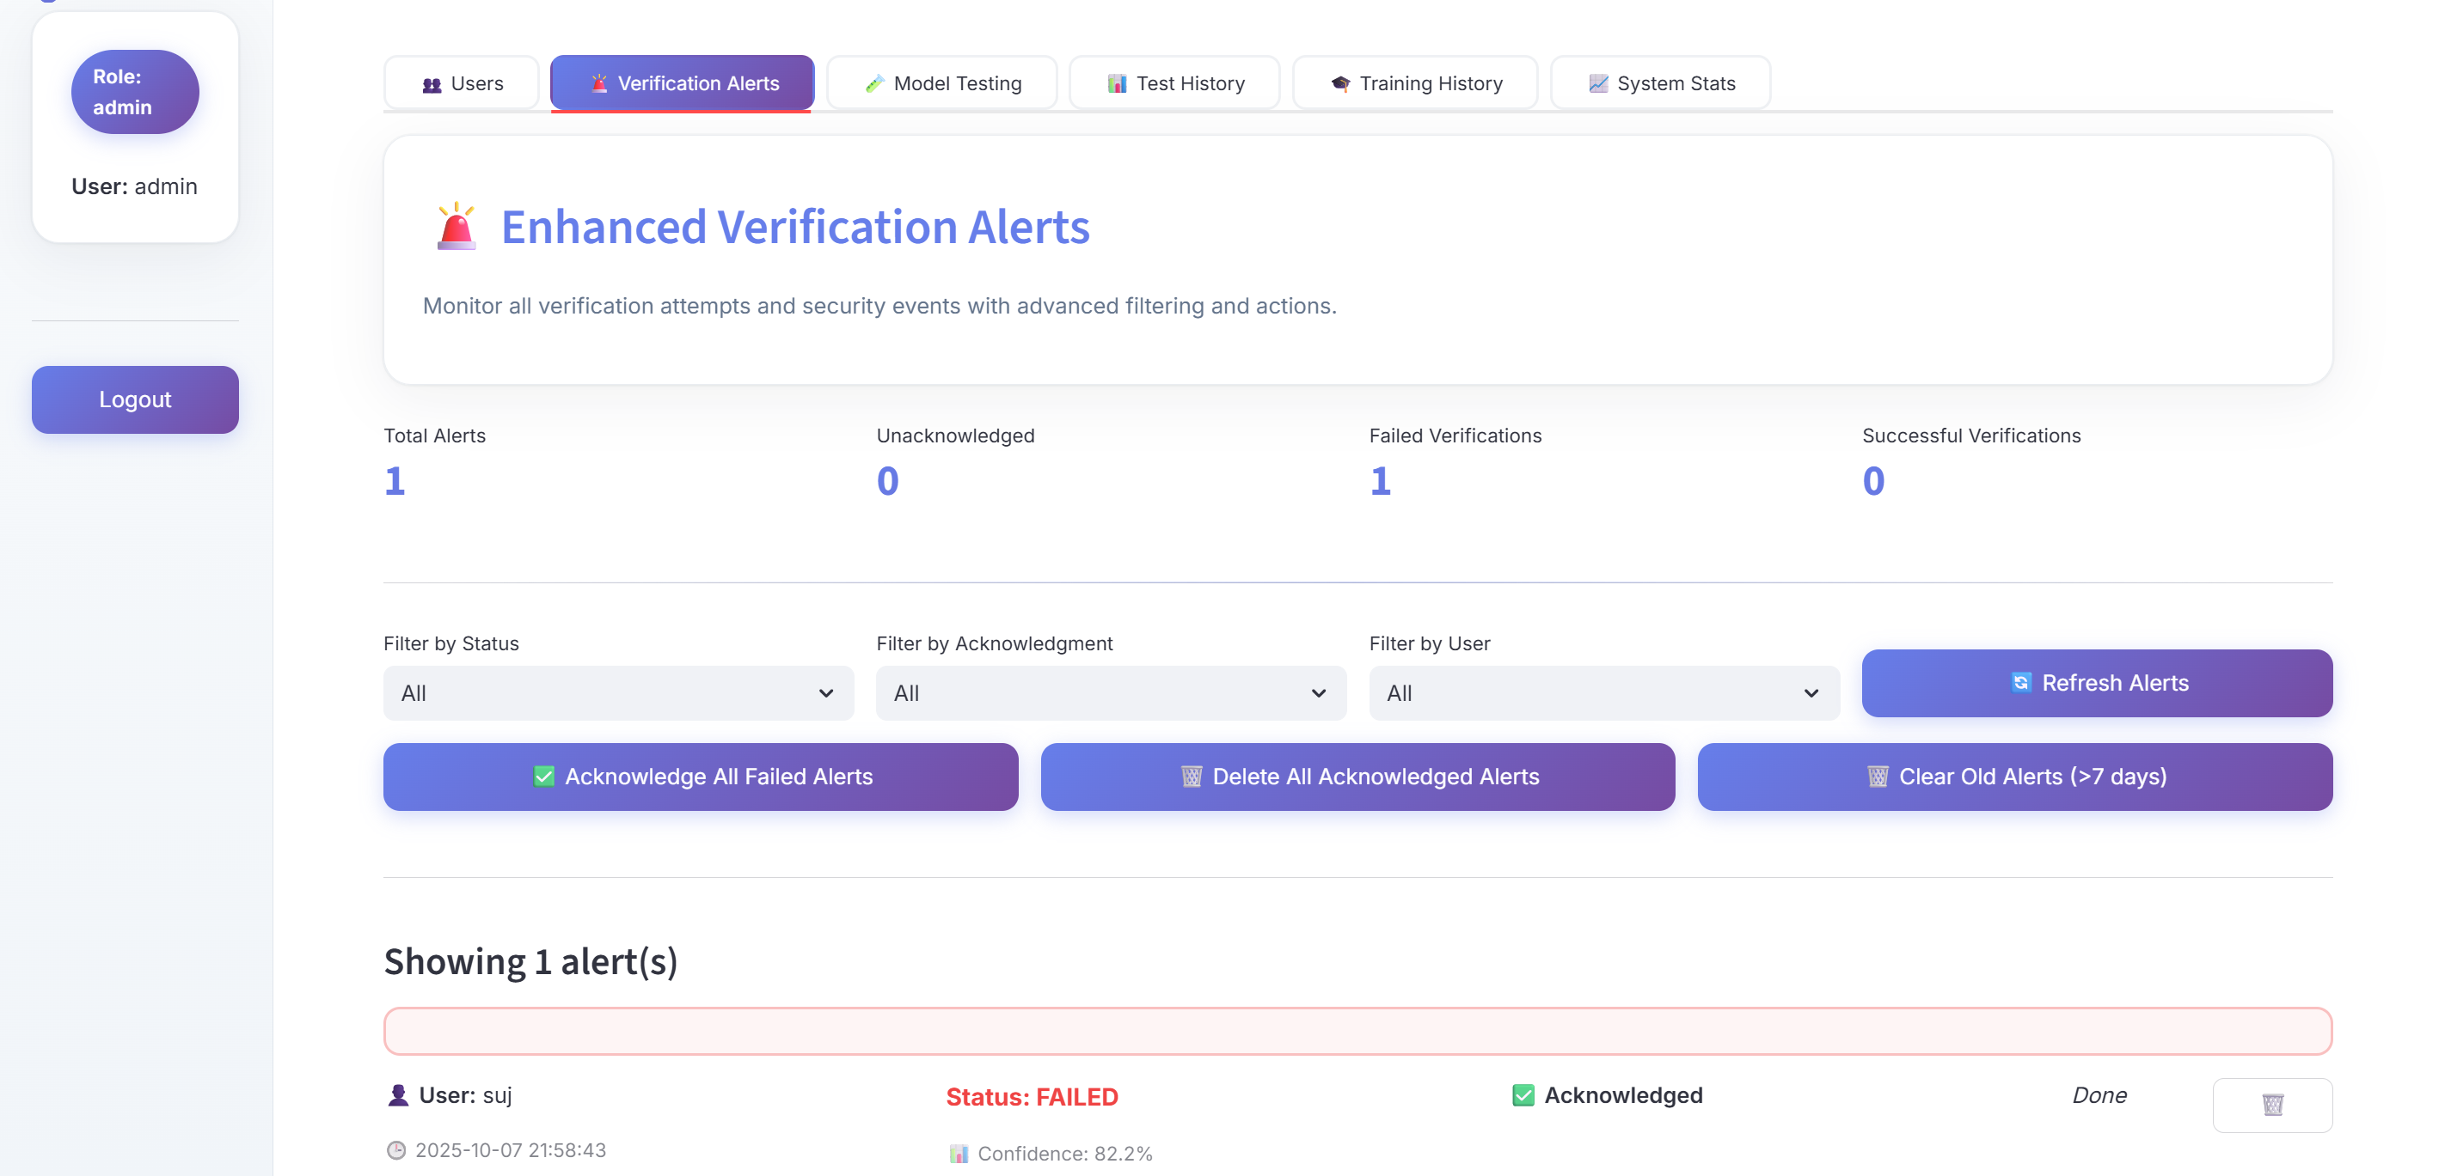
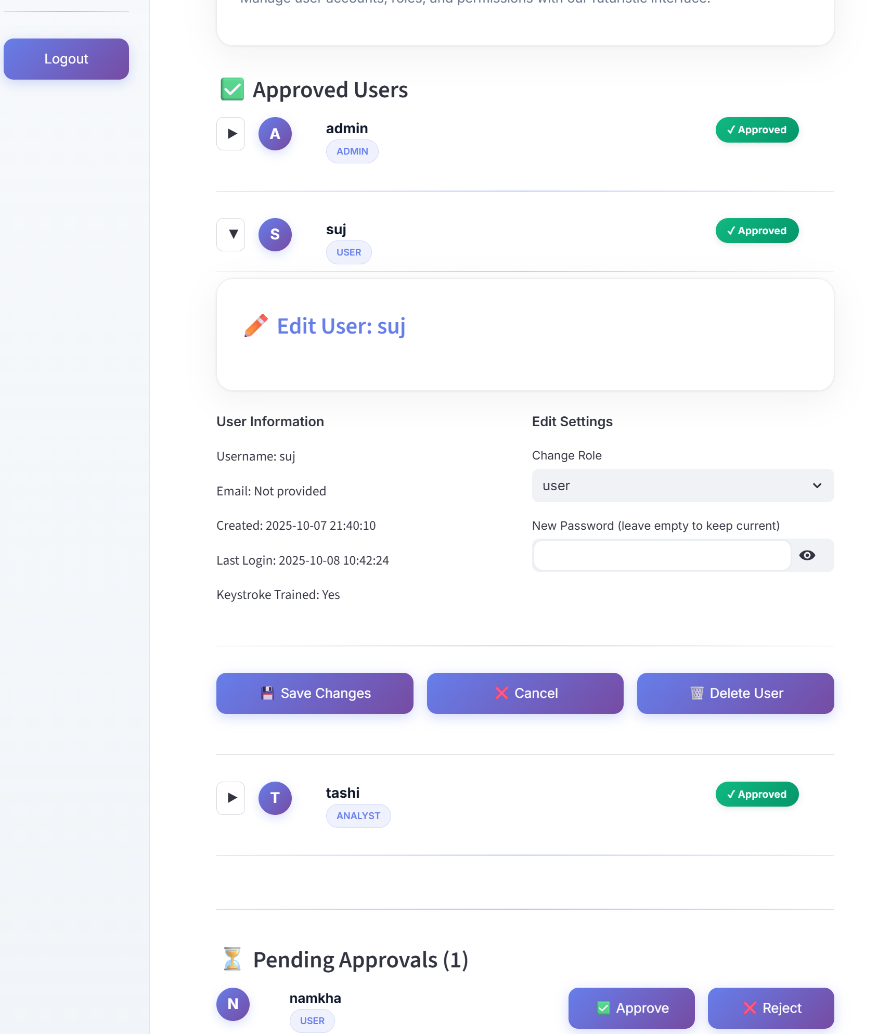
Alerts & User Management
The Admin Dashboard allows monitoring of verification attempts, acknowledgment of failed logins, and management of users — approving, rejecting, or editing user roles and permissions in real time.

Slide 14
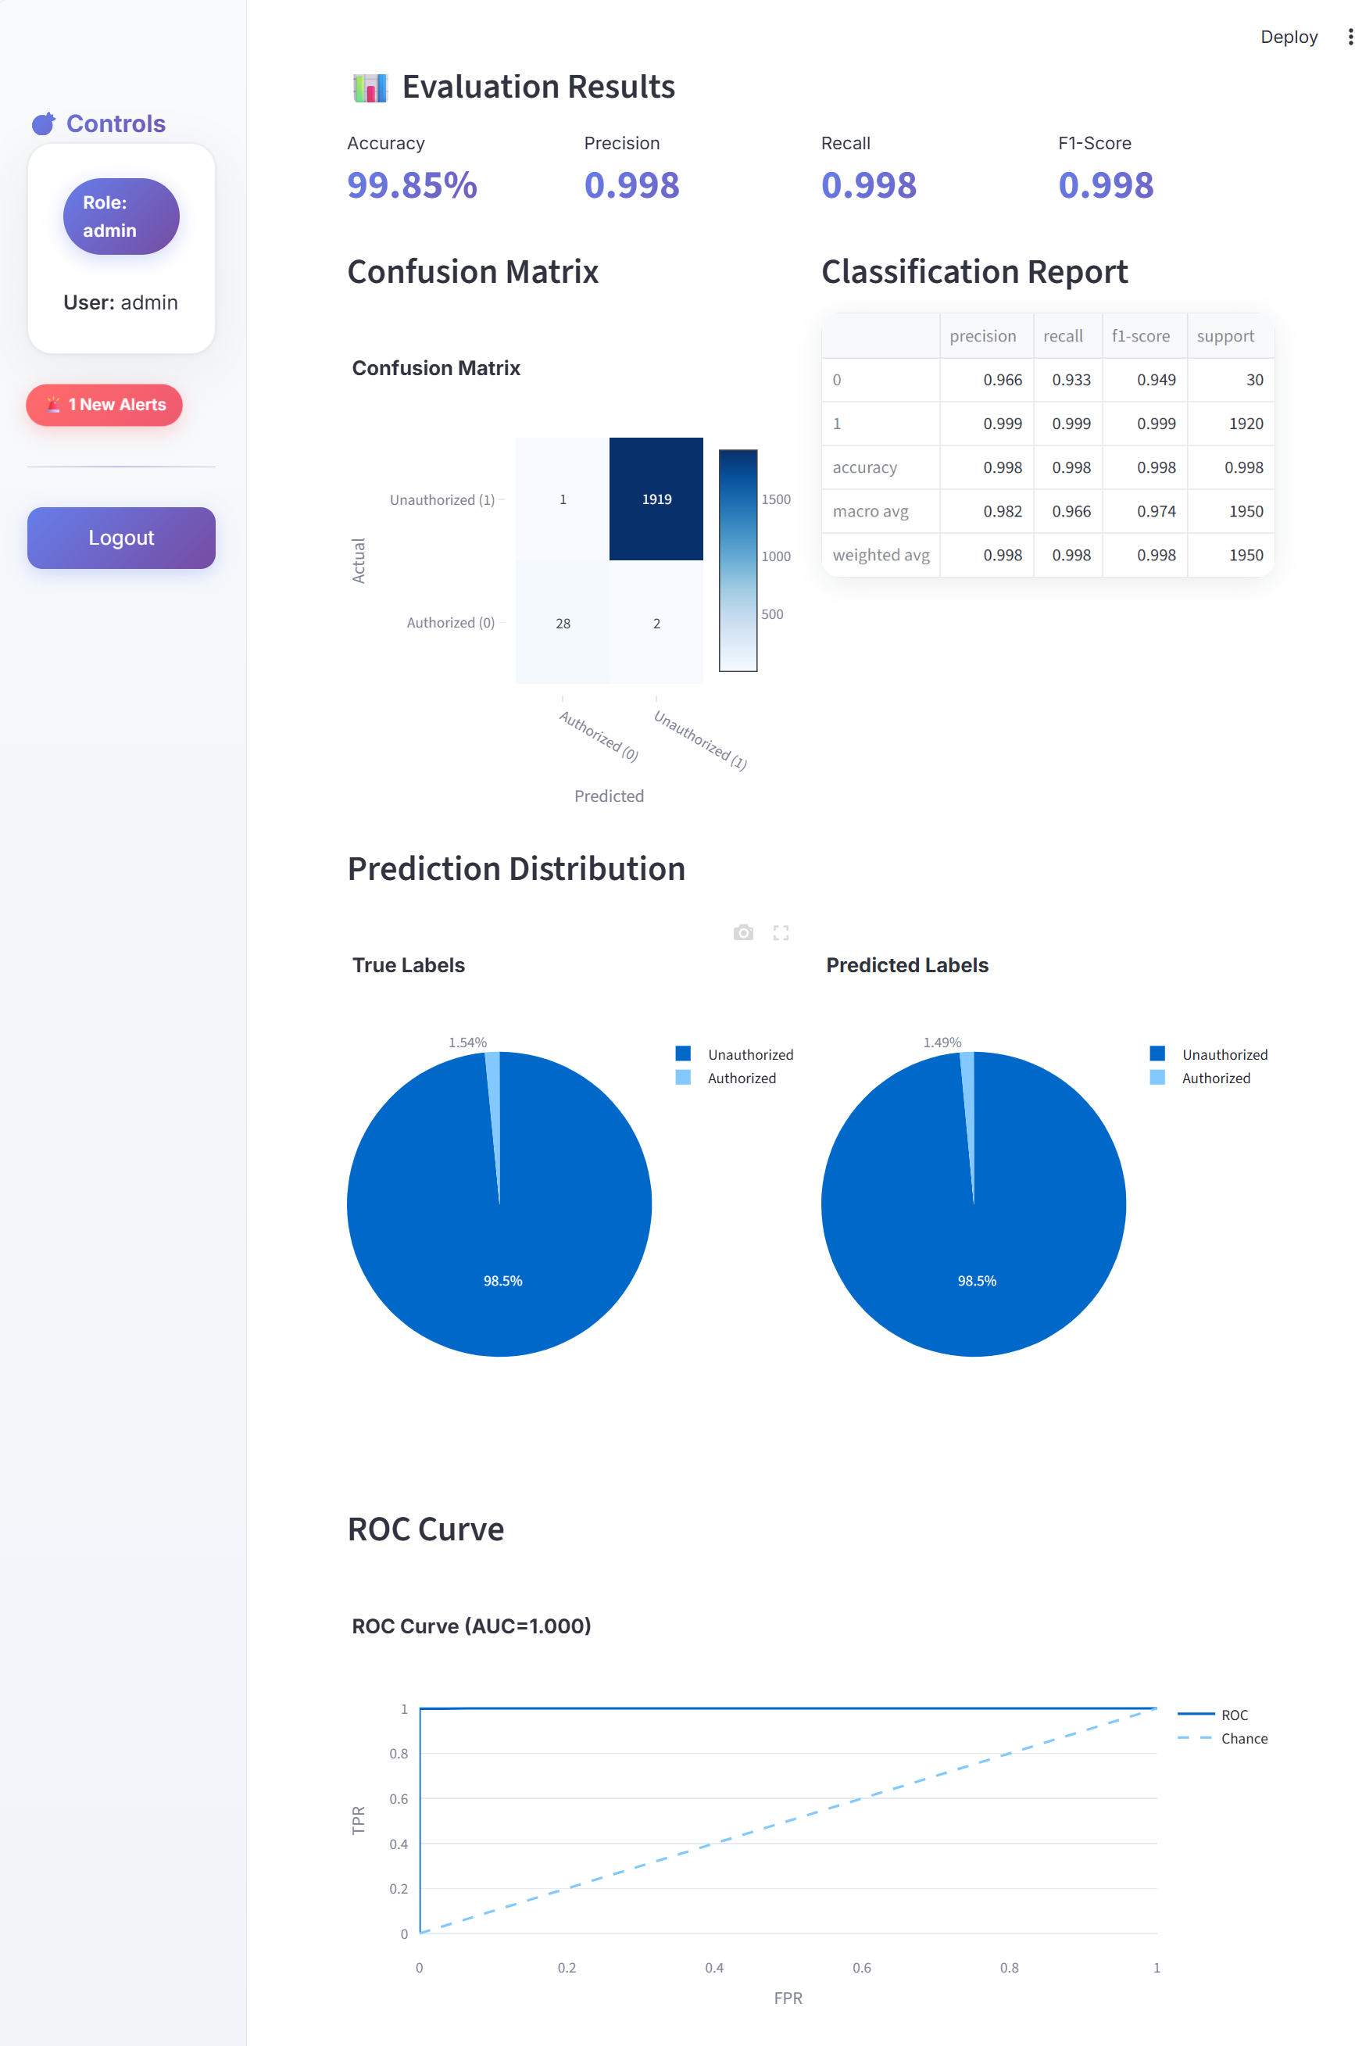
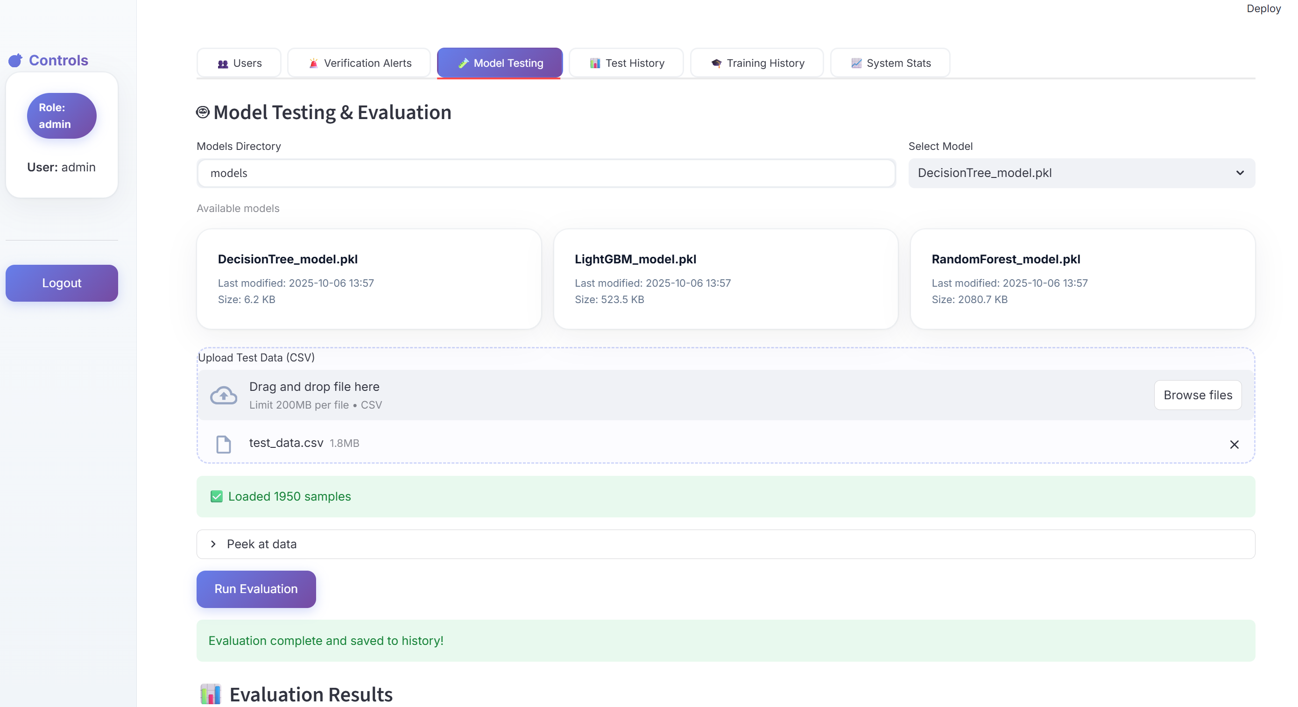
Model Testing & Evaluation
Machine learning models such as RandomForest, LightGBM, and DecisionTree are tested using uploaded datasets. The dashboard provides visual metrics like confusion matrix, ROC curve, and F1-score comparisons.

Slide 15
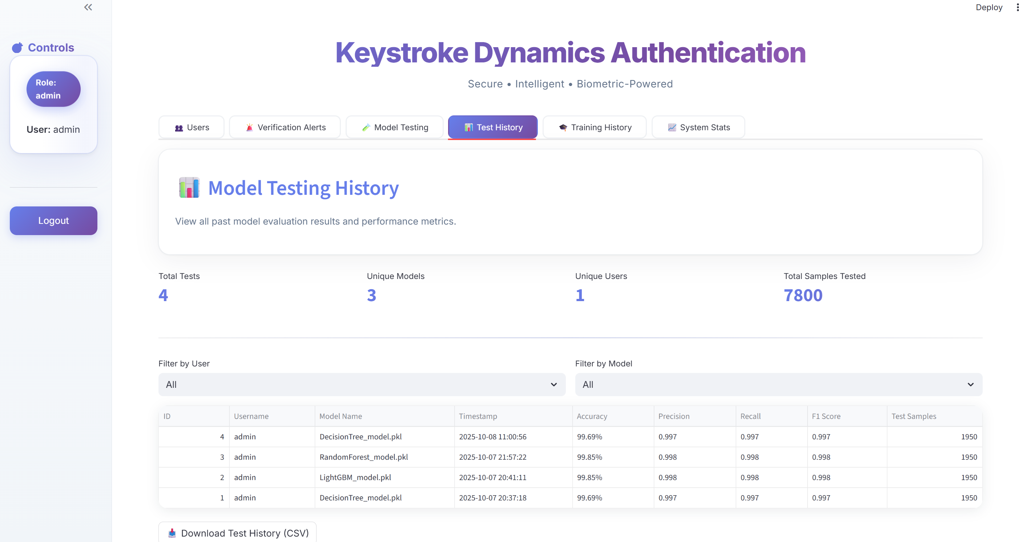
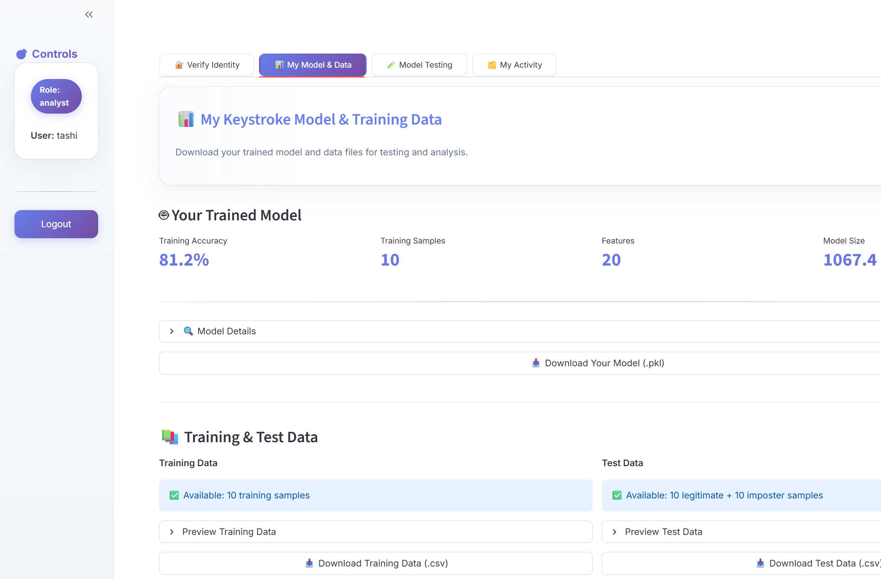
Testing History & Analyst Tools
The Testing History logs performance of multiple models and users, ensuring transparency. Analysts can access their trained models, review data, and download reports for further validation.

Slide 16
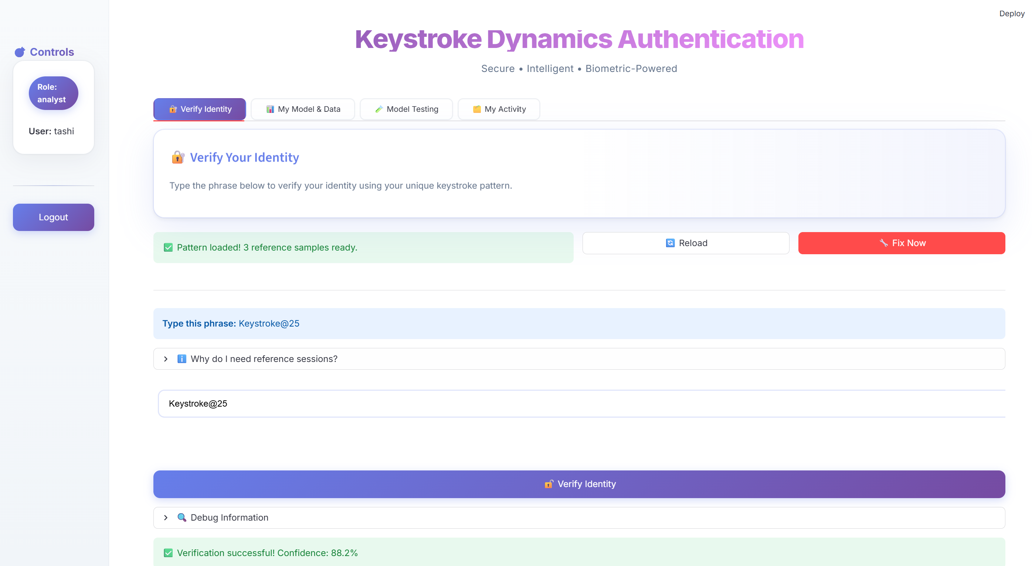
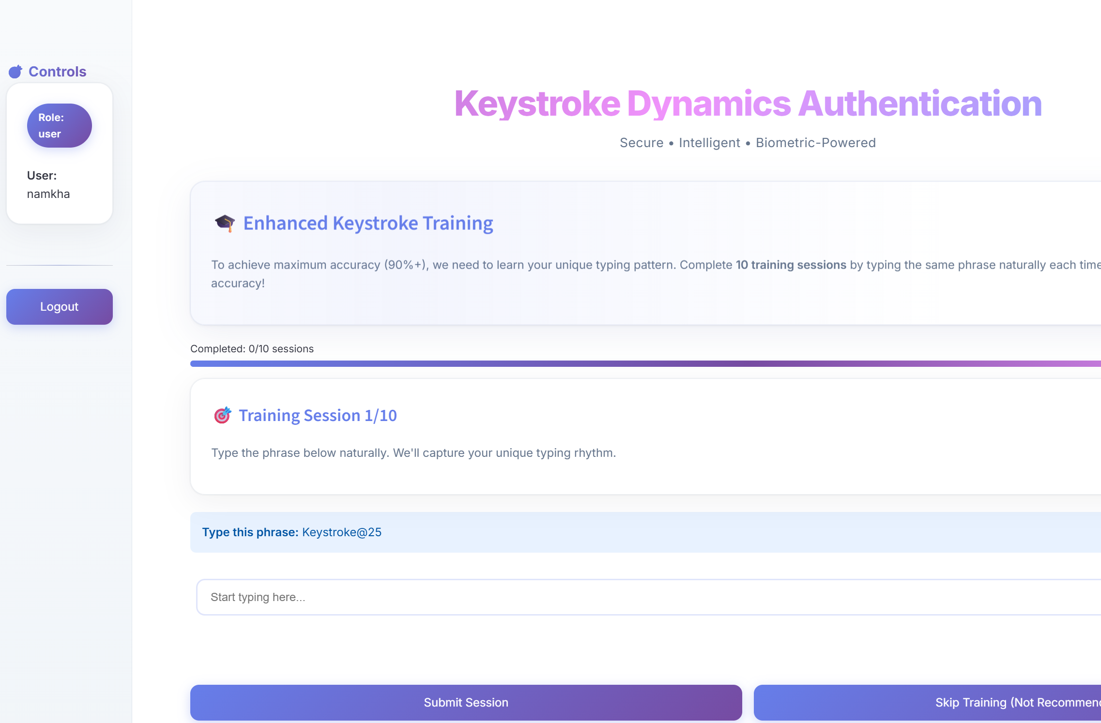
User Training & Verification
Keystroke Training & Real-Time Verification Users complete 10 training sessions to establish their unique typing pattern. During login, the system verifies identity in real-time based on typing rhythm and displays confidence scores dynamically.

Slide 17
Summary of outcomes
Successfully developed a machine learning-based keystroke authentication system.
Achieved 99.85% accuracy using LightGBM and RandomForest models.
Implemented a fully functional GUI with role-based dashboards (Admin, Analyst, User).
Demonstrated strong alignment with cybersecurity and privacy standards.
Lays foundation for future behavioral biometric research.

Slide 18
Limitations
Performance may vary across different hardware devices (keyboards, latency differences).
Accuracy depends on user consistency — emotional state, fatigue, or stress can affect typing patterns.
System currently trained on a limited dataset (1950 samples).
Real-world deployment may require multi-language and cross-platform optimization.
Lack of integration with other biometric authentication systems (e.g., face, voice).

Slide 19
Future work
Integrate deep learning (CNN, LSTM) for adaptive feature learning.
Combine multimodal biometrics — typing + face + voice for enhanced authentication.
Develop a mobile-friendly version with real-time latency optimization.
Implement Explainable AI (XAI) for transparent model decisions.

Slide 20
References
Altwaijry, N. (2020). Keystroke dynamics analysis for user authentication using a deep learning approach. International Journal of Computer Science and Network Security, 20(12), 209-216.
Arsh, A., Kar, N., Das, S., & Deb, S. (2024). Multiple approaches towards authentication using keystroke dynamics. Procedia Computer Science, 235, 2609-2618.
Gedikli, A. M., & Efe, M. Ö. (2019, December). A simple authentication method with multilayer feedforward neural network using keystroke dynamics. In Mediterranean conference on pattern recognition and artificial intelligence (pp. 9-23). Cham: Springer International Publishing.
Krishna, G. J., Jaiswal, H., Teja, P. S. R., & Ravi, V. (2019, October). Keystroke based user identification with XGBoost. In TENCON 2019-2019 IEEE Region 10 Conference (TENCON) (pp. 1369-1374). IEEE.
Tsimperidis, I., Asvesta, O.-D., Vrochidou, E., & Papakostas, G. A. (2024). IKDD: A Keystroke Dynamics Dataset for User Classification. Information, 15(9), 511. https://doi.org/10.3390/info15090511

