Slide 1
UX Scenario Document File Version 4.4
(Please Write Your App Title)
Submission Date | YYYY / MM / DD
App Ver. | X. X. X
App Developer | Name: E-mail address:

Slide 2
Table of Contents
1. Basic Information
2. Document History
3. Page Description (Guideline)
4. Detailed Login Information
5. Main Page Description
6. Sub Page Description
7. Paid Content
8. In-App Ad

Slide 3
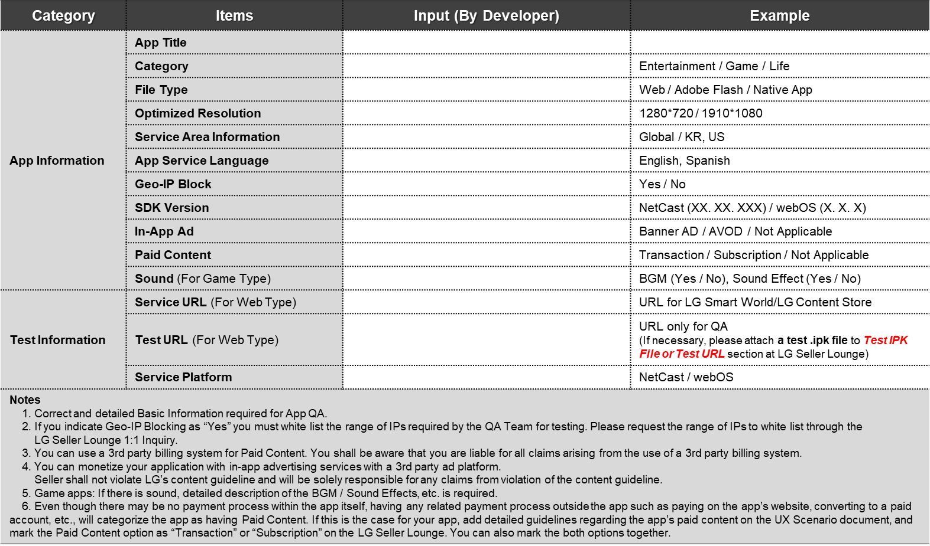
1. Basic Information

Slide 4
2. Document History
No. | Sent | Version | File Name | Contents
1 | DD.MM.YYYY | 1.0.0 | UX Scenario | Initial document

Slide 5
3. Page Description (Guideline)
1. (Write Menu Title Here)
Description
1 | Description for Number 1 button
2 | Description for Number 2 button
3 | Description for Number 3 button
4 | Description for Number 4 button
5 | Description for Number 5 button
- Place your app’s display image.
- Use unique number to indicate each menu or UI button correctly.
- Write the description on each menu or UI button of number at the right-side table.
- Next pages show examples with sample images and texts.
Detailed Information
Please write the detailed information for the above image here, if needed.
*Note
- Description of each UI button’s function and location is required for better understanding, especially for non-English apps.

Slide 6
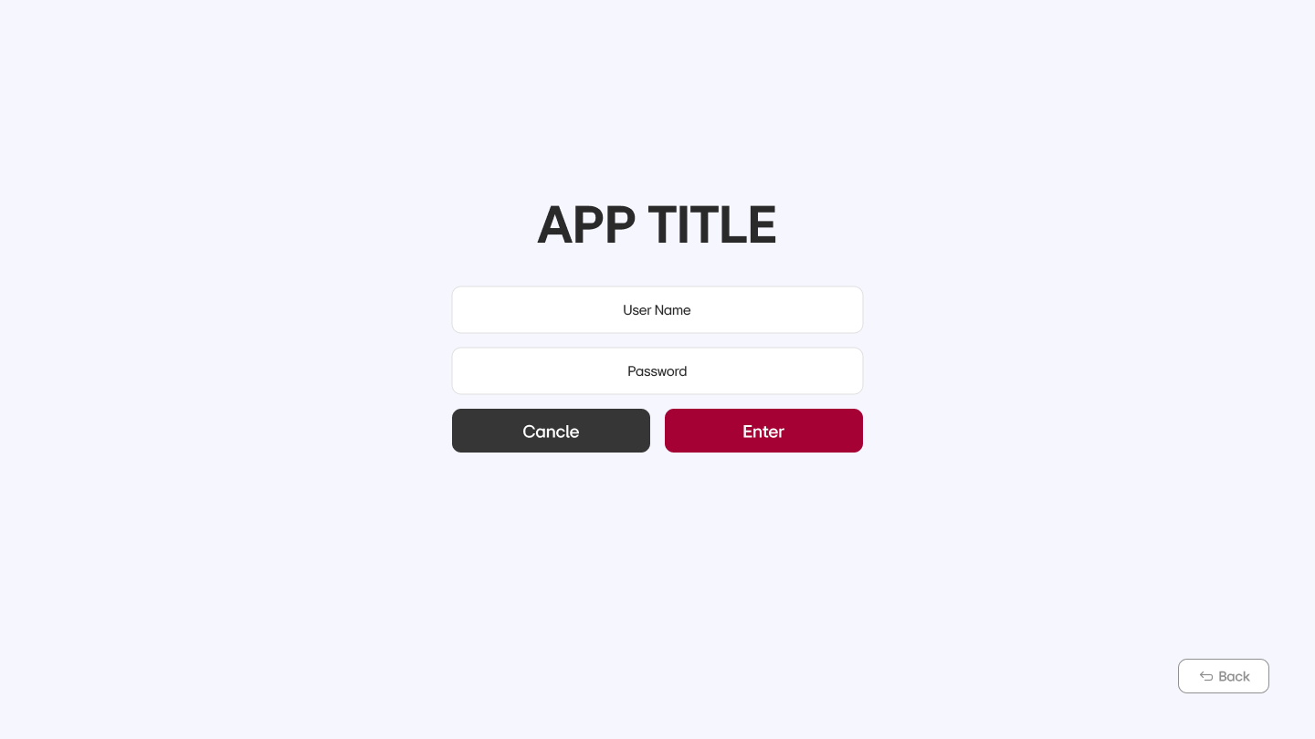
4. Detailed Login Information
Description
1 | Input field for ID
2 | Input field for password
Test Accounts (ID / PW)
1 | ID ( ) / PW ( )
2 | ID ( ) / PW ( )
3 | ID ( ) / PW ( )
Activation Codes
1
2
3
①
②
Detailed Information
- Either Access Activation Codes or Account Information (ID/PWD) is required to test an app.
*Note
- If each test account can access per device (not multiple devices), please provide a minimum of 20 test accounts or activation codes to proceed QA.
- If a limit exists to sync each account to the multiple devices, please provide a further guide with detailed instruction to unlock the access limit.

Slide 7
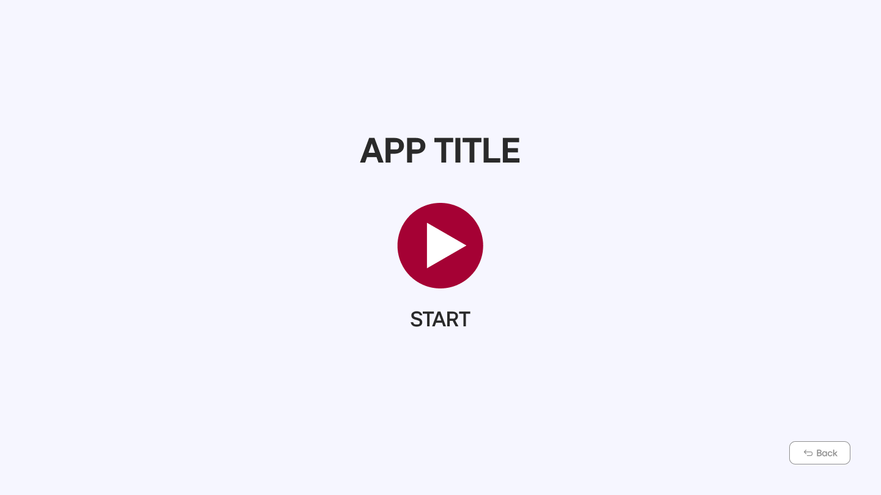
5. Main Page Description
1. Start Page
Description
1 | Displaying the app title
2 | UI button to “Start” the app
3 | Move to previous page
①
②
③
Detailed Information
Please write the detailed information for the above image here, if needed.
*Note
- Description of each UI button’s function and location is required for better understanding, especially for non-English apps.

Slide 8
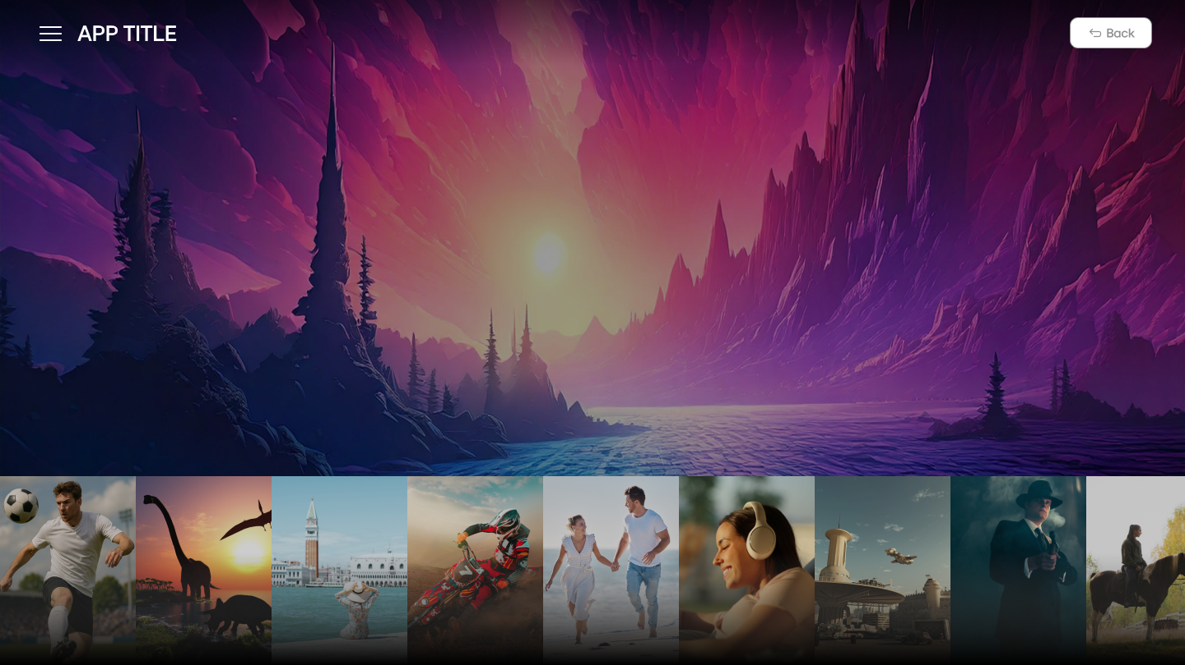
5. Main Page Description
2. Main Page
Description
1 | Displaying the app title
2 | Move to previous page
①
②
Detailed Information
Please write the detailed information for the above image here, if needed.
*Note
- Description of each UI button’s function and location is required for better understanding, especially for non-English apps.

Slide 9
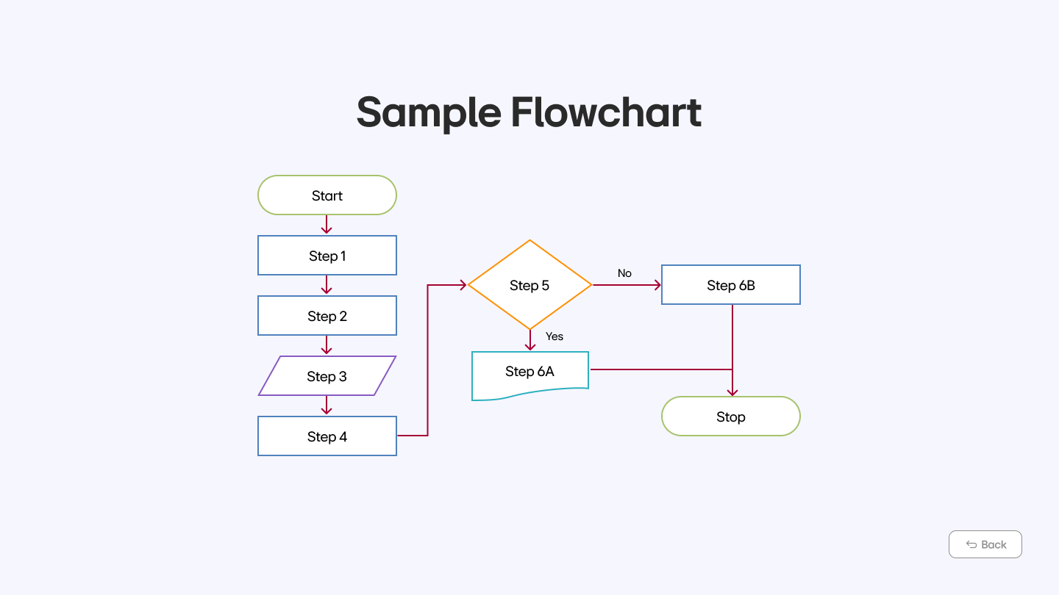
6. Sub Page Description
1. Flow Chart(Optional)
Detailed Information
Please write the detailed information for the above image here, if needed.
*Note
- This page is added for better understanding for sub page’s location and movement during QA.

Slide 10
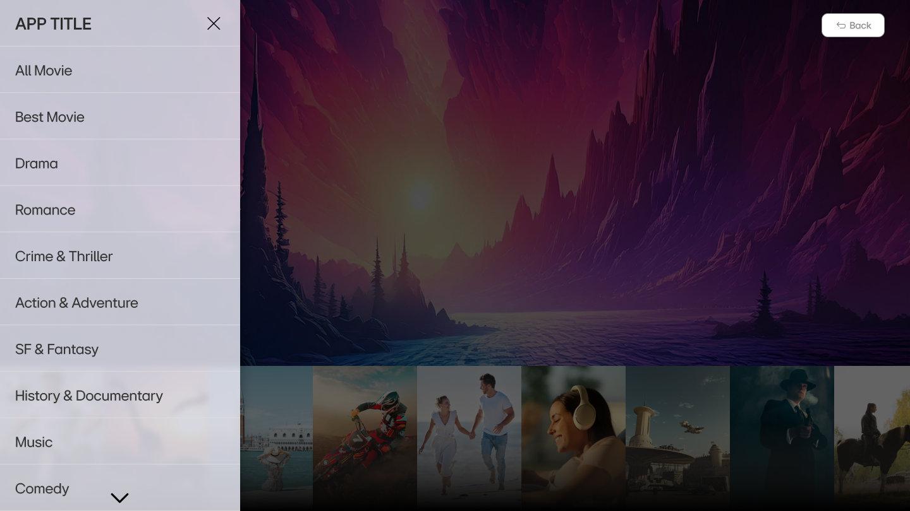
6. Sub Page Description
2. Sub Menu
Description
1 | Move to previous page
2 | Move to each content
①
②
Detailed Information
- Please write the detailed information for the above page here, if needed.

Slide 11
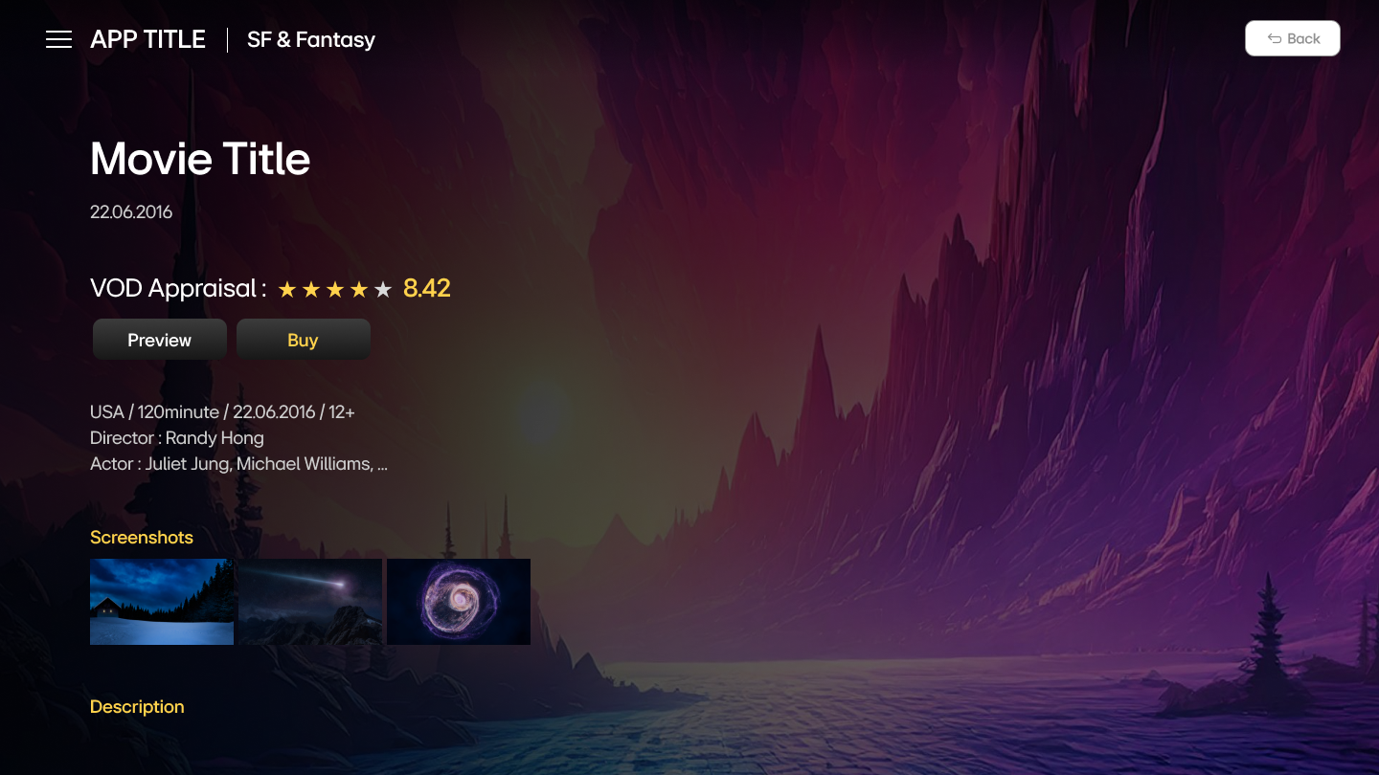
6. Sub Page Description
3. Sub Page
Description
1 | Move to previous page
2 | Move to each content
①
②
Detailed Information
- Please write the detailed information for the above page here, if needed.

Slide 12
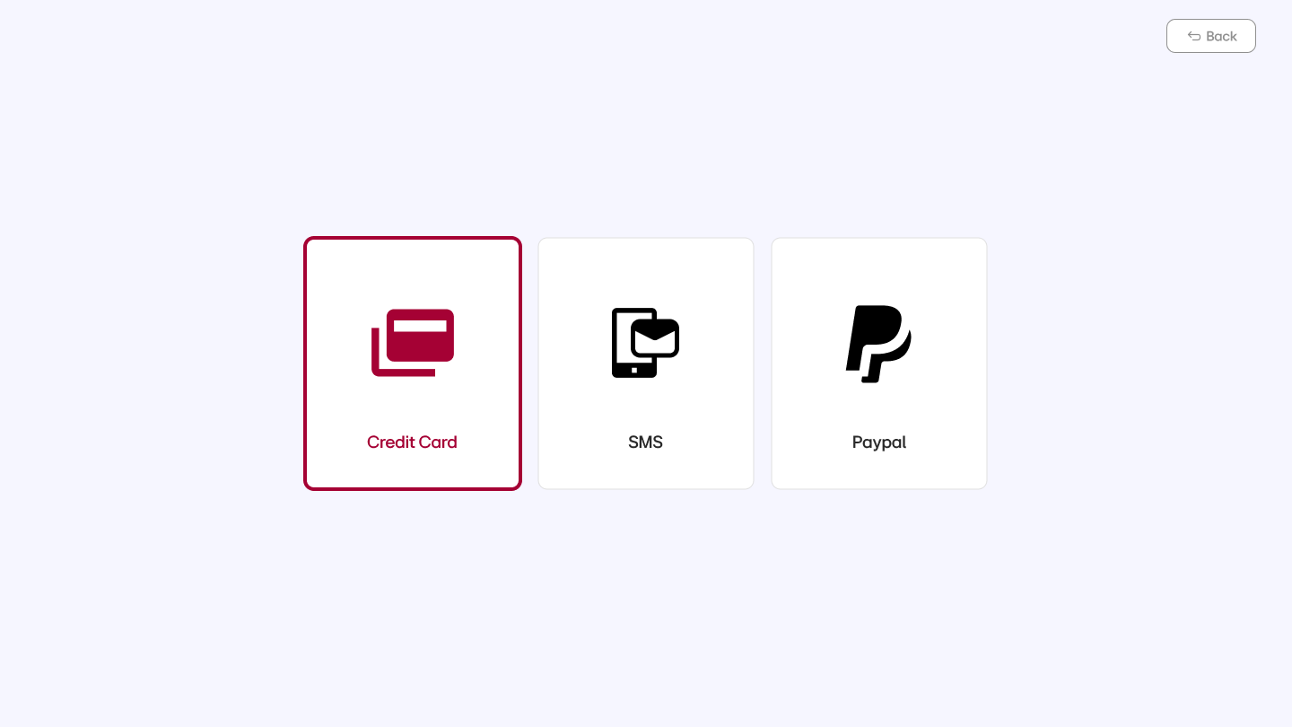
7. Paid Content
Description
1 | Move to previous page
2 | Add detailed information in each payment method. (e.g. Credit Card, SMS, PayPal)
3
4
Test Credit Cards (Mandatory)
1 | Card No. / Expiry date / CVC
2 | Card No. / Expiry date / CVC
Test Voucher Codes (Mandatory)
1
2
3
①
Detailed Information
For an app that includes Paid Content, please provide detailed instruction for payment methods on this page.
Please state the detailed information of the available payment methods, such as credit card, PayPal, SMS or voucher code.
*Important Note
Multiple credit cards or/and 10 to 20 voucher codes are necessary for QA.

Slide 13
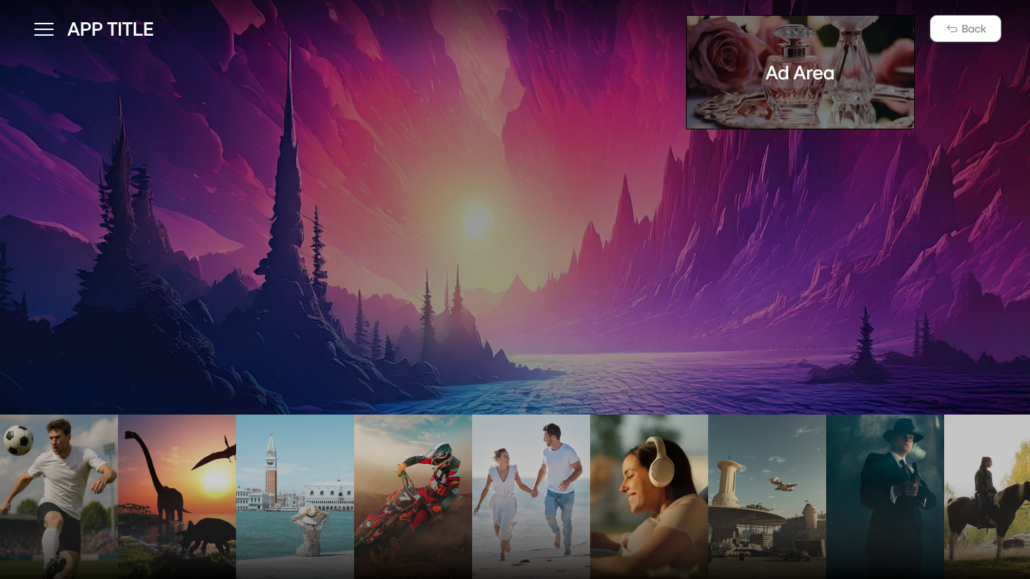
8. In-App Ad
1. Banner Type (Please Describe Ad Information)
Description
Banner Type Information
1 | Page: e.g. Main Page
 | Location: e.g. Upper Right Banner
①
②
Detailed Information
Please write the detailed information for the above page here, if needed.

Slide 14
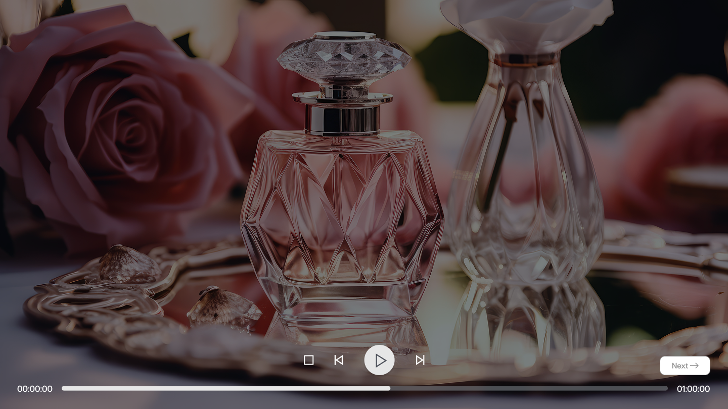
8. In-App Ad
2. Video Type (Please Describe Ad Information)
Description
Video Type Information
AD Area
Detailed Information
- Please write the detailed information for the above page here, if needed.

Slide 15
[Appendix]
If you have anything to let the LG QA Management know, please comment here. Any detailed references will be welcome.
…
..

