Slide 1
UX Scenario Document File Version 4.4
BBNL IPTV
Submission Date | 2026 / 04 / 29
App Ver. | 2.0.0
App Developer | Name: BBNL E-mail address: support@bbnl.in

Slide 2
Table of Contents
1. Basic Information
2. Document History
3. Page Description (Guideline)
4. Detailed Login Information
5. Main Page Description
6. Sub Page Description
7. Paid Content
8. In-App Ad

Slide 3
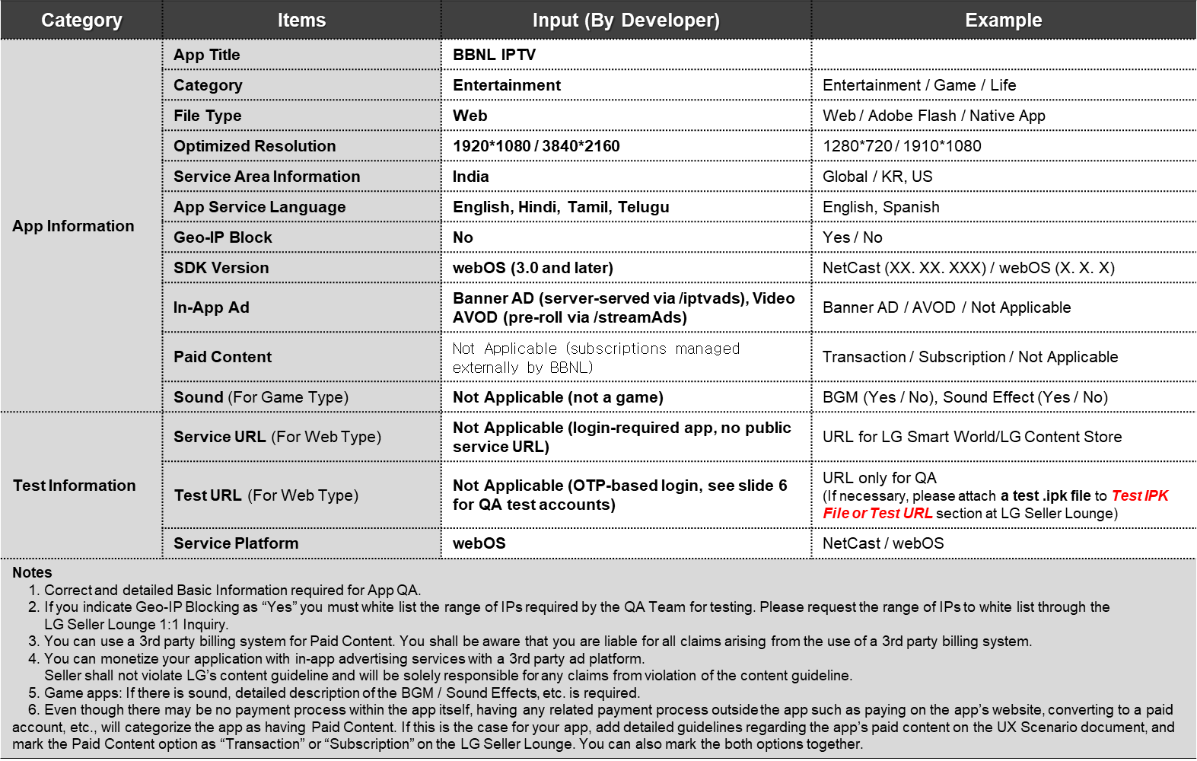
1. Basic Information

Slide 4
2. Document History
No. | Sent | Version | File Name | Contents
1 | 29.04.2026 | 1.0.0 | BBNL_IPTV_UX_Scenario_v1.0.ppt | Initial document for LG Content Store submission of com.bbnl.iptv v2.0.0

Slide 5
[Appendix]
Notes for LG QA Management:
1. AUTHENTICATION
BBNL IPTV uses phone-number-based OTP authentication only - no username/password. To test the login flow, the QA team will need test phone numbers with bypass OTP codes coordinated through the BBNL backend team. See slide 6 for placeholder credentials.
2. APP ID HISTORY
This app was previously sideloaded under com.lg.bbnl but was renamed to com.bbnl.iptv for store submission, since the com.lg.* namespace is reserved for LG system apps.
3. SUPPORTED PLATFORMS
Tested on LG webOS 3.0 (2017) and later. Earlier webOS versions are not supported because the app is built with React 19, which requires Chrome 53 and above (available from webOS 3.0).
4. SUBSCRIPTION MODEL
No in-app payments are processed. Users must already hold a valid BBNL subscription managed by their cable operator. The app authenticates and delivers content; billing is external.
5. DATA PRIVACY
Privacy Policy: https://bbnl-iptv-legal.vercel.app/privacy.html
Terms of Service: https://bbnl-iptv-legal.vercel.app/terms.html
Contact: https://bbnl-iptv-legal.vercel.app/contact.html
6. CONTACT FOR QA QUERIES
General support: support@bbnl.in
Privacy / data requests: privacy@bbnl.in
7. KEY API ENDPOINTS (for QA reference)
Authentication: /login, /loginOtp, /ssologin
Channels: /chnl_data, /chnl_categlist, /chnl_langlist
Streaming: /stream
Analytics: /trpdata, /ottlogs
Ads: /iptvads (banner), /streamAds (video)
Thank you for reviewing BBNL IPTV.

