Slide 1
Do two notions of “core” agree?
NETWORK SCIENCE · RESEARCH PROJECT
Core–periphery structure versus structural cohesion, validated by network robustness
k-core: density
cohesion: connectivity
brokers: where they differ
Sujan S · Diravina E I
Notes:
Opening line: every network analysis eventually asks which nodes form the core. Two traditions answer differently. Core–periphery models and k-cores say the core is where ties are dense. Structural cohesion, from Moody and White, says the core is what is hardest to pull apart. Our project asks whether these two answers agree, and which one points at the nodes that really hold a network together.

Slide 2
Two literatures define the core differently
CORE–PERIPHERY · K-CORE
STRUCTURAL COHESION
The core is where ties are dense
The core is what is hardest to pull apart
Borgatti–Everett (2000), Rombach et al. (2014), k-core peeling (Seidman 1983). Cheap, ubiquitous, degree-based.
Moody & White (2003): k-components, maximal groups that survive the removal of any k−1 nodes. Exact, but expensive.
RQ1
Do they agree?
RQ2
Which finds the critical nodes?
RQ3
Does a hybrid help?
Notes:
The two traditions rarely cite each other. Core–periphery models reward density: many ties, especially among core nodes. Cohesion asks a different question: how many nodes must I remove to disconnect this group? Every k-component lies inside the k-core, but not the other way round. Our three research questions: how much do they agree, which one identifies nodes that matter for keeping the network connected, and does combining them help.

Slide 3
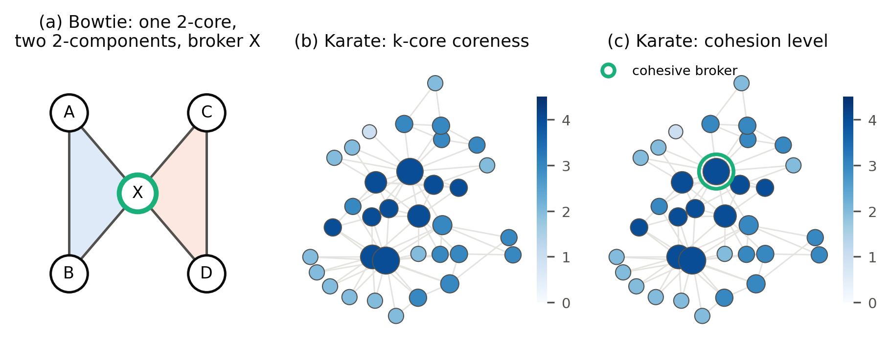
Same nodes, different organisation: the bowtie
Every node has coreness 2 and cohesion level 2 — node-level measures agree perfectly.
But one 2-core = two 2-components glued by X, the cohesive broker. Remove X and it splits.
Notes:
This toy example is the whole paper in miniature. Both measures give every node the value 2, so node rankings agree. But the k-core sees one group while cohesion sees two overlapping groups whose overlap, node X, is a broker. The karate club on the right shows the same thing on real data: coreness and cohesion level coincide at every node, yet the cohesion hierarchy singles out one broker. Proposition 3 in the paper: two k-components share fewer than k nodes, so brokers are always small glue sets.

Slide 4
Eight networks, three domains, one yardstick
Network | Domain | Nodes
Zachary karate club | Social | 34
arXiv GR-QC co-authors | Social | 4,158
EU research e-mail | Social | 986
Facebook ego networks | Social | 4,039
Yeast PPI (Collins) | Biological | 1,004
C. elegans neurons | Biological | 297
US power grid | Infrastructure | 4,941
India domestic air routes | Infrastructure | 68
R
Yardstick: robustness
Remove nodes in score order; R = mean size of the giant component. Lower R = more critical nodes found.
100
Controls
100 degree-preserving null models per network; held-out tuning; Wilcoxon, bootstrap CIs, Holm.
All graphs simple, undirected, largest connected component
Notes:
We picked networks with very different structure: dense well-mixed social networks, highly clustered collaboration and protein networks, and a sparse spatial power grid. Everything is converted to simple undirected graphs and we keep the largest component. Methods compared: degree, betweenness, adaptive degree, k-core, Borgatti–Everett, Rombach, cohesion level and our new cohesive brokerage score. The yardstick is the Schneider robustness index R. For statistics, eight networks is a small sample, so we report effect sizes and do not oversell p-values.

Slide 5
An exact, fast k-component algorithm
1
Split safely
2
Certify cheaply
3
Flow the rest
Prune to the k-core, find any vertex cut of size < k, recurse on each side plus the cut. No k-component can be lost.
k common neighbours, or a “bootstrap closure” from a node, prove k disjoint paths without max-flow (Lemma 1).
Remaining pairs: unit-capacity max-flow on the node-split graph, compiled with Numba, cut-off at k.
83 s
non-maximal
full hierarchy of Facebook (4,039 nodes, 88k edges, k up to 115)
sets returned by networkx.k_components (e.g. Les Misérables, k = 3: 32 of 34 nodes)
Verified against brute-force enumeration on 25 random graphs; 59 unit tests
Notes:
A methods contribution we did not plan. NetworkX's k_components is the standard tool, but on Les Misérables it returns a 32-node 3-component that sits strictly inside a 3-connected 34-node set, so it is not maximal. We wrote an exact algorithm. Splitting along any cut smaller than k is safe because a k-component cannot be disconnected by fewer than k nodes. Most connectivity checks are certified without max-flow using common neighbours or a bootstrap-percolation-style closure, which is proven in Lemma 1. The rest uses a fast Numba max-flow. Facebook takes 83 seconds; before our flow code it did not finish in 30 minutes.

Slide 6
RQ1 · Node by node, the two cores are the same ranking
≥ 0.99
≤ 1%
0.24–0.54
Spearman ρ between k-coreness and cohesion level, in all 8 networks
cohesion deficit; 87% of “gap” nodes lose only one level
Spearman ρ of Borgatti–Everett labels with cohesion; Rombach 0.73–0.99
Main k-core = deepest k-components in every network (AMI = 1). CP models agree least on infrastructure — but for k-cores, H1 is not supported.
Gap nodes: coreness > cohesion level, 0–15.7% of nodes (largest: Facebook)
Notes:
First result. The inequality cohesion ≤ coreness always holds, and in real networks it is almost always tight. k-coreness and cohesion level rank nodes practically identically, so if all you need is a node ranking, the cheap k-core is an excellent proxy. Borgatti–Everett is a different animal: its binary labels correlate only weakly with cohesion. Rombach sits in between, and is weakest on the power grid. Our hypothesis H1 said agreement would be lower in spatial networks; that holds for the CP models but not for the k-core.

Slide 7
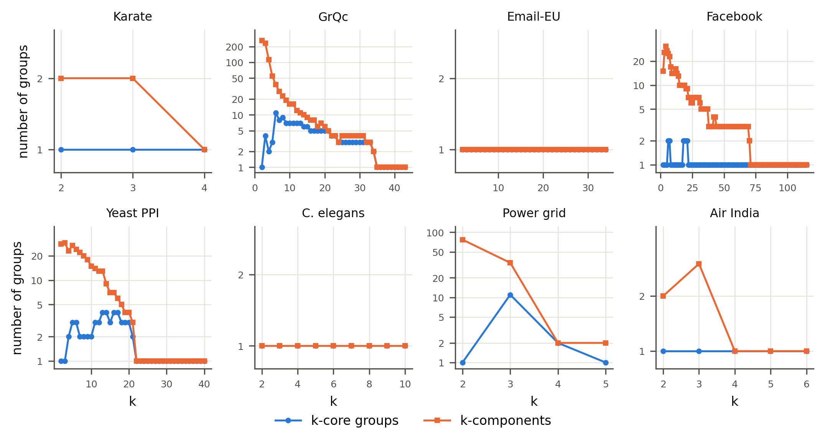
RQ1 · Group by group, they diverge
One connected k-core can hold many overlapping k-components.
260
GrQc: 1 connected 2-core holds 260 2‑components.
Up to 7.7×
more cohesive groups (power grid); none in Email-EU, C. elegans.
Gap tracks clustering and assortativity, not domain.
Orange: k-components; blue: connected k-core groups (log scale)
Notes:
Here is where the notions really differ. For every k we count how many connected groups the k-core has, and how many k-components. In Email-EU and C. elegans the lines coincide: every k-core group is fully cohesive. In GrQc, Facebook, Yeast and the power grid, a single k-core splits into many overlapping cohesive groups. Fragmentation grows with network size, so we do not interpret it alone. The size-normalised group Jaccard tracks transitivity and assortativity instead, and the null model on the next slide separates structure from size.

Slide 8
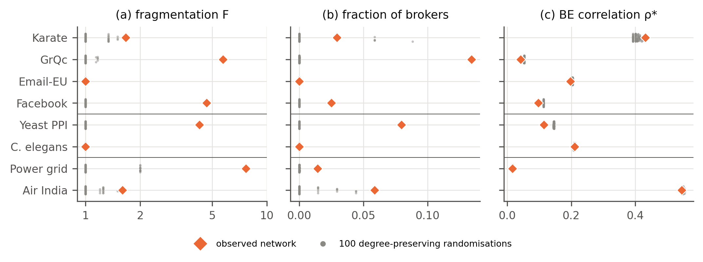
The group-level gap is real structure, not chance
In 100 rewired copies per network the gap vanishes: fragmentation ≈ 1, no brokers — as Łuczak’s theorem predicts for random graphs.
GrQc, Facebook, Yeast, power grid: observed values above all 100 copies (p = 0.02). BE fit is lower than random in 5 of 8.
Degree-preserving double-edge swaps, 10 × M swaps each
Notes:
Is the group-level gap just a consequence of the degree sequence? We rewire each network 100 times keeping every node's degree. In the rewired copies the gap disappears: k-cores become fully cohesive, fragmentation goes to 1 and brokers vanish, exactly as Łuczak's 1991 theorem says for random graphs. For GrQc, Facebook, Yeast and the power grid the real values lie above all 100 copies, the strongest result a 100-sample test can give. A side finding: the Borgatti–Everett fit is lower in the real networks than in their random versions — so it is the cohesion structure, not the density-based core–periphery fit, that carries non-random signal.

Slide 9
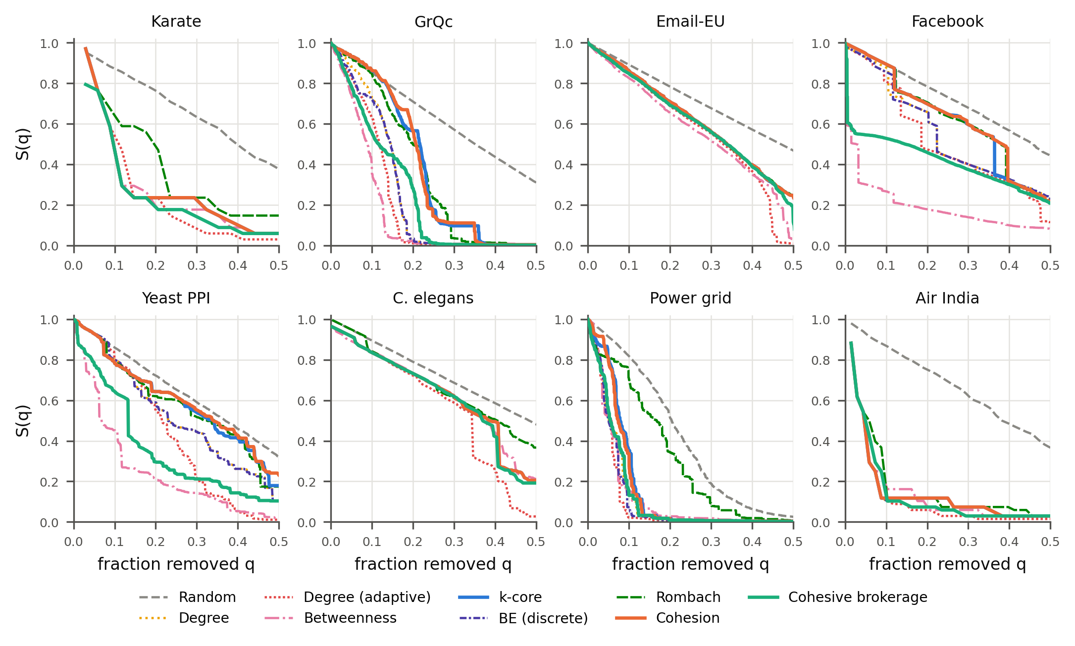
RQ2 · Brokers, not levels, find the critical nodes
Cohesion ≈ k-core: ΔR = +0.002, CI [−0.001, 0.005]. H2 not supported.
Brokers first beats k-core and cohesion in 8/8 networks; up to 44% lower R.
Gain tracks group disagreement: ρ = 0.88, p = 0.004.
Betweenness still best on 4 networks; adaptive degree beats brokerage on 6 — reported honestly
Notes:
Robustness: remove nodes in score order and watch the giant component. Because coreness and cohesion are the same ranking, their attacks are the same — H2 fails, and both are worse than plain degree. But a new score from the cohesion hierarchy, cohesive brokerage, the number of extra k-components a node belongs to, beats both in every network and cuts R by a third or more on Facebook, GrQc and Yeast. The gain is largest exactly where the group-level disagreement is large. It is not a universal winner: betweenness and adaptive degree remain strong baselines, and we say so. With eight networks and Holm correction no p-value goes below about 0.09, so we rely on effect sizes: rank-biserial −1 versus k-core.

Slide 10
Brokerage is more than articulation points
Robustness R (lower is better) | Degree | Articulation pts | Brokers k=2 | Brokers k≥3 | All levels
Facebook | 0.295 | 0.283 | 0.283 | 0.224 (best) | 0.224 (best)
Yeast PPI | 0.274 | 0.198 | 0.230 | 0.240 | 0.185 (best)
GrQc | 0.131 | 0.135 | 0.126 (best) | 0.128 | 0.128
Power grid | 0.063 | 0.113 (worst) | 0.065 | 0.063 (best) | 0.065
The signal lives in the higher levels of the cohesion hierarchy: on Facebook only k ≥ 3 brokers help, on Yeast only the full hierarchy reaches the best R, and plain articulation points hurt the power grid.
All orderings remove flagged nodes first, then the rest by degree
Notes:
The obvious objection: brokerage at k = 2 is just articulation points, which everyone knows are critical. This ablation answers it. Classical articulation points cut off tree branches; on the power grid removing them first is much worse than degree. On Facebook, the entire gain comes from brokers at k of 3 or more, i.e. small sets that glue together dense friend circles. On Yeast, neither part alone is enough; only the full multi-level hierarchy gets to 0.185. So the contribution needs structural cohesion proper, not just biconnectivity.

Slide 11
RQ3 · Hybrids do not help on held-out networks
H(λ) = λ·rank(coreness) + (1−λ)·rank(x)
λ tuned on training networks, tested only on held-out ones (2-fold by domain and leave-one-out).
core + cohesion
core + brokerage
0 held-out wins against the better single score; λ* flips between 0 and 1. Two near-identical rankings cannot complement each other. H3 not supported.
Every training fold picks λ* = 0, i.e. pure brokerage. Adding coreness only hurts: the best “hybrid” is brokerage itself.
Tuning and testing on the same networks would have overstated any hybrid gain
Notes:
We planned a hybrid score and evaluated it properly: λ is chosen on training networks and reported only on held-out networks, both with a domain-stratified 2-fold split and leave-one-network-out. The core-plus-cohesion hybrid never beats its better component — unsurprising once we know the two are the same ranking. For core-plus-brokerage the training folds always choose λ = 0. We report this negative result openly: it is exactly the overfitting trap the held-out design was built to catch.

Slide 12
They agree on who is central, not on how the centre is organised
Ranking only? Use the k-core — it matches cohesion levels (ρ ≥ 0.99) at linear cost.
Organisation? Check cohesion: a k-core may be a federation of overlapping cohesive groups.
Vulnerability? Brokers between k-components are critical, most where groups disagree.
Limits: 8 networks, static attacks, unweighted graphs, degree-only null model.
Next: adaptive brokerage, weighted cohesion, clustering-preserving null models.
Code, data pipeline and paper: reproducible with fixed seeds · Questions?
Notes:
Three takeaways. If you only need a ranking of nodes, the k-core is enough — it matches cohesion levels almost perfectly at linear cost. If you care about how the core is organised, compute cohesion: a k-core can be a federation of cohesive groups. And if you care about vulnerability, the brokers between those groups are where to look. Limitations: eight networks, static attacks, unweighted undirected graphs, and a null model that preserves degrees but not clustering. Future work: an adaptive version of brokerage, weighted cohesion, and clustering-preserving null models.

