Slide 1
LittleHelp
Home services website
sujaramesh@GitHub

Slide 2
Description
This app is created by the HOA of a subdivision for its residents. This app will help the residents to fetch contact information of the service providers like handymen, plumbers, lawn mowers, babysitters, housekeepers etc.

Slide 3
Features
The service providers can log in with user id and password
The new service provider can sign up
Users can browse to get the information about the service providers

Slide 4
Planning – User Stories
Service providers need a valid credentials to enter their details in the LittleHelp DB
The users can see the list of service providers in the LittleHelp DB
The users can avail the list of particular service provider by clicking the specific service provider tab

Slide 5
Technology
C#/.NET (Entity Framework)
Bootstrap
SQL Server
LINQ

Slide 6
DEMO

Slide 7
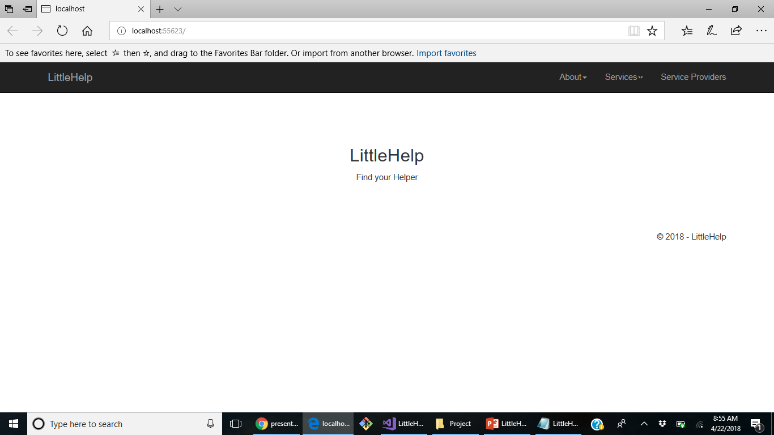
Demo – Home Page

Slide 8
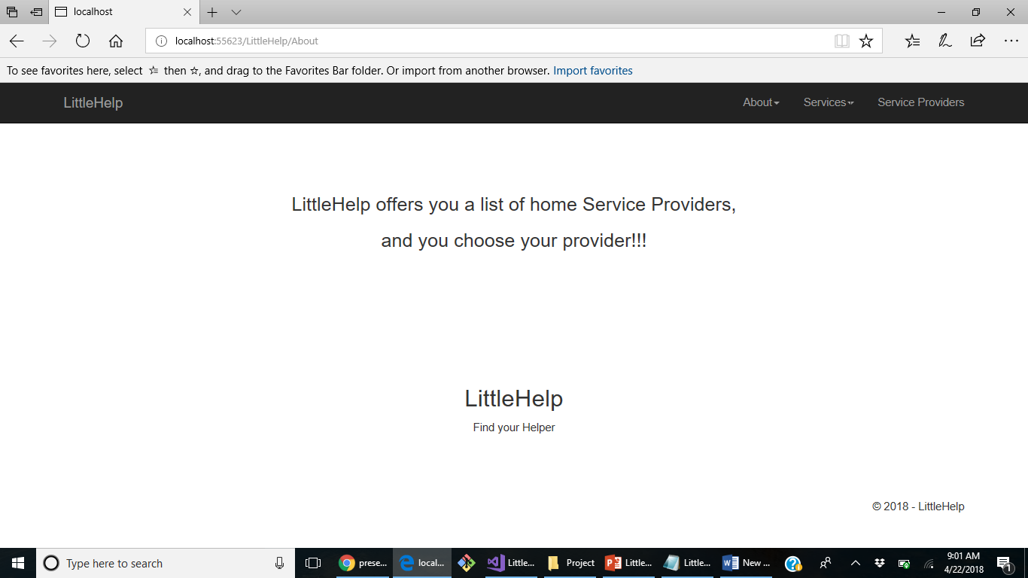
Demo - About

Slide 9
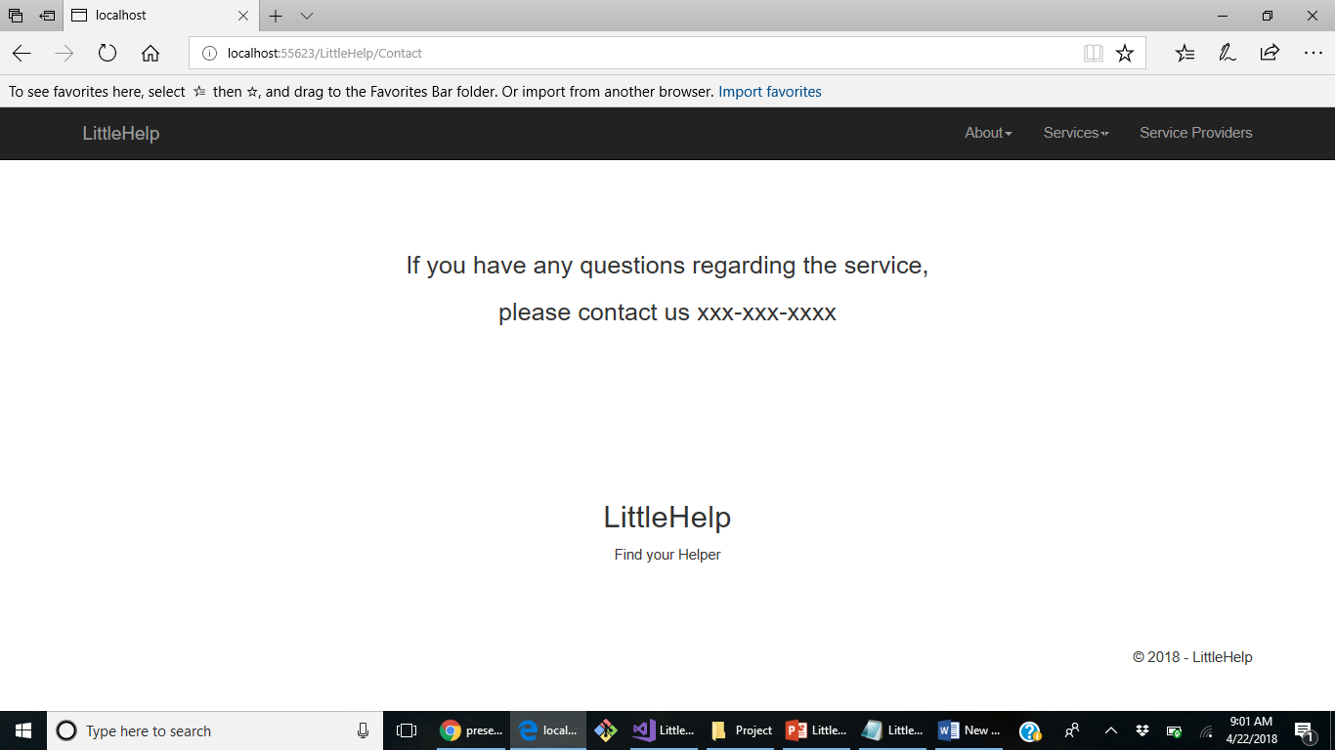
Demo – Contact us

Slide 10
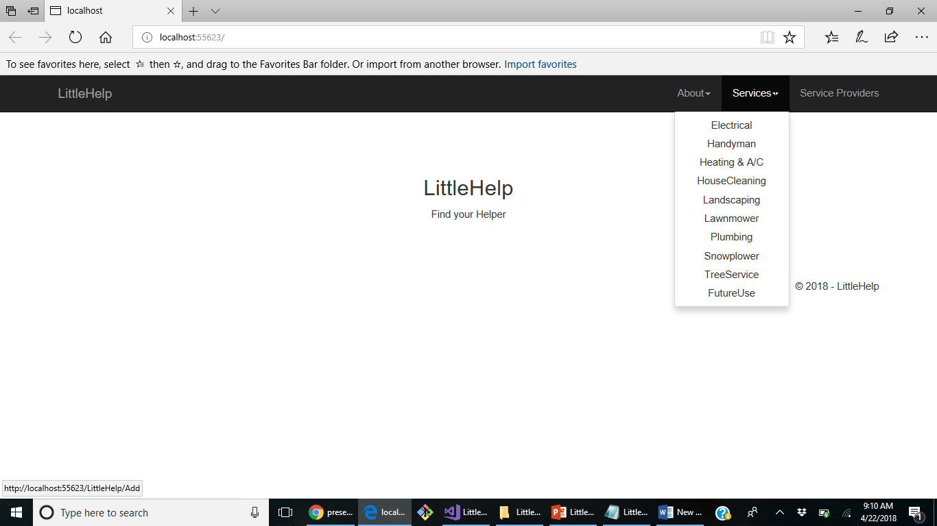
Demo - Services

Slide 11
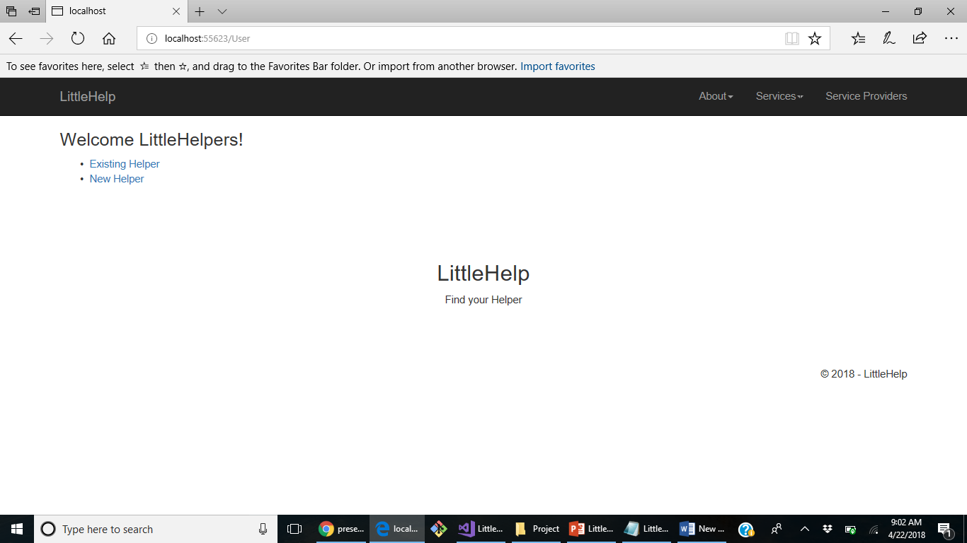
Demo – Service Providers

Slide 12
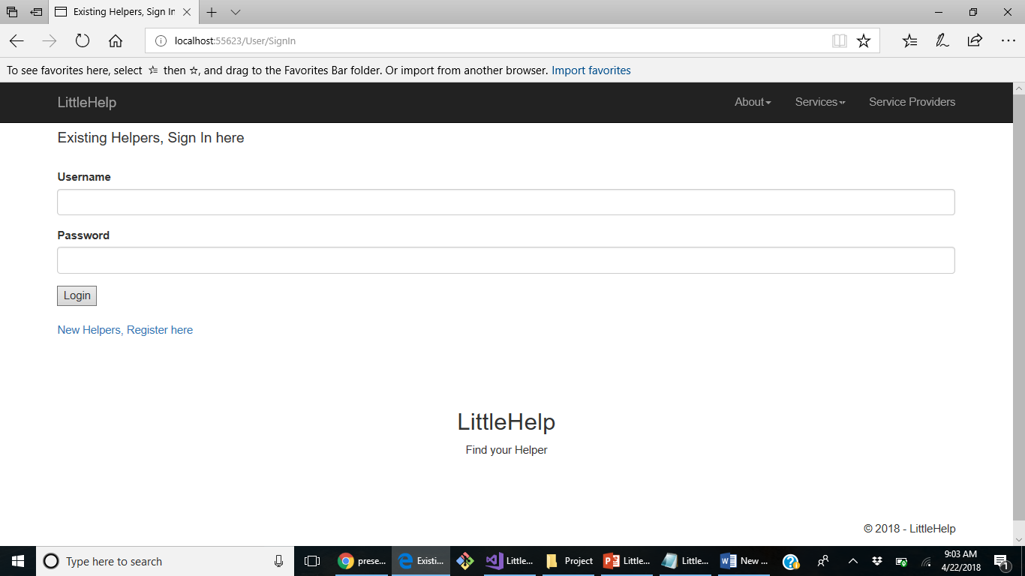
Demo – Existing Helper

Slide 13
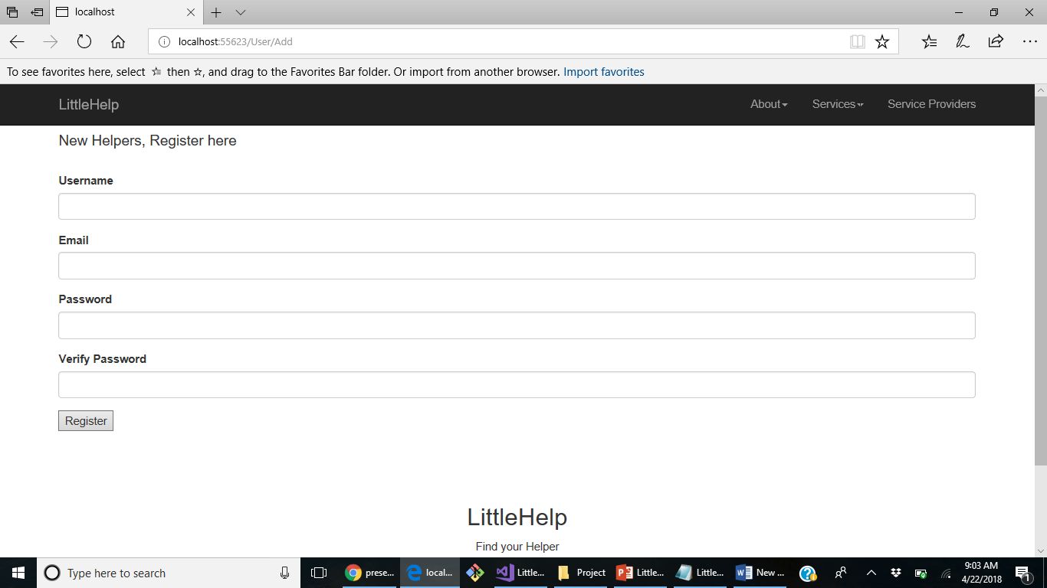
Demo – New Helper

Slide 14
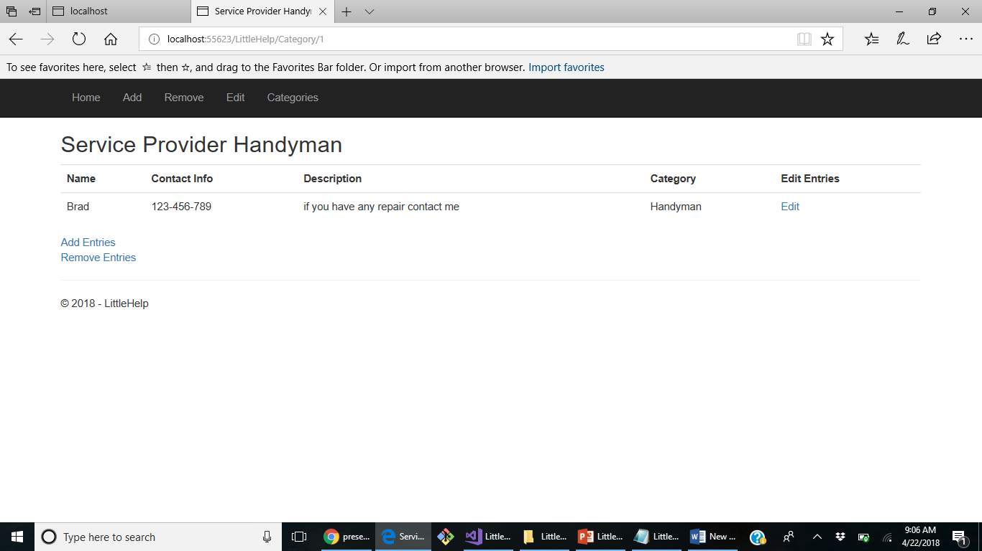
Demo - Handyman

Slide 15
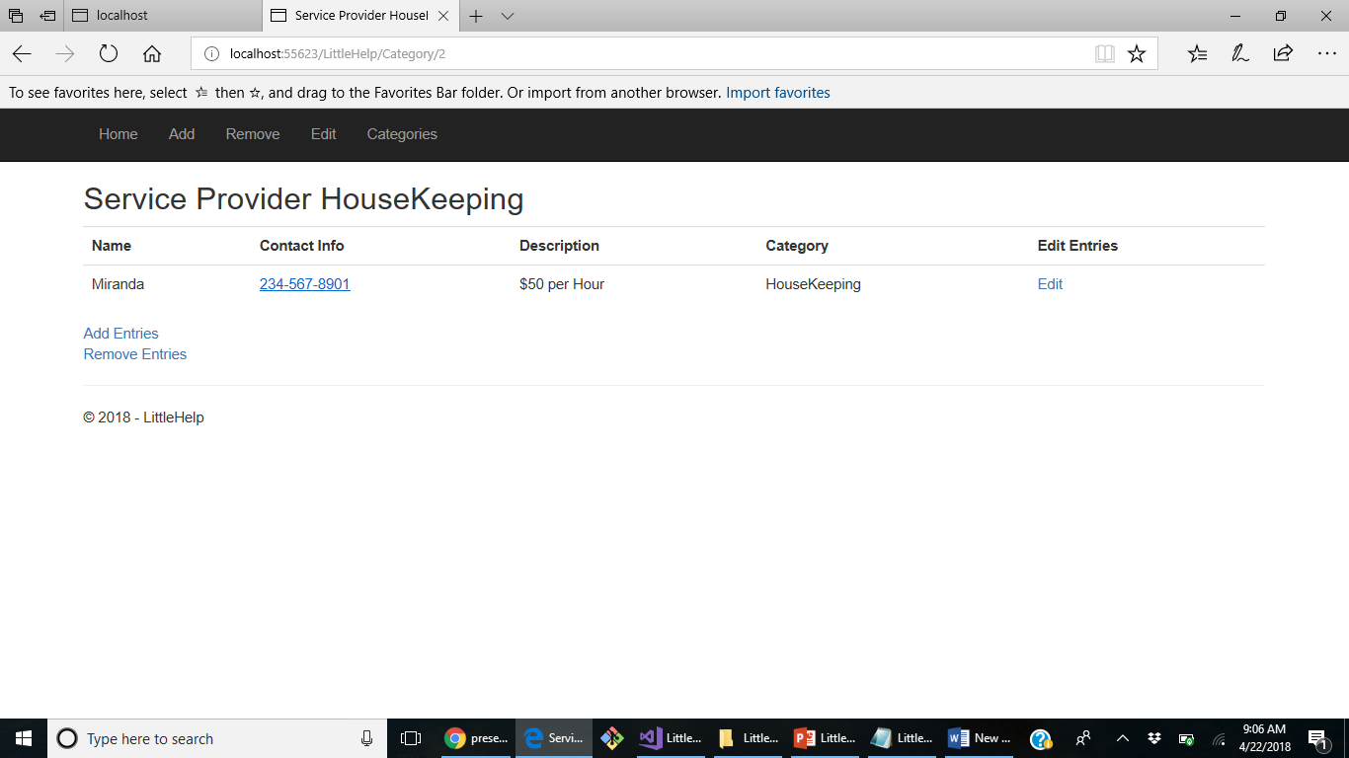
Demo - Housekeeping

Slide 16
What I learned
User Stories
Wire Framework
I became more familiar with the concepts of MVC and Entity Frame work

Slide 17
Next Step
To implement the user log in via Google Authentication
To implement resident-to-resident service sharing within the subdivision, where the user can log their issues or the service they require; the service providers can see the list of request and can fulfill them in one visit.

Slide 18
Thank You!

