Slide 1

New York Airbnb Listings EDA
By : Sujata Gandhavarapu

Slide 2

AGENDA
Project Objective
Analyze rental listing patterns
Understand pricing trends
Identify popular neighborhoods
Study relationship between reviews and price

Slide 3

Dataset overview
Dataset: New York Airbnb Listings Records: ~20,758 listings
Key features:
price
room_type
neighbourhood
number_of_reviews
availability_365
rating

Slide 4

Data Cleaning
Steps Performed
Removed duplicate records
Handled missing values
Converted rating column to numeric
Treated price outliers

Slide 5
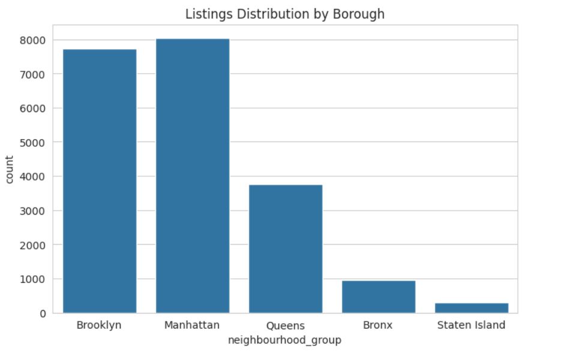
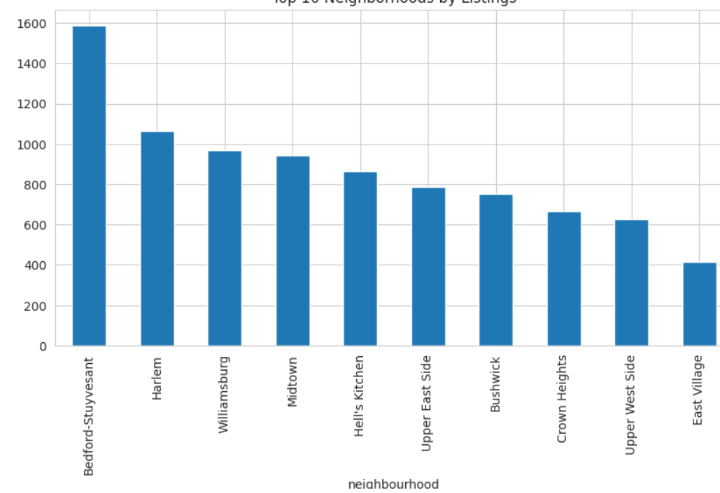
Key Visualizations
Borough distribution
Top neighborhoods

Slide 6
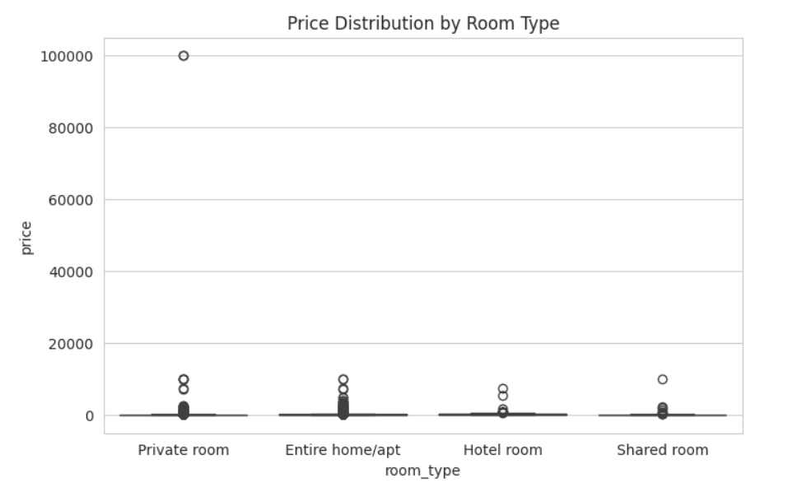
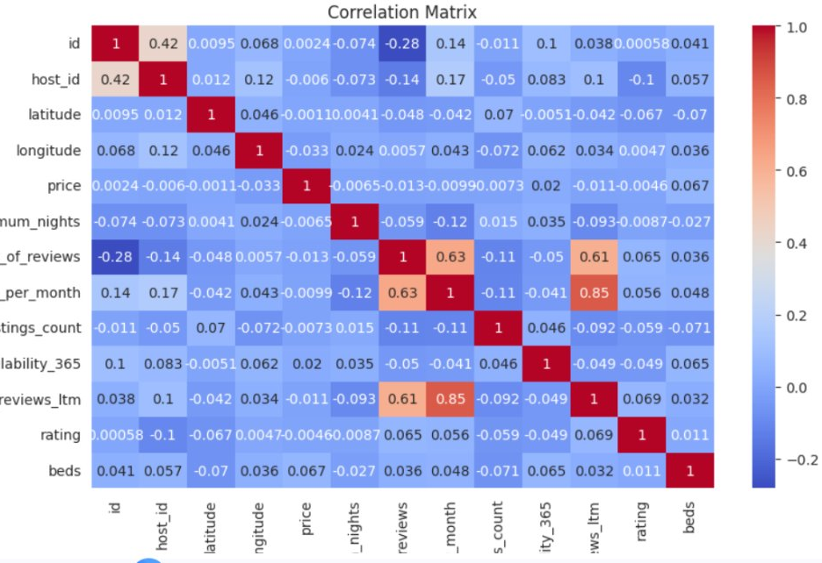
Key Visualizations
Correlation heatmap
Price vs Room Type

Slide 7

Key insights
Manhattan has the highest price range.
Entire homes are the most expensive property type.
Brooklyn has a high listing density.
Lower priced listings receive more reviews.

Slide 8
conclusion
EDA helps understand:
Pricing trends
Location demand
Host activity
Customer booking behavior

Slide 9
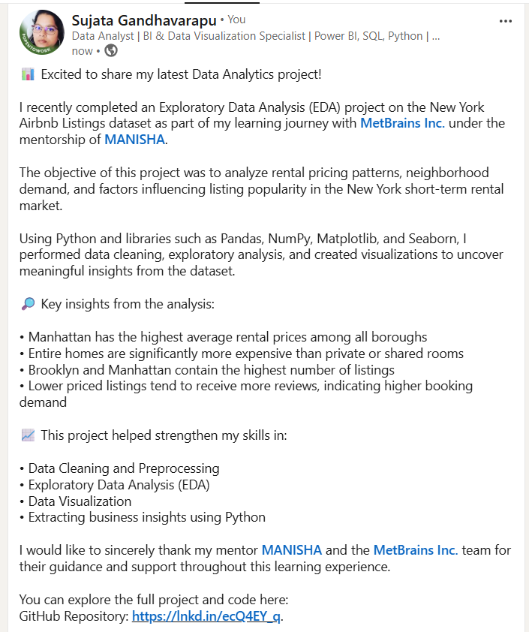
Linkedin post

Slide 10

THANK YOU
sujata
Ph: +46734847131
Mailid: sujata.gandhavarapu@gmail.com
https://www.linkedin.com/in/sujata-279863aa/

