Slide 1
BIT216 · SOFTWARE ENGINEERING PRINCIPLES
FreshGuard
Guarding Food from Waste
Assignment 2 · Iteration 1 Presentation
Working Prototype • Test Cases • Git Collaboration • Project Progress
Presented by (Individual — Iteration 1)
Simran Gopali
Student ID: E2300579
Team: Shraddha Sedhai · Sujata Bajracharya
Due: 24 July 2026

Slide 2
INTRODUCTION
Meet the Team & Project Aim
SG
Simran Gopali
SB
Sujata Bajracharya
SS
Shraddha Sedhai
E2300579
E230058
E2400153
PRESENTING TODAY
TEAM MEMBER
TEAM MEMBER
UC1 Register & Privacy · UC4 Food Analytics
UC2 Manage Inventory · UC5 Notifications
UC3 Browse Items · UC6 Meal Planning
!
PROJECT AIM
Help Malaysian households cut food waste through intelligent inventory management, expiry alerts, donation facilitation, and responsible meal planning while keeping user data and account privacy secure.
02

Slide 3
PROJECT RECAP
Objectives from Assignment 1
1
Secure User Authentication
2
Food Inventory Management
3
Automated Notifications
Registration, login, privacy controls and Two-Factor Authentication (2FA).
Add, edit, delete and track food items with expiry dates.
Alerts for items nearing expiry, meals, and donations.
4
Weekly Meal Planning
5
Food Donation Platform
6
Analytics Dashboard
Generate meal plans from available ingredients and recipes.
List, claim and coordinate surplus food with the community.
Charts and reports on food saved, waste reduced and donation impact.
03

Slide 4
ITERATION 1 SCOPE
What This Presentation Covers
UC1
UC4
UC2
UC5
UC3
UC6
Register Users &
Privacy Settings
Food Analytics
Manage Food
Inventory
View Notifications
Browse Food Items
Plan Weekly Meals
ITERATION 1
ITERATION 1
ITERATION 2
ITERATION 2
ITERATION 2
ITERATION 2
Individually developed and tested by Simran Gopali for Iteration 1:
UC1 - Register Users & Privacy Settings: account registration, email verification, login, and 2FA / listing-visibility privacy controls. UC4 - Food Analytics: visual reports on food saved and donations made, driven by logged inventory and donation activity.
04

Slide 5
ARCHITECTURE
Development & Demonstration Platform
Fe
React.js 18
Be
Node.js + Express 20
Db
MySQL 8
Frontend UI
REST API & server logic
Users, items, donations, plans
Gh
GitHub
Jt
Jest + Supertest
Fg
Jt
Version control & collaboration
Automated unit testing
05

Slide 6
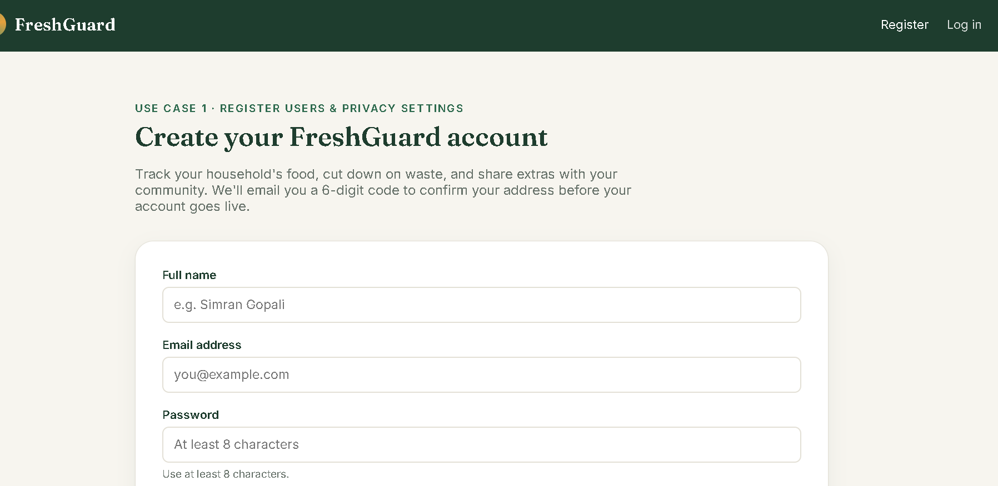
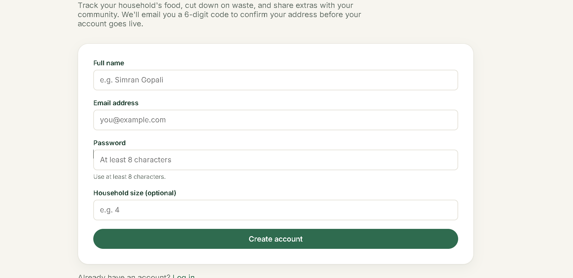

Slide 7
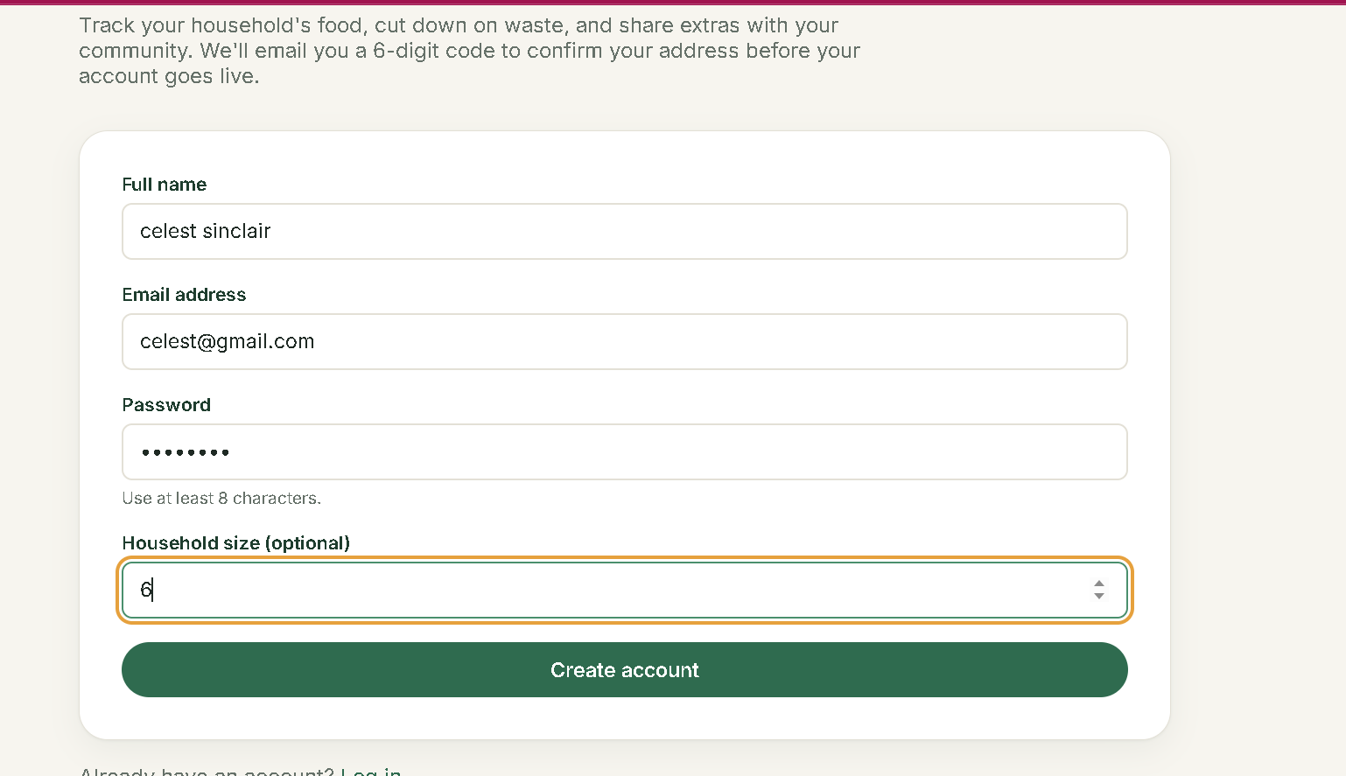

Slide 8
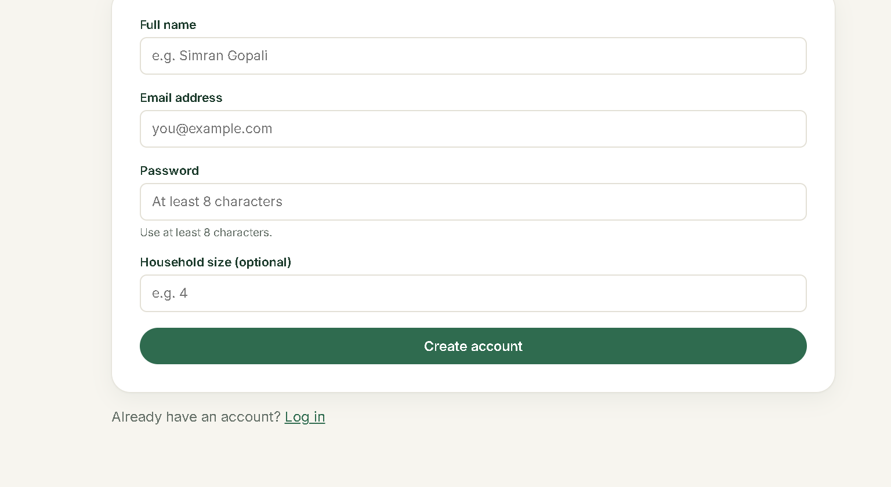

Slide 9
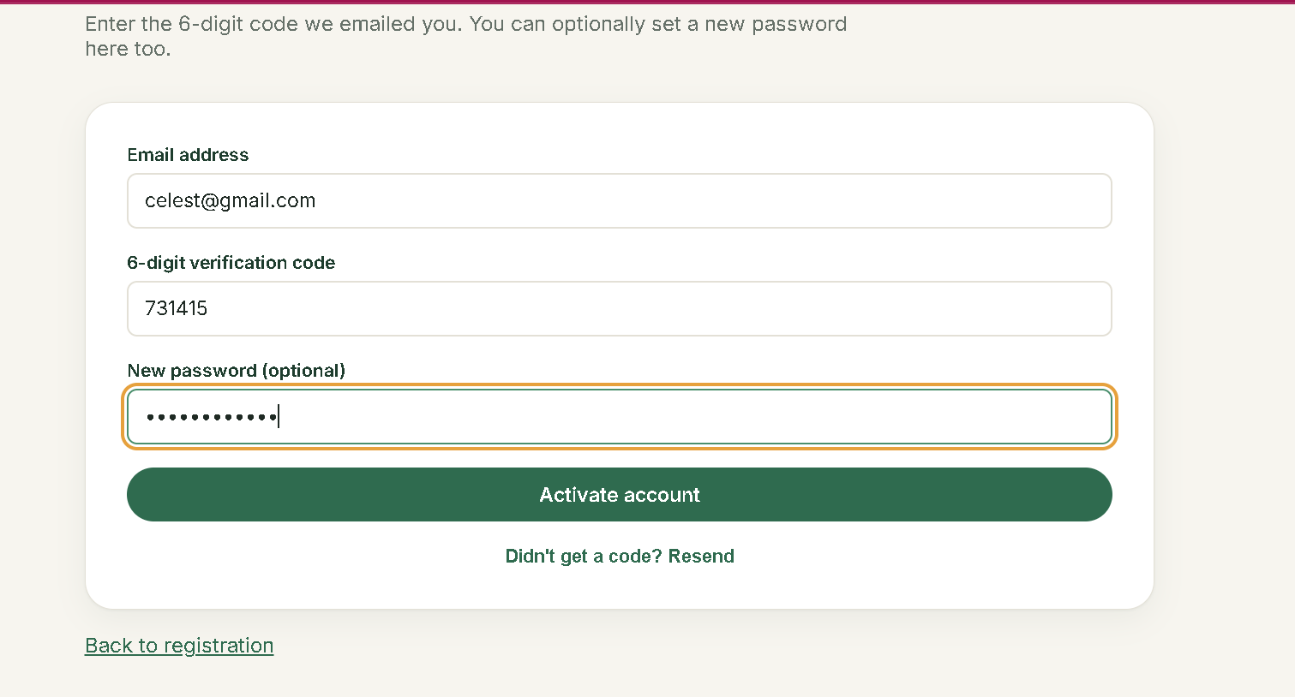

Slide 10
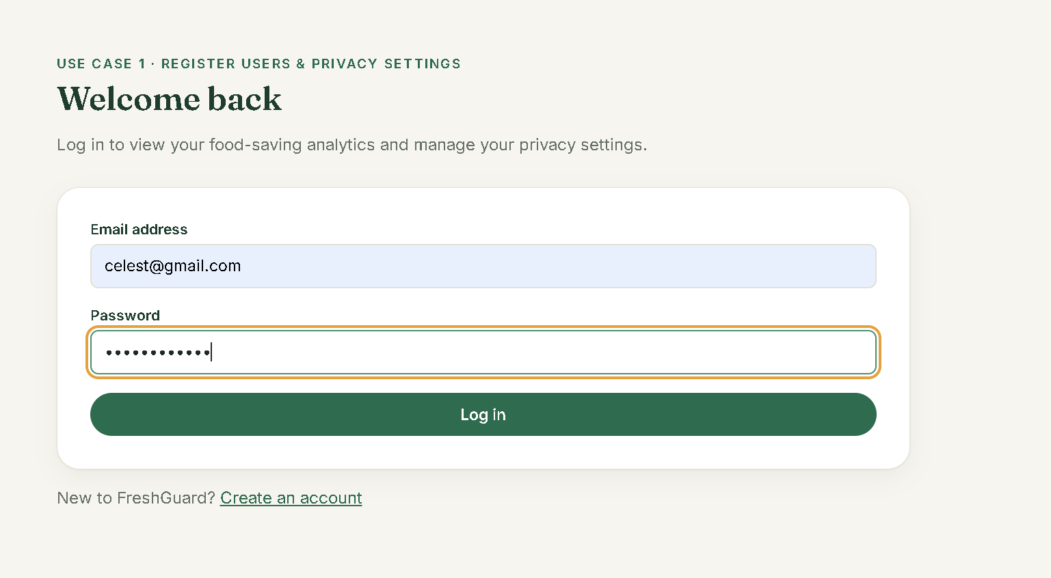

Slide 11
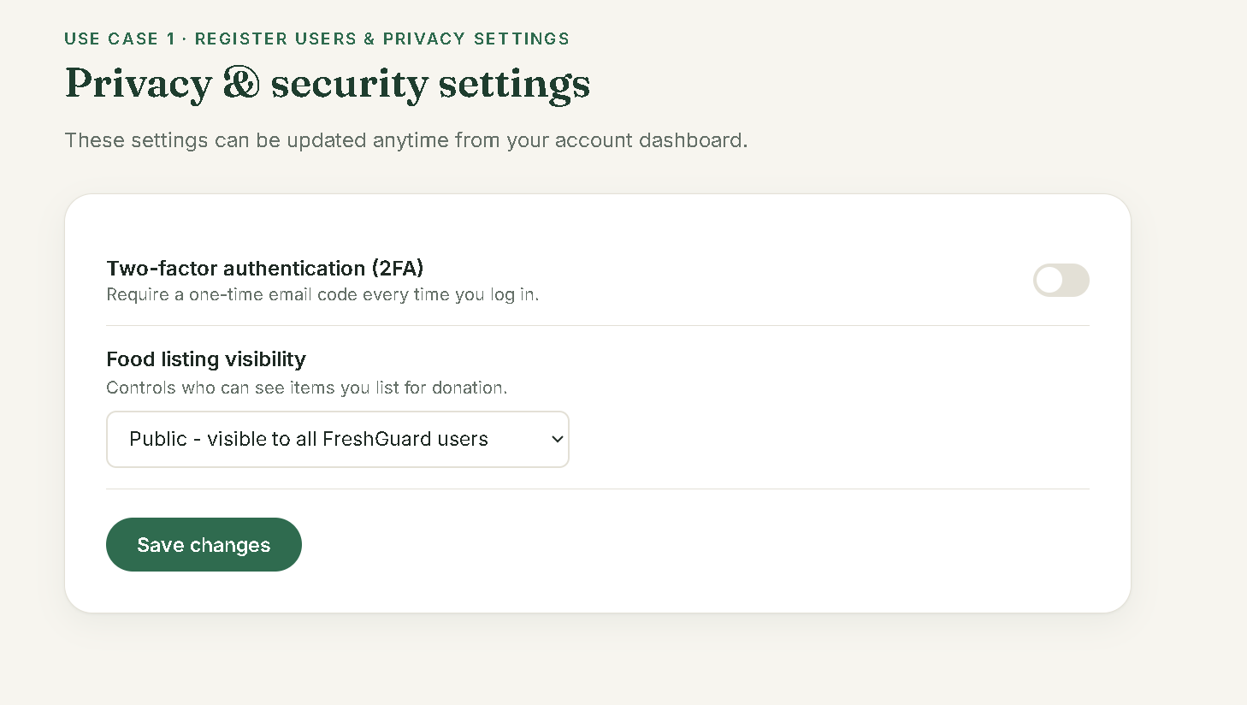

Slide 12
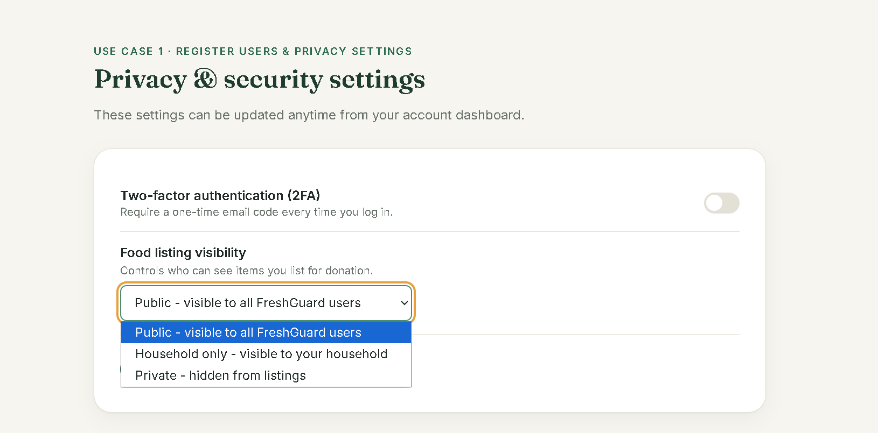

Slide 13
WORKING PROTOTYPE
UC1 — Register Users & Privacy Settings
1
→
2
→
3
→
4
Register
Verify Email
Log In
Privacy Settings
Full name, email, password & optional household size. Server validates and creates the account.
6-digit code emailed to the user; account activates once the code is confirmed.
Verified users sign in; unverified accounts are redirected to re-verify automatically.
Toggle 2FA and set listing visibility (public / household-only / private) anytime.
i
Backend: authController.js (Node/Express + MySQL). Passwords hashed with bcrypt; sessions issued as JWTs. Handles duplicate-email and expired/invalid-code cases from the SavePlate case study.
06

Slide 14
WORKING PROTOTYPE
UC4 — Food Analytics Dashboard
From the dashboard, users open “Track & Report” to see how their habits are reducing waste.
FOOD SAVED (MOCK DEMO DATA)
12.4 kg
Retrieves logged activity from inventory & donation records
Displays charts and progress indicators: food saved, donations made
DONATIONS MADE
Filters the report view by date range or category
8
Encourages continued engagement with an empty-state prompt when no data exists yet
ITEMS NEARING EXPIRY
3
07

Slide 15
TESTING
Test Objectives & Plan
Testing Type | Approach | Tools | Schedule (WBS)
Unit Testing UC1 & UC4 | White box (source-code access), automated | Jest + Supertest (MySQL pool mocked) | WBS 4.2–4.3 code → WBS 4.5 Unit Testing Week 8 Fri – Week 9 Mon
System Testing | Black box, manual browser testing (React dev server + API) | Manual (Selenium planned for Iteration 2) | WBS 4.6 Integration Testing → WBS 4.7 Prototype Complete, Week 9 Thu
REQUIREMENTS TESTED
FR-01–FR-04 Registration & validation · FR-05–FR-07 Email verification & login · FR-08 Privacy settings · FR-09–FR-11 Food Analytics
Derived directly from the SavePlate/FreshGuard case study Use Case 1 & 4 expanded descriptions and the implemented controller logic.
08

Slide 16
TESTING
Sample Test Cases & Results
ID | Scenario | Type | Result
TC1 | Register with valid, complete data | Positive | Pass ✓
TC2 | Register with required fields left blank | Negative | Pass ✓
TC5 | Register with an already-registered email | Negative | Pass ✓
TC8 | Enter an expired verification code | Negative | Pass ✓
TC10 | Log in with an incorrect password | Negative | Pass ✓
TC12 | Enable 2FA & set listings to private | Positive | Pass ✓
19 / 19
AUTOMATED TESTS PASSING
npm test (Jest + Supertest)
backend/tests/auth.test.js
backend/tests/analytics.test.js
Positive & negative scenarios covered per the assignment brief.
Full 13-case UC1 suite (plus UC4 analytics cases) documented in FreshGuard_Testing_Iteration1.xlsx, following the module's Test Case template.
09

Slide 17
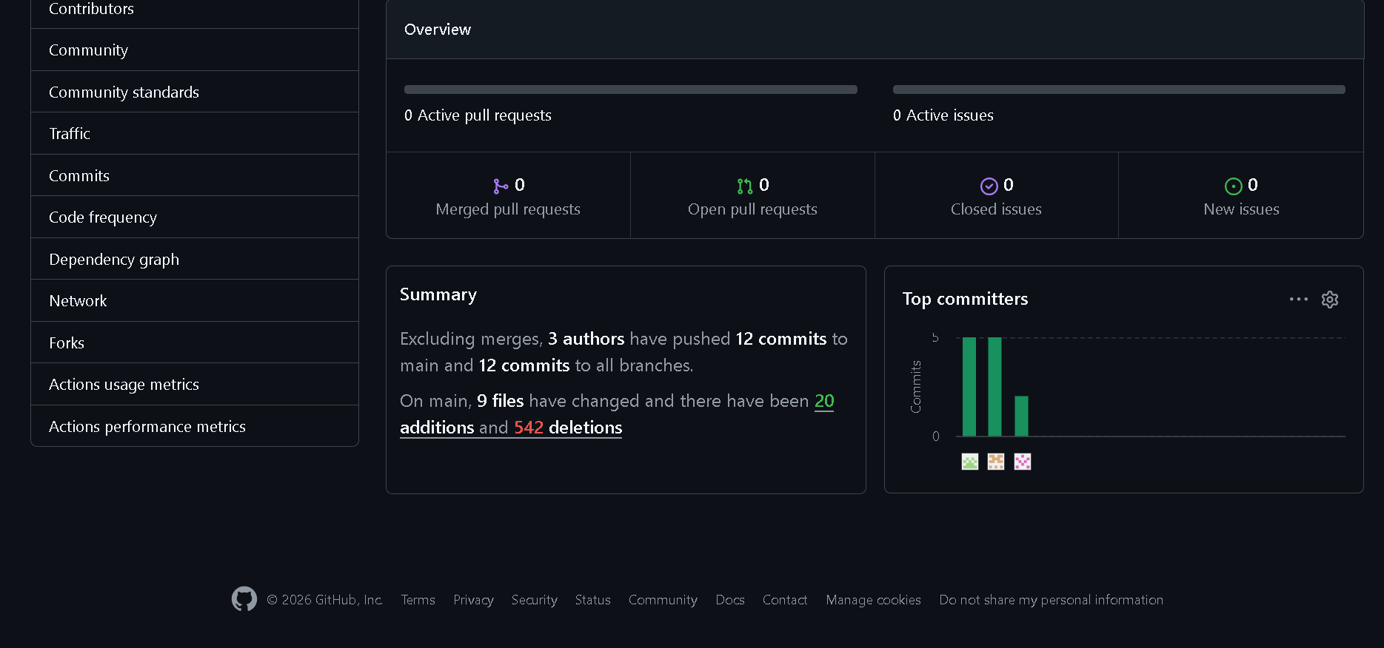
COLLABORATION
Git & Version Control
Repository Structure
Team Workflow
This Iteration
/backend — Express API, controllers, tests
Work split by use case ownership (UC1/UC4, UC2/UC5, UC3/UC6)
Backend auth & analytics modules committed and pushed
/frontend — React app, pages, styles
Feature-level commits pushed to GitHub as each use case is implemented
Automated Jest test suite added alongside implementation
.env kept out of version control via .gitignore
GitHub used for source control, versioning and backup across iterations
Ready for peer review before Iteration 2 merges
🔲
Add a GitHub commit-history / branch-graph screenshot here before presenting
(shows commit frequency and branch/merge activity for UC1 & UC4 from Assignment 1 through this submission)
10

Slide 18
PROJECT PROGRESS
Milestones vs. Baseline Schedule
✓
M1
Project Planning Complete
Week 3
ON TRACK
✓
M2
Gantt Chart Baseline (.gan)
Week 2
ON TRACK
✓
M4
Requirements Spec Document
Week 5
ON TRACK
✓
M5
Design Document Complete
Week 7
ON TRACK
✓
M6
Iteration 1 Prototype (UC1, UC4)
Week 9
ON TRACK
M7
Iteration 2 Complete (UC2,3,5,6)
Week 11
UPCOMING
11

Slide 19
REFLECTION
What Went Well & Risk Management
✓
What Went Right
!
What Could Improve
UC1 and UC4 were scoped, coded and unit-tested on schedule against the Iteration 1 milestone (Week 9).
Scope creep risk: kept feature set aligned strictly to UC1/UC4 acceptance criteria to protect the Iteration 1 deadline.
Automated Jest + Supertest suite (19/19 passing) gave fast, repeatable regression checks while building.
Firebase/MySQL quota and integration risk: mitigated with mocked DB calls in unit tests and local Firebase Emulator checks.
Case-study alternative courses (e.g. duplicate email, expired code) were mapped directly to negative test cases.
Selenium/system-level automated testing is deferred to Iteration 2, as planned in the assignment brief.
12

Slide 20
LOOKING AHEAD
Iteration 2 — Due 21 August 2026
1
Implement UC2, UC3, UC5, UC6
2
Selenium Automated Testing
Manage Inventory, Browse Items, Notifications, Meal Planning
Extend automated coverage to full system / black-box testing
3
System Integration & UAT
4
Final Gantt & Git Review
End-to-end testing across all six use cases
Compare actual progress to baseline; consolidate Git evidence
13

Slide 21
Thank You
Questions & Discussion
Simran Gopali · E2300579
BIT216 Software Engineering Principles
14

