Slide 1
LMSLocalLibrary
A Library Management System
By Sujata Naik

Slide 2
About me
a returning software engineer
excited to build elegant software solutions
enjoy gardening
enjoy reading to little children!

Slide 3
Use case
LMSLocalLibrary is a library management system used by the staff and users of a library.
Library staff are able to:
Run specialized searches (e.g. if title has been checked out, what titles a user has currently checked out etc.)
Add new books to the library’s collection
Edit book information
Edit user information

Slide 4
Use case (continued)
Library users are able to:
Edit their account information
Run basic searches (by title, by author, by category)
Check out books
Renew books
Return books
View their current checkouts

Slide 5
Technologies and tools used
Java 8
IntelliJ
Spring Boot
MariaDB
HTML, CSS (Bootstrap), JavaScript
jQuery

Slide 6
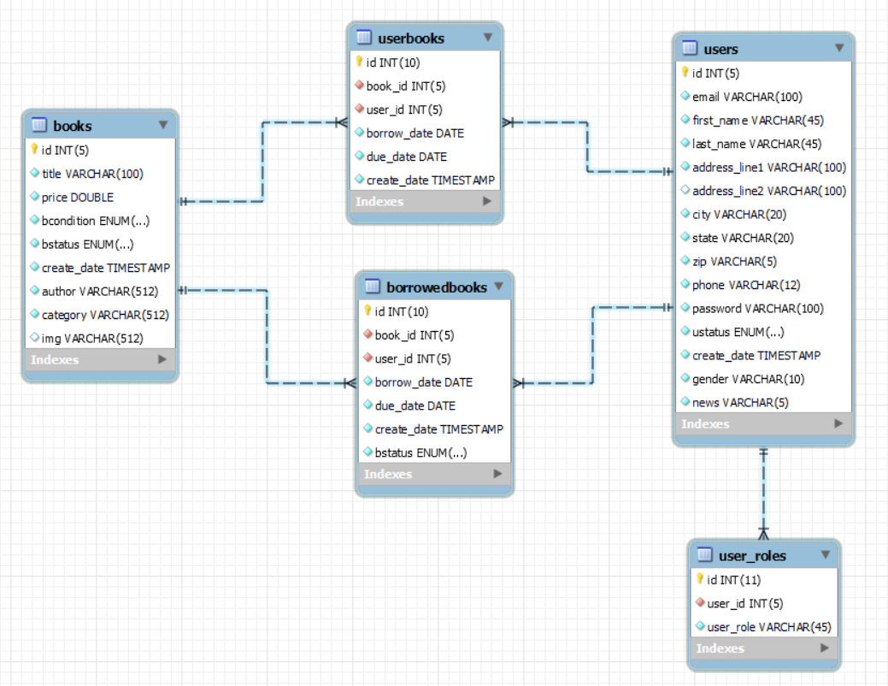
The database

Slide 7
How the application works
Java code connects to the MariaDB database to get/save information about users, books and checkouts. (Spring Data JPA)
Java code sends data from database to JSPs (Model-View-Controller)
Spring Security is used to login, authenticate and authorize users.

Slide 8
What I learned
I can build a meaningful web application myself!
Full stack development (connecting the parts together)
Spring Boot (makes it easy to get started with business logic)

Slide 9
Future improvements to LMSLocalLibrary
Users can create and save lists (of books they want to read next)
Staff can send reminder mails to users 2 days before their books are due.
Users can request books (for staff to reserve the book for that user as soon as the book is returned)

Slide 10
Thank you!

