Slide 1
LMSLocalLibrary
A Library Management System
By Sujata Naik

Slide 2

About me
a returning software engineer from India, living in Minnesota since late 2004
excited to build elegant software solutions
enjoy gardening and yoga
enjoy reading to children!

Slide 3
LMSLocalLibrary
LMSLocalLibrary is a library management system used by the staff and users of a library.
I use my local library’s website and app very frequently and wanted to try implementing some of the features myself.
I built this application in Java (with IntelliJ, Spring Boot) with MariaDB as the database, using HTML, CSS (including Bootstrap), JavaScript and jQuery for the user interface.

Slide 4
User stories
Library staff
Run specialized searches (e.g. if title has been checked out, what titles a user has currently checked out etc.)
Add new books to the library’s collection
Edit book information
Edit user information
Library user
Edit their account information
Run basic searches (by title, by author, by category)
Check out books
Renew books
Return books
View their current checkouts

Slide 5
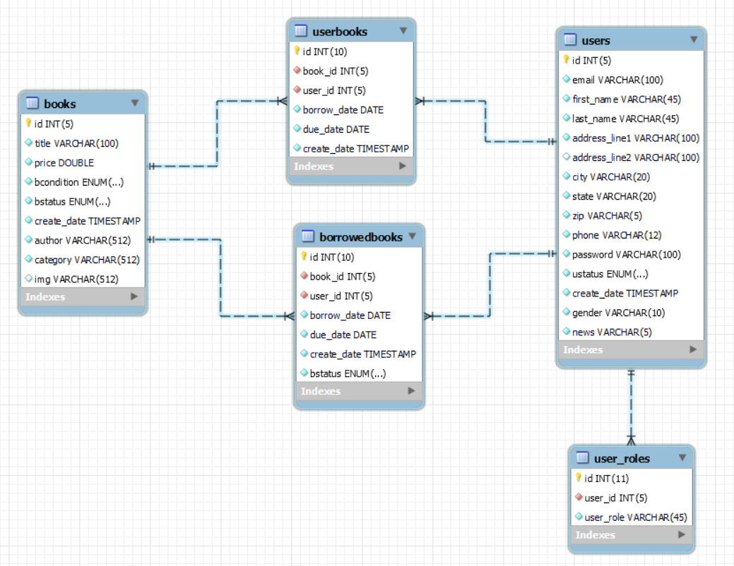
The database

Slide 6
Thank you!

