Slide 1

WEB AND SOCIAL MEDIA ANALYTICS
ON FINDING STRATEGIES TO ADD MORE VALUE FOR
THE BRAND BY PROVIDING MOST IN DEMAND FEATURES TO THE
CUSTOMERS
FOR A MOBILE MANUFACTURING BASED FIRM Sujata Pawar Pradeep Mondal Sharmin Aman

Slide 2


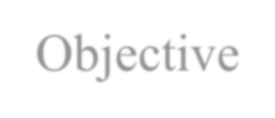
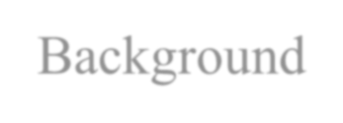




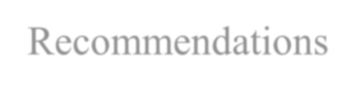
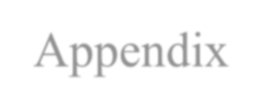



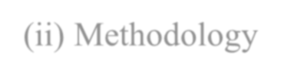
AGENDA
Objective
Background
Key Findings
Recommendations
Appendix
Data source
Methodology

Slide 3


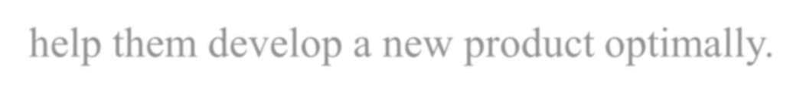
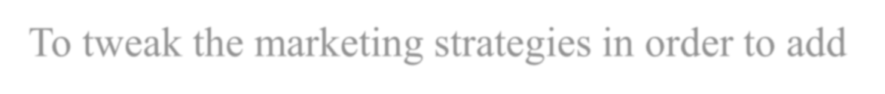
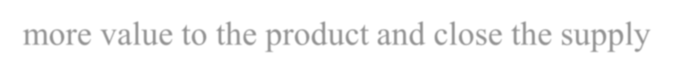

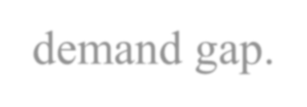
OBJECTIVE
To Provide major insights for a cell phone industry to help them develop a new product optimally.
To tweak the marketing strategies in order to add more value to the product and close the supply- demand gap.

Slide 4

BACKGROUND
As the firm has just entered the mobile market three years ago, they want to understand their competitors and preference of their users, so that they can design their strategies accordingly.

Slide 5


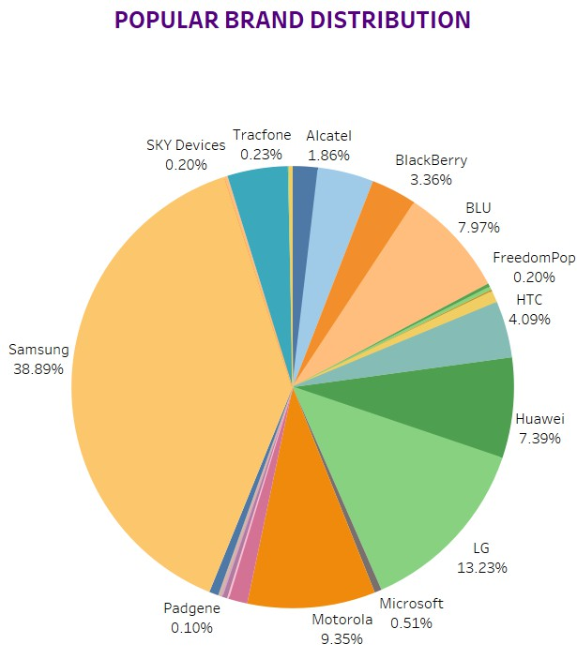
MOST POPULAR BRANDS
The most reviewed brands that has major popularity among users are Samsung(38.89%), Motorola(9.35%), LG(13.23%), Huawei(7.39%), HTC(4.09%),
Blu(7.97%) and Apple(4.04%).
Since now we know how the market is controlled by these competitors, we can focus on the features and services provided by these brands.

Slide 6



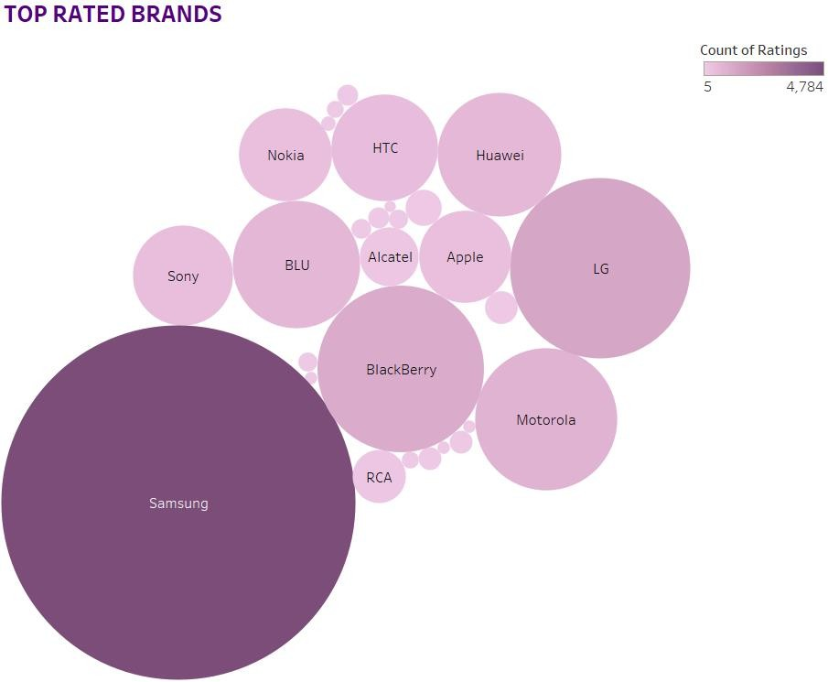
RATINGS OF BRANDS WITH RESPECT TO CUSTOMERS
By Referring the Customers’ Ratings with respect to different brands, we observe that even though Samsung controls the major sector of the market in terms of popularity, still other brands like LG, Apple, Blackberry, HTC, Huawei are positively related.
we must look at the features
provided by these each brand.

Slide 7


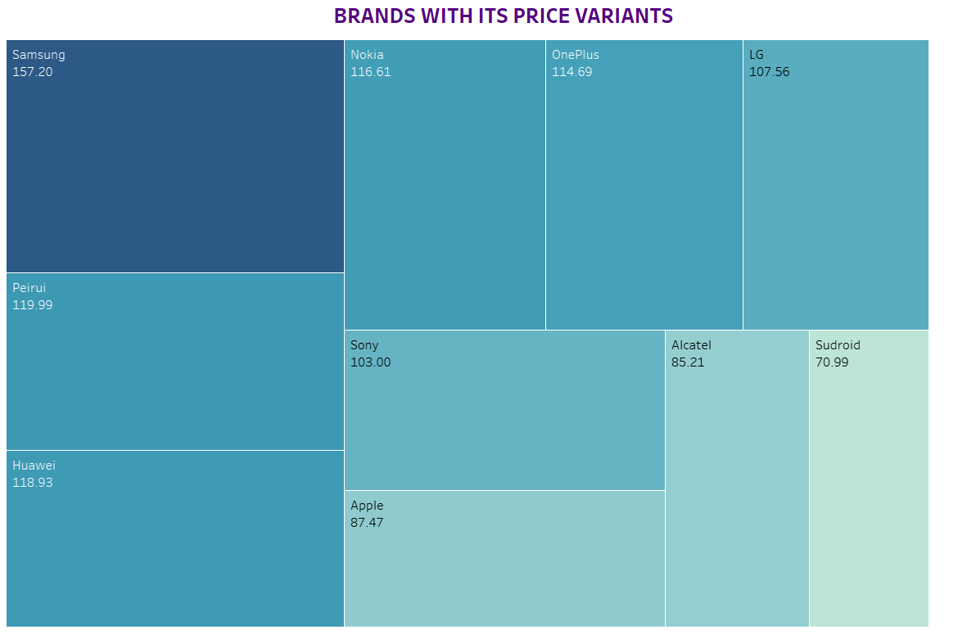
BRANDS WITH PRICE VARIANTS
The price preferred by the customers lies in the range of 150$ - 70$.
This should be the price segment that we should be targeting.

Slide 8



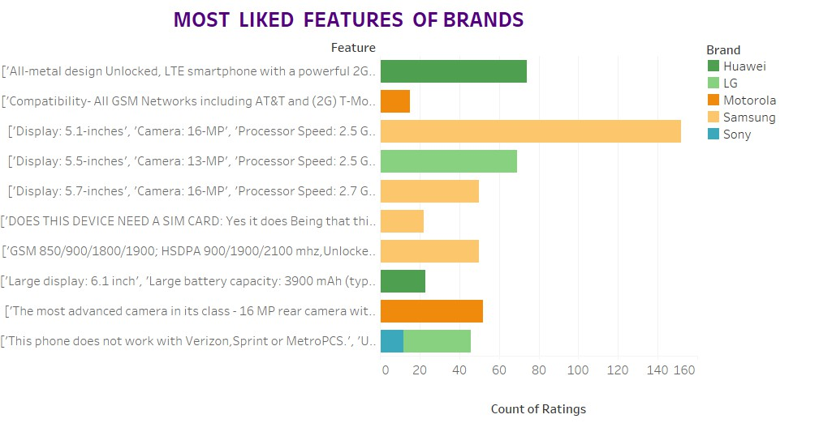
MOST FAVOURED FEATURES WITH RESPECT TO CUSTOMERS REVIEWS
One of the most desired feature includes a Display size of 5.1 inches, Camera with a 16MP rear lens and a processor having 2.5GHz cloaking speed.
Also, the all metal design LTE feature within Android, this gives us an insight that the market we are focusing upon is majorly oriented to open-source platforms.

Slide 9

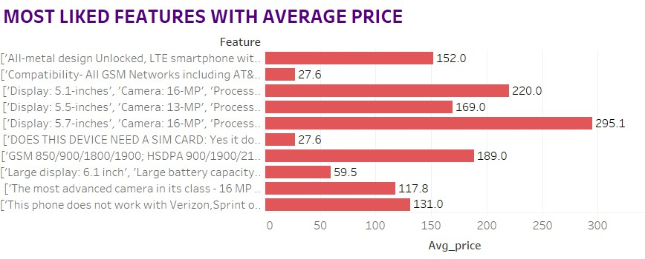
MOST LIKED FEATURE WITH AVERAGE PRICE
Although there are many features which are reviews positively, but we see that not all the features are not cheap and far more than the price range which we are targeting(150$-70$).
The only feature which is favored as well as cost effective includes a display of 5.7 inches, a camera of 16 MP, 2.7 GHz processor along with Android OS.

Slide 10

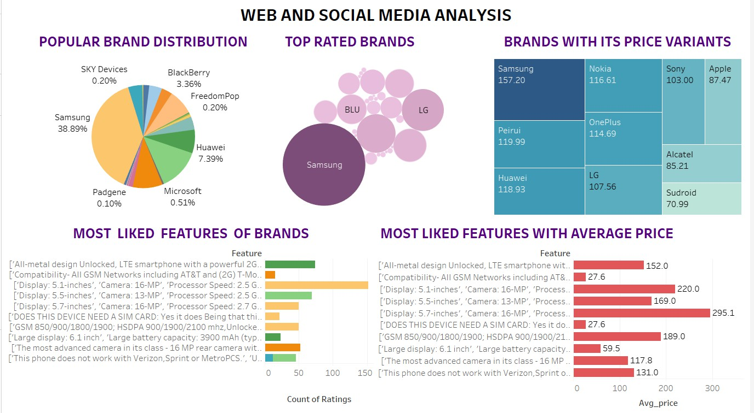
FINAL DASHBOARD OF VISUALISATIONS

Slide 11

RECOMMENDATIONS
Since now we know our competitors include brands like Samsung, Motorola, HTC, Huawei and Apple; we have to keep a keen eye on the services and features offered by them.
The market we are focusing on is a mid range price segment market since the price range preferred is in the range- 150$- 70$. This gives us the segment we need to focus and introduce our range of products in.
Features we must have- 1. Android OS, 2. 5.1-5.7 inches
screen, a processor of 2.7 GHz and a camera of lens 16MP.

Slide 12



APPENDIX
DATA SOURCE:Amazon review data (ucsd.edu)
METHODOLOGY:
Performed cleaning, preprocessing the data.
Done Text Analytics with NLP to review the customer sentiment.
Building Dashboard for visualizations in Tableau for better
understanding.
Building search engine classification using Naive Baiyes ML algorithm.

