Slide 1


INSTITUTE FOR ADVANCED COMPUTING AND SOFTWARE DEVELOPMENT AKURDI, PUNE
PROJECT PRESENTATION ON
Chatbot-Hotel-Booking
PG-DBDA SEP 2022
Submitted By:
Group No: 08
Sujata Shriram 229348 (PRN : 220941225049)
Pooja Wankhede 229331 (PRN : 220941225032)
Mr. Rohit Puranik
(Centre Coordinator)
Dr. Shantanu Pathak
(Project Guide)

Slide 2
INTRODUCTION
Chatbots, or conversational interfaces as they are also called, introduce a new way for people to interact with computer systems. Traditionally, to get an answer to a question using software, you would use a search engine or fill out a form. A chatbot allows a user to simply ask questions the same way they would to a human.
The chatbot is a computer program that humans will interact with in a natural spoken language and includes artificial intelligence techniques such as NLP (natural language processing) that makes the chatbot more interactive and trustworthy.
PROBLEM STATEMENT
Chatbot-Hotel-Booking.

Slide 3
OBJECTIVE
The aim of this project is to book hotel using chatbot, the chatbot should be able to respond user questions. Chatbot is a computer program which is made in such a way than can understand human language. Chatbots can simulate the human conversation that usually found in call center or service center by using natural language processing to adapt the responses to fit in the following situation.
Therefore, the aim of this project is to book hotel using chatbot, the chatbot should be able to respond user questions.

Slide 4
SOFTWARE AND HARDWARE REQUIREMENT
OS – Windows 7, 8 and 10 (32 and 64 bit) .
RAM – 8GB 3.2 SOFTWARE .
Python 3.10.9
TensorFlow.
RASA 3 Library.
Anaconda3

Slide 5
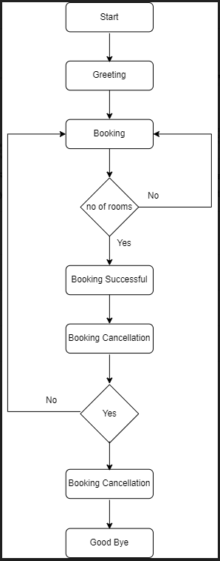
WORKFLOW OF PROJECT

Slide 6
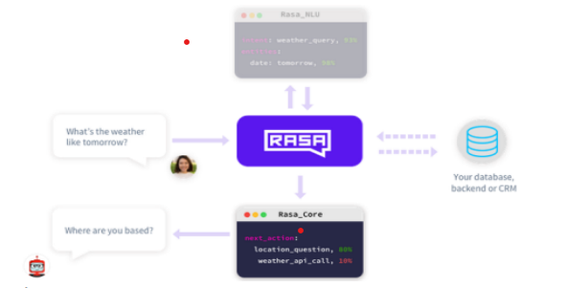
SYSTEM ARCHITECTURE

Slide 7
COMPONENTS OF RASA
Rasa NLU (Natural Language Understanding) :
Rasa NLU is an open-source natural language processing tool for intent classification (deciding what the user is asking for), extraction of the entities by bot in the form of structured data helps the chatbot understand what the user is saying.
Rasa Core (for holding conversation and deciding what to do next):
Rasa Core is a machine learning-based dialog management chatbot framework that takes the structured input of the NLU and predicts the next best action using a probabilistic model such as LSTM neural network instead of if/else statement. Under the hood it also uses reinforcement learning to improve the prediction of the next best action.

Slide 8
CHATBOT CAPABILITIES
Room Booking
Handle Greetings.
Booking Cancellation
Question answering.
Machine translation.

Slide 9
SYSTEM IMPLEMENTATION
This Project contains two major modules they are:
1. Administrator Module:
The administrator is responsible for adding the different intents. The admin can do the different actions some of them are:
• Adding Stories
• Editing Stories
• Delete Stories
2. Customer Module:
The Customer can interact with the chatbot using Rasa shell. If the customer implements the custom webpage, then it should be run on the localhost and the port number should be different from one which is running actions of rasa.

Slide 10
CONVERSATION MODEL
The conversation model will be separated into some parts. Each part has its own kind of conversation. Some parts are:
Greeting..
Booking.
Restaurant facility.
Booking cancellation.

Slide 11
RASA CONFIGURATION
Install Python 3.10.9
Install anaconda3
Create anaconda environment
conda create –n env_name python=3.10.9
conda activate env_name
Open command Prompt and navigate to project path:
Run command – rasa train
Run command – rasa shell
Use nlu.yml, stories.yml and domain.yml for conversation flow.

Slide 12
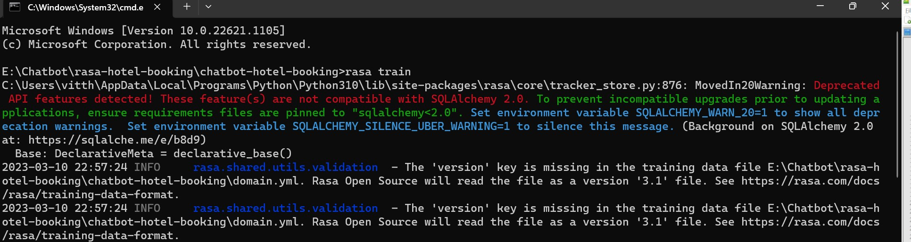
RESULT AND OUTPUT
The Rasa chat-bot implements the stories mechanism and follows the story when we are interacting with them.

Slide 13
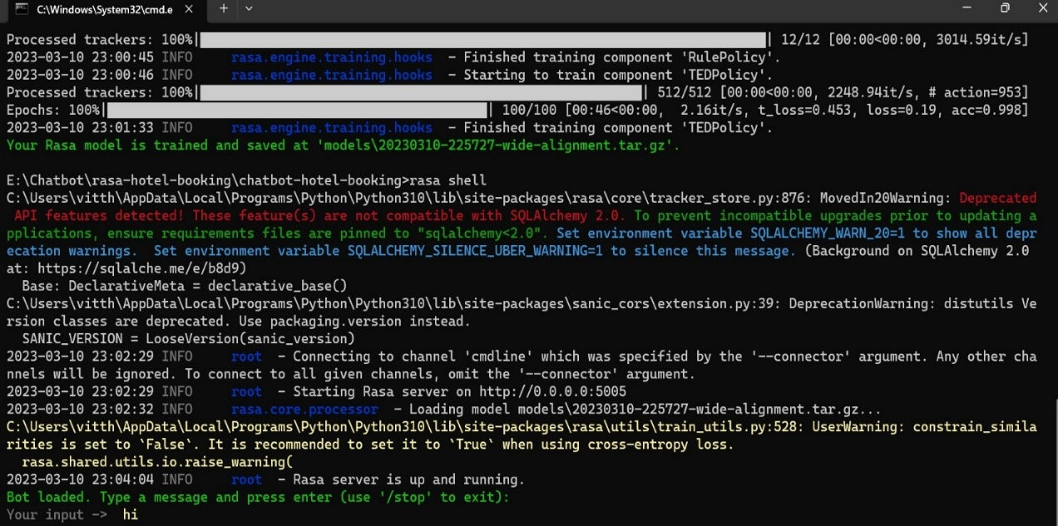
RESULT AND OUTPUT
Rasa server is running here, once it is up and running user can interact with chatbot.

Slide 14
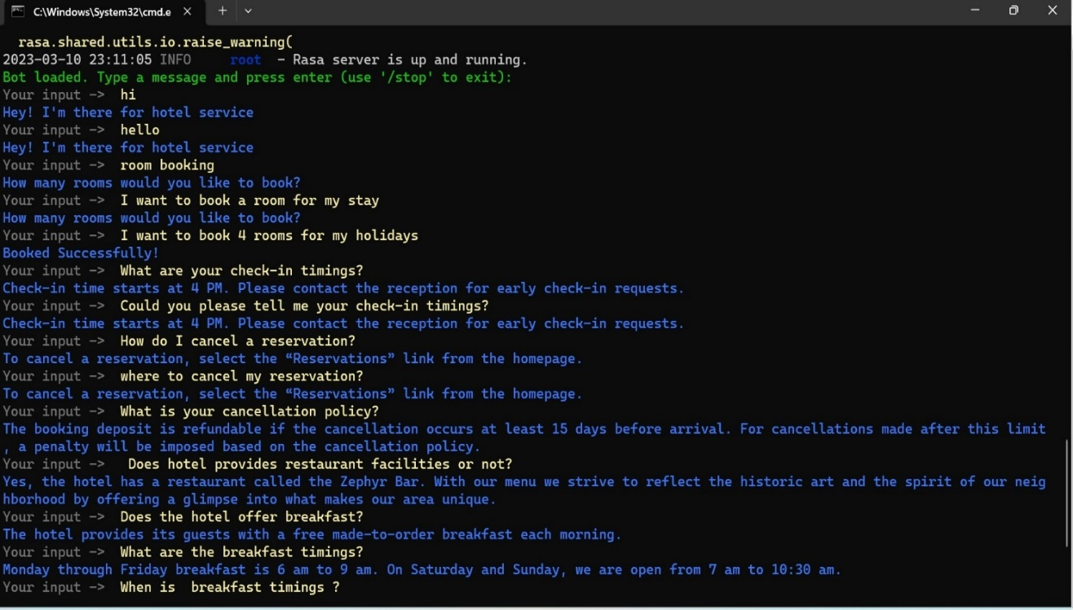
RESULT AND OUTPUT
User enters questions, chatbot response with answers.

Slide 15
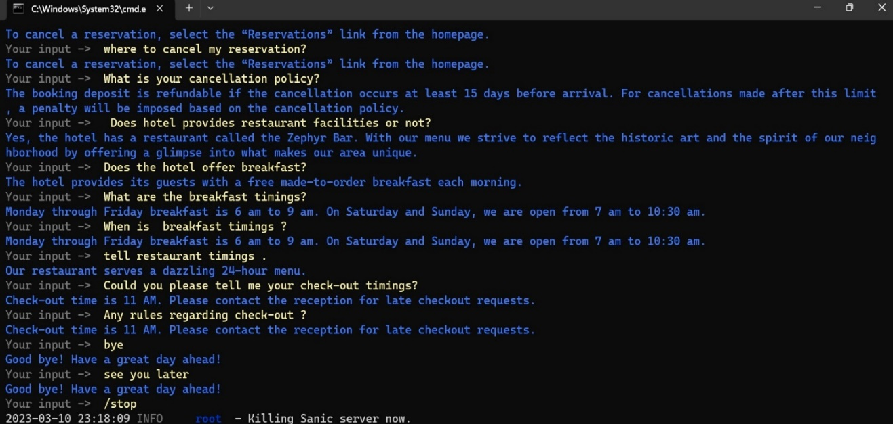
RESULT AND OUTPUT
User enters /stop to stop conversation.

Slide 16
CONCLUSION
Chatbots are the forms of automation and they would replace human agents because chatbots are fast and never get tired compared to human agents can get fatigued or overwhelmed.
The most important is chatbots make it easier to get closer to customers and they will serve the customers with fast response.

Slide 17
THANK YOU

