Slide 1
Intelligent Data Quality Monitoring using
Machine Learning for Regulatory Reporting Systems
Sujatha Chittiri | BITS ID: 2023AC05729
M.Tech AI & ML (WILP)
HSBC Global Technologies, Hyderabad
Research Area: Financial Risk Analytics

Slide 2
Introduction / Problem Context
Regulatory submissions (PRA, ECB, HKMA) demand high-quality, consistent, traceable data
Data comes from multiple systems → errors likely (missing values, outliers, inconsistencies)
Rule-based checks are limited and miss hidden patterns
Need proactive, intelligent ML-driven monitoring

Slide 3
Problem Statement
Traditional rule-based validation is:
  Time-consuming
  Not scalable
Unable to detect complex or hidden anomalies
  Leads to compliance risk and reporting delays

Slide 4
Objectives
Develop ML models (Isolation Forest, Autoencoder)
Detect data-quality issues automatically
Use SHAP for explainability
Build Streamlit dashboard
Implement reproducible pipeline in Colab

Slide 5
Scope of Work
In Scope:
  Data profiling
  Model development
  Explainability integration
  Dashboard
Out of Scope:
  Production deployment
  Real HSBC data

Slide 6
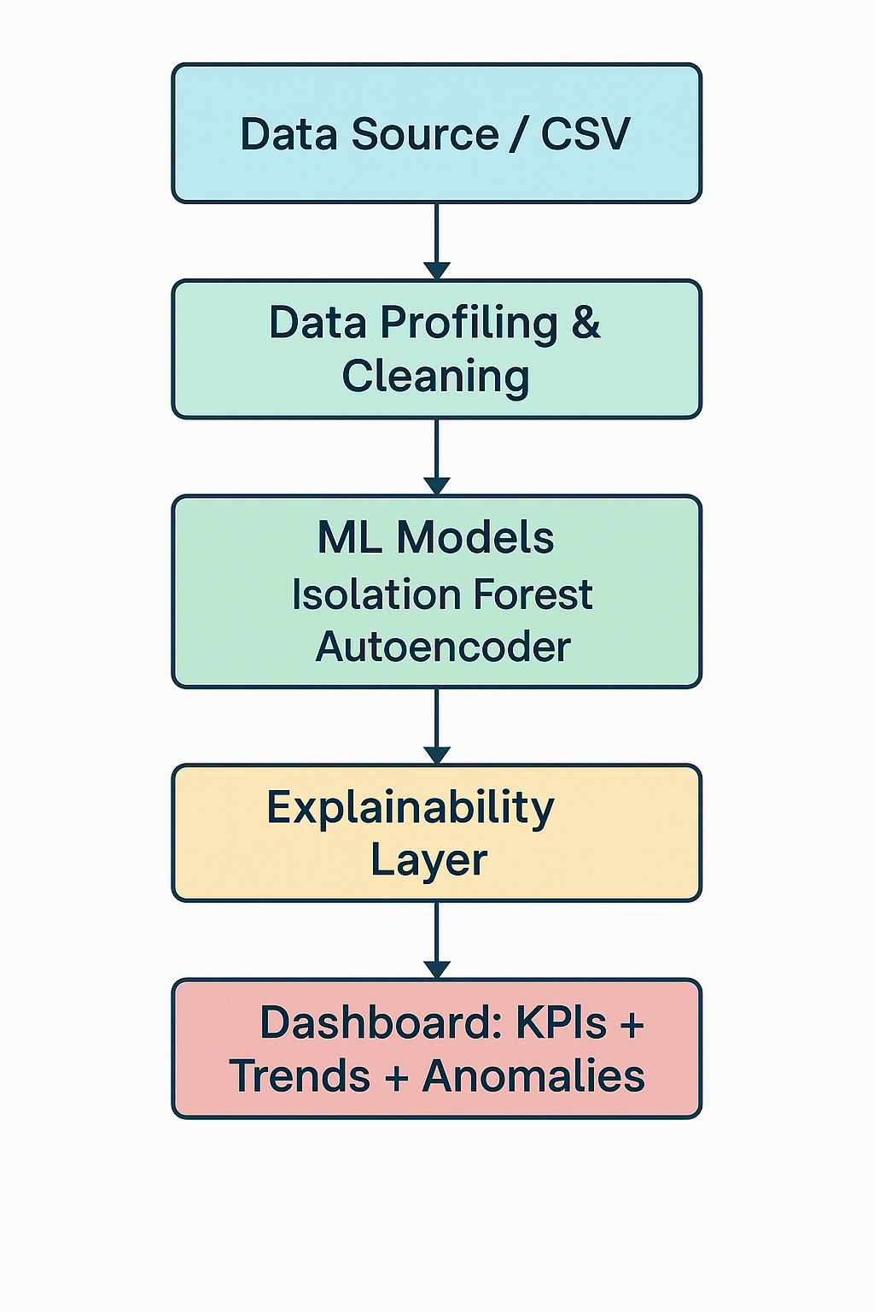
Solution Architecture

Slide 7
ML Models Used
Isolation Forest – detects outliers efficiently
Autoencoder – deep learning for pattern learning
Unsupervised learning ideal for unlabeled regulatory data

Slide 8
Explainable AI (XAI)
SHAP explains anomaly reasons such as:
  High exposure values
  Currency mismatches
  Abnormal risk weights
  Inconsistent patterns

Slide 9
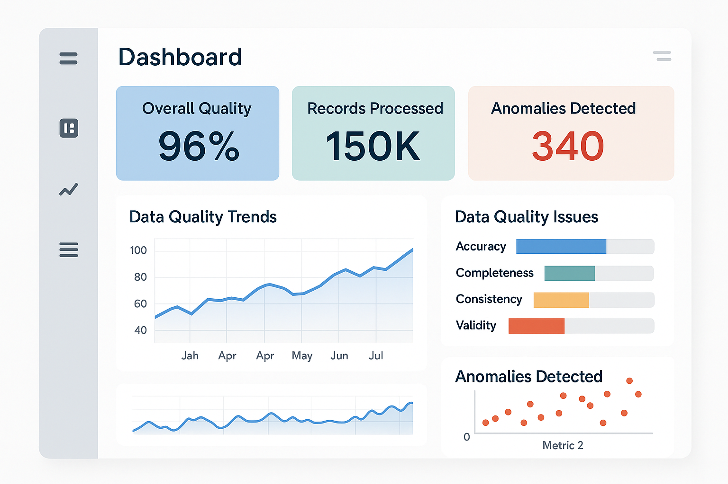
Dashboard Design (Mock)

Slide 10
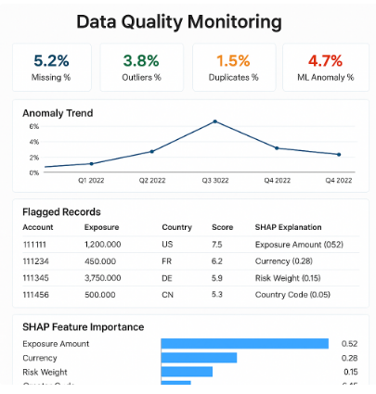
Dashboard Design (Mock)

Slide 11
Tools & Technologies
Python, Pandas, NumPy
Scikit-Learn, TensorFlow
SHAP Explainability
Streamlit
Google Colab
GitHub

Slide 12
Expected Outcomes
Early detection of data issues
Reduced manual workload
Explainable anomaly detection
Improved reporting accuracy
Scalable AI-driven framework

Slide 13
Conclusion
This project integrates ML, XAI, and monitoring dashboards to improve data quality for regulatory reporting and reduce compliance risk in financial institutions.

Slide 14
Thank You
Questions?

