Slide 1
Intelligent Data Quality Monitoring using
Machine Learning for Regulatory Reporting Systems
Sujatha Chittiri | BITS ID: 2023AC05729
M.Tech AI & ML (WILP)
HSBC Global Technologies, Hyderabad
Research Area: Financial Risk Analytics

Slide 2
Problem Statement
Why this project?
Regulatory reports are generated from multiple upstream systems
Data quality issues cause:
  Regulatory breaches
  Reporting delays
  Supervisory observations
Traditional rule-based checks:
  Catch known issues
  Fail to detect hidden or evolving anomalies
➡️ Need: An intelligent, proactive data quality monitoring solution

Slide 3
Objectives
Key Objectives of the Dissertation
Design an intelligent data quality monitoring framework
Combine:
  Rule-based validations
  Machine learning–based anomaly detection
Ensure:
  Explainability
  Regulatory defensibility
Provide operational visibility through a dashboard

Slide 4
Overall Solution Approach
High-Level Approach
Deterministic rules handle explicit violations
ML models detect hidden anomalies
Outputs are combined into a unified anomaly decision
Results are visualized for monitoring and investigation
➡️ Hybrid = Accuracy + Explainability

Slide 5
System Architecture / Pipeline
Pipeline Flow:
Regulatory-style data ingestion
Rule-based data quality engine
ML anomaly detection (unsupervised)
Unified anomaly scoring
Model Evaluation
SHAP Explainability – IF and AE
Dashboard visualization

Slide 6
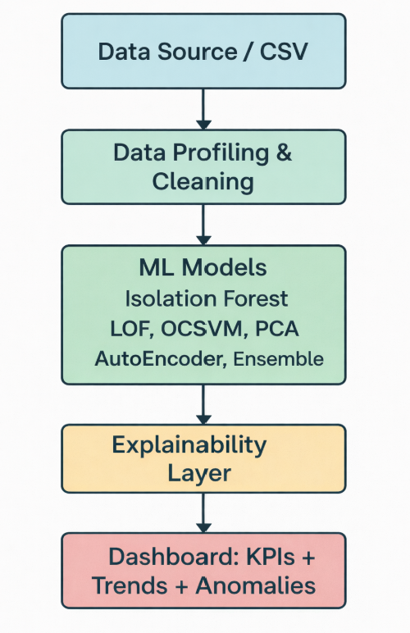
Solution Architecture

Slide 7
Dataset & Feature Selection
The synthetic dataset is modeled on the structure of HSBC regulatory reporting data.
The original HSBC dataset contains 60+ fields.
From these, 16 features were selected based on:
  Regulatory importance
  Risk and capital impact
  Data quality sensitivity
  Suitability for multivariate anomaly detection
Examples: Exposure Amount, Risk Weight, RWA, Capital Requirement, Country, Counterparty Type, Maturity, Collateral Flag.

Slide 8
Regulatory Thresholds
How thresholds are defined
Regulators (PRA / ECB / EBA) do not prescribe fixed percentages
Institutions define internal thresholds aligned with:
  Risk appetite
  Materiality
Proxy thresholds used
Completeness issues: < 1–2%
Invalid reference data: < 0.5%
Duplicates: 0% tolerance
Overall anomaly rate: < 5%

Slide 9
Rule Based Data Quality Engine
Implemented checks:
Completeness validation
Valid code lists (country, currency)
Duplicate key detection
Capital calculation validation
Outlier exposure checks
Thresholds inspired by PRA, EBA, ECB data quality guidelines.
Output: RULE_ANOMALY_FLAG

Slide 10
Unsupervised ML Models Used
Model | Purpose
Isolation Forest | Detect sparse abnormal patterns
LOF | Detect local density deviations
OCSVM | Boundary-based anomaly detection
PCA | Reconstruction error detection
Autoencoder | Deep pattern reconstruction
Multiple models are used to capture different types of anomalies.

Slide 11
Model Comparison Results
Evaluation Metrics
ROC-AUC
Precision@5%
Key Observations
Ensemble model performs better than individual models.
Model | ROC_AUC | Precision@5%
Isolation Forest | 0.595767634 | 0.339912281
LOF | 0.586153467 | 0.614035088
OCSVM | 0.604966764 | 0.48245614
PCA | 0.574870861 | 0.561403509
Autoencoder | 0.57384073 | 0.353070175
Ensemble | 0.609705366 | 0.396929825

Slide 12
Evaluation Results
Rule-based ROC AUC
ML-based ROC AUC
Hybrid ROC AUC (highest)
System | ROC_AUC
Rule-Based | 0.951636728
ML-Based (Ensemble) | 0.633438738
Hybrid (Rule + ML) | 0.960873662
Overlap analysis shows significant ML-only detection.
=== OVERLAP ANALYSIS ===
Total rows: 8480
True anomalies: 1247
Rule-only anomalies: 1355
ML-only anomalies: 322
Detected by both: 102
Final anomalies: 1779

Slide 13
Hybrid Decision Logic
Final anomaly decision:
Rule Flag + ML Flag → FINAL_ANOMALY_FLAG
This helps detect:
  Rule-only anomalies
  ML-only anomalies
  Overlapping anomalies
ML-only anomalies demonstrate the additional value of AI/ML beyond rules.

Slide 14
Explainable AI (SHAP)
SHAP is used to interpret model predictions.
It shows which features contribute most to anomaly detection such as:
  Exposure to Capital Ratio
  Risk Weight
  Credit Quality Step
  Exposure Amount
This supports regulatory auditability.

Slide 15
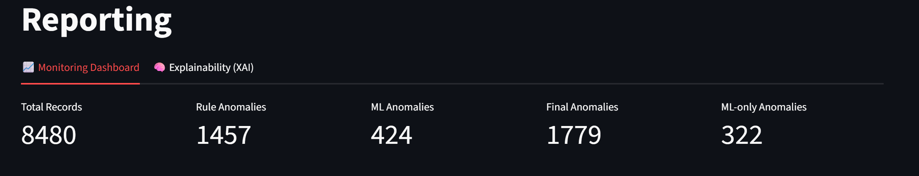
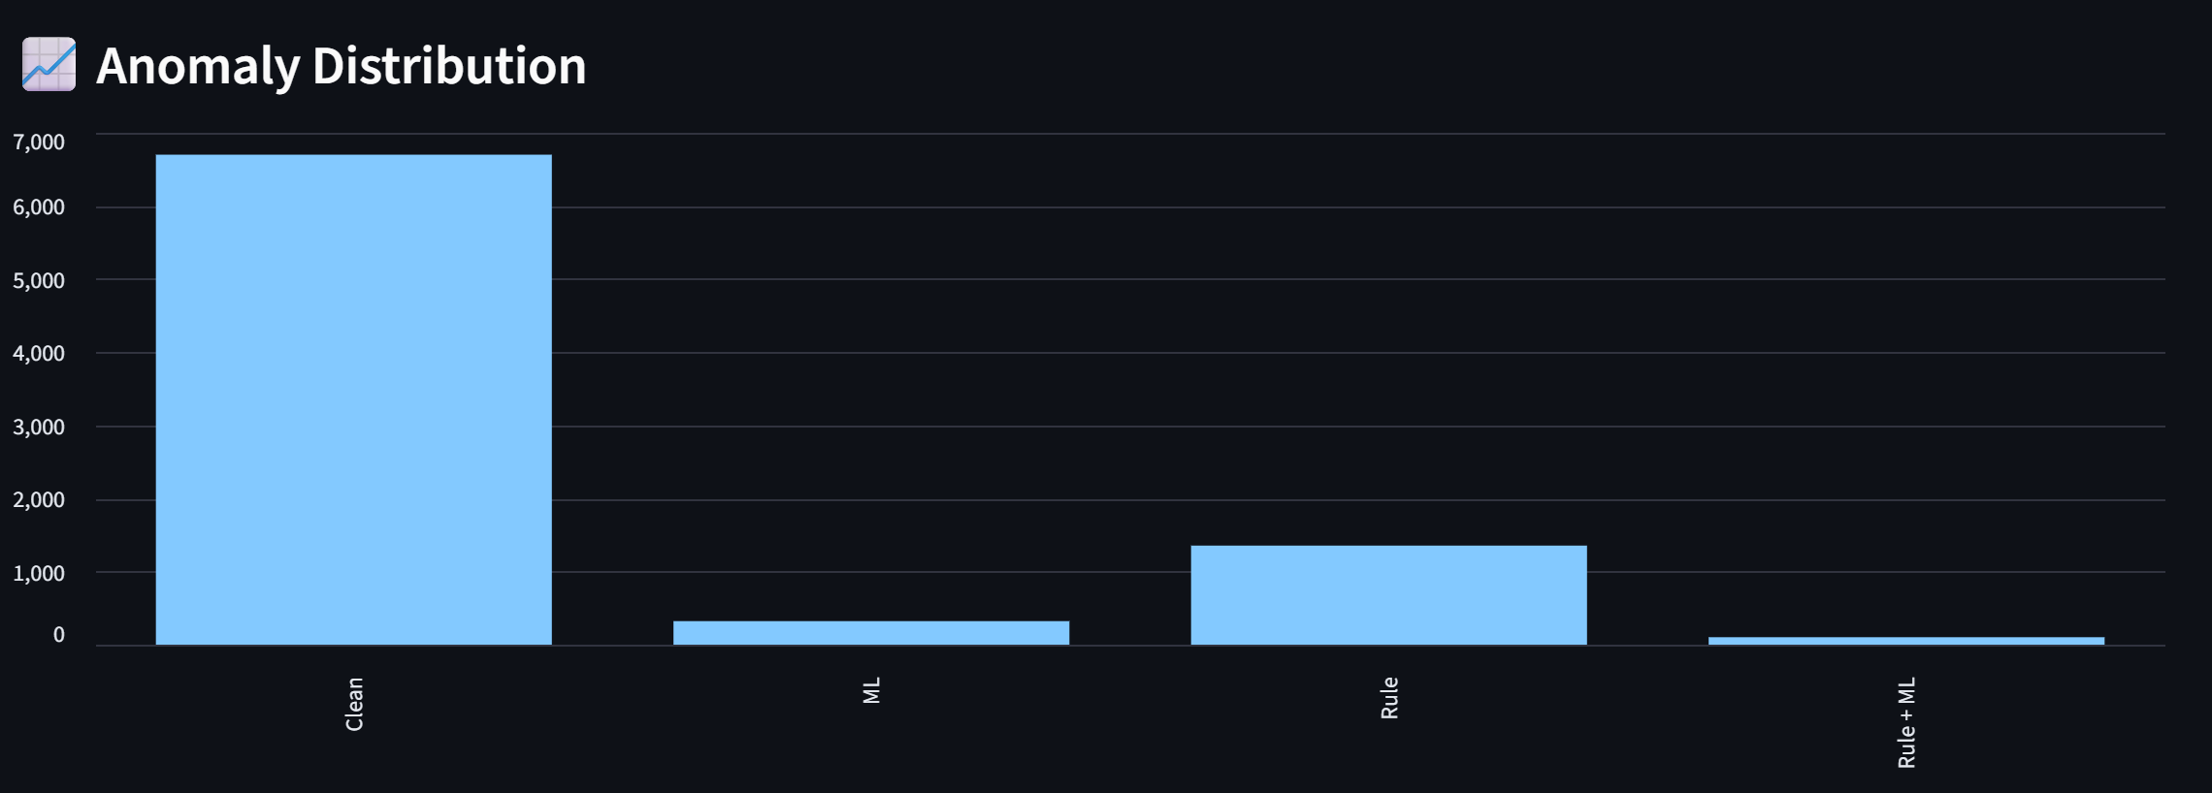
Dashboard Overview
Dashboard displays:
  KPI summary
  Rule vs ML anomaly distribution

Slide 16
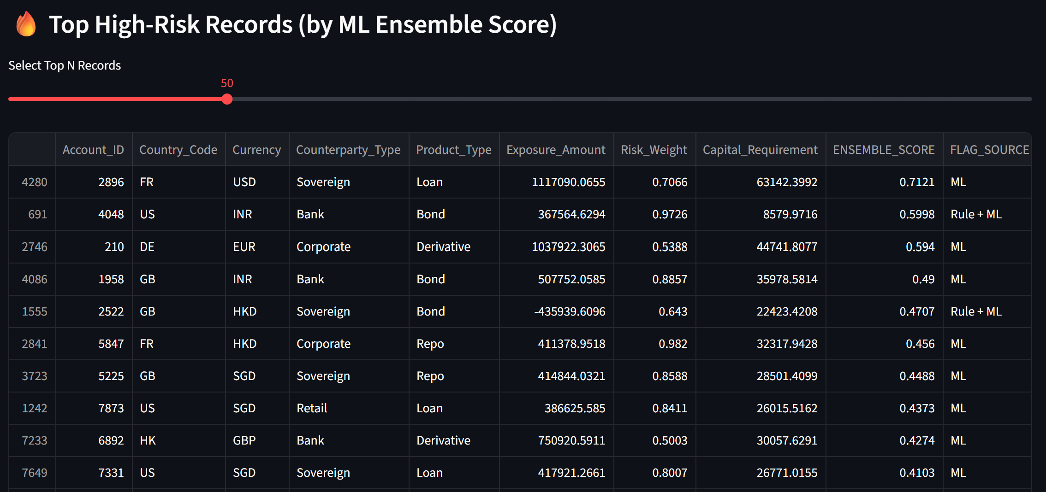
Investigation View
Top high-risk records sorted by ML ensemble score.

Slide 17
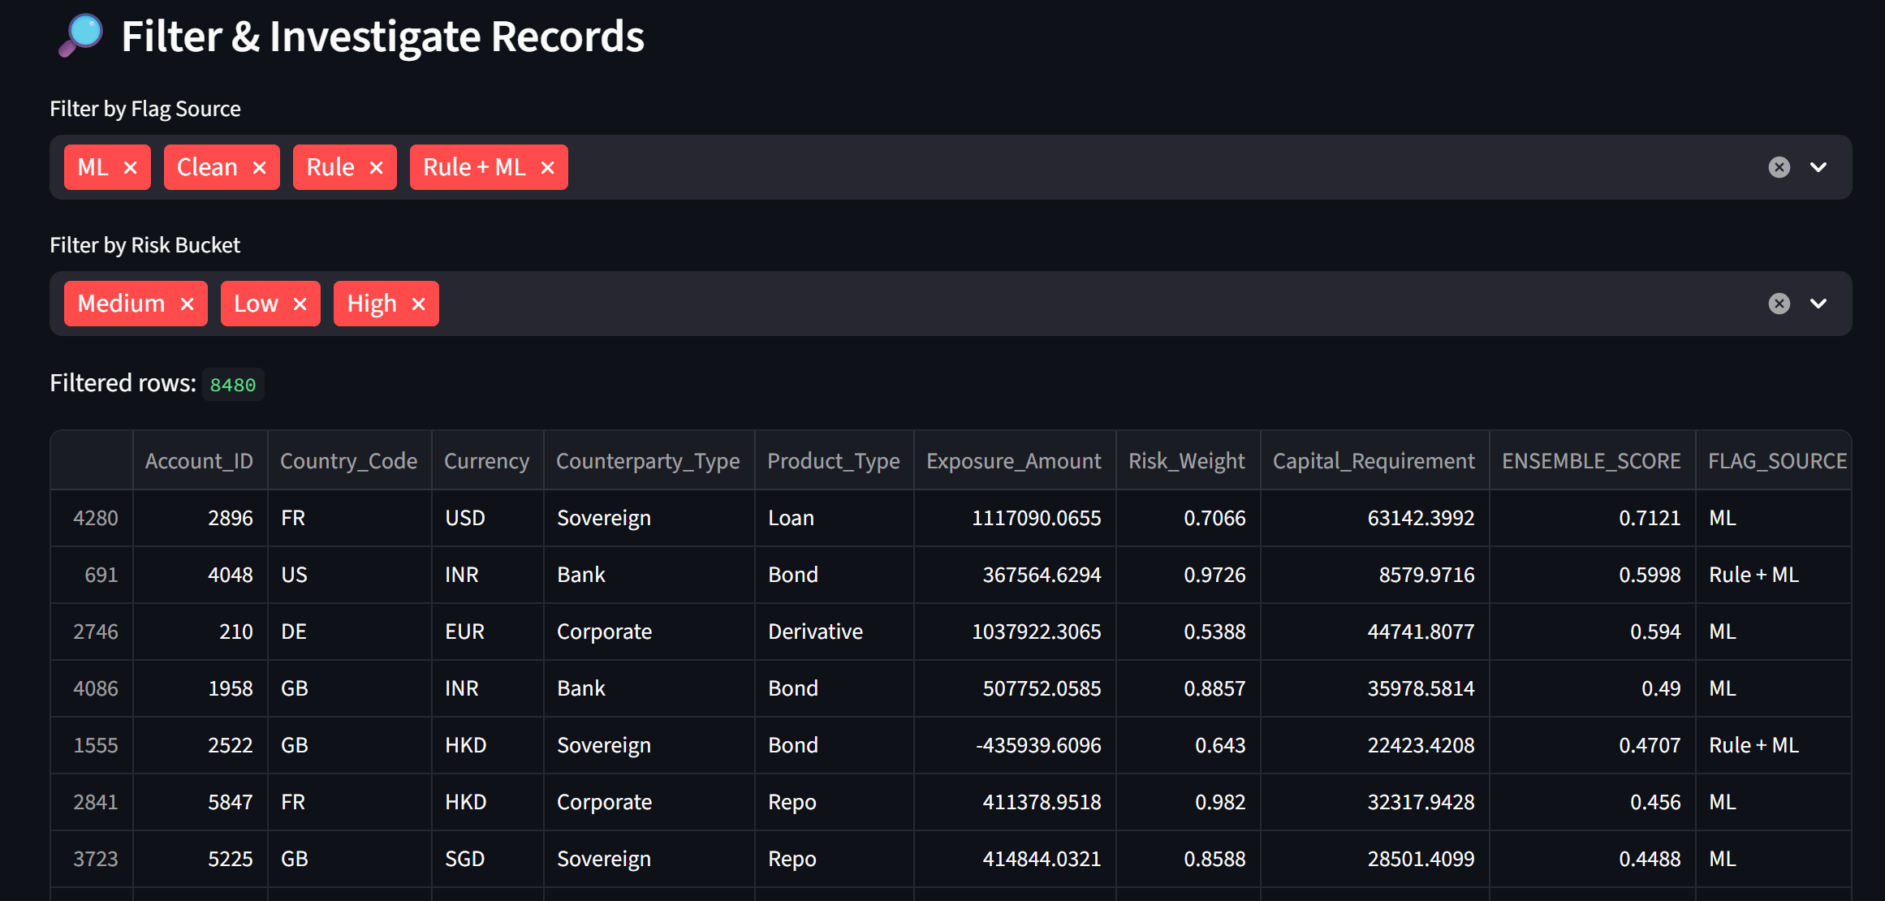
Investigation View
Filters available for flag source and risk bucket.

Slide 18
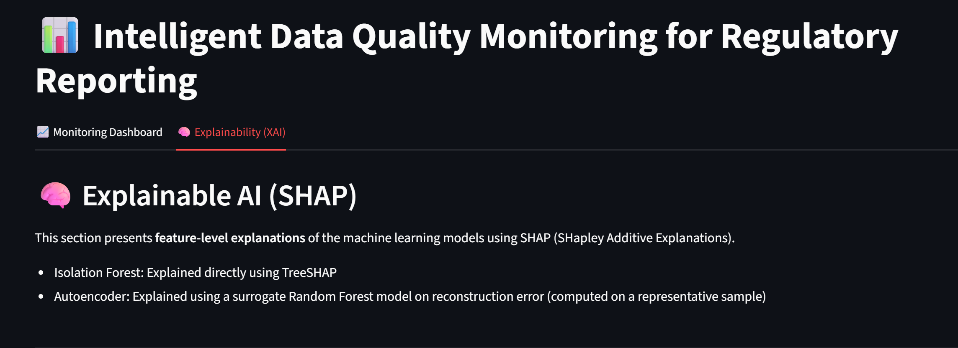
Explainability View in Dashboard
Provides interpretation support for investigators while analyzing anomalies.

Slide 19
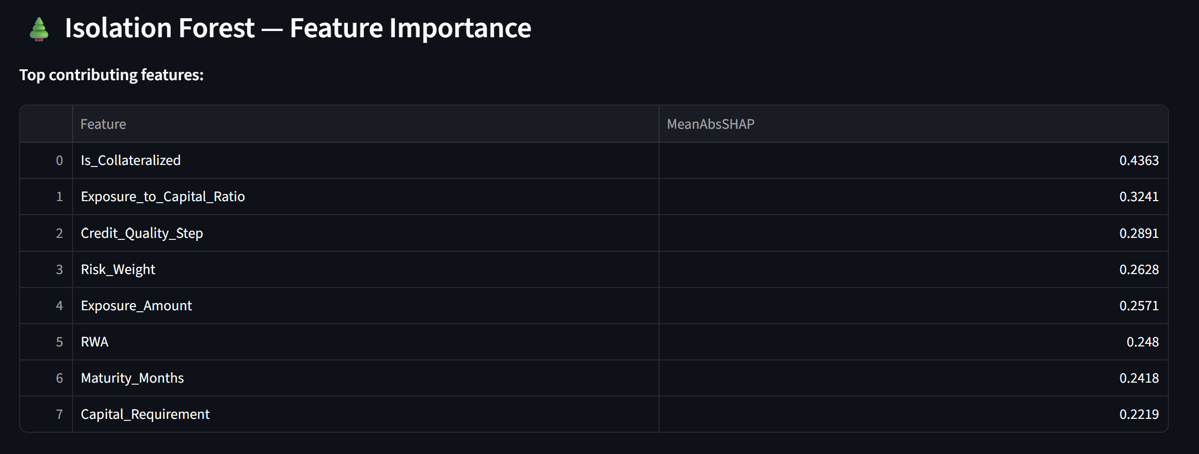
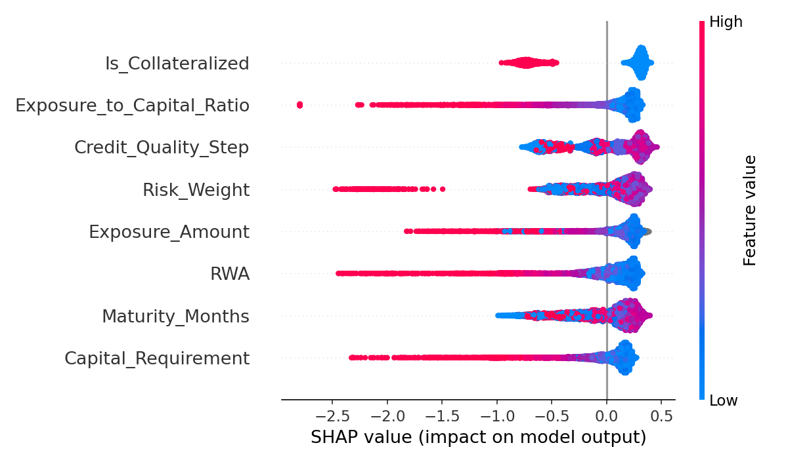
Isolation Forest – Feature Importance

Slide 20
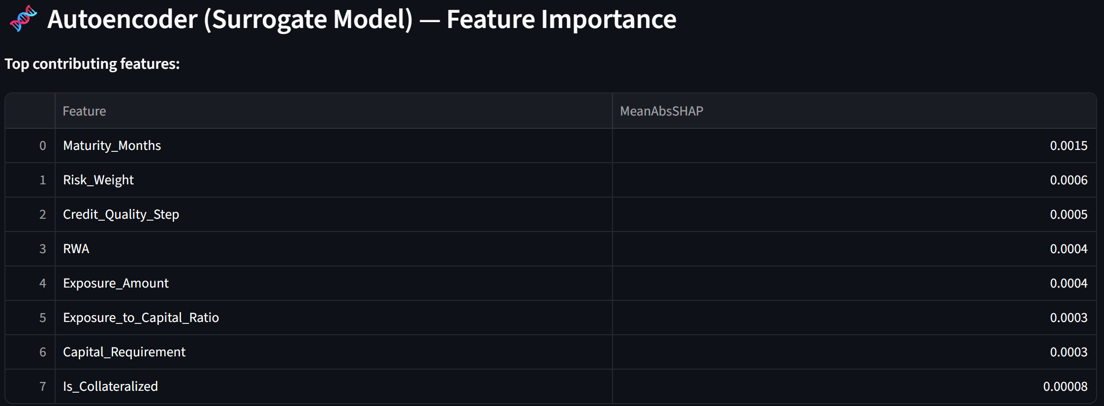
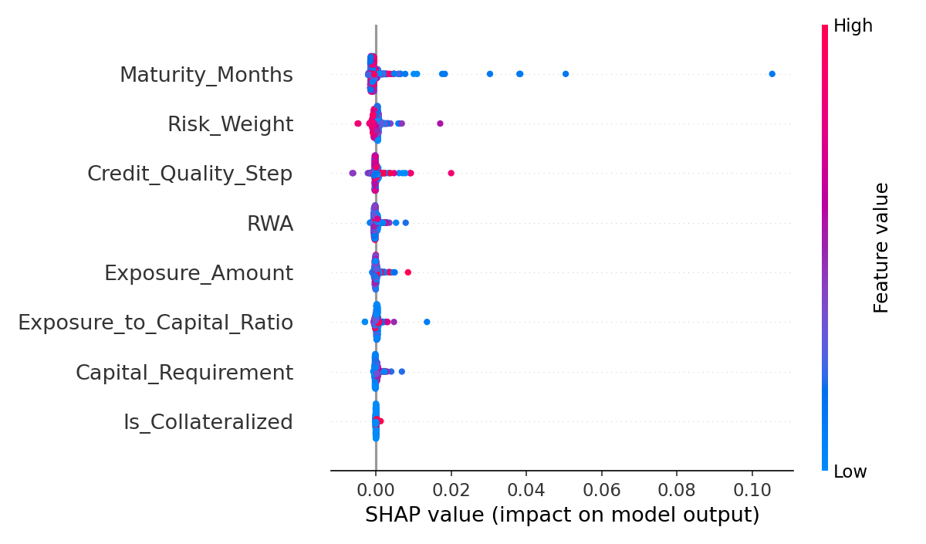
Autoencoder (Surrogate Model) -Feature Importance

Slide 21
Mapping to HSBC Project
The solution directly aligns with:
  Data quality challenges in HSBC regulatory reporting
  Regulatory expectations for accuracy and auditability
  Potential integration into existing reporting workflow

Slide 22
Key Contributions
Intelligent data quality monitoring framework
Comparison of multiple unsupervised ML models
Hybrid rule + ML decision system
SHAP explainability
Operational dashboard

Slide 23
Challenges Faced
Key Challenges
Defining realistic regulatory thresholds
Lack of labeled anomaly data
Balancing explainability vs accuracy
Dashboard performance in cloud environments
Mitigation
Configuration-driven thresholds
Unsupervised learning
Hybrid detection approach

Slide 24
Future Work
Drift detection
Model tuning
More feature inclusion
Integration with live reporting systems

Slide 25
Conclusion
AI/ML significantly enhances data quality monitoring beyond traditional rule-based systems and is highly suitable for regulatory reporting environments.

Slide 26
Thank You
Questions?

