Slide 1
Intelligent Data Quality Monitoring using
Machine Learning for Regulatory Reporting Systems
Sujatha Chittiri | BITS ID: 2023AC05729
M.Tech AI & ML (WILP)
HSBC Global Technologies, Hyderabad
Research Area: Financial Risk Analytics

Slide 2
Problem Statement
Why this project?
Regulatory reports are generated from multiple upstream systems
Data quality issues cause:
  Regulatory breaches
  Reporting delays
  Supervisory observations
Traditional rule-based checks:
  Catch known issues
  Fail to detect hidden or evolving anomalies
➡️ Need: An intelligent, proactive data quality monitoring solution

Slide 3
Objectives
Key Objectives of the Dissertation
Design an intelligent data quality monitoring framework
Combine:
  Rule-based validations
  Machine learning–based anomaly detection
Ensure:
  Explainability
  Regulatory defensibility
Provide operational visibility through a dashboard

Slide 4
Overall Solution Approach
High-Level Approach
Deterministic rules handle explicit violations
ML models detect hidden anomalies
Outputs are combined into a unified anomaly decision
Results are visualized for monitoring and investigation
➡️ Hybrid = Accuracy + Explainability

Slide 5
System Architecture / Pipeline
Pipeline Flow:
Regulatory-style data ingestion
Rule-based data quality engine
ML anomaly detection (unsupervised)
Unified anomaly scoring
Dashboard visualization

Slide 6
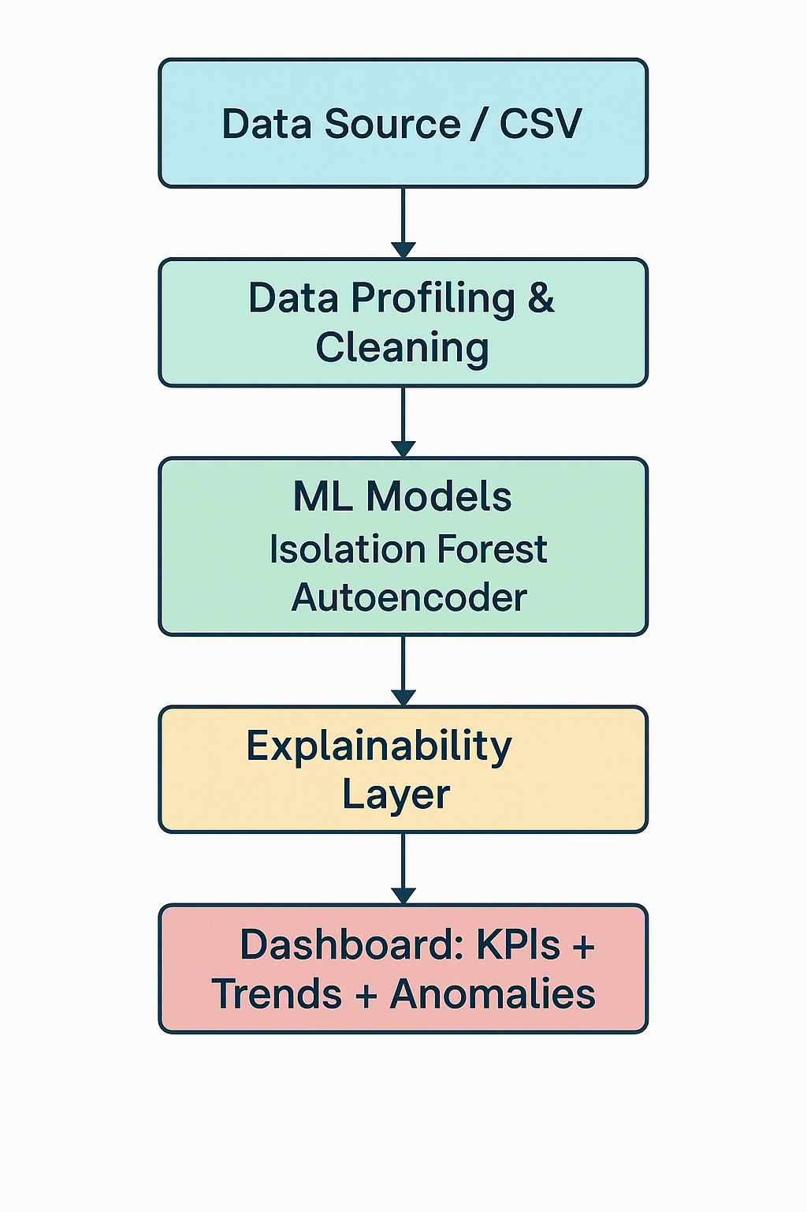
Solution Architecture

Slide 7
Rule Based Data Quality Engine
What rules are implemented?
Missing mandatory fields
Invalid country / currency codes
Negative exposure values
Risk-weight boundary violations
Duplicate records
Statistical outliers
Each rule produces:
Individual violation flags
A cumulative DQ Rule Score
➡️ Fully explainable

Slide 8
Machine Learning Models Considered
Models Evaluated
Isolation Forest
Local Outlier Factor (LOF)
One-Class SVM
Autoencoder
Why unsupervised?
Regulatory data has limited labeled anomalies
Models must learn normal behaviour patterns

Slide 9
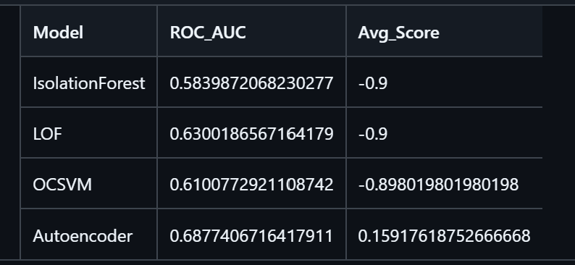
Model Comparison Results
Evaluation Metrics
ROC-AUC
Precision at top anomaly percentiles
Key Observations
Autoencoder → best non-linear anomaly detection
LOF → scalability limitations
OCSVM → sensitive to hyperparameters
Isolation Forest → scalable and explainable

Slide 10
Why Isolation Forest + Autoencoder?
Final Model Selection Justification
Autoencoder:
  Captures complex non-linear patterns
Isolation Forest:
  Scales well to large datasets
  Supports explainability (SHAP-compatible)
Hybrid approach balances:
  Detection performance
  Regulatory explainability
➡️ ROC-AUC alone is not sufficient for regulatory systems

Slide 11
Unified Anomaly Scoring Logic
How final decision is made
Final Anomaly Flag =
Rule Violation
OR
ML Anomaly Score > Threshold
Rule violations = hard regulatory breaches
ML anomalies = soft / hidden issues
➡️ Zero false negatives for deterministic violations

Slide 12
Explainability in the Project
How decisions are explainable
Rule-level explanations:
  Exact rule causing the issue is known
ML-level explanations:
  Anomaly score indicates deviation from normal patterns
Decision-level transparency:
  Clear OR logic between rules and ML
SHAP integration planned in final phase

Slide 13
Regulatory Thresholds
How thresholds are defined
Regulators (PRA / ECB / EBA) do not prescribe fixed percentages
Institutions define internal thresholds aligned with:
  Risk appetite
  Materiality
Proxy thresholds used
Completeness issues: < 1–2%
Invalid reference data: < 0.5%
Duplicates: 0% tolerance
Overall anomaly rate: < 5%

Slide 14
Dashboard Overview
Dashboard provides:
Total records vs anomalies
Rule vs ML anomaly split
Time-based anomaly trends
Severity-based prioritization

Slide 15
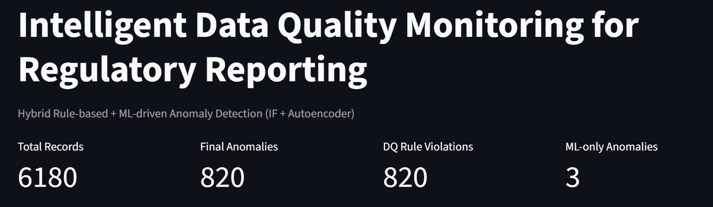
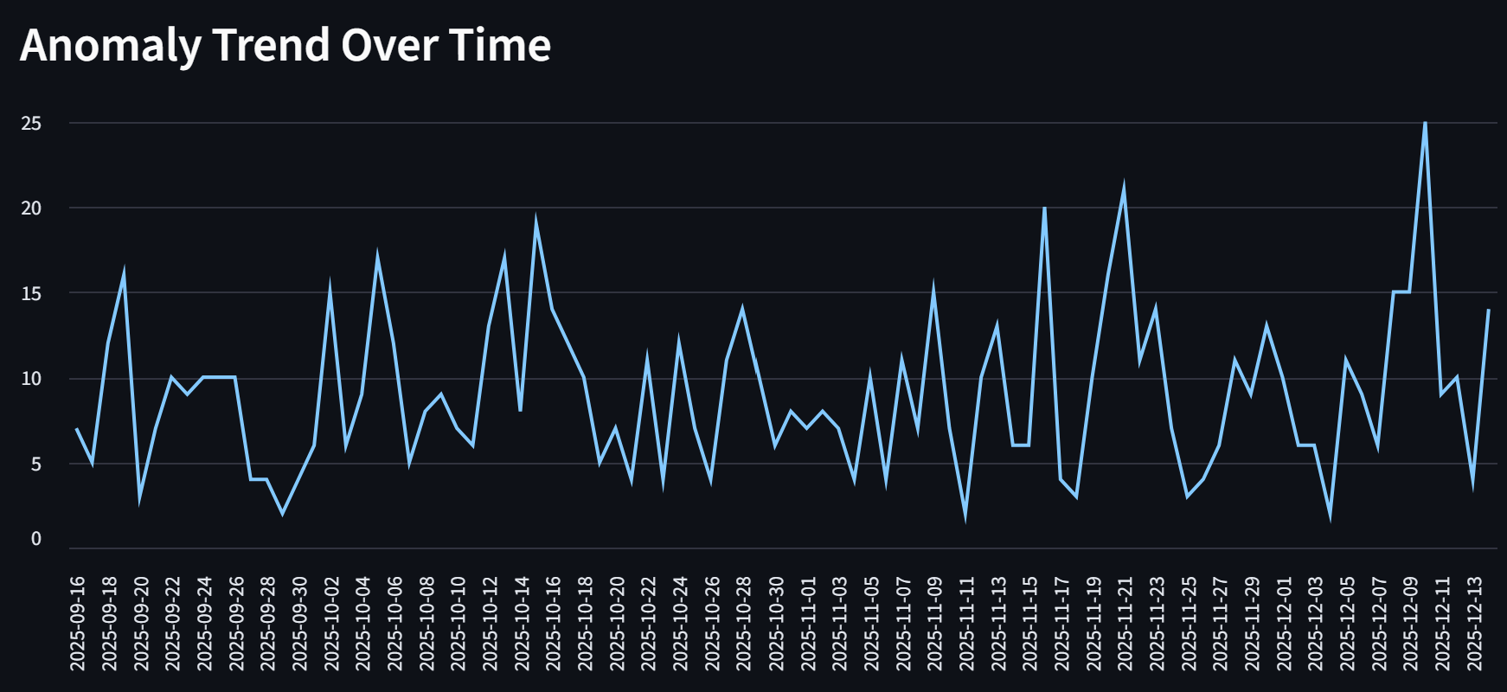
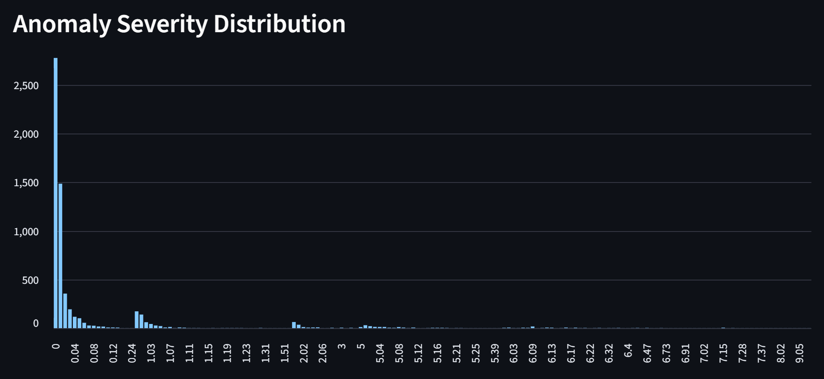

Slide 16
Dashboard Drilldown
For each flagged record:
Rule score
ML anomaly score
Final anomaly flag
Severity ranking
➡️ Enables investigation and root-cause analysis

Slide 17
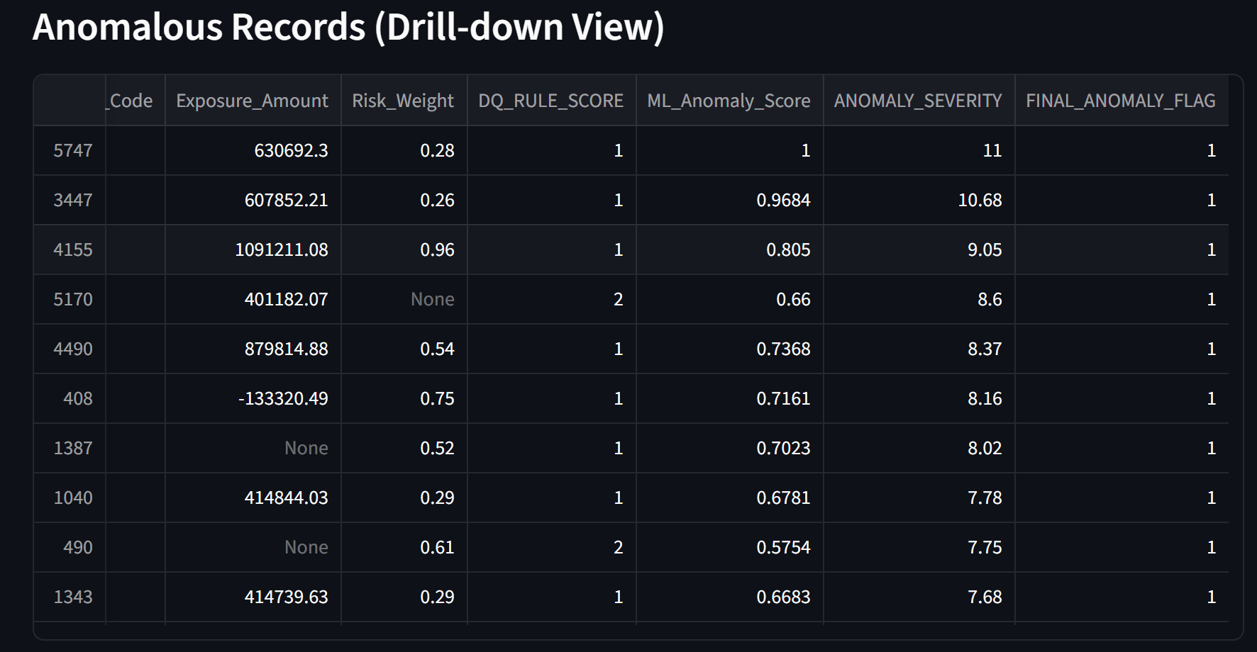

Slide 18
Work Completed Till Mid-Sem
Completed Milestones
Data generation & profiling
Rule-based DQ engine
ML model comparison
Model justification
Unified scoring logic
Dashboard prototype
Git-based project structure

Slide 19
Challenges Faced
Key Challenges
Defining realistic regulatory thresholds
Lack of labeled anomaly data
Balancing explainability vs accuracy
Dashboard performance in cloud environments
Mitigation
Configuration-driven thresholds
Unsupervised learning
Hybrid detection approach

Slide 20
Roadmap for Final Submission
Planned Enhancements
SHAP-based feature-level explainability
Model tuning and sensitivity analysis
Drift detection
Enhanced dashboard interactivity
Final dissertation documentation

Slide 21
Conclusion
Summary
Proposed an intelligent, explainable data quality framework
Combined rule-based and ML-based detection
Achieved proactive anomaly identification
Aligned with regulatory expectations
➡️ Strong foundation for final dissertation

Slide 22
Thank You
Questions?

