Slide 1
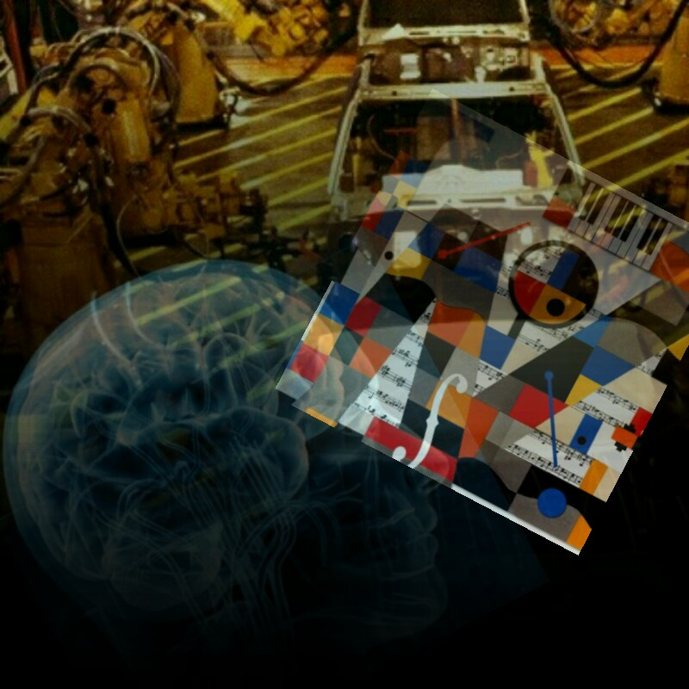
iSing
Notes:
We’re thinking of the name ‘Toccata’ – a musical term that means ‘to touch’ (like in the famous Bach piece). What do you think?

Slide 2
Introduction – What is Autism?
Genetic
Affects social ability
Often non-verbal
Hypersensitivity to sensory input - AE will talk about noise, MT will talk about temp and text
Attention deficit hyperactivity disorder – hyperactivity and inclusiveness, inattentiveness
Important to help people integrate
Usually diagnosed at age 3
Early intervention is key to helping people learn communication and social skills
Notes:
Wid – 3 minutes

Slide 3
A Device for use in Music Therapy
One-to-one
Calming
Needs be intuitive, non complex to use
Pitch and volume can be customised to suit the user
Communicative - musical ‘call and response’
Non-verbal communication
Building social skills and confidence
Notes:
Alison – 2 minutes

Slide 4
Hardware
Neuroscience evidence for this working
Shape and ergonomics
Smart and responsive to touch pressure
Temperature and texture can be customised to suit the user
Can be used with headphones for portability
Notes:
Mihnea – 2 minutes

Slide 5
Software
Can customise the sound that it makes - volume, pitch, timbre
Can save custom settings for individual users
Learning chilren`s attention span
Understanding children`s ability to cope
Improving capability of children’s attention span
Notes:
Sujatha – 2 minutes

Slide 6
Industrial Engineering
To enable children to focus on task
Prolong the productivity.
Adaptability to manufacturing environment
Utilising calming music therapy to increase the adaptability .
Proof of Industrial Engineering techniques.

Slide 7
Conclusion
1 in 77 ‘epidemic’
Business case and USP (why is this better than an iPad?)
Easy to use
Suitable for all ages
Broader market than just people on the autistic spectrum
Affordable for users
Several large manufacturers have expressed interest
Ability of children to adapt to manufacturing environment
Notes:
Mihnea – 1 minute

Slide 8
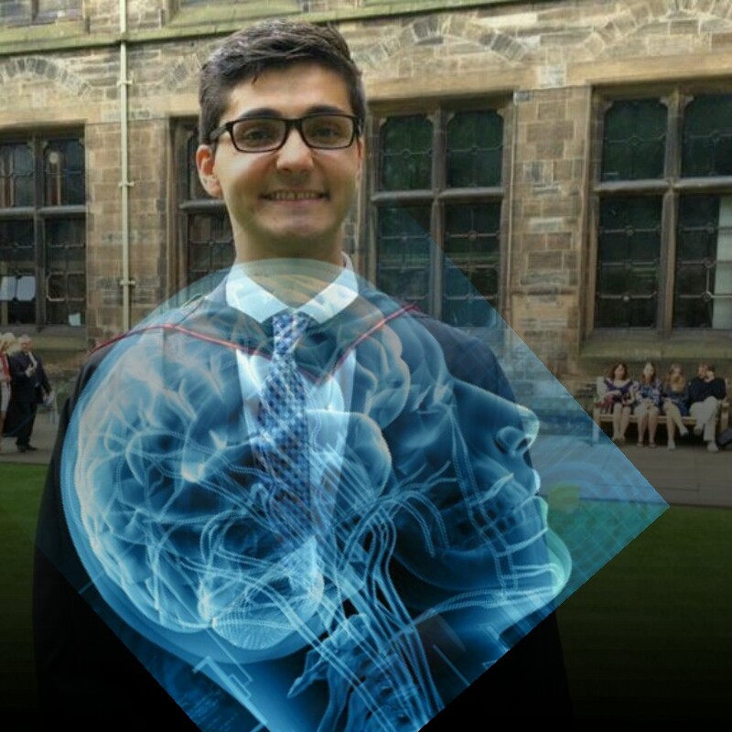
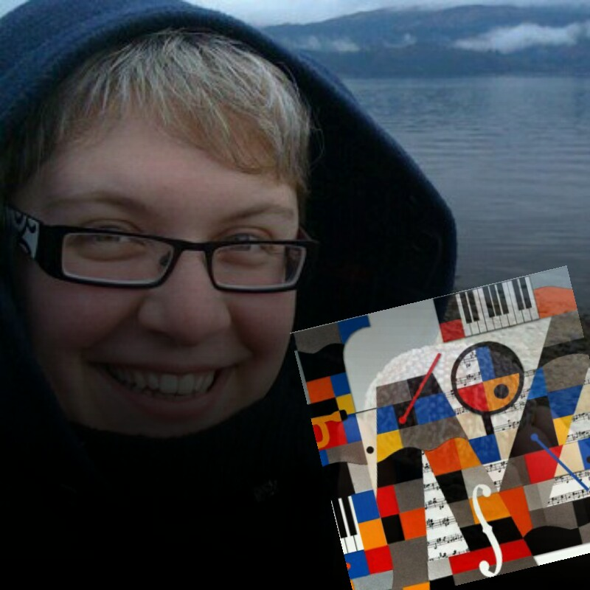
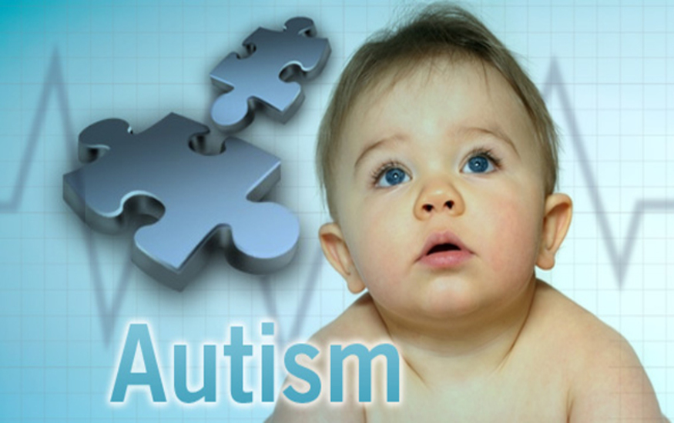
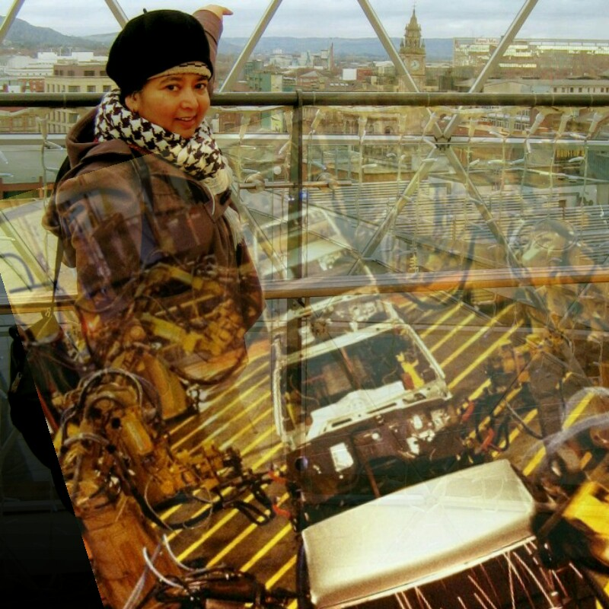
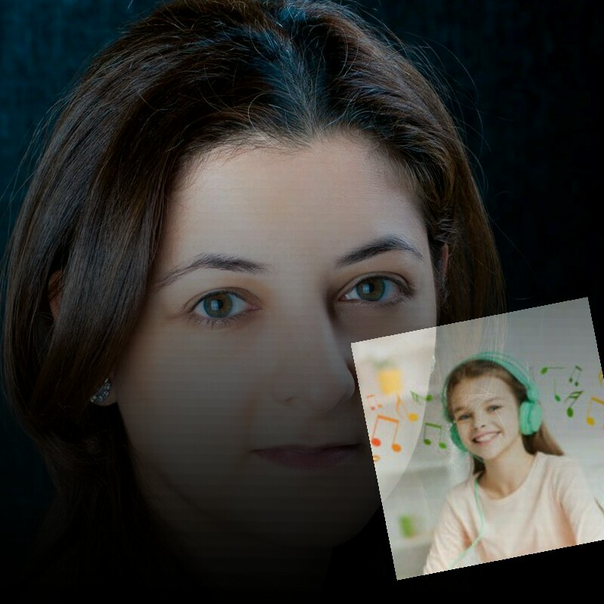
iSing

