Slide 1
iQOO HACKATHON 2026 · GRAND FINALE APPLICATION
Festival Guardian
Predict. Respond. Relay.
Point your phone at a crowd and get a live stampede-risk score. If the network jams, alerts hop from phone to phone.
TEAM FALLING STARS
Poornachandra P M · Dushyanth M · M Sujay

Slide 2
Crowds turn deadly in minutes
Nobody sees it building
Networks fail at peak
Help arrives late
Density rises gradually. By the time it feels dangerous, exits are already blocked.
Thousands of phones in one spot overload towers, so calls and messages fail.
Organizers get no early signal and no location, so response starts after the crush.
Festival grounds, temple queues, railway platforms.

Slide 3
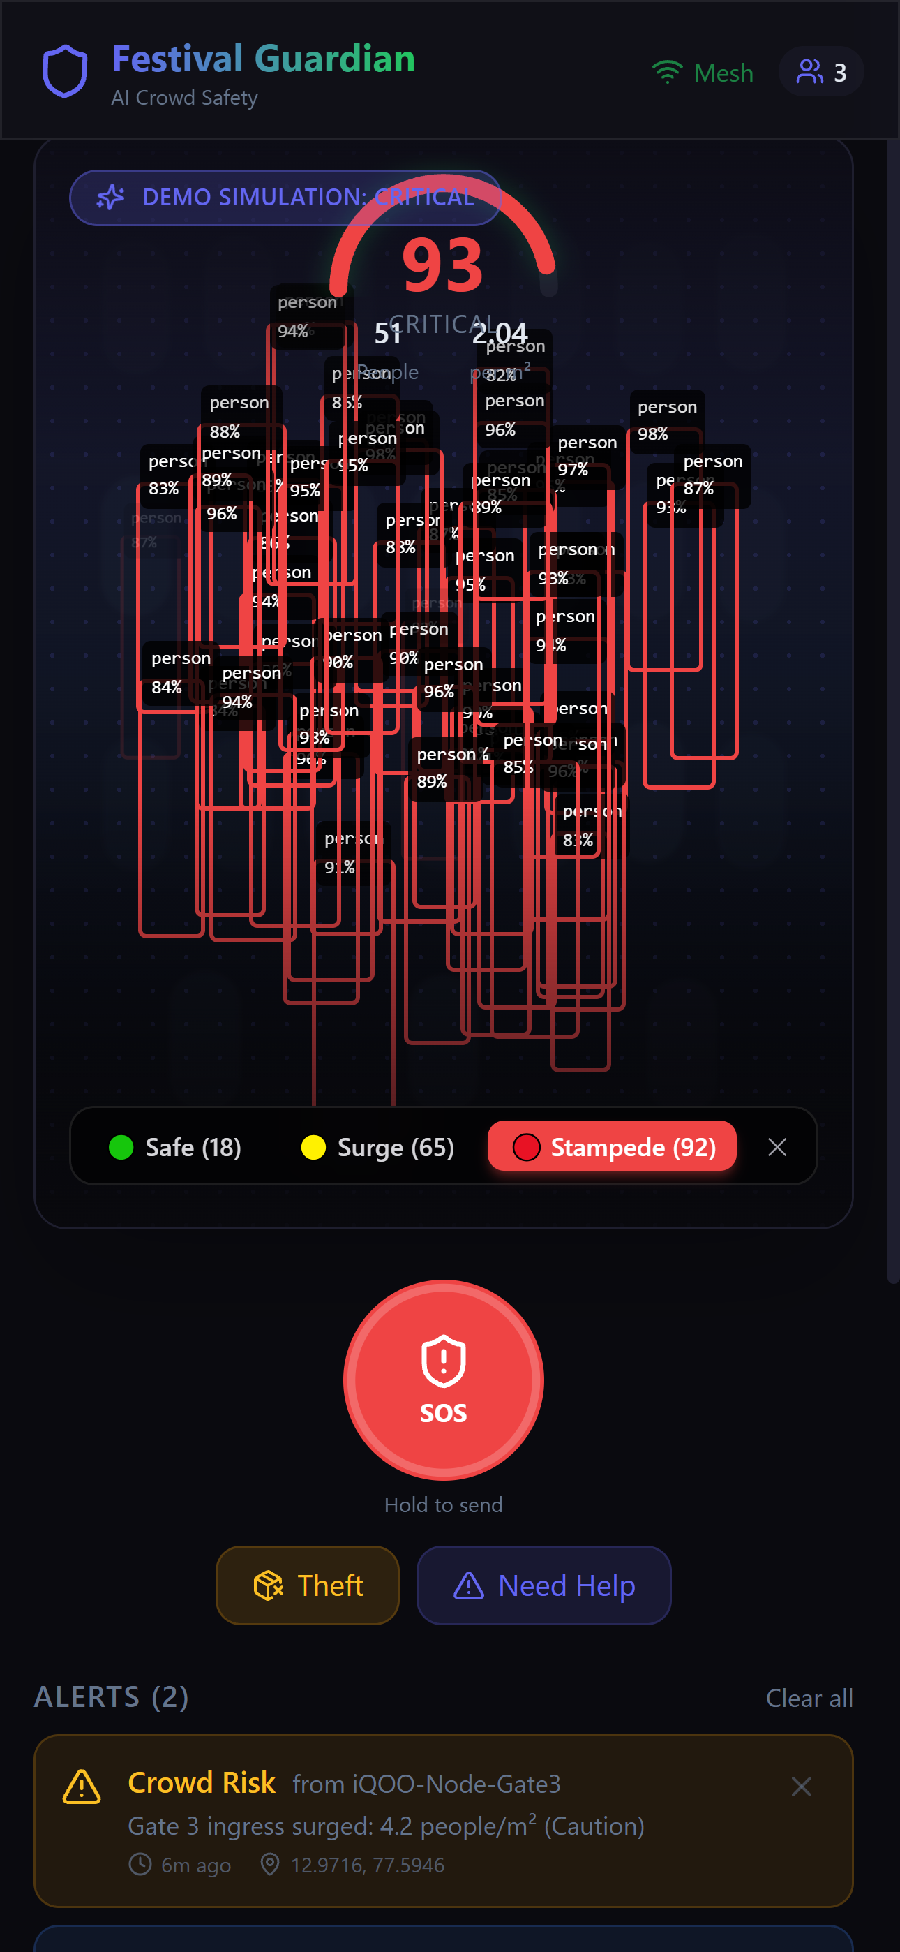
Point. Read. Warn.
Point the camera
Detection runs on the phone's NPU/GPU, with no upload.
Live risk meter
Density and flow combine into one clear 0–100 risk score.
Early warning
Organizers are alerted before a crush or stampede forms.
Actual screenshot — live prototype (demo/test data)

Slide 4
How it works, today vs. the Finale build
1
2
3
4
5
Camera
Detect
Score
Alert
Relay
Live feed from the phone
TensorFlow.js (COCO-SSD) runs on-device, in-browser, over WebGL
Density + flow become a 0-100 risk score
A typed Alert object is created, with TTL + dedup
Working today same-device; native phone-to-phone at the Finale
Today: real on-device detection, in a web prototype. Finale: ported to native Android + Nearby Connections for true phone-to-phone offline relay.

Slide 5
Offline SOS relay — the Finale target
No network? Alerts hop from phone to phone until one reaches a connection. The relay logic (TTL, dedup, typed alerts) is built; the phone-to-phone hop is the Finale build.
Person in the crowd
Nearby phone (Hop 1)
Nearby phone (Hop 2)
Volunteer with signal
Today: relay engine verified across browser tabs (same device). Finale: Android Nearby Connections, two real phones, one offline.

Slide 6
Who gets the alert
Event organizers
Live risk score, location and photo on their phone.
Emergency services (108 / 112)
A pre-filled emergency call with the exact location and incident type.
Family and nearby volunteers
Trusted contacts and nearby app users get the alert pin and guidance.

Slide 7
Today vs. the Finale build
Built today (web prototype)
Finale: Red Light (phone only)
• Real on-device detection: TF.js + COCO-SSD over WebGL
• Alert engine: typed alerts, TTL, dedup — all working
• Relay verified same-device (browser tabs)
• Port detection to TFLite, run on the Snapdragon NPU
• Android Nearby Connections for real phone-to-phone hops
• Live demo: 2-3 iQOO phones, one offline
Scored on: phone-first execution, AI integration, Office Kit, real-world relevance, pitch.

Slide 8
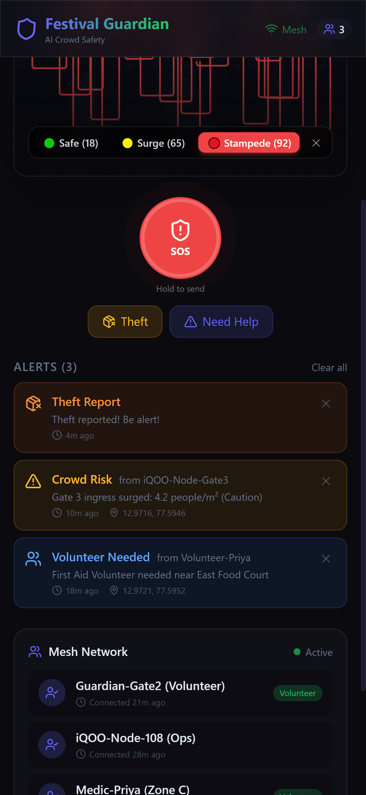
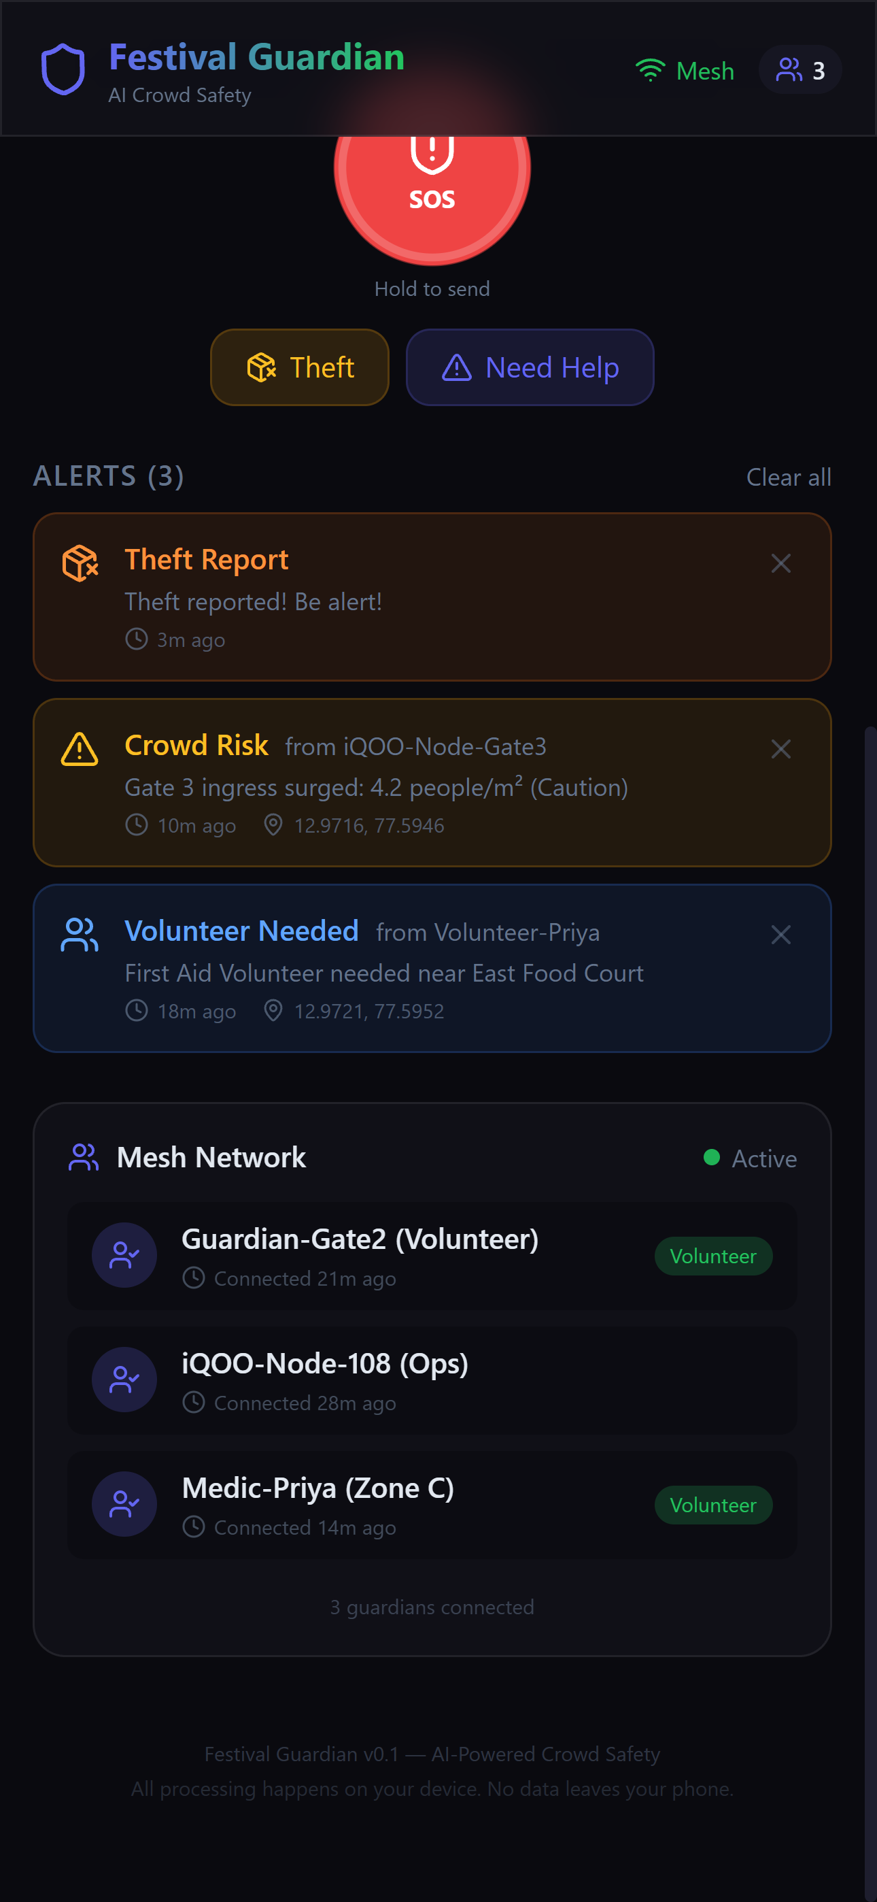
Live prototype — not a mockup
Actual screenshots from the working web prototype. Names, coordinates and counts are demo/test data. Mesh peers shown are seeded for the UI; live device-to-device relay is the Finale build.
SOS, theft & volunteer alerts
Mesh network — connected peers

Slide 9
48 hours: what we ship
0-12h
12-30h
30-42h
42-48h
Detection + meter
Offline relay
Alerts + first aid
Polish + pitch
On-device counting and a live risk score
Two-phone SOS hop working end to end
Location, photo and a voice-guided first-aid card
Demo rehearsal, backup video, final deck
Festival Guardian: predict, respond, relay.
Thank You

