Slide 1

iQOO HACKATHON 2026 · GRAND FINALE APPLICATION
Festival Guardian
Predict. Respond. Relay.
Point your phone at a crowd and get a live stampede-risk score. If the network jams, alerts hop from phone to phone.
TEAM FALLING STARS
Poornachandra P M · Dushyanth M · M Sujay
Notes:
Open with the hook line. One sentence: point the phone at a crowd, get a live risk score; if the network fails, alerts hop between phones.

Slide 2



Crowds turn deadly in minutes
Nobody sees it building
Networks fail at peak
Help arrives late
Density rises gradually. By the time it feels dangerous, exits are already blocked.
Thousands of phones in one spot overload towers, so calls and messages fail.
Organizers get no early signal and no location, so response starts after the crush.
Festival grounds, temple queues, railway platforms.
Notes:
Add one verified Indian stampede statistic or headline here before presenting. Keep it to a single fact the judges can picture.

Slide 3
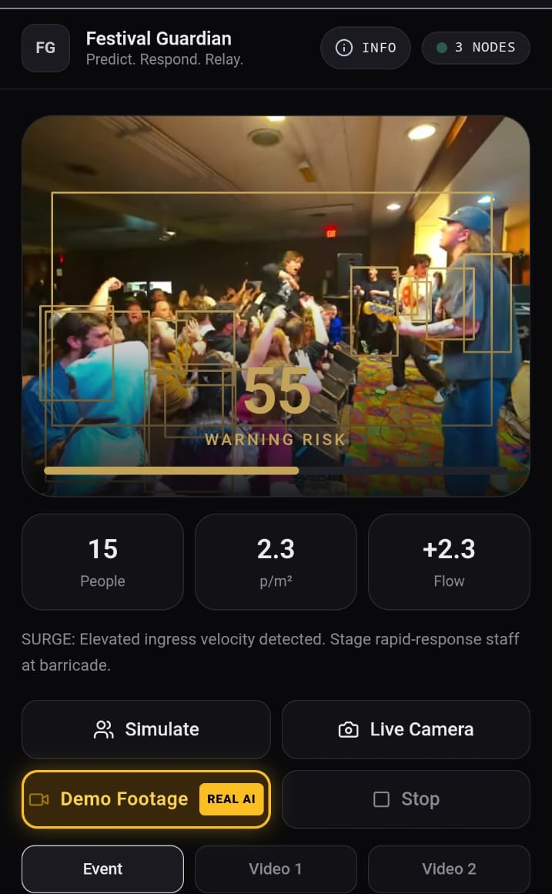



Point. Read. Warn.
Point the camera
On-device detection, in-browser today — no upload, no cloud call.
Live risk meter
Density and flow combine into one clear score.
Early warning
Organizers are alerted before a crush forms.
Real detection on real crowd footage — not synthetic data
Notes:
This screenshot shows the Demo Footage mode (tagged REAL AI in-app) running actual TF.js/COCO-SSD detection on real concert crowd video, not a synthetic number generator. This is the strongest proof-of-real-AI moment in the deck.

Slide 4


How it works, today vs. the Finale build
1
2
3
4
5
Camera
Detect
Score
Alert
Relay
Live feed from the phone
TensorFlow.js (COCO-SSD) runs on-device, in-browser, over WebGL
Density + flow become a 0-100 risk
A typed Alert object is created, with TTL + dedup
Working today same-device; native phone-to-phone at the Finale
Today: real on-device detection, in a web prototype. Finale: ported to native Android + Nearby Connections for true phone-to-phone offline relay.
Notes:
Be upfront in Q&A: vision AI is genuinely on-device (TF.js/COCO-SSD/WebGL) in a Next.js web prototype. The relay engine (TTL, dedup, typed alerts) is real code, but todays transport is BroadcastChannel, which only works across tabs on one device, not phone-to-phone yet. True offline multi-device relay via Android Nearby Connections is the planned 48-hour Finale build.

Slide 5
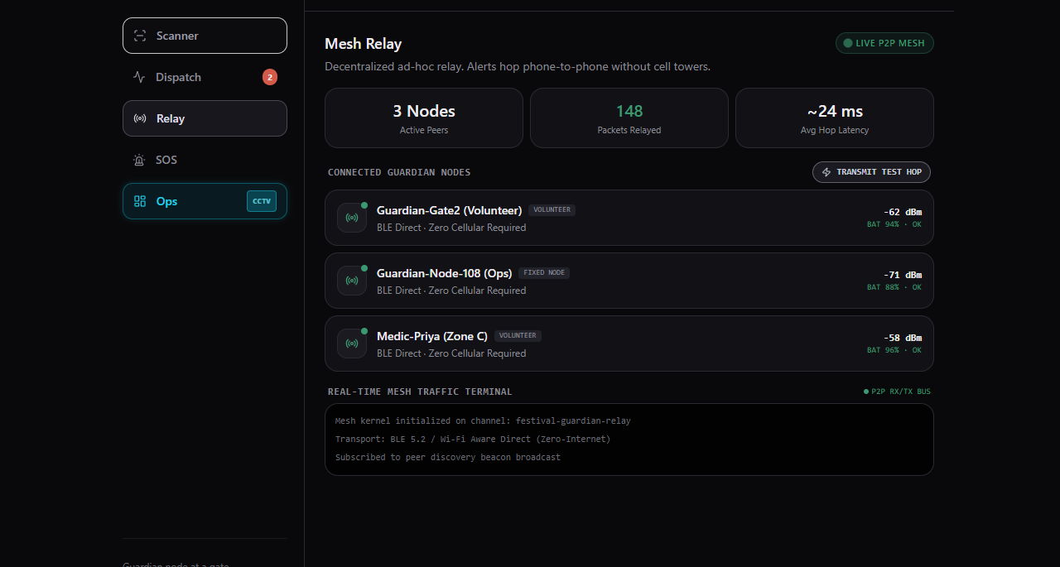
Relay engine — real code, local sim today
TTL hop bounds, packet dedup and a live node list are real and working. The transport shown here is a same-device simulation; true phone-to-phone hops ship at the Finale.
Today: relay engine + telemetry UI verified same-device. Finale: Android Nearby Connections, two real phones, one offline.
Notes:
Be precise if asked: the relay protocol (alert IDs, TTL, dedup) is implemented and tested today via BroadcastChannel across browser tabs on one device. The signal-strength and battery figures shown are simulated telemetry for the demo, not real radio readings yet. True phone-to-phone hops over Bluetooth/Nearby Connections is the planned 48-hour Finale build.

Slide 6



Who gets the alert
Event organizers
Live risk score, location and photo on their phone.
Emergency services (108 / 112)
A pre-filled emergency call with the exact location.
Family and nearby volunteers
Trusted contacts and nearby app users get the alert and pin.
Notes:
Say who receives the output. Concrete receivers make the idea feel real, like the Pune winner naming the civic body.

Slide 7



Roadmap: from node to network
Phase 1 — today
One app, one role. A Guardian node (camera, risk meter, SOS) built and demoed.
Phase 2 — split by role
Separate Guardian (node) and Dispatch (organizer) views: a map of zones, live risk per gate, the alert feed with hop/source — no camera needed for Dispatch.
Phase 3 — bring your own cameras
The same detection pipeline reads an RTSP/CCTV feed instead of a phone camera — venues use hardware they already have, no rebuild required.
Phase 1 is what we built and demo today. Phases 2-3 are the near-term extension, not a rebuild — same detection pipeline, new input/output.
Notes:
Keep this slide explicitly forward-looking. Do not let Phase 2/3 bleed into language used for what is demoed live today — that discipline is what makes the roadmap credible rather than a wish list.

Slide 8


Today vs. the Finale build
Built today (web prototype)
Finale: Red Light (phone only)
Real on-device detection: TF.js + COCO-SSD over WebGL
Alert engine: typed alerts, TTL, dedup — all working
Relay verified same-device (browser tabs)
Port detection to TFLite, run on the Snapdragon NPU
Android Nearby Connections for real phone-to-phone hops
Live demo: 2-3 iQOO phones, one offline
Scored on: phone-first execution, AI integration, Office Kit, real-world relevance, pitch.
Notes:
Confirm exact Office Kit / Red Light-Green Light rules for this event before the Finale. Green Light (phone+laptop) time goes to model export/quantization and pitch rehearsal, not core build.

Slide 9
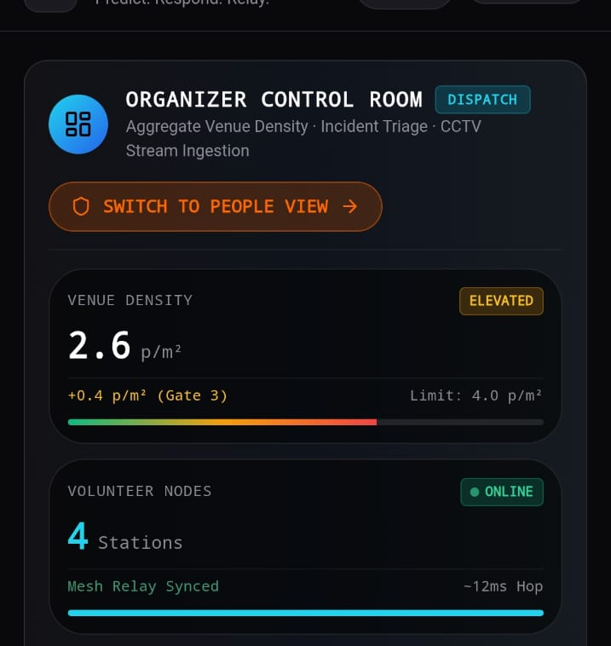
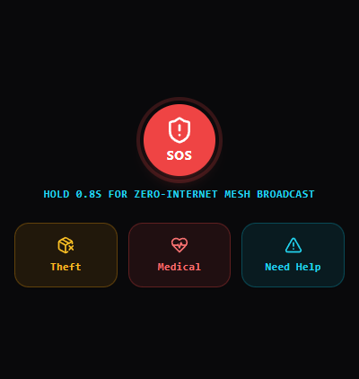
Two views, one app: Guardian + Dispatch
A volunteer at a gate sees only their node. An organizer sees the aggregate — venue density, active incidents, and a chokepoint focus across zones. Names, counts and incidents are demo data.
Organizer Control Room — Dispatch view
Guardian node — SOS / Theft / Medical
Notes:
Real captures from the running app: unified alert feed (crowd risk, theft, volunteer request) and the mesh network panel showing connected peer devices.

Slide 10
48 hours: what we ship
0-12h
12-30h
30-42h
42-48h
Detection + meter
Offline relay
Alerts + first aid
Polish + pitch
On-device counting and a live risk score
Two-phone SOS hop working end to end
Location, photo and a voice-guided first-aid card
Demo rehearsal, backup video, final deck
Festival Guardian: predict, respond, relay.
Thank You
Notes:
Close on the tagline. Scope is deliberate: the risk meter fully live, plus a two-phone relay.

