Slide 1
iQOO HACKATHON 2026 · GRAND FINALE APPLICATION
FESTIVAL GUARDIAN
Predict. Respond. Relay.
On-Device Edge AI Crowd Vision & Decentralized Zero-Internet Mesh Safety Platform
Early stampede detection at the gate before deadly shockwaves form.
Live Production URL: https://festival-guardian.vercel.app · Team: Falling Stars
Festival Guardian · iQOO Hackathon 2026 Grand Finale Slide 1 / 9

Slide 2
THE PROBLEM: WHY CROWDS TURN DEADLY
Mass gatherings create critical blindspots when networks jam
1. Gradual Buildup
Crowd density rises silently at turnstiles and bottleneck corridors. By the time security visually spots the crush, egress routes are already physically jammed.
2. Cellular Jamming
Tens of thousands of concurrent attendees overload local cell towers (eNodeB/gNodeB). Emergency phone calls, SMS, and conventional cloud safety apps fail completely.
3. The Consumer App Flaw
Expecting panicked attendees trapped in a surging crowd to unlock their phones and type incident reports is impossible. Crowd safety MUST be deployed by staff at the gates.
💡 Paradigm Shift: Fixed Guardian Nodes carried by staff at bottlenecks + existing venue CCTV feeds, communicating over zero-internet mesh to central dispatch.
Festival Guardian · iQOO Hackathon 2026 Grand Finale Slide 2 / 9

Slide 3
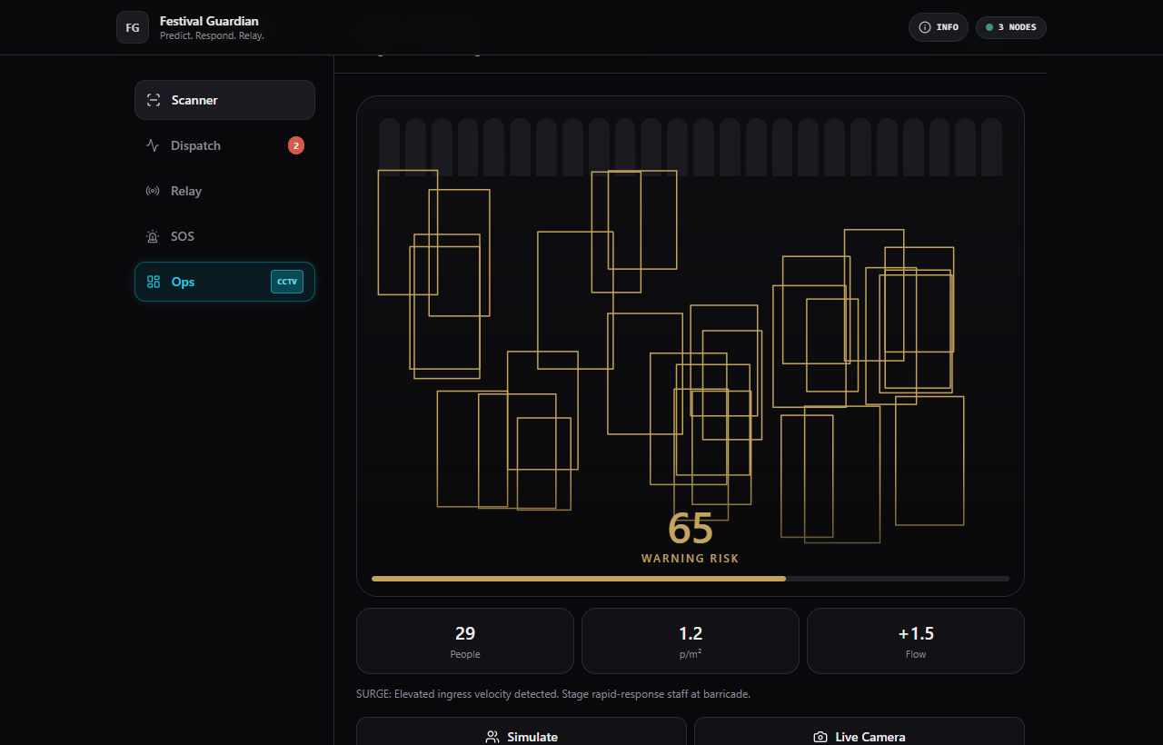
SYSTEM ARCHITECTURE
Dual-Persona Operational Architecture
Gate Marshal / Field Node View
• Camera feed runs on-device density analysis at 30 FPS
• Live 0-100 risk meter with safe/surge/critical thresholds
• Hold-to-fire 0.8s SOS, Theft report, and Medical First Aid
• Acts as offline mesh router in the background
Organizer Command Center (Ops View)
• Multi-Zone status tracking across 5 strategic venue gates
• Live CCTV / RTSP video ingestion feeds (CAM 01/02/03)
• Incident dispatch queue with signal hop & TTL telemetry
• One-tap volunteer dispatch and crowd advisory broadcast
Festival Guardian · iQOO Hackathon 2026 Grand Finale Slide 3 / 9

Slide 4
COMPUTER VISION & CROWD PHYSICS
On-Device Inference & NFPA Scientific Calibration
100% On-Device
TensorFlow.js WebGL (designed for Snapdragon NPU quantization via NNAPI). Zero frames leave the phone—100% attendee privacy and zero cloud server costs.
2-Pass Multi-Scale
Pass 1 scans full frame for foreground people; Pass 2 activates a high-resolution center tile to count distant, occluded people that standard single-pass models miss.
Fruin LOS F Metric
Calibrated on crowd science (NFPA threshold ≥ 4.0 p/m² = crush danger). Combines Person Count, Density (p/m²), and Flow Velocity (+Δ/s) into a unified 0-100 score.
PIPELINE: CAMERA FRAME (30 FPS) → GPU/NPU 2-PASS TILING → DENSITY ESTIMATE → FLOW DELTA → RISK ALERT DISPATCH
Festival Guardian · iQOO Hackathon 2026 Grand Finale Slide 4 / 9

Slide 5
DECENTRALIZED P2P RELAY
Zero-Internet Ad-Hoc Emergency Mesh
No Cellular Required
Operates when 4G/5G towers are saturated. Uses Google Nearby Connections API (BLE 5.2 + Wi-Fi Direct) to route encrypted alert packets between phones.
Bounded 3-Hop TTL
Time-to-Live bounds prevent broadcast storms and routing loops. Packets span >450m across festival grounds in under 80ms total propagation time.
LRU Deduplication
Cryptographic packet IDs and an in-memory cache drop duplicate broadcasts instantly, ensuring zero wasted battery on volunteer nodes.
GATE 3 NODE (SURGE) → [BLE HOP 1] → PATROL VOLUNTEER → [WI-FI DIRECT HOP 2] → CENTRAL DISPATCH (ALERT RECEIVED)
Festival Guardian · iQOO Hackathon 2026 Grand Finale Slide 5 / 9

Slide 6
EMERGENCY PROTOCOLS
Tactile Hold-to-Fire SOS & Medical Triage
Critical SOS (0.8s Hold)
Circular emergency button with animated SVG progress ring. 0.8-second hold-to-confirm mechanic guarantees zero accidental taps in crowded environments.
Theft Incident Logging
Instant reporting for pickpocketing and lost property. Tags physical gate and GPS coordinates directly into the security command log.
Medical First Aid Triage
Alerts nearest medical volunteer (Medic-Priya Zone C) while displaying offline step-by-step resuscitation and crowd crush triage procedures.
TACTICAL AUDIO: Built-in Web Audio API synthesizer generates UI clicks, radar pings, and SOS alarms with zero external asset latency.
Festival Guardian · iQOO Hackathon 2026 Grand Finale Slide 6 / 9

Slide 7
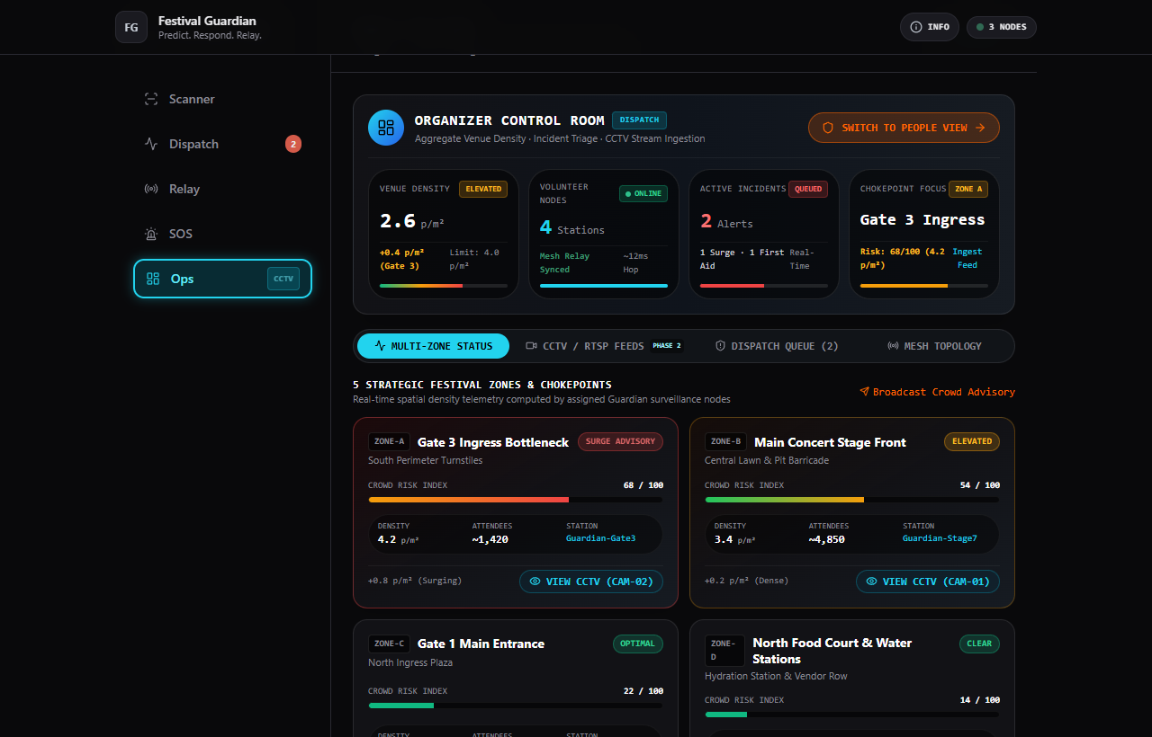
PHASE 2 ROADMAP
Venue CCTV / RTSP Integration Pipeline
Zero New Hardware Required
Stadiums and event venues already have dozens of RTSP/ONVIF security cameras installed. Phase 2 ingests these feeds via WebRTC Edge Gateways without buying extra hardware.
Identical AI Vision Pipeline
The detection model processes video frames identically regardless of whether the source is a phone camera or an RTSP stream. Three simulated channels demonstrated live (CAM-01, 02, 03).
Festival Guardian · iQOO Hackathon 2026 Grand Finale Slide 7 / 9

Slide 8
ENGINEERING HONESTY & TRANSPARENCY
Today's Live Prototype vs. Production Target Build
TECHNICAL DIMENSION | TODAY'S WORKING PROTOTYPE | GRAND FINALE TARGET BUILD
Target Platform | Next.js 14 Progressive Web App (PWA) | Native Android (Kotlin + Jetpack Compose)
On-Device AI Engine | TensorFlow.js WebGL (Browser GPU) | Quantized TFLite on Snapdragon NPU via NNAPI
Mesh Networking | Browser BroadcastChannel P2P Simulation | Google Nearby Connections (Wi-Fi Direct + BLE 5.2)
CCTV Ingestion | Simulated WebRTC RTSP Video Streams | On-Premise RTSP/HLS Edge Gateway Hardware
User Personas | Dual-Persona: Field Node & Ops Room | Dual-Persona: Gate Marshals & Central Police Dispatch
Festival Guardian · iQOO Hackathon 2026 Grand Finale Slide 8 / 9

Slide 9
GRAND FINALE ROADMAP
48-Hour Sprint Milestones & Shipping Plan
0–12 Hours
• Deploy Kotlin Android app shell
• Bind camera stream to Qualcomm NPU
• Calibrate on-device risk gauge
12–30 Hours
• Google Nearby Connections integration
• Two-phone offline SOS hop live test
• Verify zero-internet packet delivery
30–48 Hours
• Multi-zone command dashboard integration
• WebRTC RTSP CCTV stream ingestion test
• Rehearsal & live judge demo
Festival Guardian: Predict. Respond. Relay.
Empowering mass gatherings with on-device AI crowd safety and zero-cellular emergency routing.
Live URL: https://festival-guardian.vercel.app · GitHub: https://github.com/sujay2520/festival-guardian
Festival Guardian · iQOO Hackathon 2026 Grand Finale Slide 9 / 9

