Slide 1
Arcana Hackathon IIT M
Sujay Srivastava, Siddhesh Mahajan
Public Sentiment Analysis (StockTwits) and STOCK Co-Occurrence

Slide 2
The AIM
We built a public sentiment analysis model of stocks using tweets on public forum ( here StockTwits)
Investors often want to know public sentiments on stocks because it can help them make informed investment decisions. Public sentiment can provide insights into how the market perceives a particular stock, which can impact its price and trading volume.
Why StockTwits?
StockTwits is a social media platform that is specifically focused on discussing stocks, and it allows users to share their thoughts and opinions on individual stocks, as well as broader market trends. By analyzing the sentiment of StockTwits users, investors can gain a better understanding of how the broader market is feeling about specific stocks and potentially make more informed investment decisions.

Slide 3
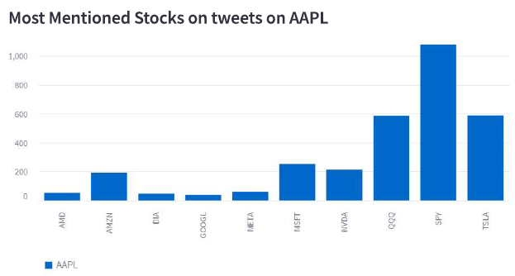
Method
#1 Co-occurrence of Companies in Tweets
Co-occurrence of companies in tweets can be a good public sentiment parameter because it can provide insights into how people are talking about different companies in relation to each other. This can be particularly useful for investors who are interested in understanding the competitive landscape, current trends,etc.

Slide 4
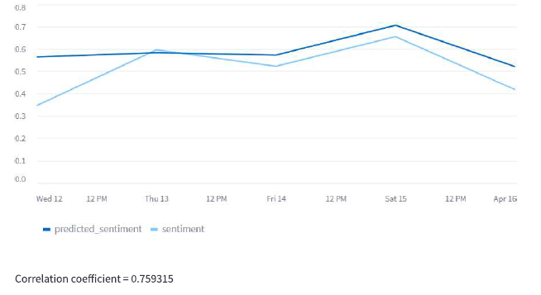
# 2 Sentimental Analysis of stocks
The recent tweets with particular company tagged is captured from StockTwits. Percentage of tweets which predicts bullish market (as opposed to) is considered as the sentiment of the stocks.

