Slide 1
STOCK TICKER

Slide 2
STOCK RETRIEVING FUNCTION
public class Stock extends AsyncTask<String, String, String> {
@Override
protected String doInBackground(String... params) {
HttpURLConnection connection = null;
BufferedReader reader = null;
try {
URL url = new URL(params[0]);
connection = (HttpURLConnection) url.openConnection();
connection.connect();
InputStream stream = connection.getInputStream();
reader = new BufferedReader(new InputStreamReader(stream));
String line = "";
StringBuffer buffer = new StringBuffer();
while ((line = reader.readLine()) != null) {
buffer.append(line+",");
}return buffer.toString();
} catch (Exception e) {
Toast.makeText(getApplicationContext(),"Error Fetching Stock Quotes",Toast.LENGTH_SHORT).show();
} finally {
if (connection != null) {
connection.disconnect();
try {
if (reader != null) {
reader.close();}
} catch (IOException e) {
e.printStackTrace(); }
}return null; }

Slide 3
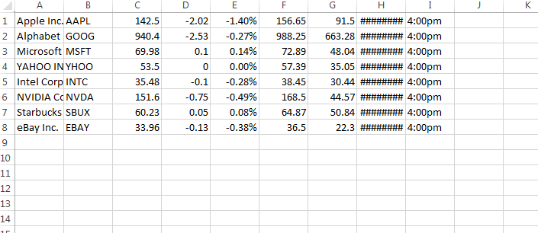
EXAMPLE STOCK VALUES

Slide 4
protected void onPostExecute(String s) {
try {
super.onPostExecute(s);
s = s.replaceAll("[\"]+", "");
String[] sampleArray = s.split(",");
SpannableStringBuilder builder = new SpannableStringBuilder();
int arrayCount = sampleArray.length;
for (int i = 0; i < arrayCount; i = i + 9) {
builder.clear();
String temp1 = "Name : " + sampleArray[i] + "\t\tSymbol :" + sampleArray[i + 1] + "\n\nPrice :" + sampleArray[i + 2] + "\t\tChange : ";
String temp2 = sampleArray[i + 3] + "(" + sampleArray[i + 4] + ")";
String temp3 = "\n\n" + "52 Week High : " + sampleArray[i + 5] + "\t\t" + "52 Week Low : " + sampleArray[i + 6] + "\n\n" + " Date : " + sampleArray[i + 7] + "\t\tTime :" + sampleArray[i + 8];
SpannableString spannable = new SpannableString(temp1);
spannable.setSpan(new ForegroundColorSpan(Color.BLACK), 0, temp1.length(), 0);
SpannableString spannable3 = new SpannableString(temp3);
spannable3.setSpan(new ForegroundColorSpan(Color.BLACK), 0, temp3.length(), 0);
builder.append(spannable);
if (temp2.contains("+")) {
SpannableString spannable1 = new SpannableString(temp2);
spannable1.setSpan(new ForegroundColorSpan(Color.rgb(0, 128, 0)), 0, temp2.length(), 0);
spannable1.setSpan(new StyleSpan(Typeface.BOLD), 0, temp2.length(), 0);
builder.append(spannable1);
}

Slide 5
else {
SpannableString spannable1 = new SpannableString(temp2);
spannable1.setSpan(new ForegroundColorSpan(Color.RED), 0, temp2.length(), 0);
spannable1.setSpan(new StyleSpan(Typeface.BOLD), 0, temp2.length(), 0);
builder.append(spannable1);
}
builder.append(spannable3);
TextView stockDetails = new TextView(getApplicationContext());
stockDetails.setText(builder);
textViews.add(stockDetails);
}

Slide 6
STOCK SEARCHING FUNCTION
public void searchStock(View view){
try {
stockLayout.removeAllViews();
textViews.clear();
cardViews.clear();
InputMethodManager inputManager = (InputMethodManager) getSystemService(Context.INPUT_METHOD_SERVICE);
inputManager.hideSoftInputFromWindow(getCurrentFocus().getWindowToken(), 0);
String stockSymbol=autoCompleteTextView.getText().toString();
autoCompleteTextView.setText(stockSymbol+"+");
String url="http://download.finance.yahoo.com/d/quotes.csv?s="+stockSymbol+"&f=nsac1p2kjd1t1";
new Stock().execute(url);
}
catch (Exception e){
Toast.makeText(getApplicationContext(),e.toString(),Toast.LENGTH_LONG).show();
}
}

Slide 7
CLEARING ALL STOCKS
public void clear(View view){
autoCompleteTextView.setText("");
stockLayout.removeAllViews();
textViews.clear();
cardViews.clear();
InputMethodManager inputManager = (InputMethodManager) getSystemService(Context.INPUT_METHOD_SERVICE);
inputManager.hideSoftInputFromWindow(getCurrentFocus().getWindowToken(), 0);
String url="http://download.finance.yahoo.com/d/quotes.csv?s=AAPL+GOOG+MSFT+YHOO+INTC+NVDA+SBUX+EBAY&f=nsac1p2kjd1t1";
new Stock().execute(url);
}

Slide 8
CREATE & RESUME FUNCTION
public class MainActivity extends AppCompatActivity {
AutoCompleteTextView autoCompleteTextView;
LinearLayout stockLayout;
List<TextView> textViews=new ArrayList<TextView>();
List<CardView> cardViews=new ArrayList<CardView>();
protected void onCreate(Bundle savedInstanceState) {
super.onCreate(savedInstanceState);
setContentView(R.layout.activity_main);
setRequestedOrientation(ActivityInfo.SCREEN_ORIENTATION_PORTRAIT);
this.getWindow().setSoftInputMode(WindowManager.LayoutParams.SOFT_INPUT_STATE_ALWAYS_HIDDEN);
autoCompleteTextView=(AutoCompleteTextView)findViewById(R.id.stockSymbol);
stockLayout=(LinearLayout)findViewById(R.id.stockLayout);
}

Slide 9
protected void onResume() {
super.onResume();
try {
//Check Internet connection
ConnectivityManager connectivityManager = (ConnectivityManager) getSystemService(Context.CONNECTIVITY_SERVICE);
NetworkInfo networkInfo = connectivityManager.getActiveNetworkInfo();
if (!(networkInfo != null && networkInfo.isConnected())) {
Toast.makeText(getApplicationContext(), "Please TURN ON Data Connection", Toast.LENGTH_SHORT).show();
startActivity(new Intent(Settings.ACTION_WIFI_SETTINGS));
} else {
//get Stock quotes
String url="http://download.finance.yahoo.com/d/quotes.csv?s=AAPL+GOOG+MSFT+YHOO+INTC+NVDA+SBUX+EBAY&f=nsac1p2kjd1t1";
new Stock().execute(url);
}
}
catch (Exception e){
Toast.makeText(getApplicationContext(),e.toString(),Toast.LENGTH_LONG).show();
}
}

