Slide 1
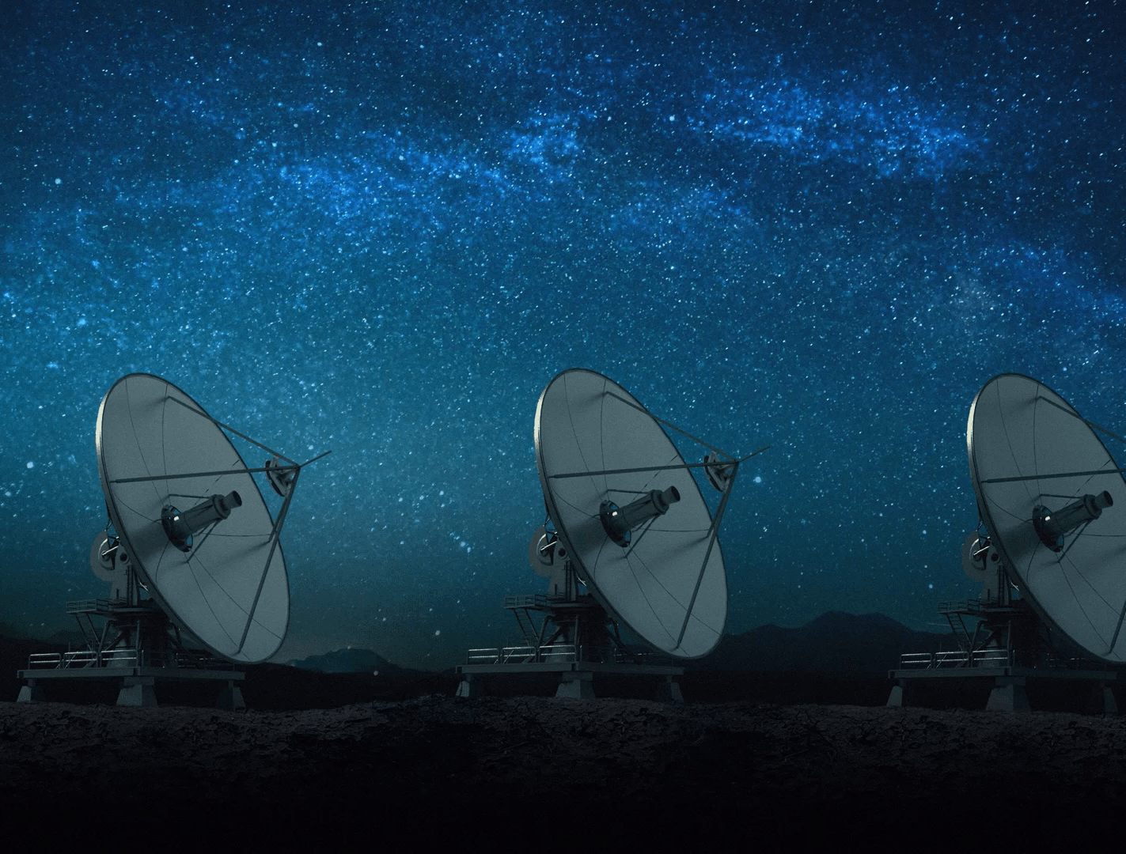
AI for Space:
From pixels to intelligence
Hands on Workshop
Cypher 2026
Suguna Jayaraj (Ex Swissre/AIG/Lloyd’s)
Founder, Entropy Analytix

Slide 2
Agenda
AI in Space: Introduction
Satellite Data Manipulation
Spatial Feature Engineering
GeoAI Foundation Models
Geospatial Application with VLM

Slide 3
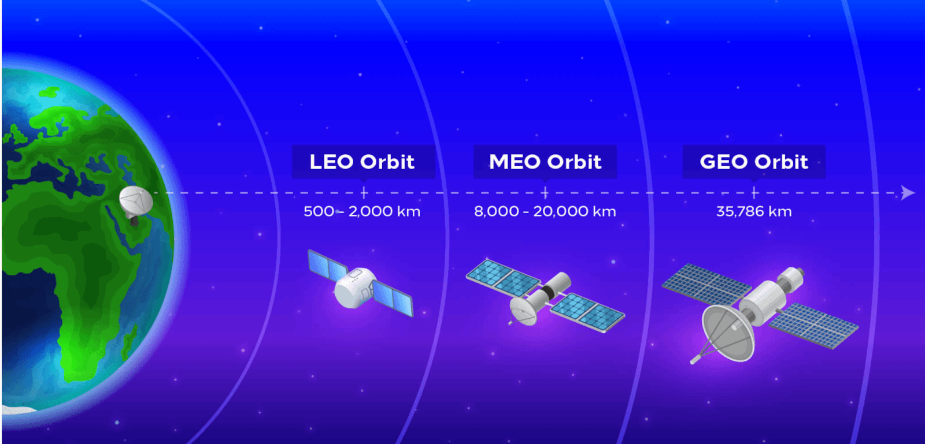
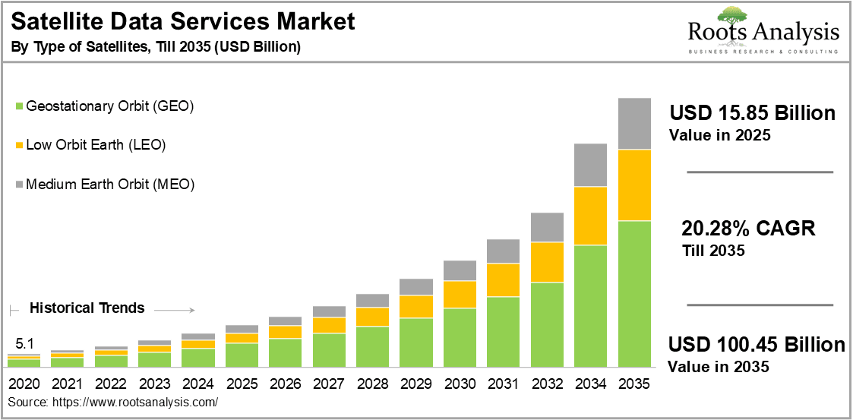
Introduction – Satellite data
Introduction

Slide 4

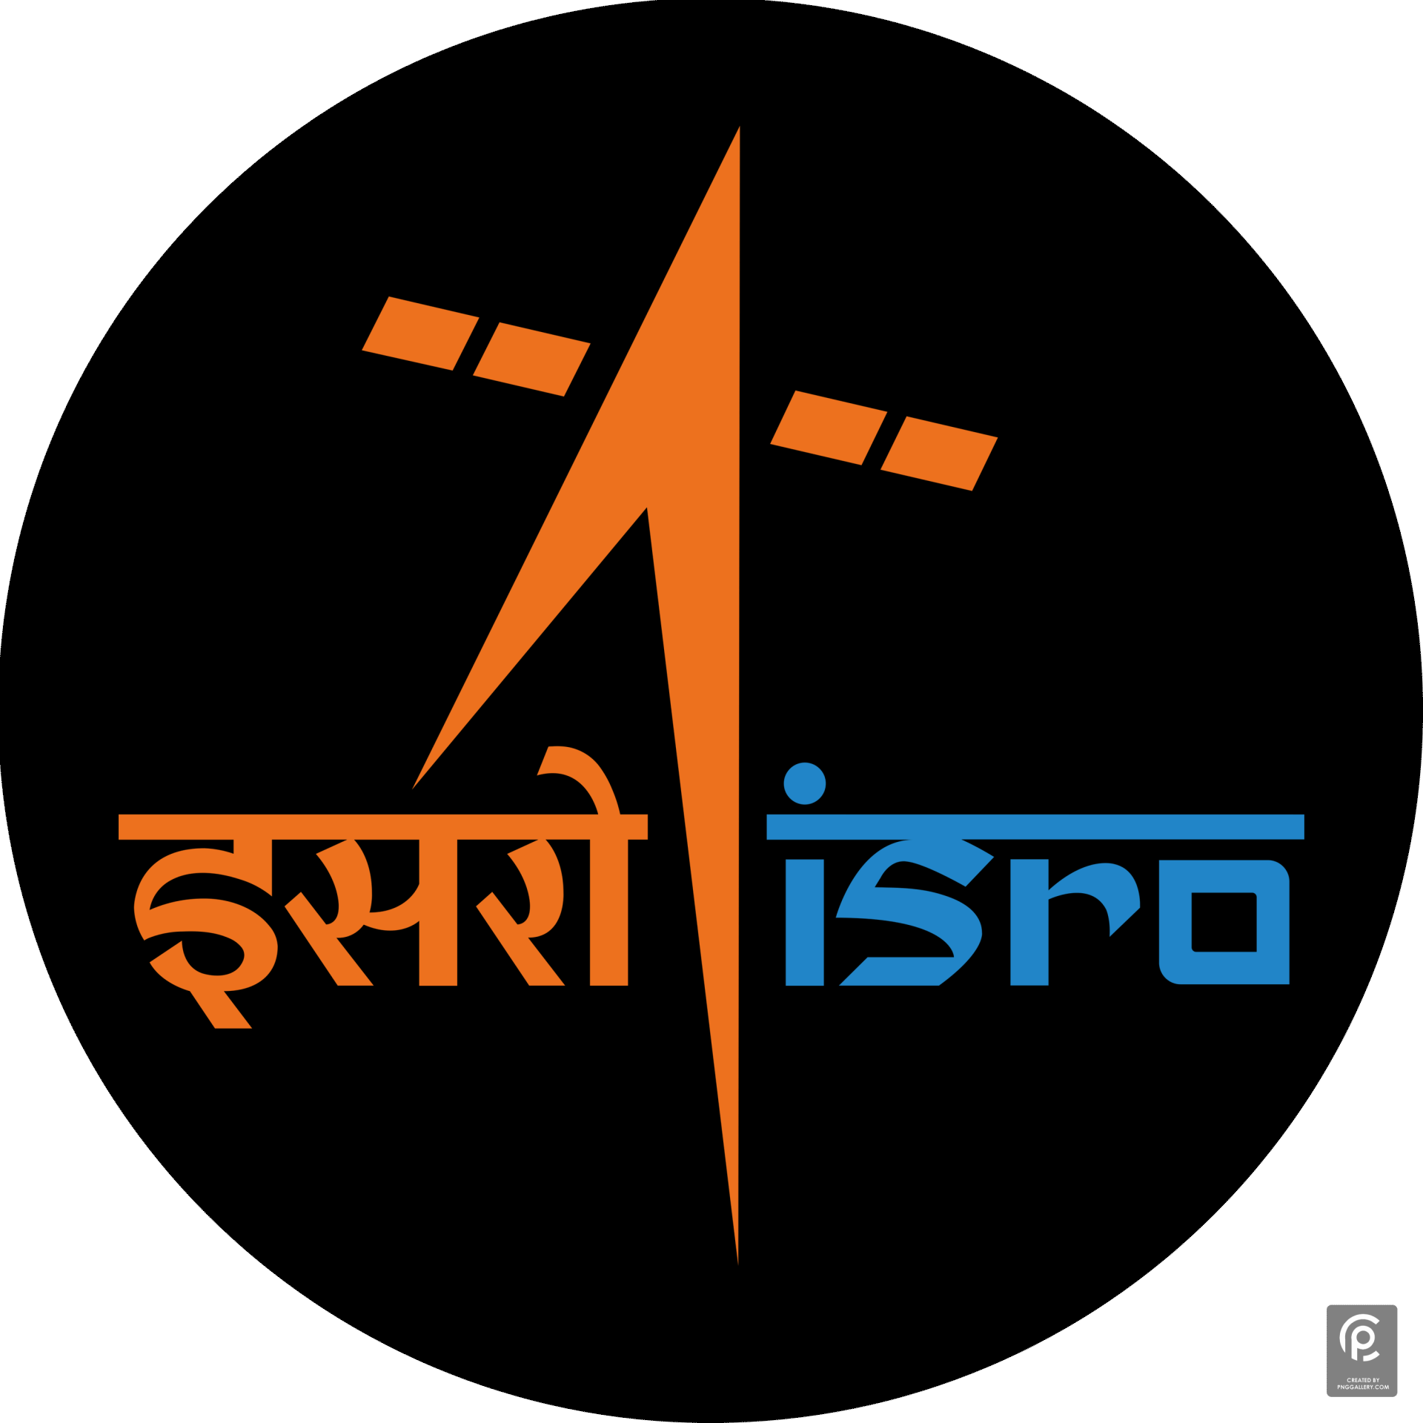





Satellite data – sources
Introduction
Govt Space data providers
Private Players

Slide 5
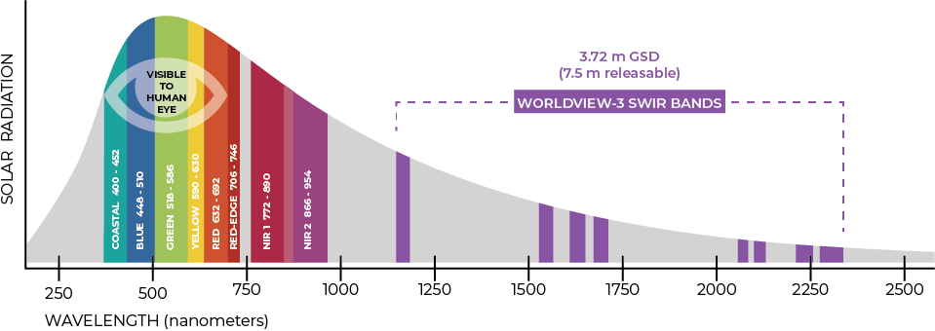
Satellite IMAGE – What is different?
Introduction
Satellite or aerial images that reveal these additional spectral bands are called multispectral. They show things like:
Chlorophyll activity, which is used to classify plant species and determine vegetation age, health, or stress
Mineral content in the soil, which is important for mining
Water content in soil and vegetation, which is useful for predicting floods and wildfires
Material characteristics used to create urban maps or reveal camouflage

Slide 6
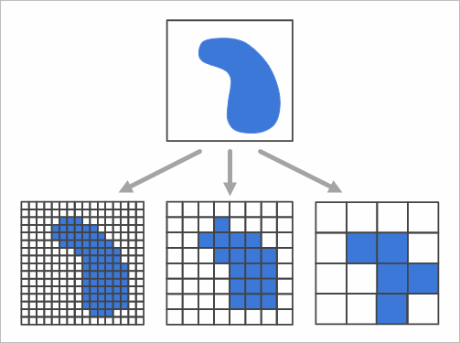
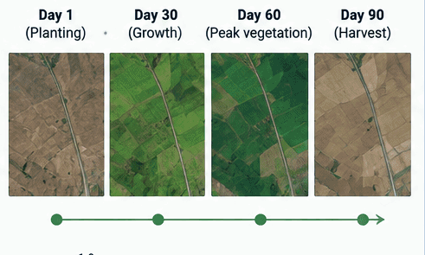
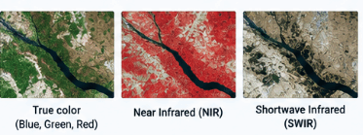
Understanding resolution
Introduction
Spatial Resolution
(Where?)
Temporal Resolution
(When?)
Spectral Resolution
(What?)

Slide 7
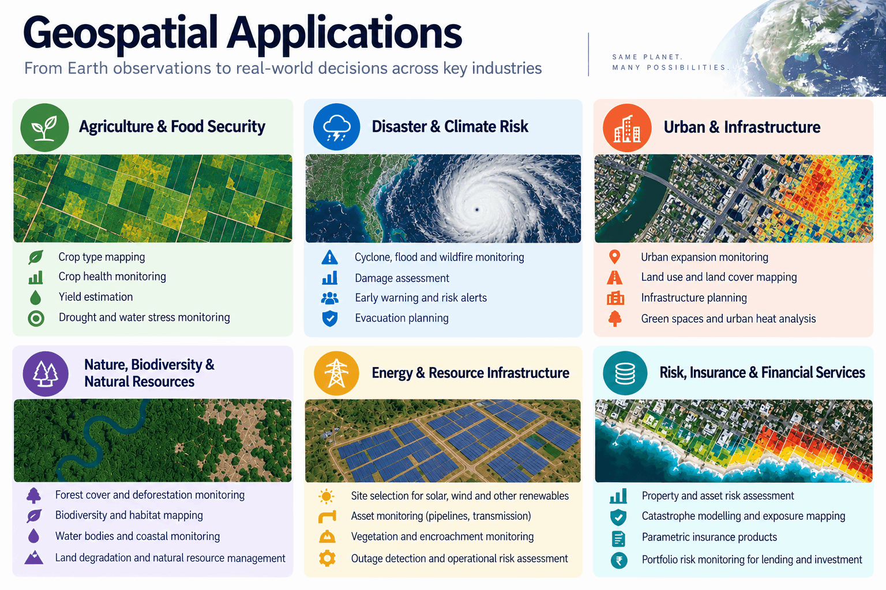
EARTH OBSERVATION APPLICATIONS
Introduction

Slide 8
Hands on – Module 1
DATA PREPARATION

Slide 9
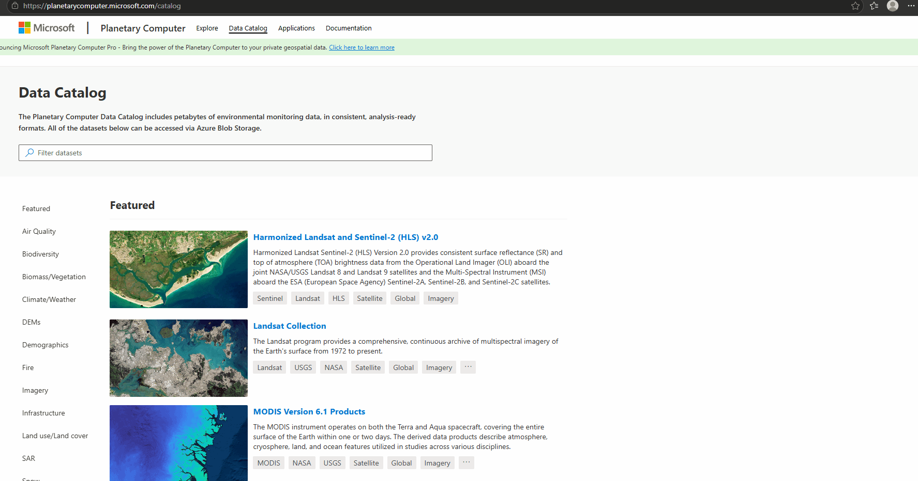
Data download
Module – 1
Data Catalog | NASA Earthdata
Data Collections | Copernicus Data Space Ecosystem
EarthExplorer
Google Earth Engine
Data Catalog | Planetary Computer
Lot of geospatial datasets are available open source available for consumption in the form of API, downloads and Python packages
Challenge is in testing the right data source, resolution and level of processing for the use case and geography of study.

Slide 10
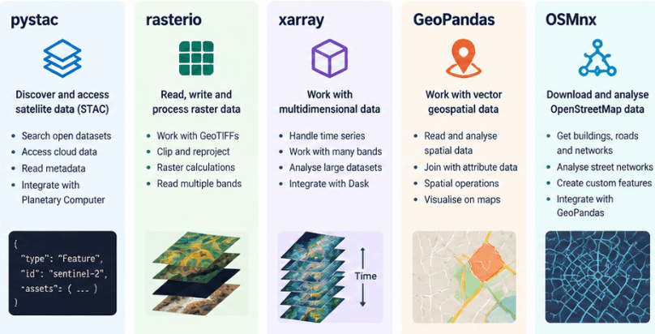
Geospatial libraries
Module – 1

Slide 11
TRY OPTIONS
Module – 1
Change Cities
Bangalore
center = [12.9716, 77.5946]
bbox = [77.5807, 12.9581, 77.6085, 12.9851]
Mumbai
bbox = [72.8634, 19.0625, 72.8920, 19.0895]
center = [19.0760, 72.8777]
For area conversions use UTM 32643
2)Change Basemap from Satellite to "OpenTopoMap","Roadmap"
3) Change dates and cloud cover cutoffs and check scenes

Slide 12
Hands on – Module 2
Feature engineering

Slide 13
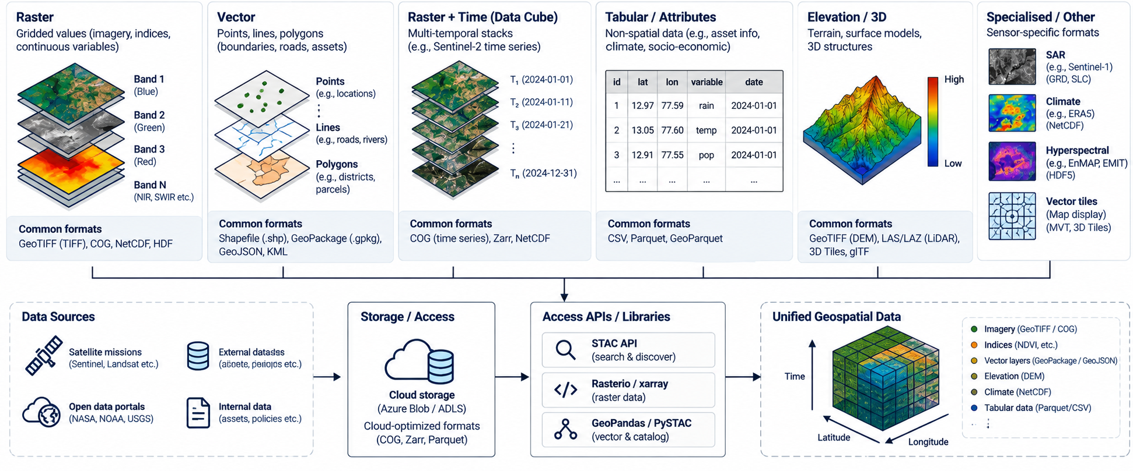
Data manipulation
Module – 2
Translating and merging of the datasets requires an understanding of the real world data

Slide 14
CREATING FEATURES
Module – 2
Index | Full Name | Primary Target | Band calculation
NDVI | Normalized Difference Vegetation Index | Vegetation | NDVI = (NIR − Red) / (NIR + Red)
NDWI | Normalized Difference Water Index | Water | NDWI = (Green – NIR) / (Green + NIR)
NDBI | Normalized Difference Built-up Index | Built-up areas | NDBI = (SWIR − NIR) / (SWIR + NIR)
SAVI | Soil Adjusted Vegetation Index | Vegetation with soil influence | SAVI = [(NIR − Red) / (NIR + Red + L)] × (1 + L)
Feature engineering adds physical meaning to spectral measurements giving ML models variables that describe what is happening on the ground.
Index-based approach is usually applied together with classification methods, spectral analysis, field surveys, or other remote sensing data.

Slide 15
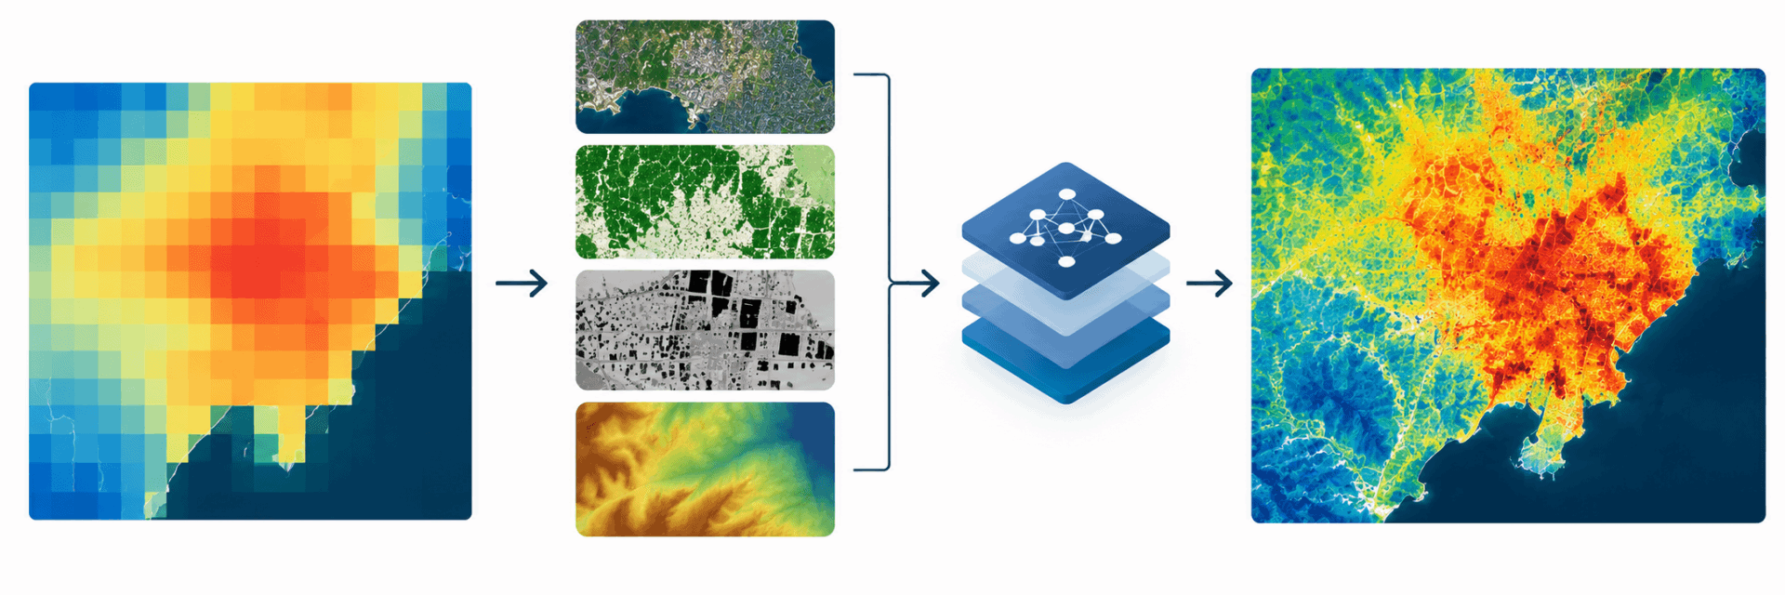
downscaling
Module – 2
Classification models are trained on a higher resolution using spatial features and scaled to lower resolutions
X=[NDVI, NDBI, NDWI, DEM, LULC, Building Density,…]
y=LST (120m)
y^​=f(X)​
Then apply the learned relationship using the 10 m predictors to generate: LST10m​

Slide 16
TRY OPTIONS
Module – 2
Add a new feature
savi = (nir - red) / (nir + red + 0.5 * 10000) * 1.5
2) Change date and model for a winter or different scene

Slide 17
Applications
Module – 2
Urban heat intelligence
10 m LST + buildings + population + land use
→ Heat hotspots
→ Heat inequality / exposure
→ Cooling-priority zones
→ Urban greening optimisation
Crop water stress
Fine LST + NDVI/vegetation + soil moisture
→ Crop thermal stress
→ Irrigation requirement
→ Evapotranspiration estimation
→ Yield/stress prediction
Wildfire Risk
Fine LST + vegetation + drought + fuel + terrain
→ Hot/dry zones
→ Pre-fire vegetation stress
→ Fire susceptibility
→ Post-fire damage assessment

Slide 18
Hands on – Module 3
Geoai foundation model

Slide 19
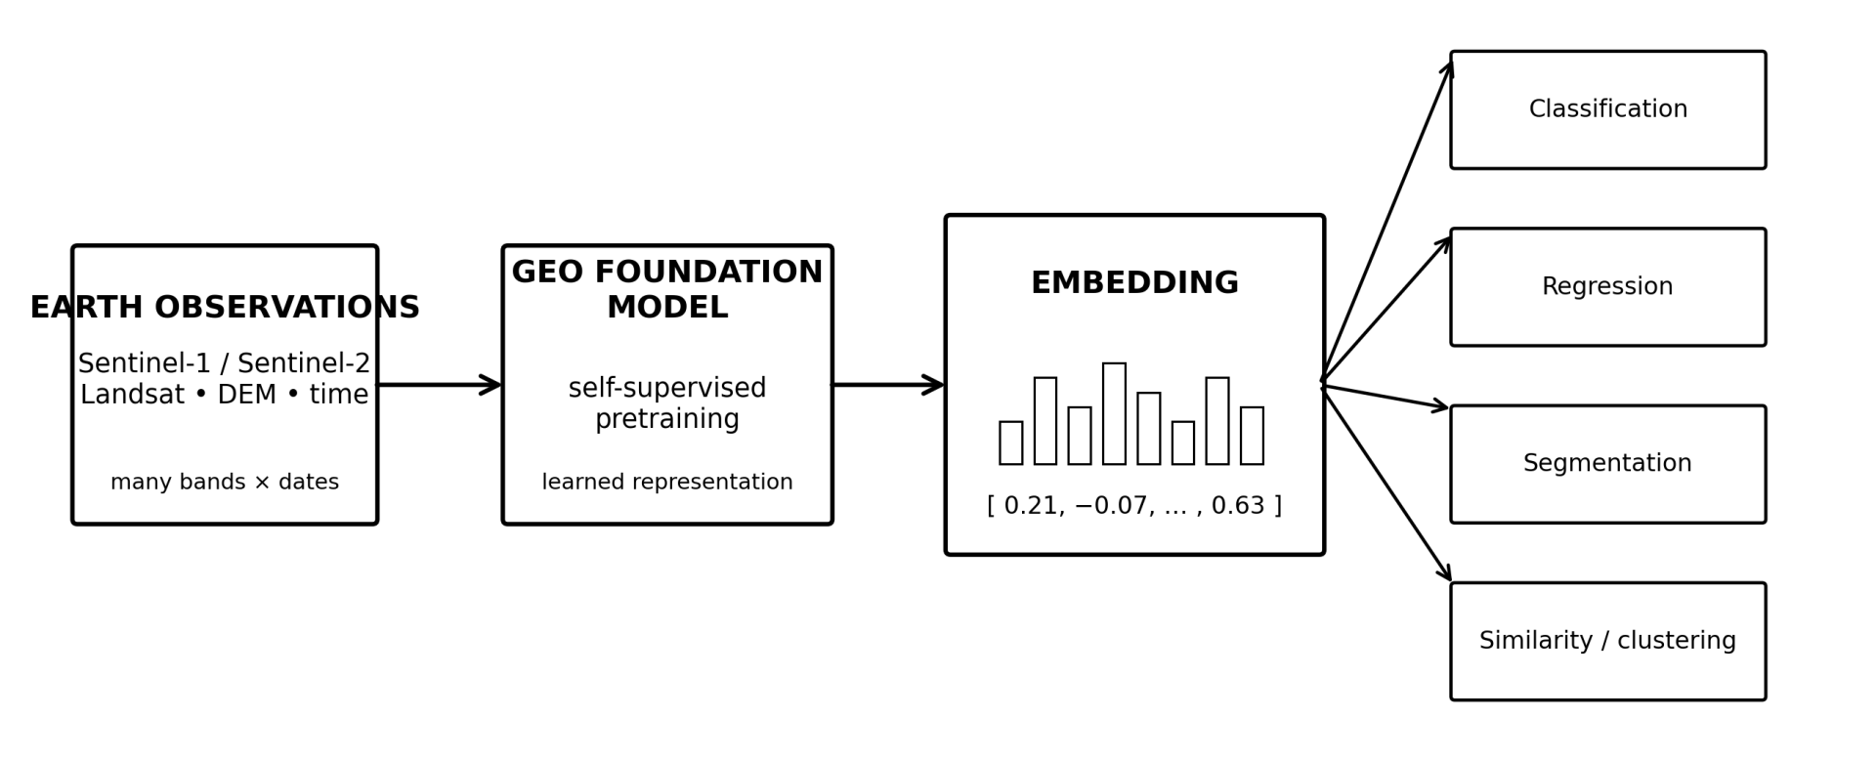
Geoai EMBEDDINGS
Module – 3
A normal pixel might be: Red = 0.18, Green = 0.24, NIR = 0.51
An EO foundation model turns the observations into something more like: [0.21, −0.07, 0.43, …, 0.63]

Slide 20
Geoai foundation models
Module – 3
Model | Main data / resolution | What it learns | Good downstream uses | Open?
TESSERA | Sentinel-1 + Sentinel-2; 10 m; annual temporal representation | Pixel-wise Earth representation | Crop classification, ecosystem mapping, regression, similarity | Yes
AlphaEarth Foundations | Multi-source EO; 10 m; annual embeddings | 64-D representation of spatial + temporal Earth context | Classification, regression, change detection, similarity | Embeddings available
Prithvi-EO-2.0 | Harmonized Landsat + Sentinel-2; 30 m; multi-temporal | Spatiotemporal EO representation | Land cover, crop mapping, flood, burn scars, segmentation | Yes
Clay | Sentinel-1/2 + other EO; spatial + temporal metadata | General Earth representation | Classification, regression, embeddings, environmental applications | Open source
SatMAE | Satellite imagery; multi-temporal/multispectral | Masked-autoencoder representation | Classification, segmentation, transfer learning | Research/open

Slide 21
TRY OPTIONS
Module – 3
Change embedding year
savi = (nir - red) / (nir + red + 0.5 * 10000) * 1.5
2) Change date and model for a winter or different scene

Slide 22
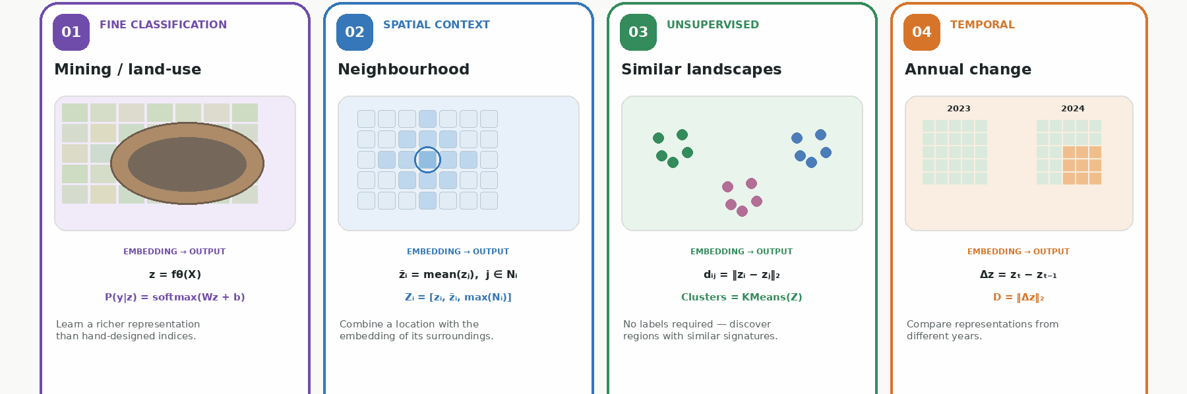
USING EMBEDDINGS
Module – 3

Slide 23
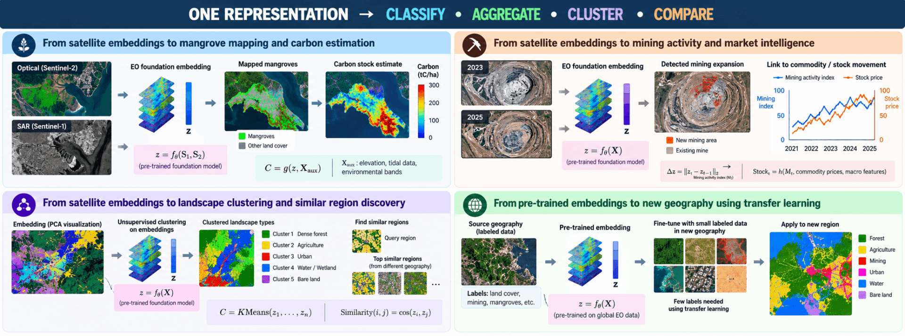
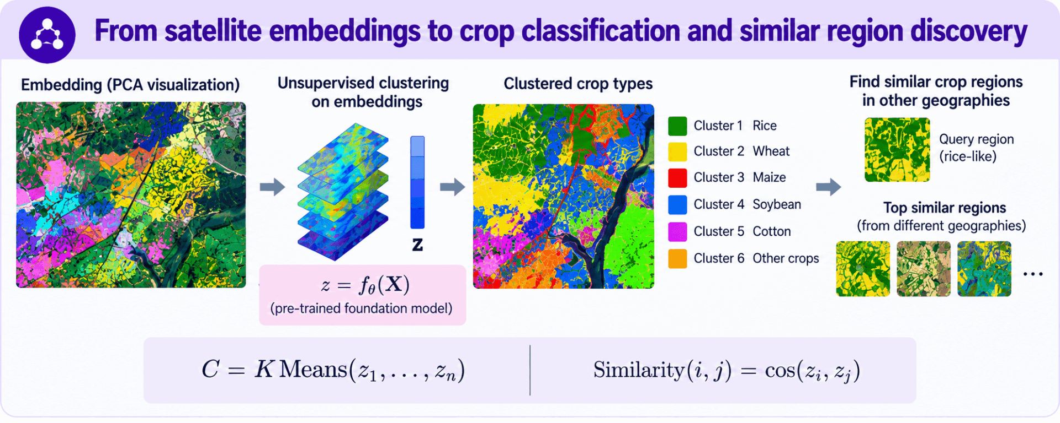
Downstream applications
Module – 3

Slide 24
Hands on – Module 4
GEOSPATIAL application with VLM

Slide 25
opportunities
Multimodal fusion : Combining optical, SAR, LiDAR, DEM, weather and ground observations
Domain specific ground truth: Learning with labels on the ground, drones, ioT devices, sensors
Synthetic & simulated EO data : Creating training data for rare events such as disasters and extreme hazards

Slide 26
Thank you!

