Slide 1
MIMIC NLP
Sujay Gopinathan (sg59258)

Slide 2
User Story
Find the most common disease from the MIMIC-III database and do NLP on the notes with the ICD9 code corresponding to the disease.
Will use DIAGNOSES_ICD, NOTEEVENTS, D_ICD_DIAGNOSES from the MIMIC-III database https://physionet.org/content/mimiciii/1.4/
Use Spacy, SciSpacy, Word2Vec, tSNE plots and medSpacy as NLP tools.

Slide 3
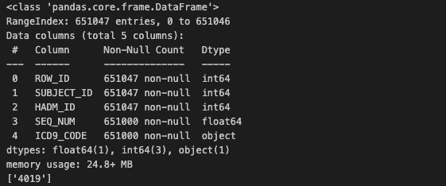
Read the MIMIC-III files
Download the DIAGNOSES_ICD, NOTEEVENTS and D_ICD_DIAGNOSES csv files from the MIMIC-III database.
Read the csv files using pandas
Find the most common disease identified by the ICD9_CODE from the DIAGNOSES_ICD file.
ICD9_CODE = 4019 is the most common disease
Create a new csv (disease_notes.csv) for all notes of patients with ICD9 code as 4019.

Slide 4
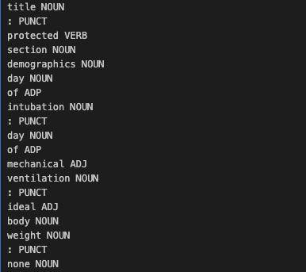
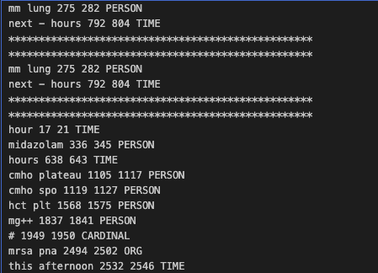
Spacy Assignment
Read the disease_notes.csv file, preprocess the data and then load into the model using Spacy.
Print out the lines from each note
Print out the tokens and NER’s

Slide 5
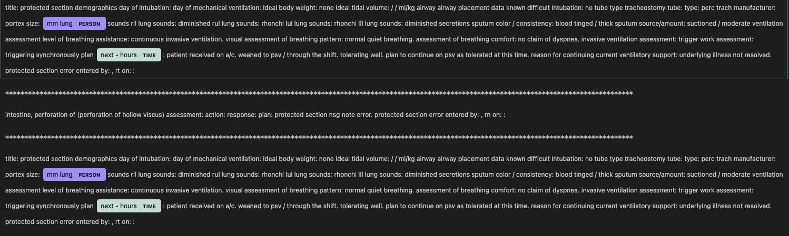
Spacy Entity Visualization

Slide 6
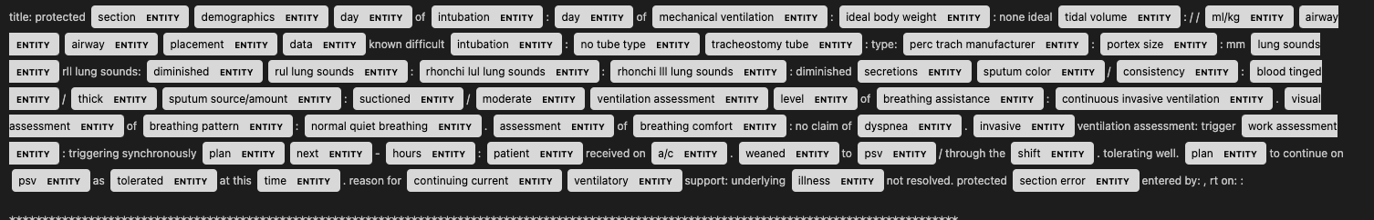
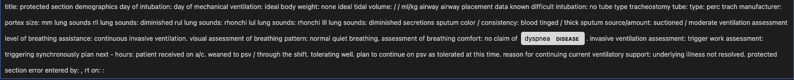
SciSpacy Assignment
Do the same exercise as Spacy with an untrained model (en_core_sci_md) and visualize the named entities
SciSpacy is able to do much better than Spacy
Use NER model (en_ner_bc5cdr_md) to identify diseases

Slide 7
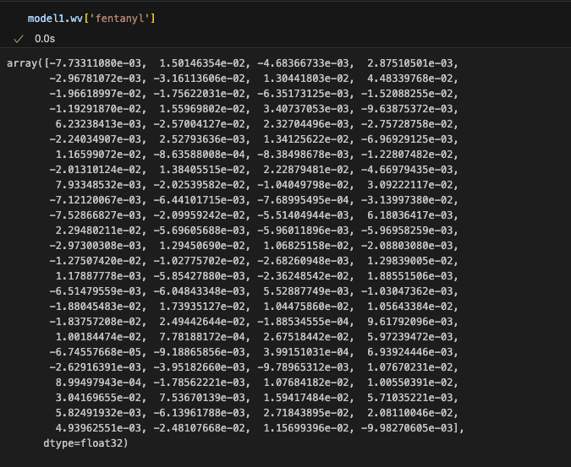
Word2Vec Assignment
Load the CORE untrained model and read the disease_notes.csv file
Build the corpus
Create the word2vec embeddings

Slide 8
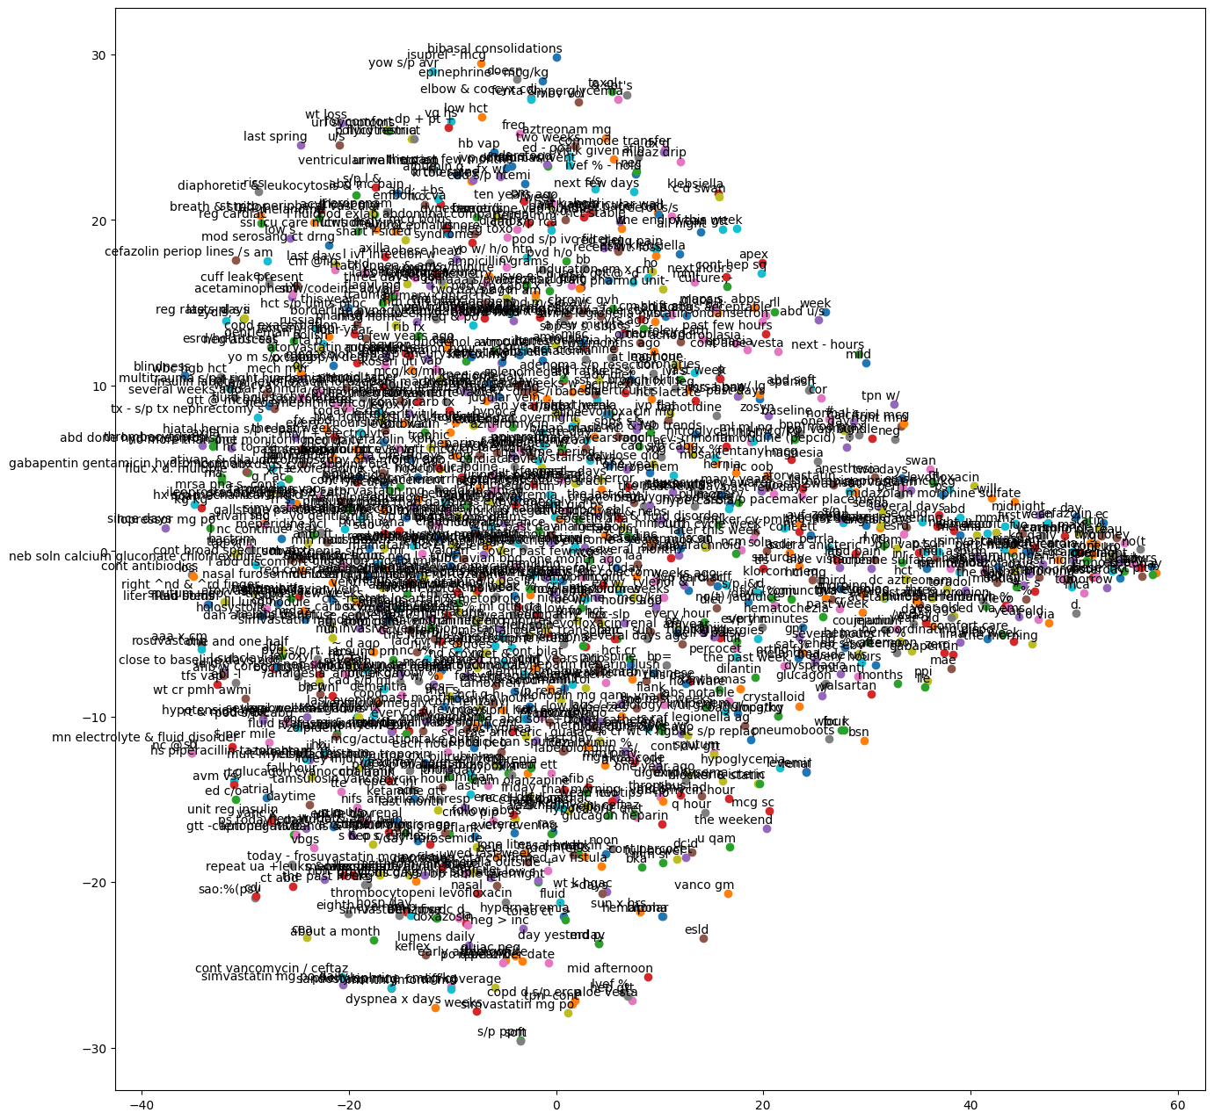
tSNE Plot for untrained model
1. For untrained model, the tSNE plot is very noisy.

Slide 9
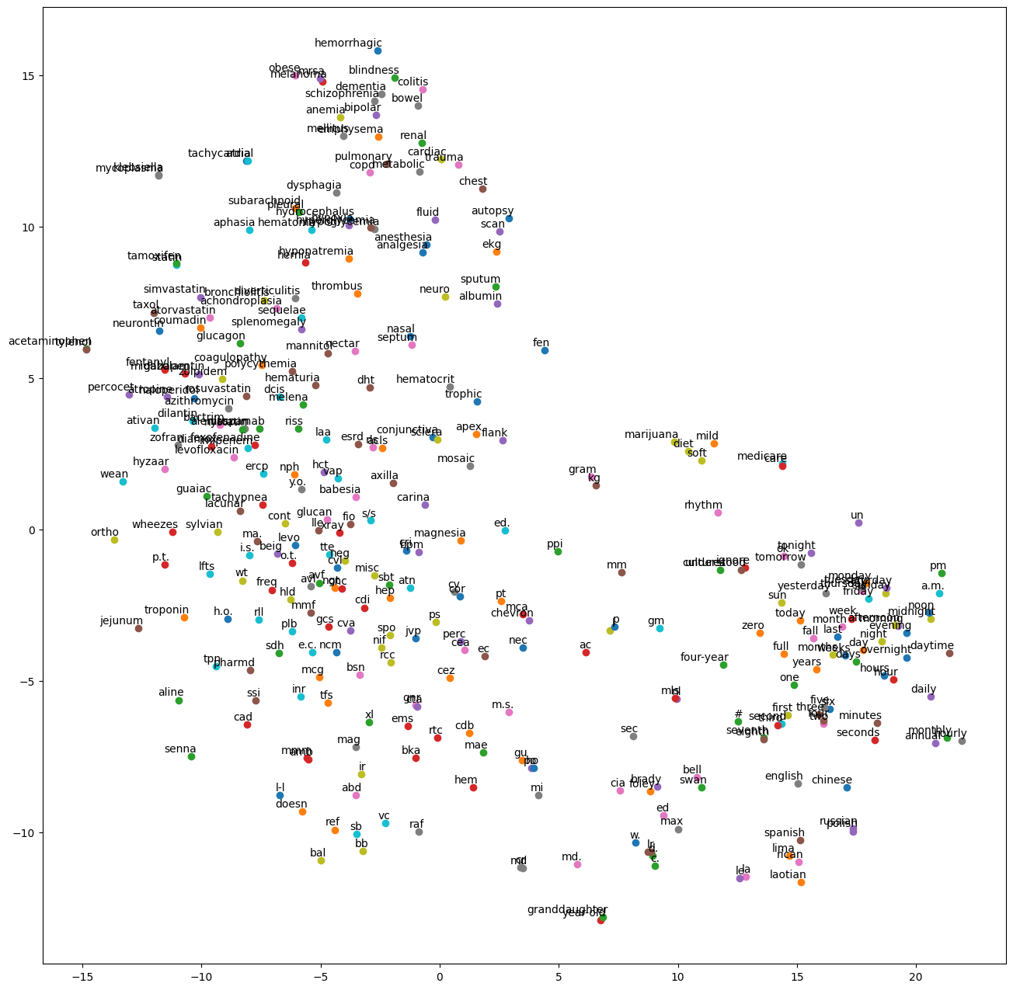
tSNE plot using a pre-trained model
1. For pretrained model, the plot is much better.

Slide 10
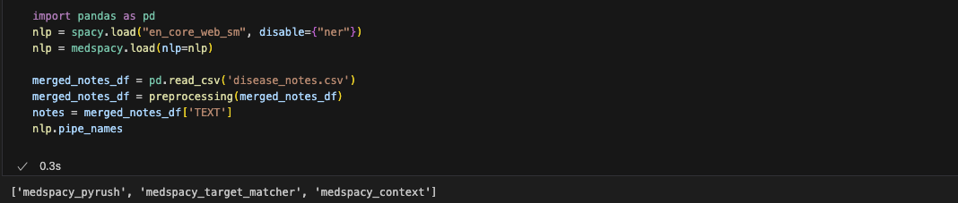
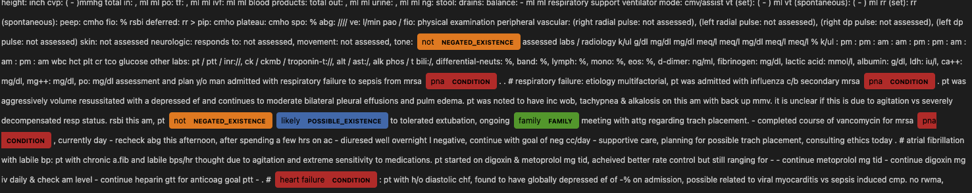
MedSpacy Assignment
Install medspacy and load the model.
Read disease_notes.csv after pre-processing
Display the pipes in the pipeline
Add target rules to the medspacy_target_matcher pipe
Visualize the entities

