Slide 1
STATISTICS CASE STUDY SUBMISSION
Group Name: SuHaNiSh
Sujay DSa (DDA1610008)
Harshit Rai (DDA1610117)
Nithin Raghuveer (DDA1610258)
Shyam Kumar V N (DDA1610248)

Slide 2
Abstract
A consumer finance company is looking towards a statistics-based solution to assess risks associated with approving a loan application. The likeliness of the applicant to stay committed to repay a loan leads to two scenarios from the company’s perspective:
If the applicant is likely to repay the loan, then not approving the loan to the person results in a loss of business to the company.
If the applicant is not likely to repay the loan i.e. default, then approving the loan to the person results in a financial loss to the company.
Company profile/Business understanding:
This company is the largest online credit marketplace, facilitating personal loans, business loans, and financing for elective medical procedures. Borrowers can easily access lower interest rate loans through a fast online interface. Investors provide the capital to enable many of the loans in exchange for earning interest.
A dataset made out of prior loans disbursed and their repayment status is provided by the company. They have narrowed down the attributes relevant for analysis as ten driver variables.
The objective of the analysis is to understand the driving factors behind loan default so that the company can utilize this knowledge for portfolio and risk assessment.

Slide 3
Solution Methodology
Start
Formulate null and alternate hypothesis based on insights derived
Evaluate hypothesis w.r.t to the results of the testing.
Extract subset without outliers.
Also retain only driver variables in the subset
EDA: Perform Univariate Analysis
1. Perform missing value treatment
2. Plot Distributions for variables
3. Find normality of distributions
4. Obtain summary statistics
Select confidence levels and the suitable statistical tests to carry out on the samples obtained.
Peer Review
Perform graphical analysis of the subset in tableau and R.
EDA: Perform Multivariate Analysis
1. Plot Distributions against loan status and interest rate groups
2. Obtain summary statistics for sub groups
Perform hypothesis testing for mean based on loan status group
Document Results
Derive Hypothesis w.r.t. loan_status and int_rate_group.
Perform hypothesis testing for mean based on interest rate group as well
Stop
Outlier Treatment
1. Perform IQR treatment over annual income.
2. Find out statistics with and without outliers 3. Remove outliers
Derive additional insights from graphs obtained in R and Tableau

Slide 4
Missing Value and Outlier Treatment
Missing Value Treatment
On an initial analysis of the driver variables, we identified the value “n/a” under the emp_len variable.
The no of records having this value was 288.
Hence, we ignored these records from the analysis
Also, no missing values were found when the other driver variables were analysed.
Outlier treatment
A few outliers were detected on the upper range of Annual_inc. It was unclear if these were genuine outliers or not . Also , they constituted less than 10 % of observations and were hence removed from the analysed data.
Some outliers were detected in Loan amount and Funded amount. But as per business logic these were valid loan amounts and hence were not removed or imputed with alternate values.
https://www.lendingclub.com/foliofn/rateDetail.action

Slide 5
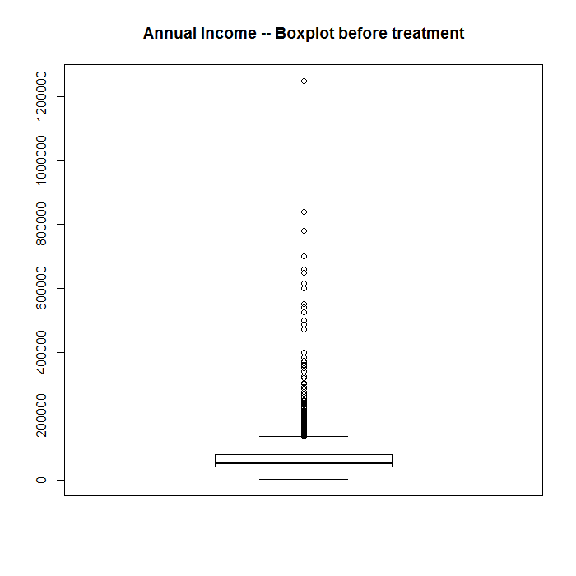
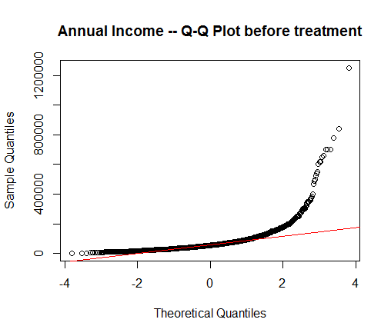
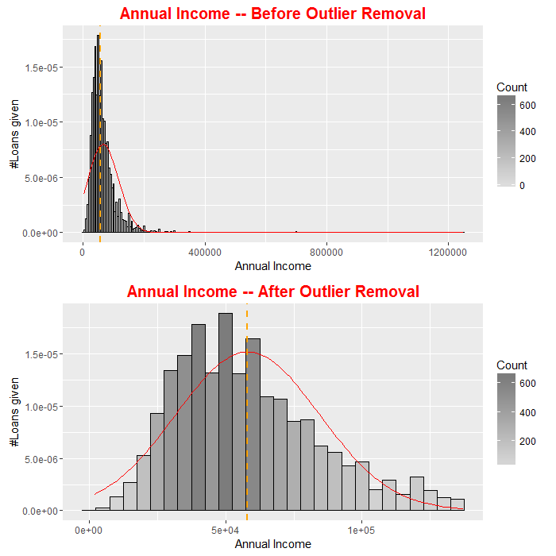
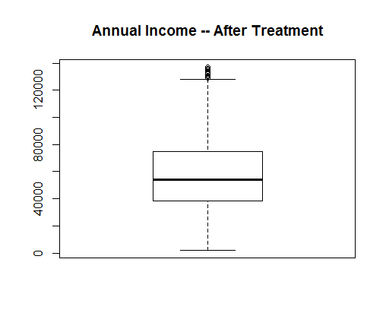
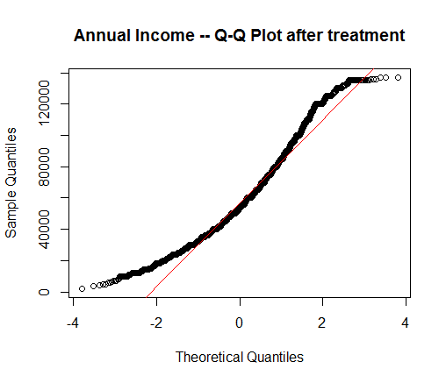
Univariate Analysis and Outlier Treatment
Annual Income
Found 397 Values which were detected as Outliers. These records were ignored.

Slide 6
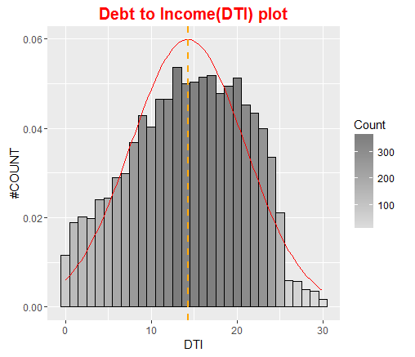
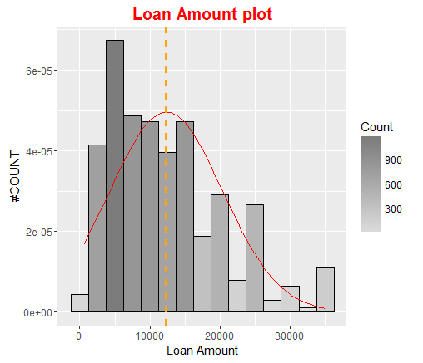
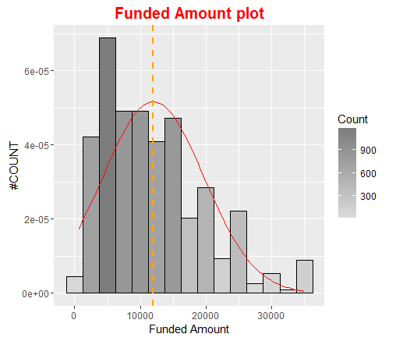
Univariate Analysis and Outlier Treatment
DTI, Loan Amount, Funded Amount
Most of the loan amount is below 20k
Most of the funded amount is below 20k

Slide 7
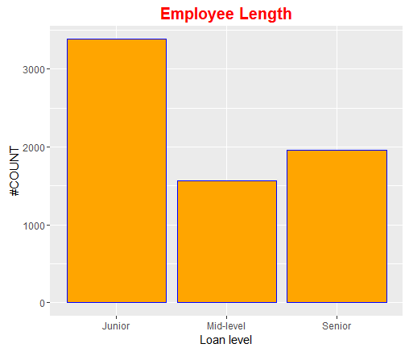
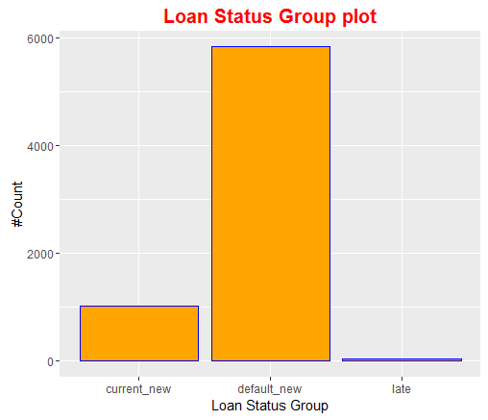
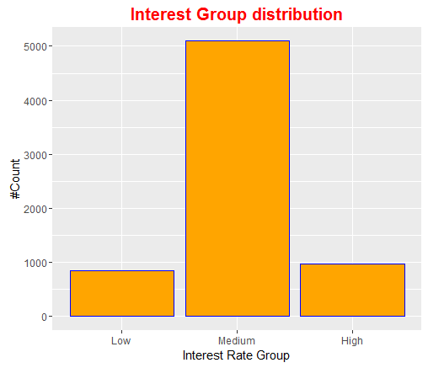
Univariate Analysis and Outlier Treatment
Junior Level Employees have the most number of loans
Most Loans are being defaulted
Most Loans in the Medium Interest Group

Slide 8
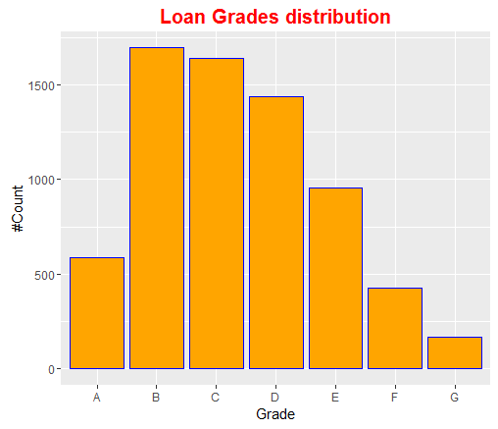
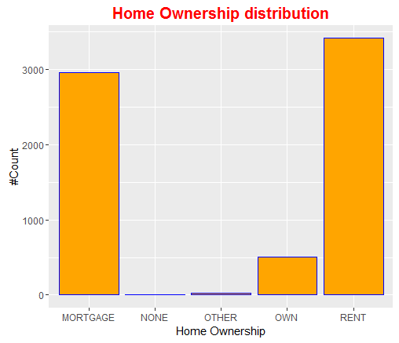
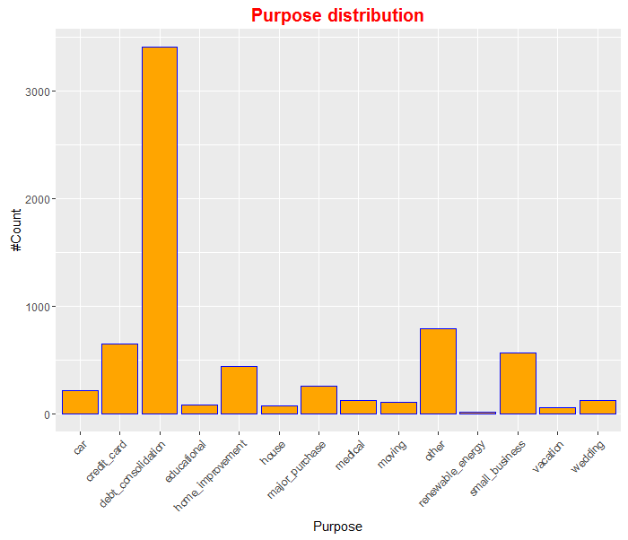
Univariate Analysis and Outlier Treatment
Most Loan grades are between B and E
Most Loans are given out to people in rented and mortgaged properties
Most Loans are given out towards debt consolidation

Slide 9
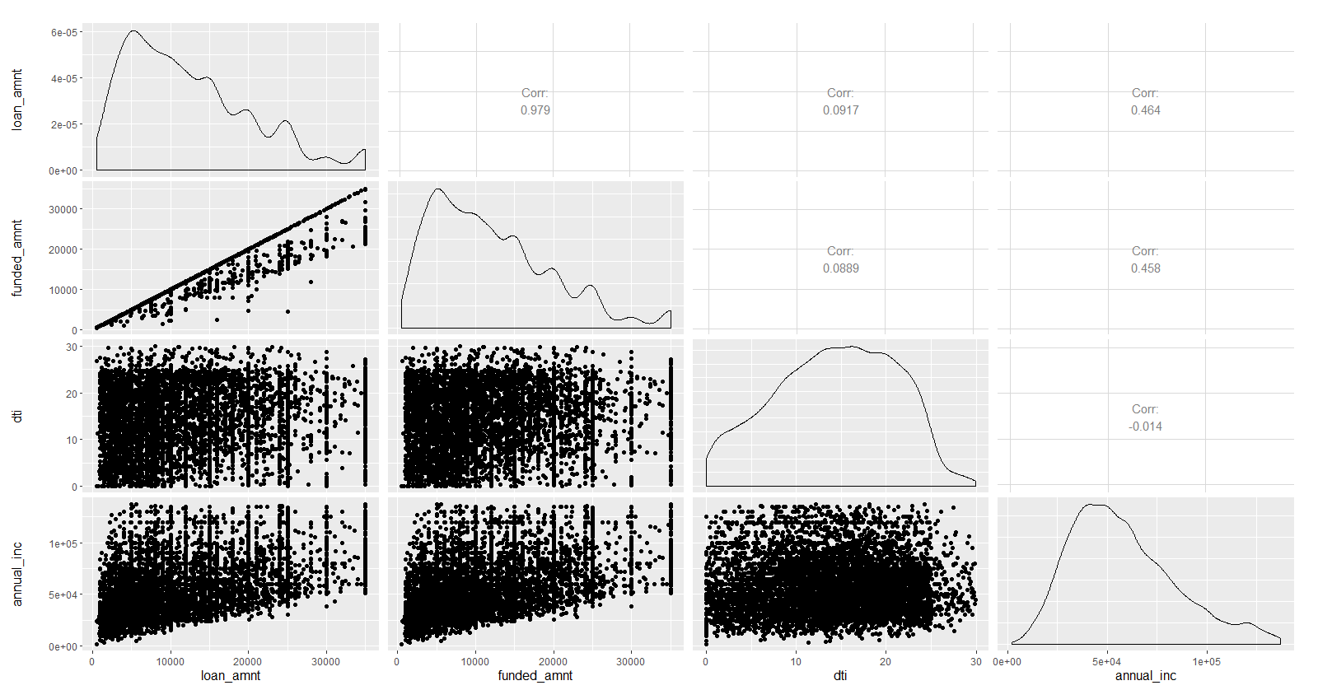
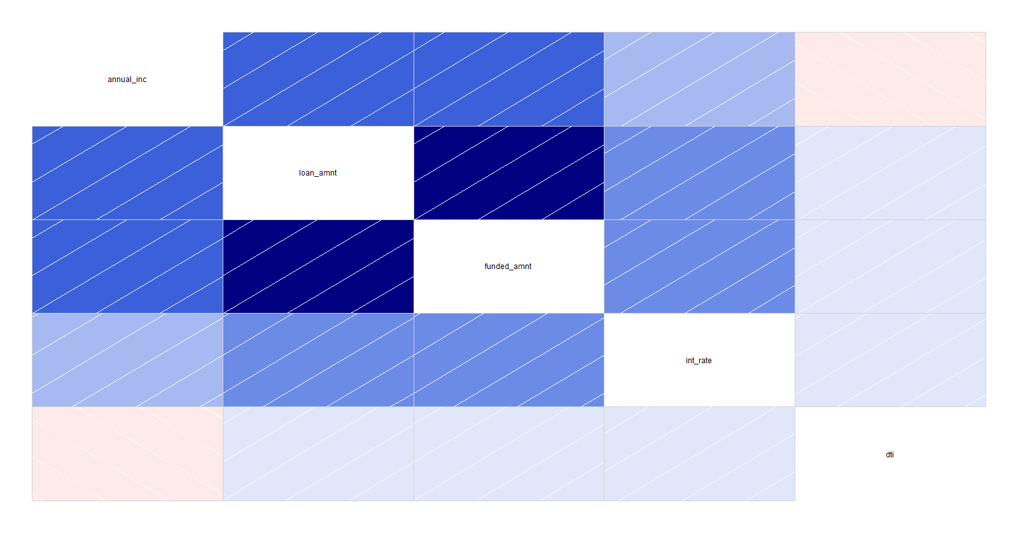
Multivariate Analysis
Correlation between Debt to Income ratio , Annual Income , Loan amount and Funded amount

Slide 10
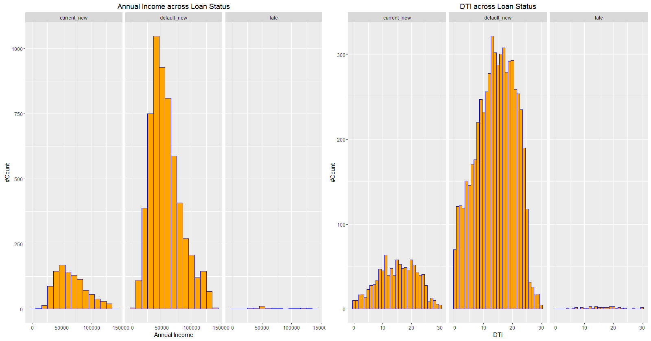
Multivariate Analysis

Slide 11
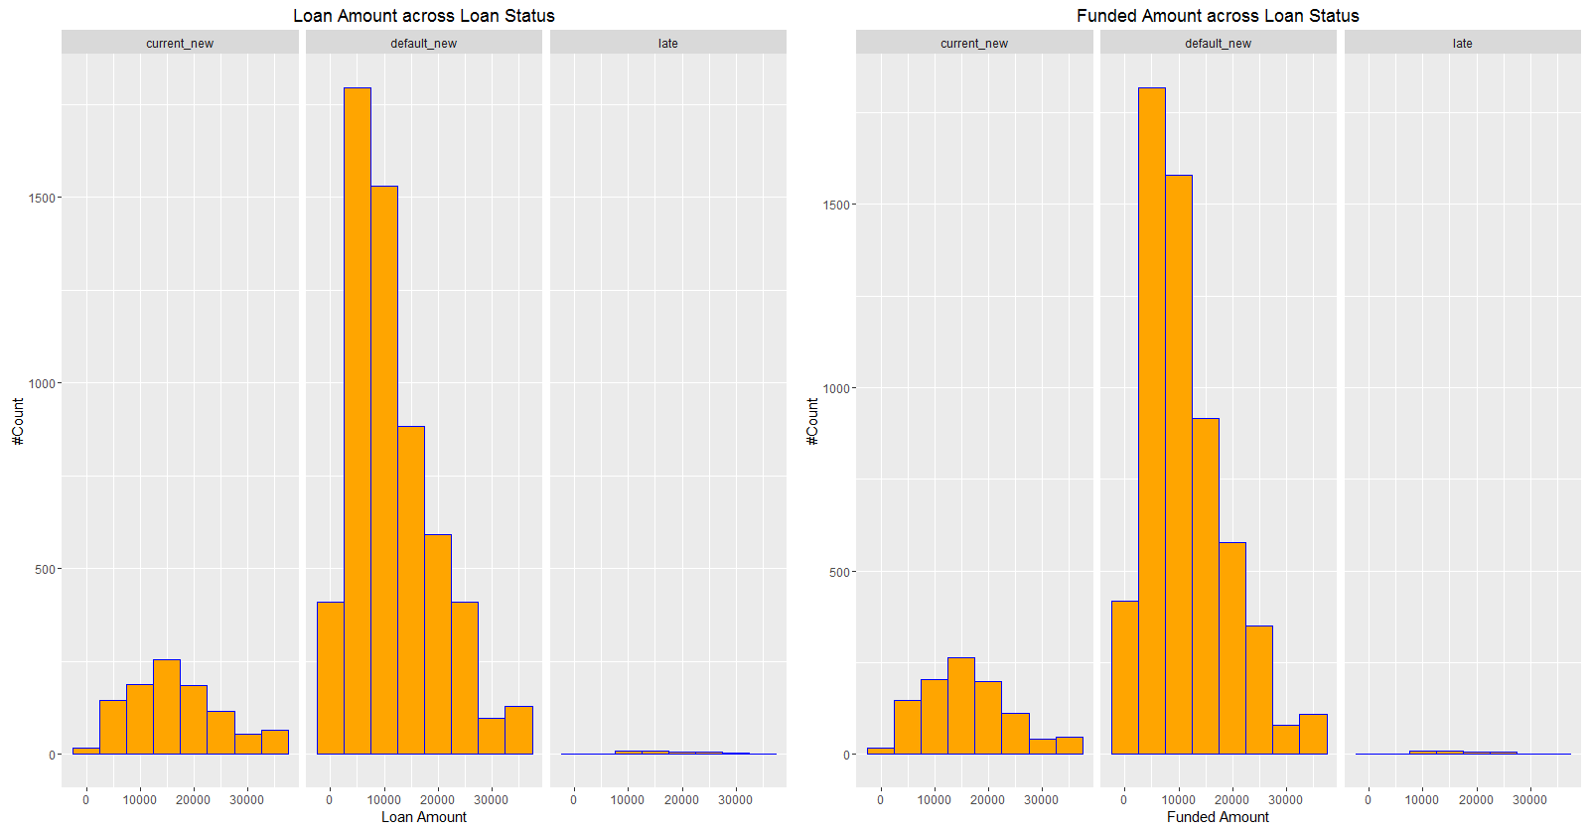
Multivariate Analysis

Slide 12
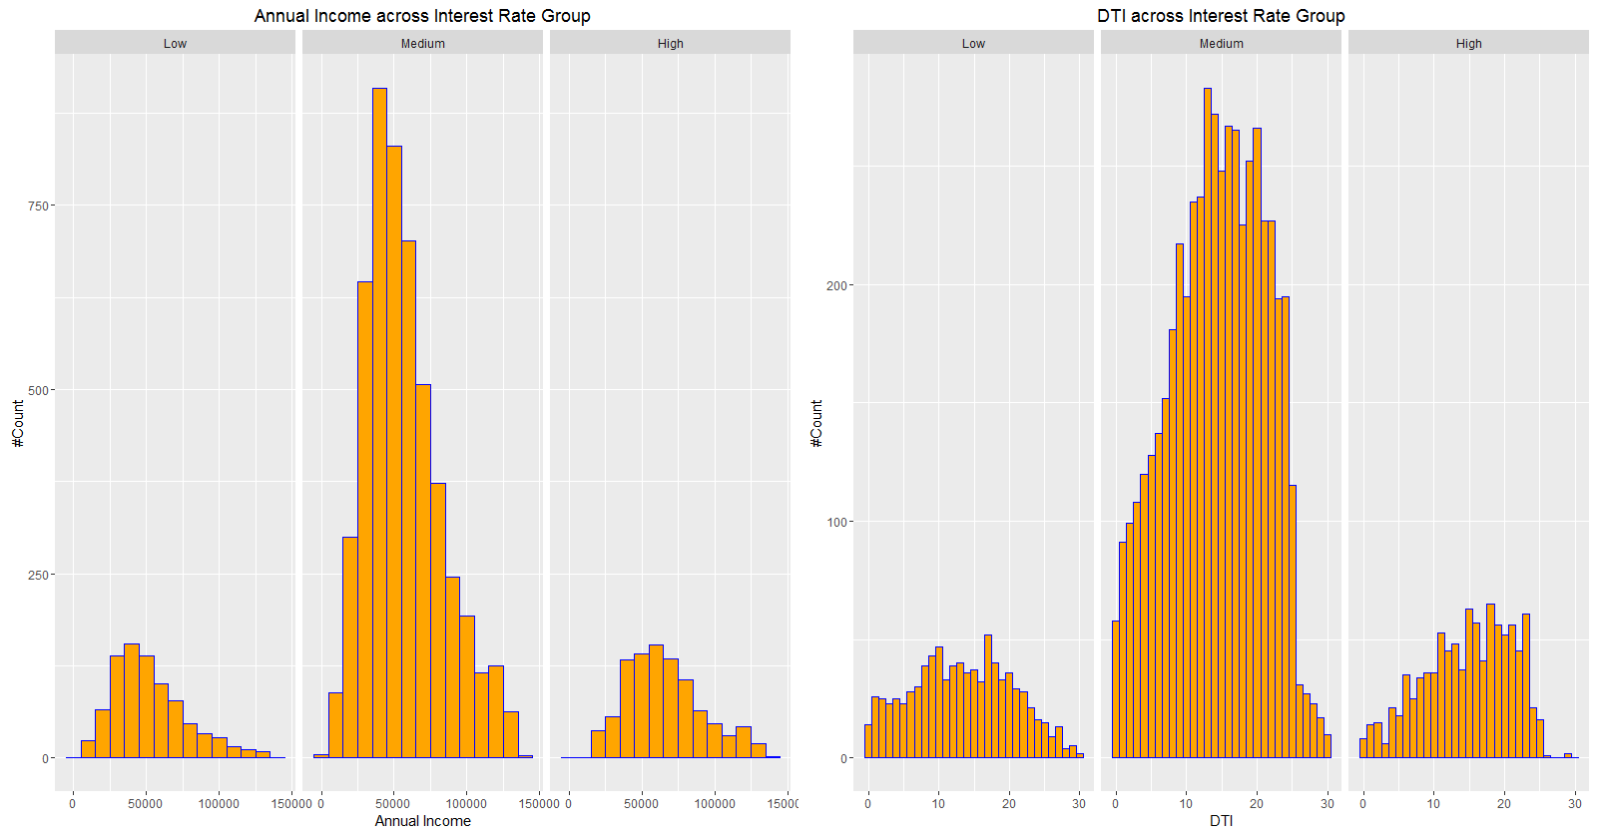
Multivariate Analysis

Slide 13
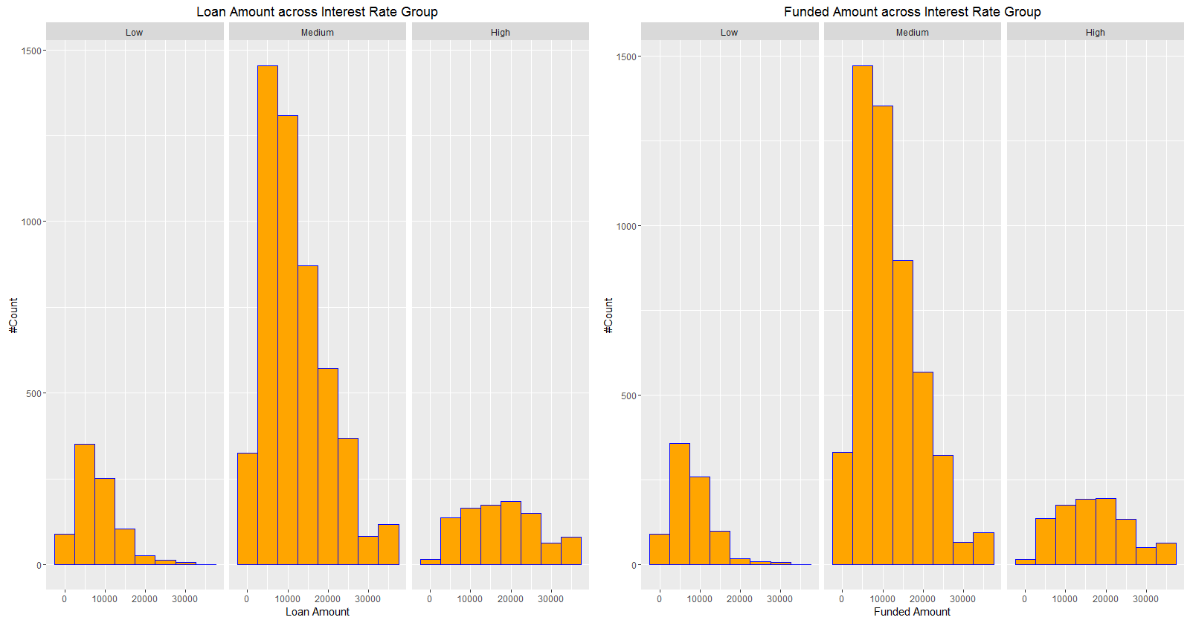
Multivariate Analysis

Slide 14
Results
Results of the Hypothesis Test done on the mean values of the continuous driver variables for two levels of loan_status_1 - default_new and current_new at 95% confidence level
Loan Amount
Null hypothesis: The loan_amt means are the same for default_new and current_new levels of loan_status_1
Alternate hypothesis: The loan_amt group means are varying for default_new and current_new levels of loan_status_1
Test statistic: t = -17.753
p value corresponding to the test statistic: p= 2.2 e-16
Insight: The calculated t statistic does not lie within the expected interval and p<0.05, hence the null hypothesis is rejected
This means that the difference in group means of loan amounts for default and current loans is statistically significant. The average loan amounts are different for default and current loan categories.
Debt to Income Ratio(DTI)
Null hypothesis: The dti group means are the same for default_new and current_new levels of loan_status_1
Alternate hypothesis: The dti group means are not the same for default_new and current_new levels of loan_status_1
Test statistic: t = -4.0768
p value corresponding to the test statistic: p= 4.823e-05
Insight: The calculated t statistic does not lie within the expected interval and p<0.05, hence the null hypothesis is rejected.
This means that the difference in group means of debt to income ratio for default and current loans is statistically significant. The average debt to income ratios are different for default and current loan categories.

Slide 15
Results
Annual Income
Null hypothesis: The annual_inc group means are the same for default_new and current_new levels of loan_status_1
Alternate hypothesis: The annual_inc group means are not the same for default_new and current_new levels of loan_status_1
Test statistic: t = -10.773
p value corresponding to the test statistic: p= 2.2e-16
Insight: The calculated t statistic does not lie within the expected interval and p<0.05, hence the null hypothesis is rejected.
This means that the difference in group means of annual incomes for default and current loans is statistically significant. The average annual incomes are different for default and current loan categories.
Funded Amount
Null hypothesis: The funded_amt group means are the same for default_new and current_new levels of loan_status_1
Alternate hypothesis: The funded_amt group means are varying for default_new and current_new levels of loan_status_1
Test statistic: t= -17.936
p value corresponding to the test statistic: p= 2.2 e-16
Insight: The calculated t statistic does not lie within the expected interval and p<0.05, hence the null hypothesis is rejected.
This means that the difference in group means of funded amounts for default and current loans is statistically significant. The average funded amounts are different for default and current loan categories.

Slide 16
Results
Results of the Hypothesis Test done on the mean values of the continuous driver variables for two levels of int_rate_grp - high and low at 95% confidence level
Annual Income
Null hypothesis: The annual_inc group means are the same for high and low levels of int_rate_grp
Alternate hypothesis: The annual_inc group means are not the same for high and low levels of int_rate_grp
Test statistic: t=11.212
p value corresponding to the test statistic: p= 2.2e-16
Insight: The calculated t statistic does not lie within the expected interval and p<0.05, hence the null hypothesis is rejected.
This means that the difference in group means of annual incomes for high and low interest loans is statistically significant. The average annual incomes are different for high and low interest loan categories.
Debt to Income(DTI) Ratio
Null hypothesis: The dti group means are the same for high and low levels of int_rate_grp
Alternate hypothesis: The dti group means are not the same for high and low levels of int_rate_grp
Test statistic: t=4.7989
p value corresponding to the test statistic: p=1.736e-06
Insight: The calculated t statistic does not lie within the expected interval and p<0.05, hence the null hypothesis is rejected.
This means that the difference in group means of debt to income ratio for high and low interest loans is statistically significant. The average debt to income ratio are different for high and low interest loan categories.

Slide 17
Results
Loan Amount
Null hypothesis: The loan_amt group means are the same for high and low levels of int_rate_grp
Alternate hypothesis: The loan_amt group means are not the same for high and low levels of int_rate_grp
Test statistic: t=27
p value corresponding to the test statistic: p=2.2e-16
Insight: The calculated t statistic does not lie within the expected interval and p<0.05, hence the null hypothesis is rejected.
This means that the difference in group means of loan amounts for high and low interest loans is statistically significant. The average loan amounts are different for high and low interest loan categories.
Funded Amount
Null hypothesis: The funded_amt group means are the same for high and low levels of int_rate_grp
Alternate hypothesis: The funded_amt group means are not the same for high and low levels of int_rate_grp
Test statistic: t=27.082
p value corresponding to the test statistic: p=2.2e-16
Insight: The calculated t statistic does not lie within the expected interval and p<0.05, hence the null hypothesis is rejected.
This means that the difference in group means of funded amounts for high and low interest loans is statistically significant. The average funded amounts are different for high and low interest loan categories.

Slide 18
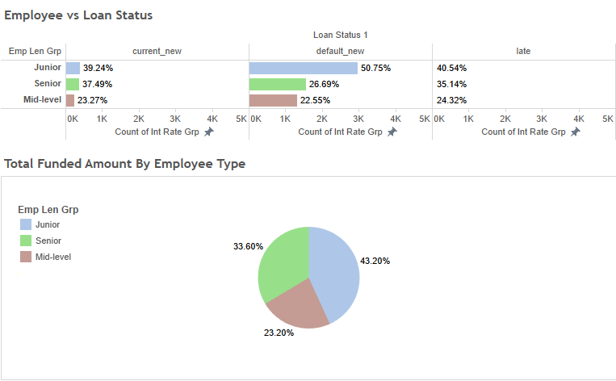
Conclusions
Mid level employees have shown least tendency to default. This group however had the least amount of total funding. Business could probably benefit from trying to target this group.
Junior level employees on the other hand, have shown the most tendency to default; so collaterals may be considered before disbursing loans.

Slide 19
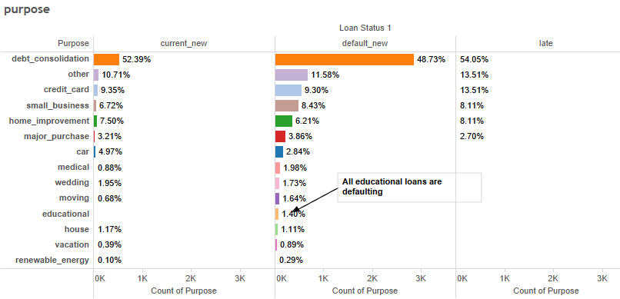
Conclusions
Loans availed for Debt consolidation , “Other” and Credit Card purposes contributed to over 50% of defaults. It was also noticed that all open loans availed for Educational purposes were defaults.
The Business could benefit by exercising caution when disbursing loans for these purposes.

Slide 20
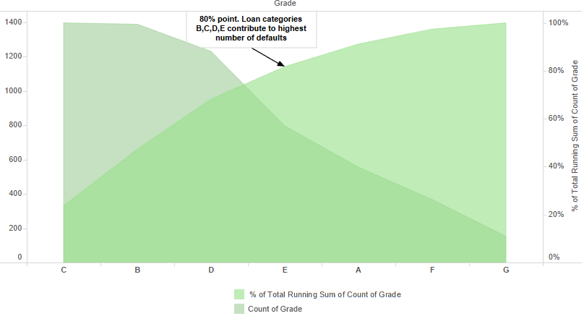
Conclusions
Loans of Grade B , C , D and E are the largest contributors to defaults.
Caution/Collaterals recommended while considering these applicants.

Slide 21
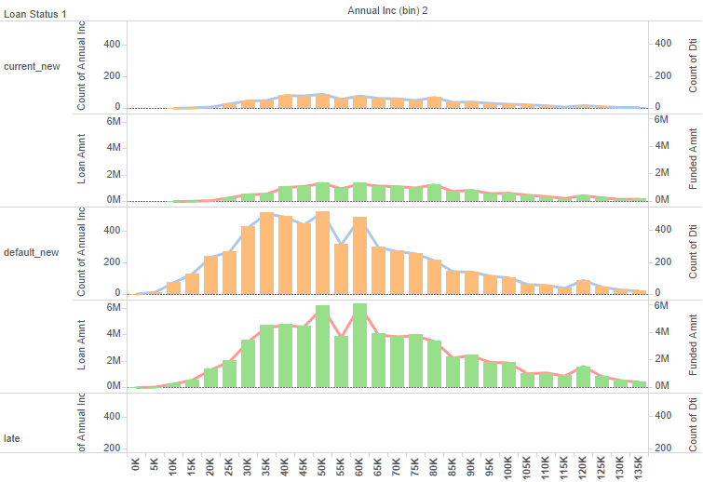
Conclusions
Most defaults occurred when the annual income of applicants was between 30K – 60 K.
Caution/Collaterals recommended while considering these applicants.

Slide 22
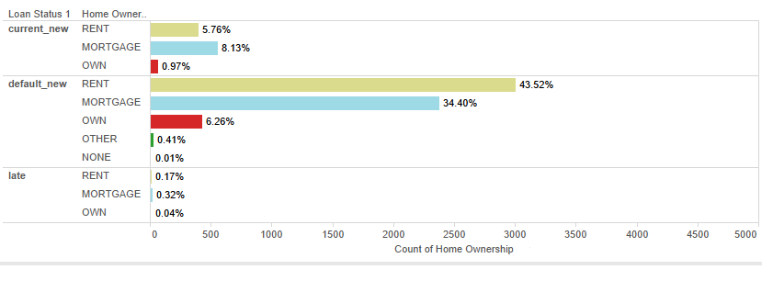
Conclusions
Almost 75 % of those defaulting on their loans resided in rented or mortgaged homes.
Caution/Collaterals recommended while considering these applicants.

