Slide 1
INVESTMENT CASE STUDY SUBMISSION
Group Name: SuHaNiSh
Sujay DSa & Roll number
Harshit Rai (APFE1680330)
Nithin Raghuveer (APFE1680818)
Shyam Kumar V N & Roll number

Slide 2
Abstract
Spark Funds, an asset management company seeks to invest in various sectors across countries and wants to ensure that they chose the right investment type, sectors and countries.
Salient features that influenced the investment decision:
Spark Funds intends to invest in areas that were already attracting attention from other investors.
They have an investment target between 5- 15 million USD in each round.
Preference was given to English speaking countries due to the relative ease of communications with the companies that were invested in.
The data made available for analysis came from Crunchbase.com and includes investment details in various sectors across the globe. Details available in these datasets include the type of funding , funding rounds, types and the amount raised. Given this historical information on investments , the aim was to use the insights derived to enable Spark Funds make a data driven investment decision.

Slide 3
Analysis approach
Formulate assumptions: Example: Sectors without mapping were classified as “others”
Start
Evaluation w.r.t success criteria
Identify Data Sources: Data was present in investments , rounds2 and mapping file
Data Cleaning and Preparation: In order to merge, we needed to convert the company permalink to lower case. There were other tasks as well
High level exploration of data from the sources: We imported the data into data frames and explored the various columns and observations
Suggest most preferable investment type, Sector, Country based on prior Investment pattern
Peer and Process review
Problem definition: Understanding what spark funds wants to achieve.
Identify Data quality issues faced: We found some missing values, outliers, inconsistent cases etc
Merge data into single source. We created a master data frame.
Document Results
Data Analysis goals: What kind of visualization and data will help the CEO take decisions
Filtering/Visualization: We made use of ggplot on various subsets to fine tune our analysis
Stop
Identify Mapping criteria and columns

Slide 4
Analysis
The Crunch Base data was spread across three files:
Companies – Basic data of companies including the Company Name, Status, Category or Sector, Location and Date of Founding.
Rounds2 – Investment details including the investment type, funding rounds and funding amounts.
Mapping file – Maps numerous sector names to eight main sectors for ease of analysis.
We initially merged the Companies and the Rounds2 file to consolidate the data of interest to us into a single file. Each funding was referenced by a unique hyperlink value which was used to affect this merge.
The requirement for Spark Funds was to identify the best funding type , sectors and countries to make these investments in. Our analysis was guided by this business requirement and hence we focussed on these three areas.

Slide 5
Analysis
Funding type Analysis : Sparks Funds was looking at four major funding types i.e. Venture , Angel, Seed or Private Equity
Knowing that each of these funding options had a typical investment amount and that the investment target for each round of investment was between 5-15 million USD , we calculated the average investment amounts in these funding types to understand the type of funding that would meet Spark Funds requirements.
Based on these calculations we would recommend Spark Funds to take the Venture route of funding *
* Since the Crunchbase data had a lot of (~ 17%) missing values, for the Raised amount, we computed the funding type mean for each type and imputed these values wherever missing. We believe that this would be a more accurate approach rather than imputation with an overall mean.
Funding Type | Venture | Seed | Angel | Private Equity
Average Investment (in Million USD) | 11.75 | 0.96 | 0.72 | 73.3

Slide 6
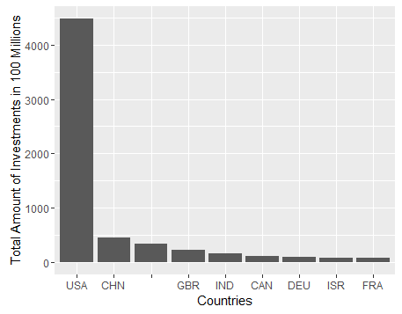
Analysis
Country Analysis: Spark Funds wants to invest in countries having the highest funding in the preferred investment type. This is part of the broader strategy to invest where most of the investments are occurring. Also the preference was English speaking countries.
In order to arrive at this we aggregated the available information from Crunchbase to arrive at the top nine countries in terms of funding . From these we picked up the top three English speaking countries* .
The Top 3 English speaking Countries in terms of total investment amounts are
USA , GBR and IND.
A list of English speaking countries is available here
* Some of the data did not have a country code associated with it but have been considered. the analysis

Slide 7
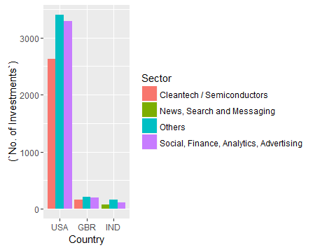
Analysis
Sector Analysis : Another area of interest that was of interest was the actual sectors that received the maximum funding. The crunch base data had a large number of sectors which we broadly segregated into 8 sectors for a more meaningful insight.
On the basis of this we then calculated the Top 3 sectors in terms of no. of Investments for each of the top 3 English speaking countries.

Slide 8
Assumptions
The funding type means were imputed for the missing funding amount values . This made up for almost 17% of the observations and hence were included as part of the analysis.
A number of companies did not have an associated country code . We have assigned these as a blank country code and proceeded with the analysis. This “Blank” country code was the third highest in terms of investment amounts but is understood to comprise of various countries that are both English and non English speaking.
A number of Sectors did not map to any of the specific eight sectors and were categorised as “Others”.

Slide 9
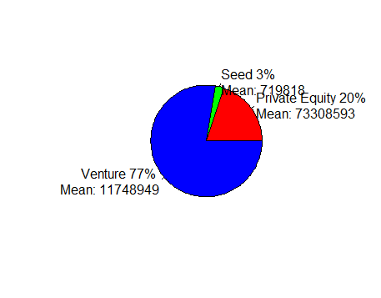
Conclusions
On the basis of the CrunchBase data and the subsequent analysis we were able to provide our investment recommendations :
The most suitable investment type is Venture

Slide 10
Conclusions
The most active English speaking countries in terms on investments are USA , Great Britain and India
The most funded sectors in these countries are *
1) Cleantech/Semiconductors ,
2) Others
3) News, Search and Messaging
4) Social , Finance ,Analytics , Advertising
For an understanding of the various sectors refer the Mapping file:

Slide 11
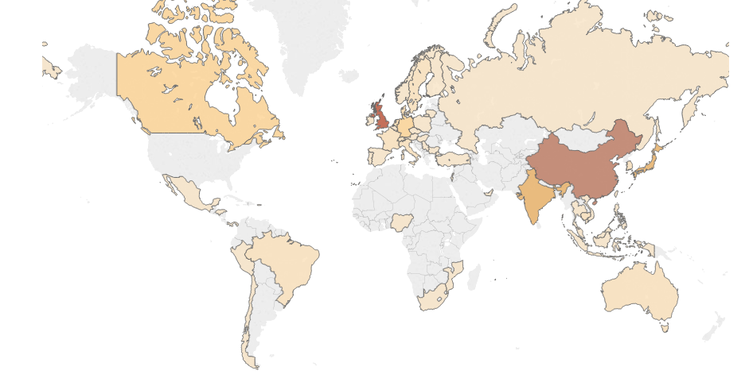

Heat Map of all investments without USA’s overbearing numbers

