Slide 1
Telecom Churn Case Study
SUBMISSION
Group Name: SuHaNiSh
Sujay DSa (DDA1610008)
Harshit Rai (DDA1610117)
Nithin Raghuveer (DDA1610258)
Shyam Kumar V N (DDA1610248)

Slide 2
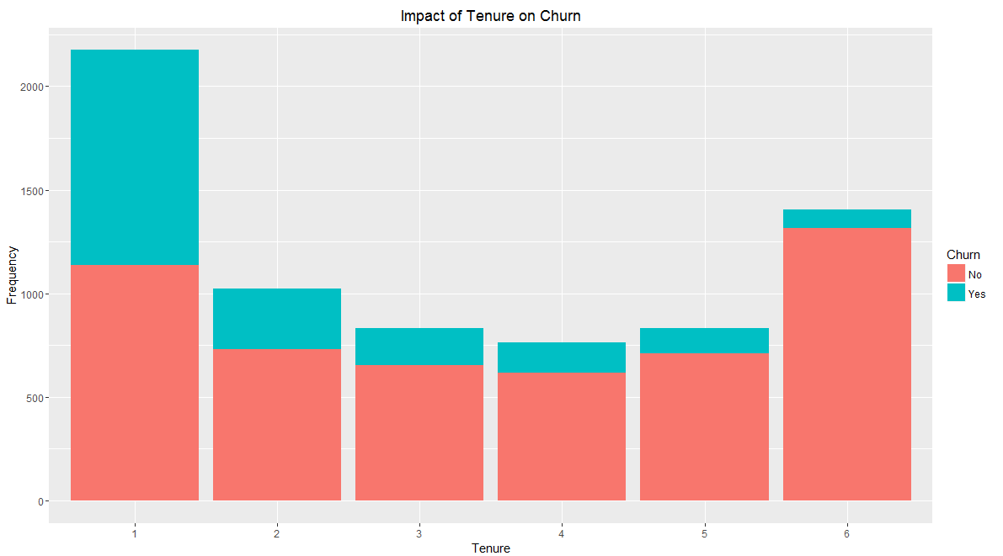
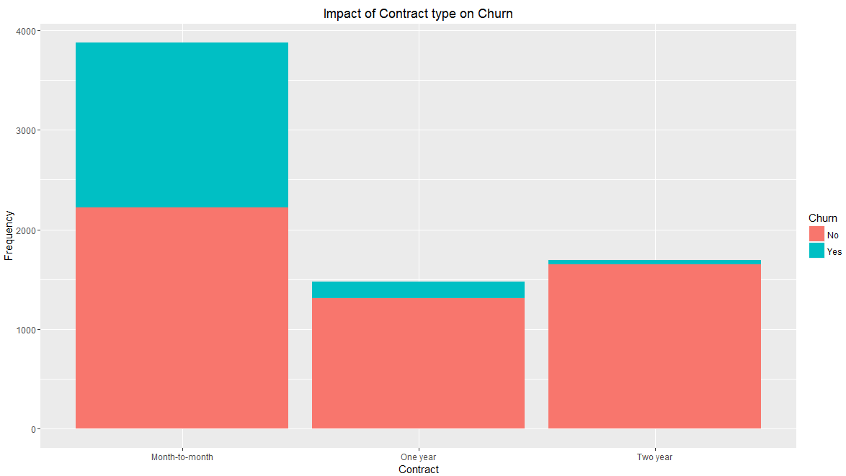
EDA plots and insights
The plot above indicates that newer customers whose tenure is under a year have shown a higher tendency to churn.
Customers on a month-to-month contract are more likely to churn. Customers tied down to a two year contract have not tended to change providers

Slide 3
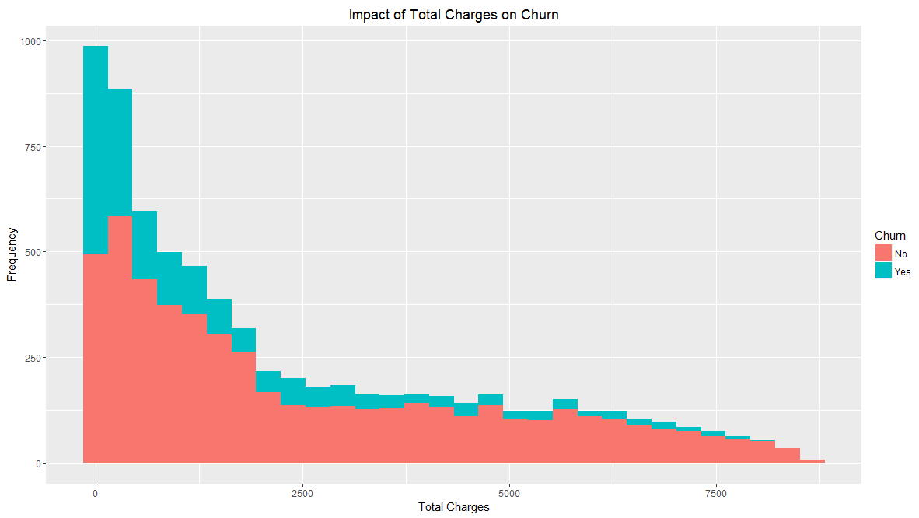
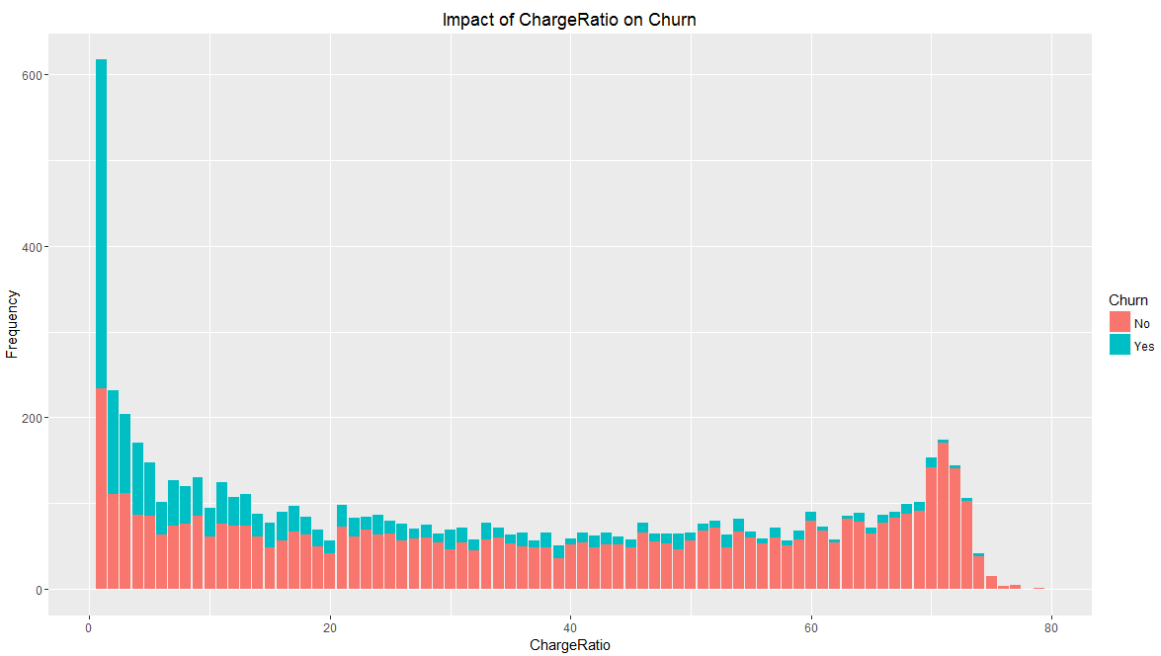
EDA plots and insights
Customers who are billed for a lesser total charge have been more open to churn
Customers for whom the charge ratio ( total/monthly charges) is less are more likely to switch to other providers. These customers are probably those who have not opted for value added services

Slide 4
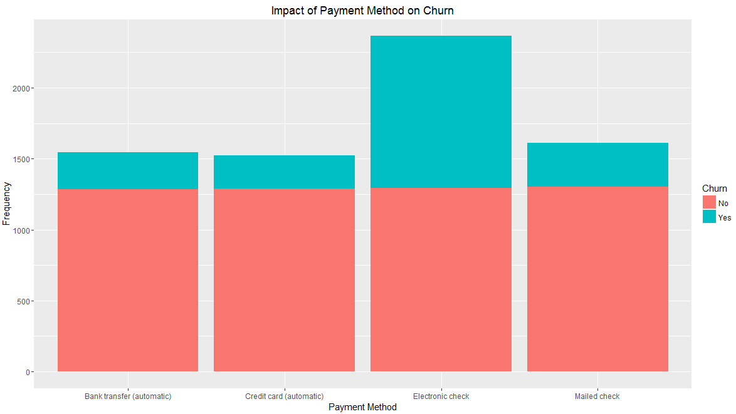
EDA plots and insights
A majority of the customers who have opted for electronic check as the payment method have churned

Slide 5
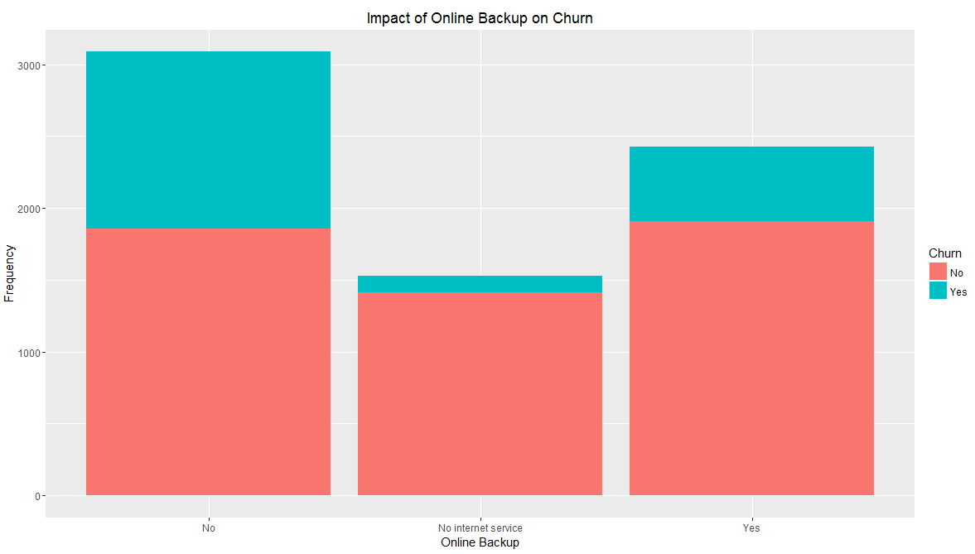
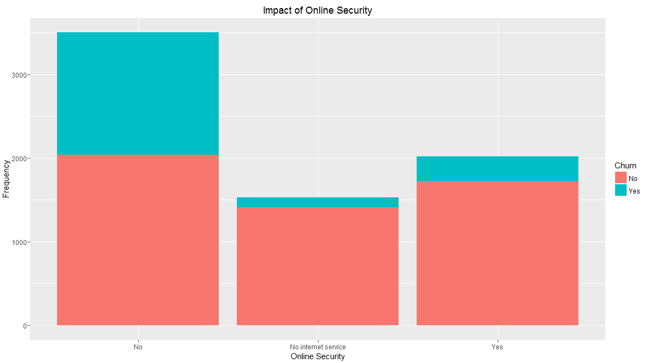
EDA plots and insights
A large proportion of customers who have subscribed for online security and backup have churned. Customers without internet service have tended to stay with the original provider.

Slide 6
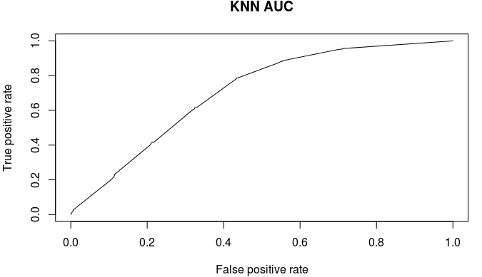
K-NN model insights and results
Metric | Value
Accuracy | 78.86 %
Sensitivity (Positive = “Yes” | 58.29%
Specificity (Positive=“Yes”) | 86.31 %
AUC | .7051
Since the model has a fairly high specificity, we can predict with a fair amount of accuracy the customers who are not going to move out. However, the model has significantly lesser sensitivity which implies that the accuracy with which it can predict the customers who will churn is very less. Hence the model may not be suited to business needs.

Slide 7
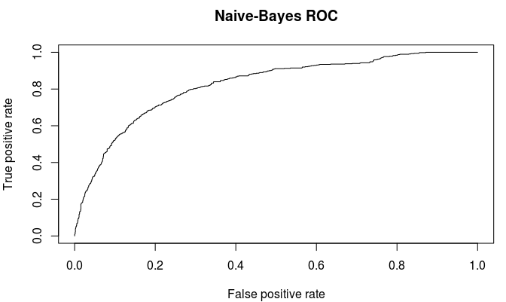
Naïve Bayes model insights and results
Metric | Value
Accuracy | 70.09 %
Sensitivity (Positive = “Yes” | 83.96 %
Specificity (Positive=“Yes”) | 65.07 %
AUC | 0.8224
Since the model has a fairly high sensitivity, the model can with a fair amount of accuracy predict the customers who are going to move out. However, the model has significantly lesser specificity which implies that the accuracy with which it can predict the customers who will not churn is very less. Also the overall accuracy of the model is fairly less when compared to the other models. Hence it may not be suited to business needs

Slide 8
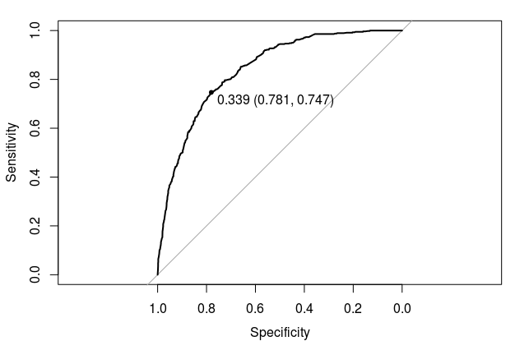
Logistic Regression model insights and results
Metric | Value
Accuracy | 74.98 %
Sensitivity (Positive = “Yes” | 77.54 %
Specificity (Positive=“Yes”) | 74.05 %
AUC | 0.8403
Since the model has a fairly high specificity, the model can with a fair amount of accuracy predict the customers who are not going to move out. This is also the case with the sensitivity metrics reported for this model. Considering this along with the AUC and accuracy values makes this model a good balanced solution to the business requirement of predicting churn.

Slide 9
Logistic Regression model insights and results
As per the logistic regression model obtained the variables that influence the churn are :
Contract
PaperlessBilling
PaymentMethod
SeniorCitizen
MultipleLines
InternetService
StreamingTV
StreamingMovies
tenureYears
Insights : the peripheral services like Paperless Billing and Payment Methods plus Value added services like streaming movies/TV, Internet actually have a strong bearing on churn
Recommendation: The Telco should bring out more convenience measures plus fuel some innovations/study other mobile markets for ideas or even new data plans for specific apps (asuming the country doesnt have NetNeutrality) or reduced rates for Voice calls made on data networks to places where there are higher call volumes going out of the country.

Slide 10
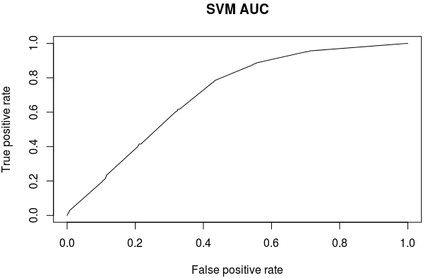
SVM Model insights and results
Metric | Value
Accuracy | 80.28 %
Sensitivity (Positive = “Yes” | 44.92 %
Specificity (Positive=“Yes”) | 93.07 %
AUC | 0.7051
Since the model has a very high specificity, the model can with a fair amount of accuracy predict the customers who are not going to move out. However, the model has significantly lesser sensitivity which implies that the accuracy with which it can predict the customers who will churn is very less. Hence the model may not be suited to business needs.

Slide 11
Conclusion
The Logistic regression model provides the best result in terms of AUC and trade-off between sensitivity , specificity and accuracy for the telecom data. This model will be able to predict with a fair amount of accuracy the tendency of a customer to churn.
The analysis on the customer data provided throws up some interesting findings:
Newer customers ( less than one year) have shown greater tendency to shift providers
Customers that have not been tied to long term contracts are more likely to consider switching services.
A majority of the customers on Fiber optics but not using the streaming TV and movie services have tended to churn
Customers who have not opted for additional services have been quicker to migrate as indicated by the charge ratio (Total/Monthly charges)

Slide 12
Conclusion
In light of the earlier findings and the current business situation where competitors are targeting existing customers we have the following recommendations to make :
Offer attractive options and incentivize signing up for long term contracts
Promote value added services such as streaming movies and TV in order to improve loyalty especially to the category who have the bandwidth to use such services (fiber)
Target newer customers with offers as they have been more liable to churn

