Slide 1
Retail-Giant Sales Forecasting Case Study SUBMISSION
Sujay DSa (DDA1610008)
Harshit Rai (DDA1610117)
Nithin Raghuveer (DDA1610258)
Shyam Kumar V N (DDA1610248)

Slide 2
Abstract
Global Mart is an online store having worldwide operations. It takes orders and delivers across the globe and deals with all the major product categories - consumer, corporate & home office.
The major regions around the globe that the store caters are :
US
Canada
LATAM
EU
Africa
EMEA
APAC
The store would like to forecast the sales and demand for the next 6 months so that it can manage inventory and revenue accordingly.

Slide 3
Problem solving methodology
Start
Business understanding
Data preparation (Step 4) Find the top five groups (Market +Segment ) based on profitability.
Model building (Step 4)
Check the residuals for white noise.
Model evaluation (Step 1)
Forecast the sales and quantity for the next 6 months using the models obtained earlier.
Report forecasts, findings and suggestions
Data understanding : Understand the sales data provided and its attributes
Model building (Step 1)
Plot the sales and quantity time series for one of the groups obtained in the previous step.
Model building (Step 5)
Obtain optimal values of p, d & q for modelling.
Model evaluation (Step 2)
Evaluate the accuracy of the forecast by comparing the values with the last 6 months that was provided with original data. Use MAPE as a metric
Data preparation (Step1)
Treat for missing values and convert attributes to correct data types
Model building (Step 5)
Build the model using optimal values of p, d and q obtained in previous step
Stop
Model building (Step 2)
Smoothen the Time series plot
Data preparation (Step 2) Segment the data on the basis of market and segment into twenty one groups
Model building (Step 3)
Smoothen the Time series plot
Model evaluation
Repeat the process for each of the groups.
Model building (Step 6)
Repeat the model building steps for groups obtained in Data preparation (Step 4)
Data preparation (Step 3) Aggregate transactional data into monthly data on Sales and Profit.
Model building (Step 4)
Check the residuals for white noise.

Slide 4
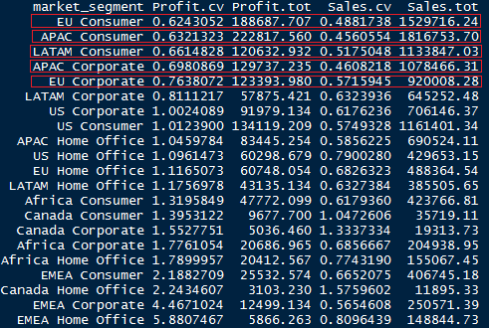
Segmentation Approach
The data was segmented into groups on the basis of the Market and Categories. Of the 21 segments that were obtained , the five most profitable (Total profits) and consistent ( Profit co-variance) segment were chosen.
The top 5 groups thus obtained were a) APAC Consumer b)EU Consumer c)APAC Corporate d) EU Corporate e) LATAM Consumer

Slide 5
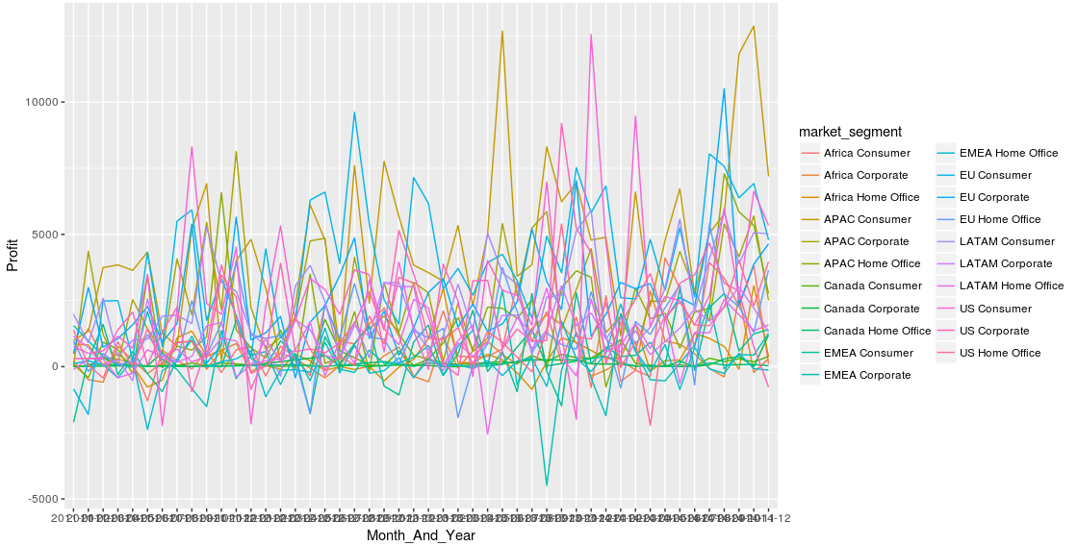
Sales trends for all segments and markets

Slide 6
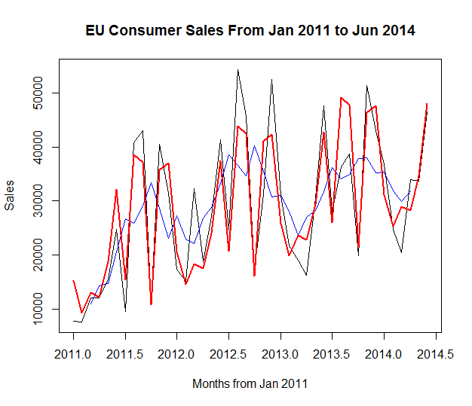
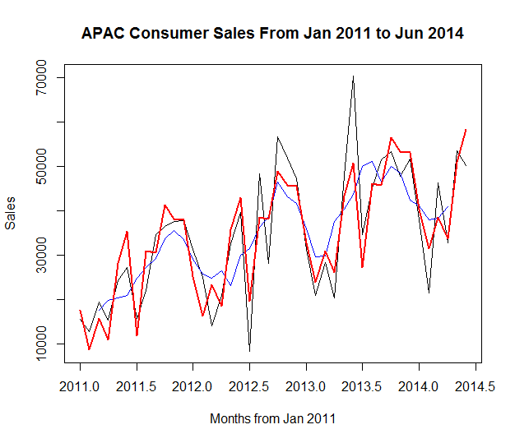
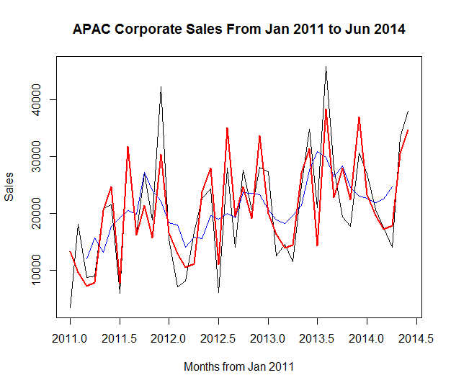
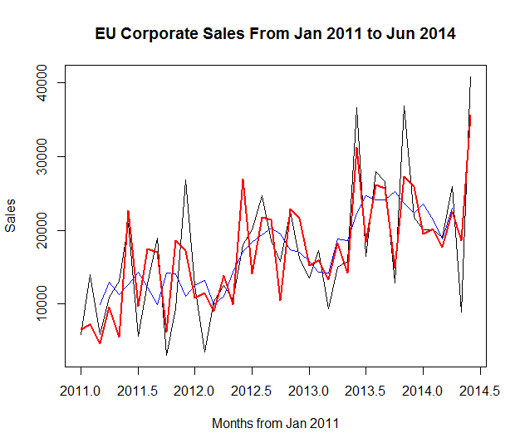
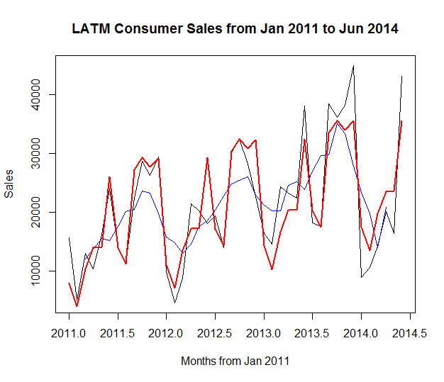

Plot of Sales Data over Time* And Model Fit
* Time starting from Jan 2011 to June 2014

Slide 7
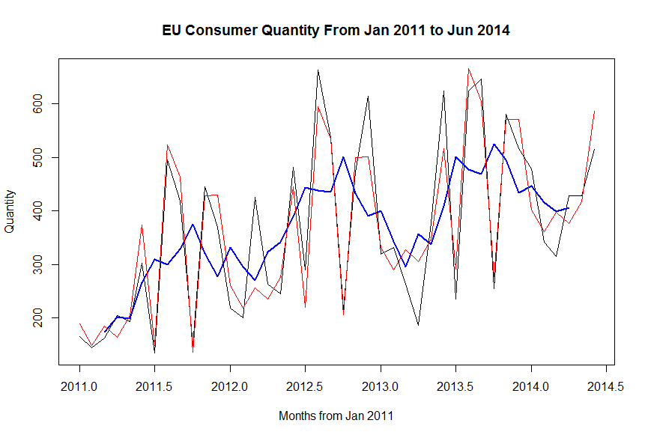
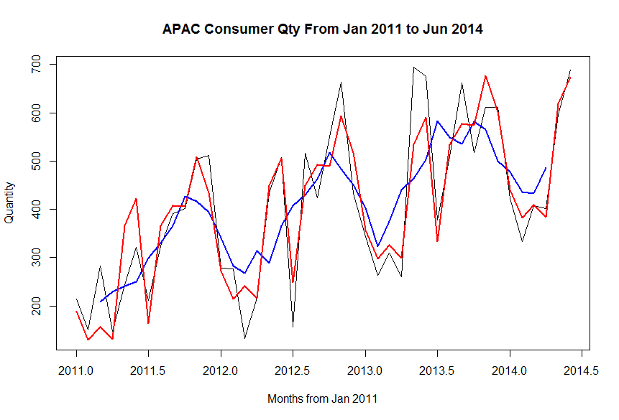
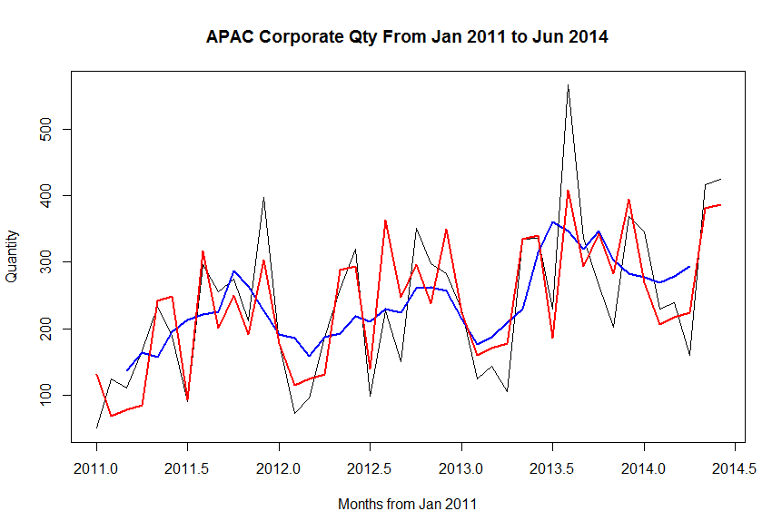
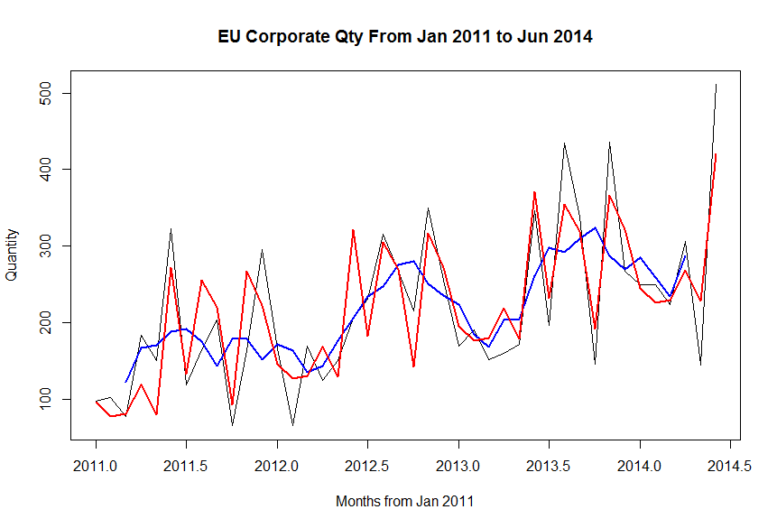
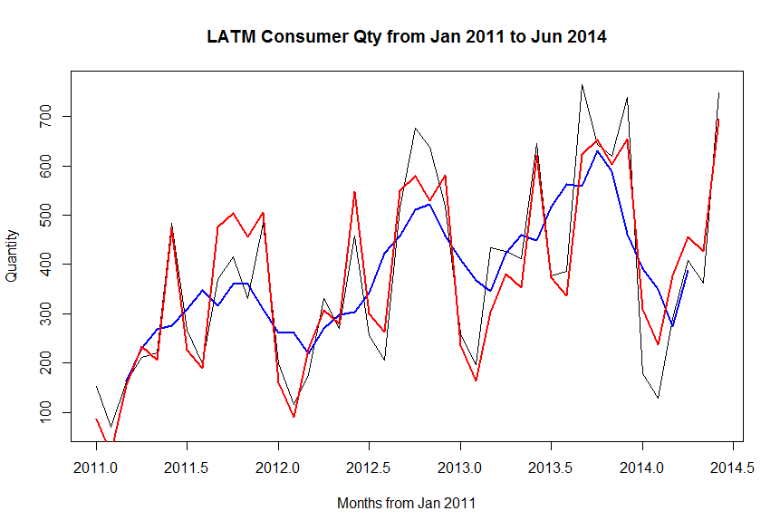
Plot of Quantity Data over Time* And Model Fit
* Time starting from Jan 2011 to June 2014

Slide 8
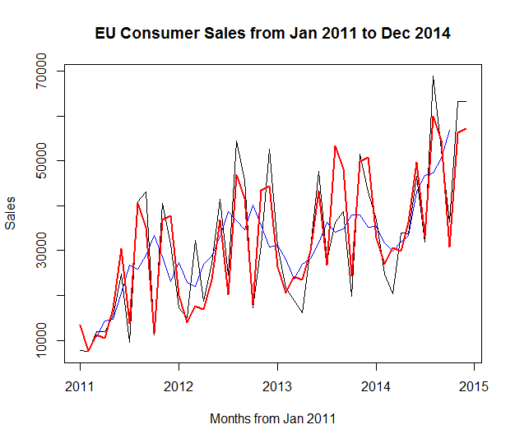
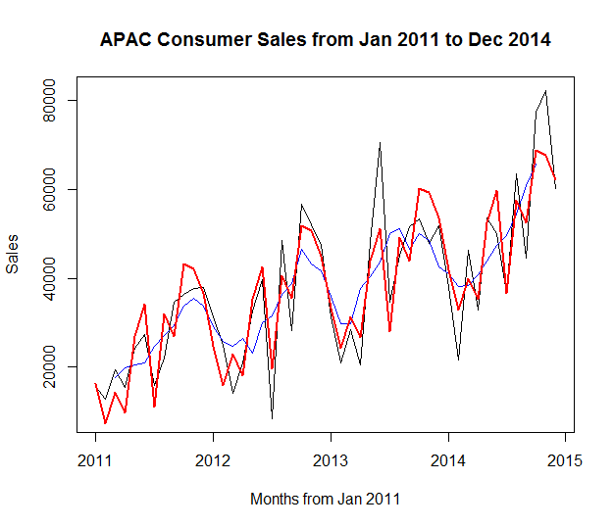
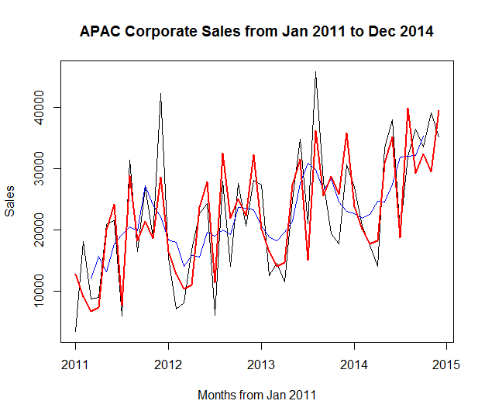
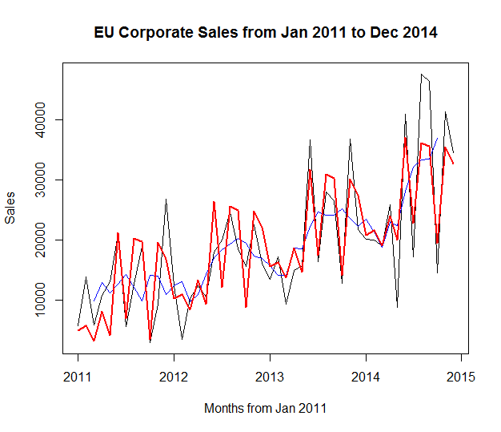
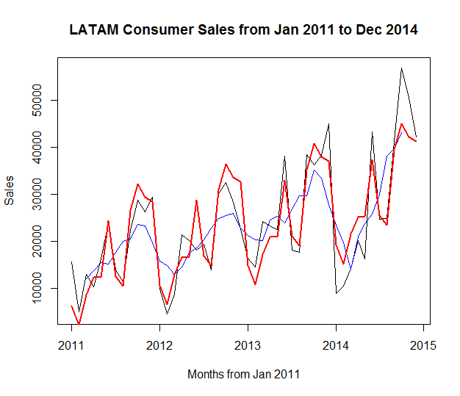
Evaluation of Sales Models For Top 5 Markets

Slide 9
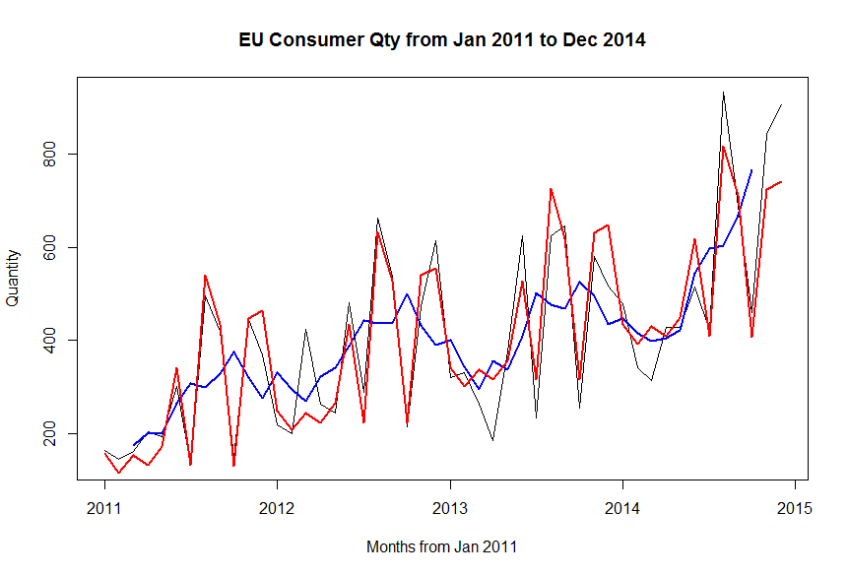
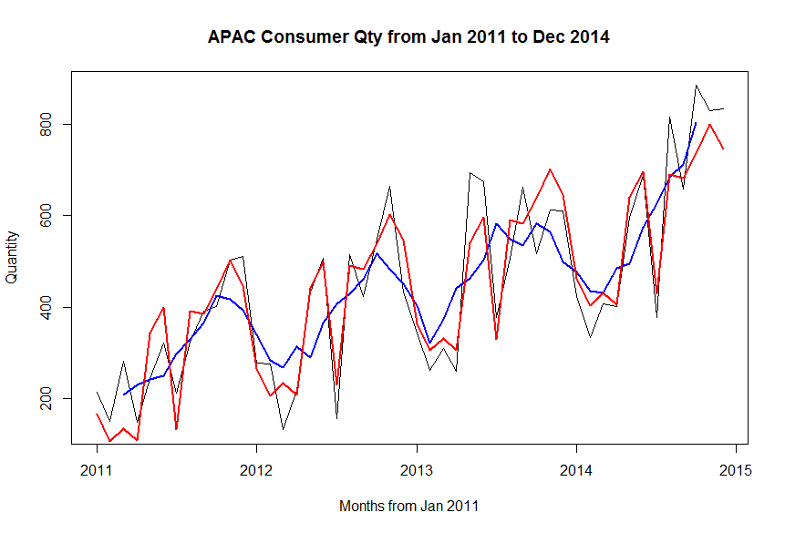
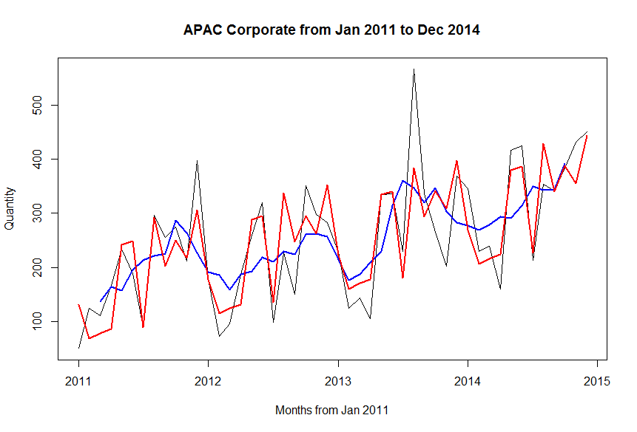
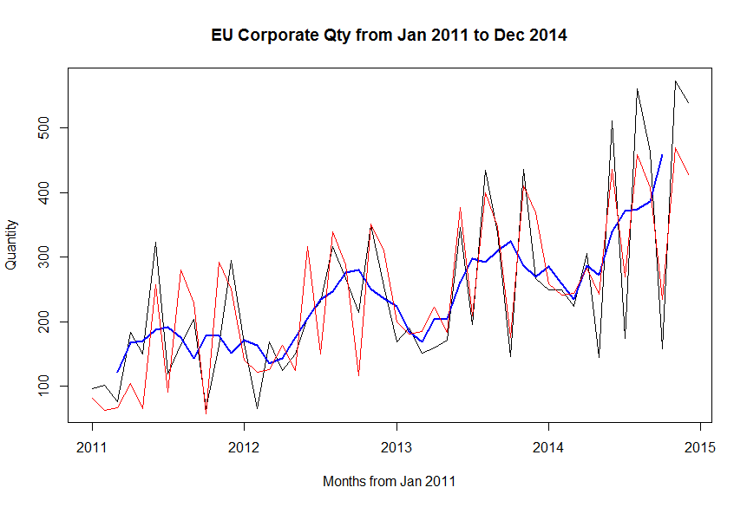
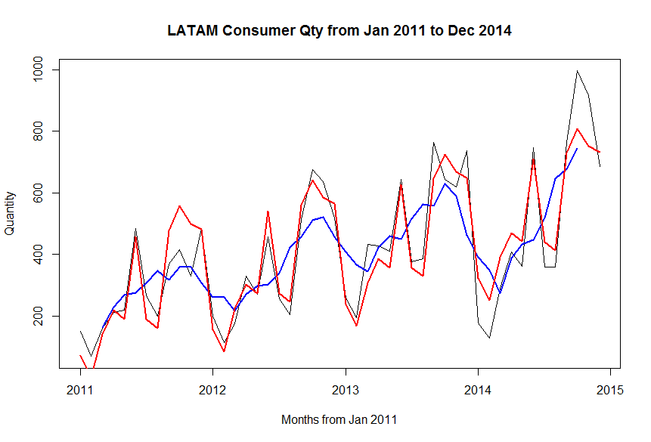
Evaluation of Quantity Models For Top 5 Markets

Slide 10
Forecasts
APAC Consumer
MAPE : 9.88% for Sales, 10.60% for Quantity
Forecasts | Jan -15 | Feb-15 | March-15 | April-15 | May-15 | June-15
Quantity | 562 | 504 | 531 | 505 | 739 | 796
Sales | 50330.35 | 41389.26 | 48386.18 | 43712.31 | 60889.57 | 68152.87
EU Consumer
MAPE : 9.4% for Sales , 10.43 for Quantity
Forecasts | Jan -15 | Feb-15 | March-15 | April-15 | May-15 | June-15
Quantity | 526 | 485 | 522 | 500 | 541 | 711
Sales | 39343.36 | 33413.42 | 37075.75 | 36349.85 | 42842.27 | 56205.61

Slide 11
Forecasts
APAC Corporate
MAPE : 15% for Sales, 8.13% for Quantity
Forecasts | Jan -15 | Feb-15 | March-15 | April-15 | May-15 | June-15
Quantity | 315 | 252 | 262 | 270 | 426 | 432
Sales | 27429.25 | 23752.99 | 21347.63 | 21945.58 | 34625.81 | 38842.40
EU Corporate
MAPE : 22% for Sales, 28.69 for Quantity
Forecasts | Jan -15 | Feb-15 | March-15 | April-15 | May-15 | June-15
Quantity | 318 | 300 | 304 | 342 | 302 | 495
Sales | 26181.25 | 26868.93 | 24354.35 | 29252.73 | 25263.11 | 42322.53

Slide 12
Forecasts
LATAM Consumer
MAPE : 8.8 % for sales, 14.2% for Quantity
Forecasts | Jan -15 | Feb-15 | March-15 | April-15 | May-15 | June-15
Quantity | 407 | 336 | 475 | 553 | 525 | 793
Sales | 23451.22 | 19433.46 | 25786.87 | 29507.25 | 29548.60 | 41528.73

Slide 13
Forecasted trends

Slide 14
Forecasted trends

Slide 15
Conclusions
The forecasting carried out on the sales data provided some interesting insights :
Low sales are recorded across all groups in the month of February
Sales are at a peak during the month of June. For LATAM Consumer, the sales increase by as much as 10% during this period.
Major sales are recorded in APAC Corporate space.
The Consumer segment records a major amount of sales in all markets
APAC and EU markets are the markets with the most sales
Based on this we would recommend
Inventory management practices are required to meet the major Regions and segments. We have forecasted the demand for the six months for the top 5 segments and markets in order to help achieve this.
To overcome the low sales in February targeted promotions and discounts may be offered to consumers.

