Slide 1
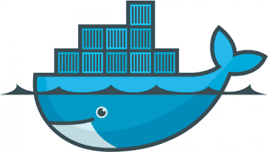

Notes:
Docker is a set of platform as a service (PaaS) products that use OS-level virtualization to deliver software in packages called containers.^{[4]} The service has both free and premium tiers. The software that hosts the containers is called Docker Engine.^{[5]} It was first released in 2013 and is developed by Docker, Inc.^{[6]}

Slide 2
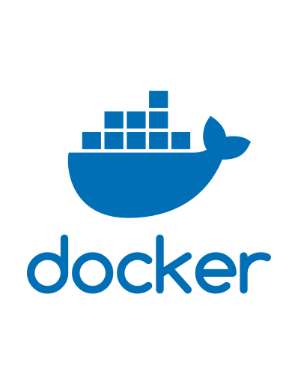

?
What is Docker
?
Why is everyone using Docker
Package
Shipping
Running
Building
Node 21
Prisma 7
App
Notes:
Docker is a platform for building, running and shipping applications,
//
I am sure you have come across a problem where your code works on your system but does not work in somewhere else?
Can happen if files are missing, software version does not match , if config of settings is diff.
// to run in dev or Qa
It can package apps with everything it need and store it
// for anyone to load it team mates
Docker compose-up creates isolated env called container
//VM , Container

Slide 3
Docker Engine
Node 21
Prisma 7
Dev
Node 16
Prisma 7
QA
Container
Shipping
Running
Building
Package
Node 21
Prisma 7
App
Node 20
Prisma 7
Prod
Notes:
Docker is a platform for building, running and shipping applications,
//
I am sure you have come across a problem where your code works on your system but does not work in somewhere else?
Can happen if files are missing, software version does not match , if config of settings is diff.
// to run in dev or Qa
It can package apps with everything it need and store it
// for anyone to load it team mates
Docker compose-up creates isolated env called container
//VM , Container

Slide 4
Docker Engine
Package
Node 21
Prisma 7
Dev
Shipping
Running
Building
Node 21
Prisma 7
App
Node 16
Prisma 7
QA
Container
Node 20
Prisma 7
Prod
Notes:
Docker is a platform for building, running and shipping applications,
//
I am sure you have come across a problem where your code works on your system but does not work in somewhere else?
Can happen if files are missing, software version does not match , if config of settings is diff.
// to run in dev or Qa
It can package apps with everything it need and store it
// for anyone to load it team mates
Docker compose-up creates isolated env called container
//VM , Container

Slide 5

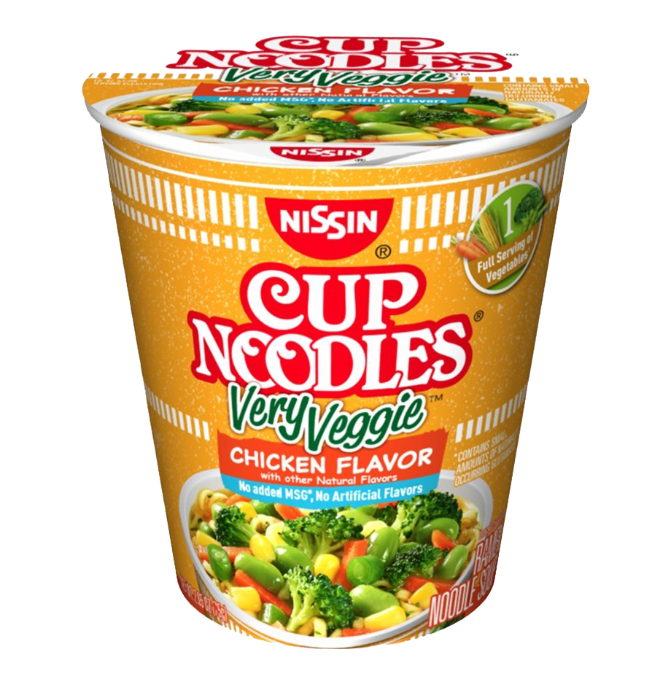

Slide 6
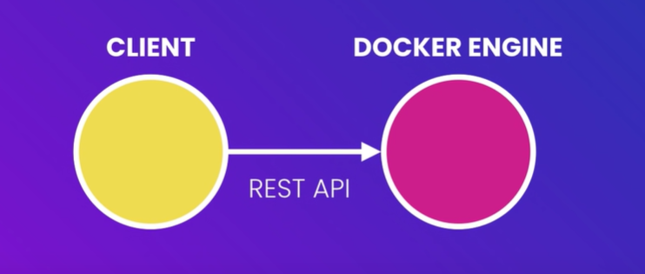
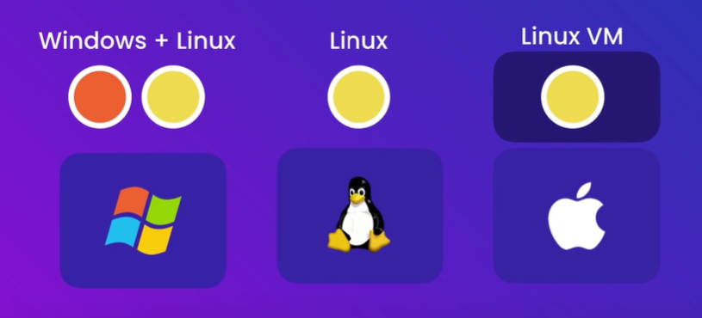
https://docs.docker.com/engine/install/
Architecture Of Docker
Installing
A running container uses an isolated filesystem. This isolated filesystem is provided by an image, and the image must contain everything needed to run an application - all dependencies, configurations, scripts, binaries, etc. The image also contains other configurations for the container, such as environment variables, a default command to run, and other metadata.
Image
Container
Kernal
Start a OS, Install Node, copy app files,run the app
How do we run Node js?
Notes:
Docker engine or server
Containers are process,
Containers has kernal (like engine of car)

Slide 7
https://docs.docker.com/engine/install/
Architecture Of Docker
Installing
A running container uses an isolated filesystem. This isolated filesystem is provided by an image, and the image must contain everything needed to run an application - all dependencies, configurations, scripts, binaries, etc. The image also contains other configurations for the container, such as environment variables, a default command to run, and other metadata.
Image
Container
Kernal
Start a OS, Install Node, copy app files,run the app
How do we run Node js?
Notes:
Docker engine or server
Containers are process,
Containers has kernal (like engine of car)

Slide 8
ENV of Docker
ENV docker install
Ls of Docker Desktop (Windows app)
ADD Docker in Command prompt
Check WORKDIR IMAGES in Docker hub website
RUN a Dockerfile
EXPOSE docker
Notes:
Docker ps – check the list of running container
FROM node:alpine
COPY . /app
WORKDIR /app
CMD node app.js
cmd : docker build –t hello-docker .
We use period(.) to represent current dir
Docker image ls
Docke run image name

Slide 9
Basic Commands

Slide 10
A
B
C
D
I :Create and run a new
container from an image
it :Execute a command
in a running container
Rm :remove image/ container
Environment varibles used in Dockerfile
run :Create and run a new
container from an image
exec :Execute a command
in a running container
ps :List containers
build Build an image
from a Dockerfile
pull :Download an image
from a registry
push :Upload an image to
a registry
images :List images
login :Log in to a registry
logout :Log out from a registry
search :Search Docker
Hub for images
version :Show the Docker
version information
info : Display system-wide
information
docker-compose up
docker-compose Down
ADD
COPY
ENV
CMD
FROM
LABEL
STOPSIGNAL
USER
VOLUME
WORKDIR
ONBUILD
EXPOSE
YML file
Basic Linux Cmds
ls : to list data
cd : change directory
pws : Print Work Directory
mkdir : Make / Create Dir
Cp :Copy
Docker Image ls
Docker Image ls -q
Docker Image rm $(Image ID)
Docker container rm $(Image ID)
ARG CODE_VERSION=latest
Notes:
Yml is the python version of json
The FROM instruction initializes a new build stage and sets the Base Image,
ARG CODE_VERSION=latest
An ARG declared before a FROM is outside of a build stage, so it can't be used in any instruction after a FROM
The LABEL instruction adds metadata to an image. A LABEL is a key-value pair.
The EXPOSE instruction informs Docker that the container listens on the specified network ports at runtime.
The ENV instruction sets the environment variable <key> to the value <value>

Slide 11
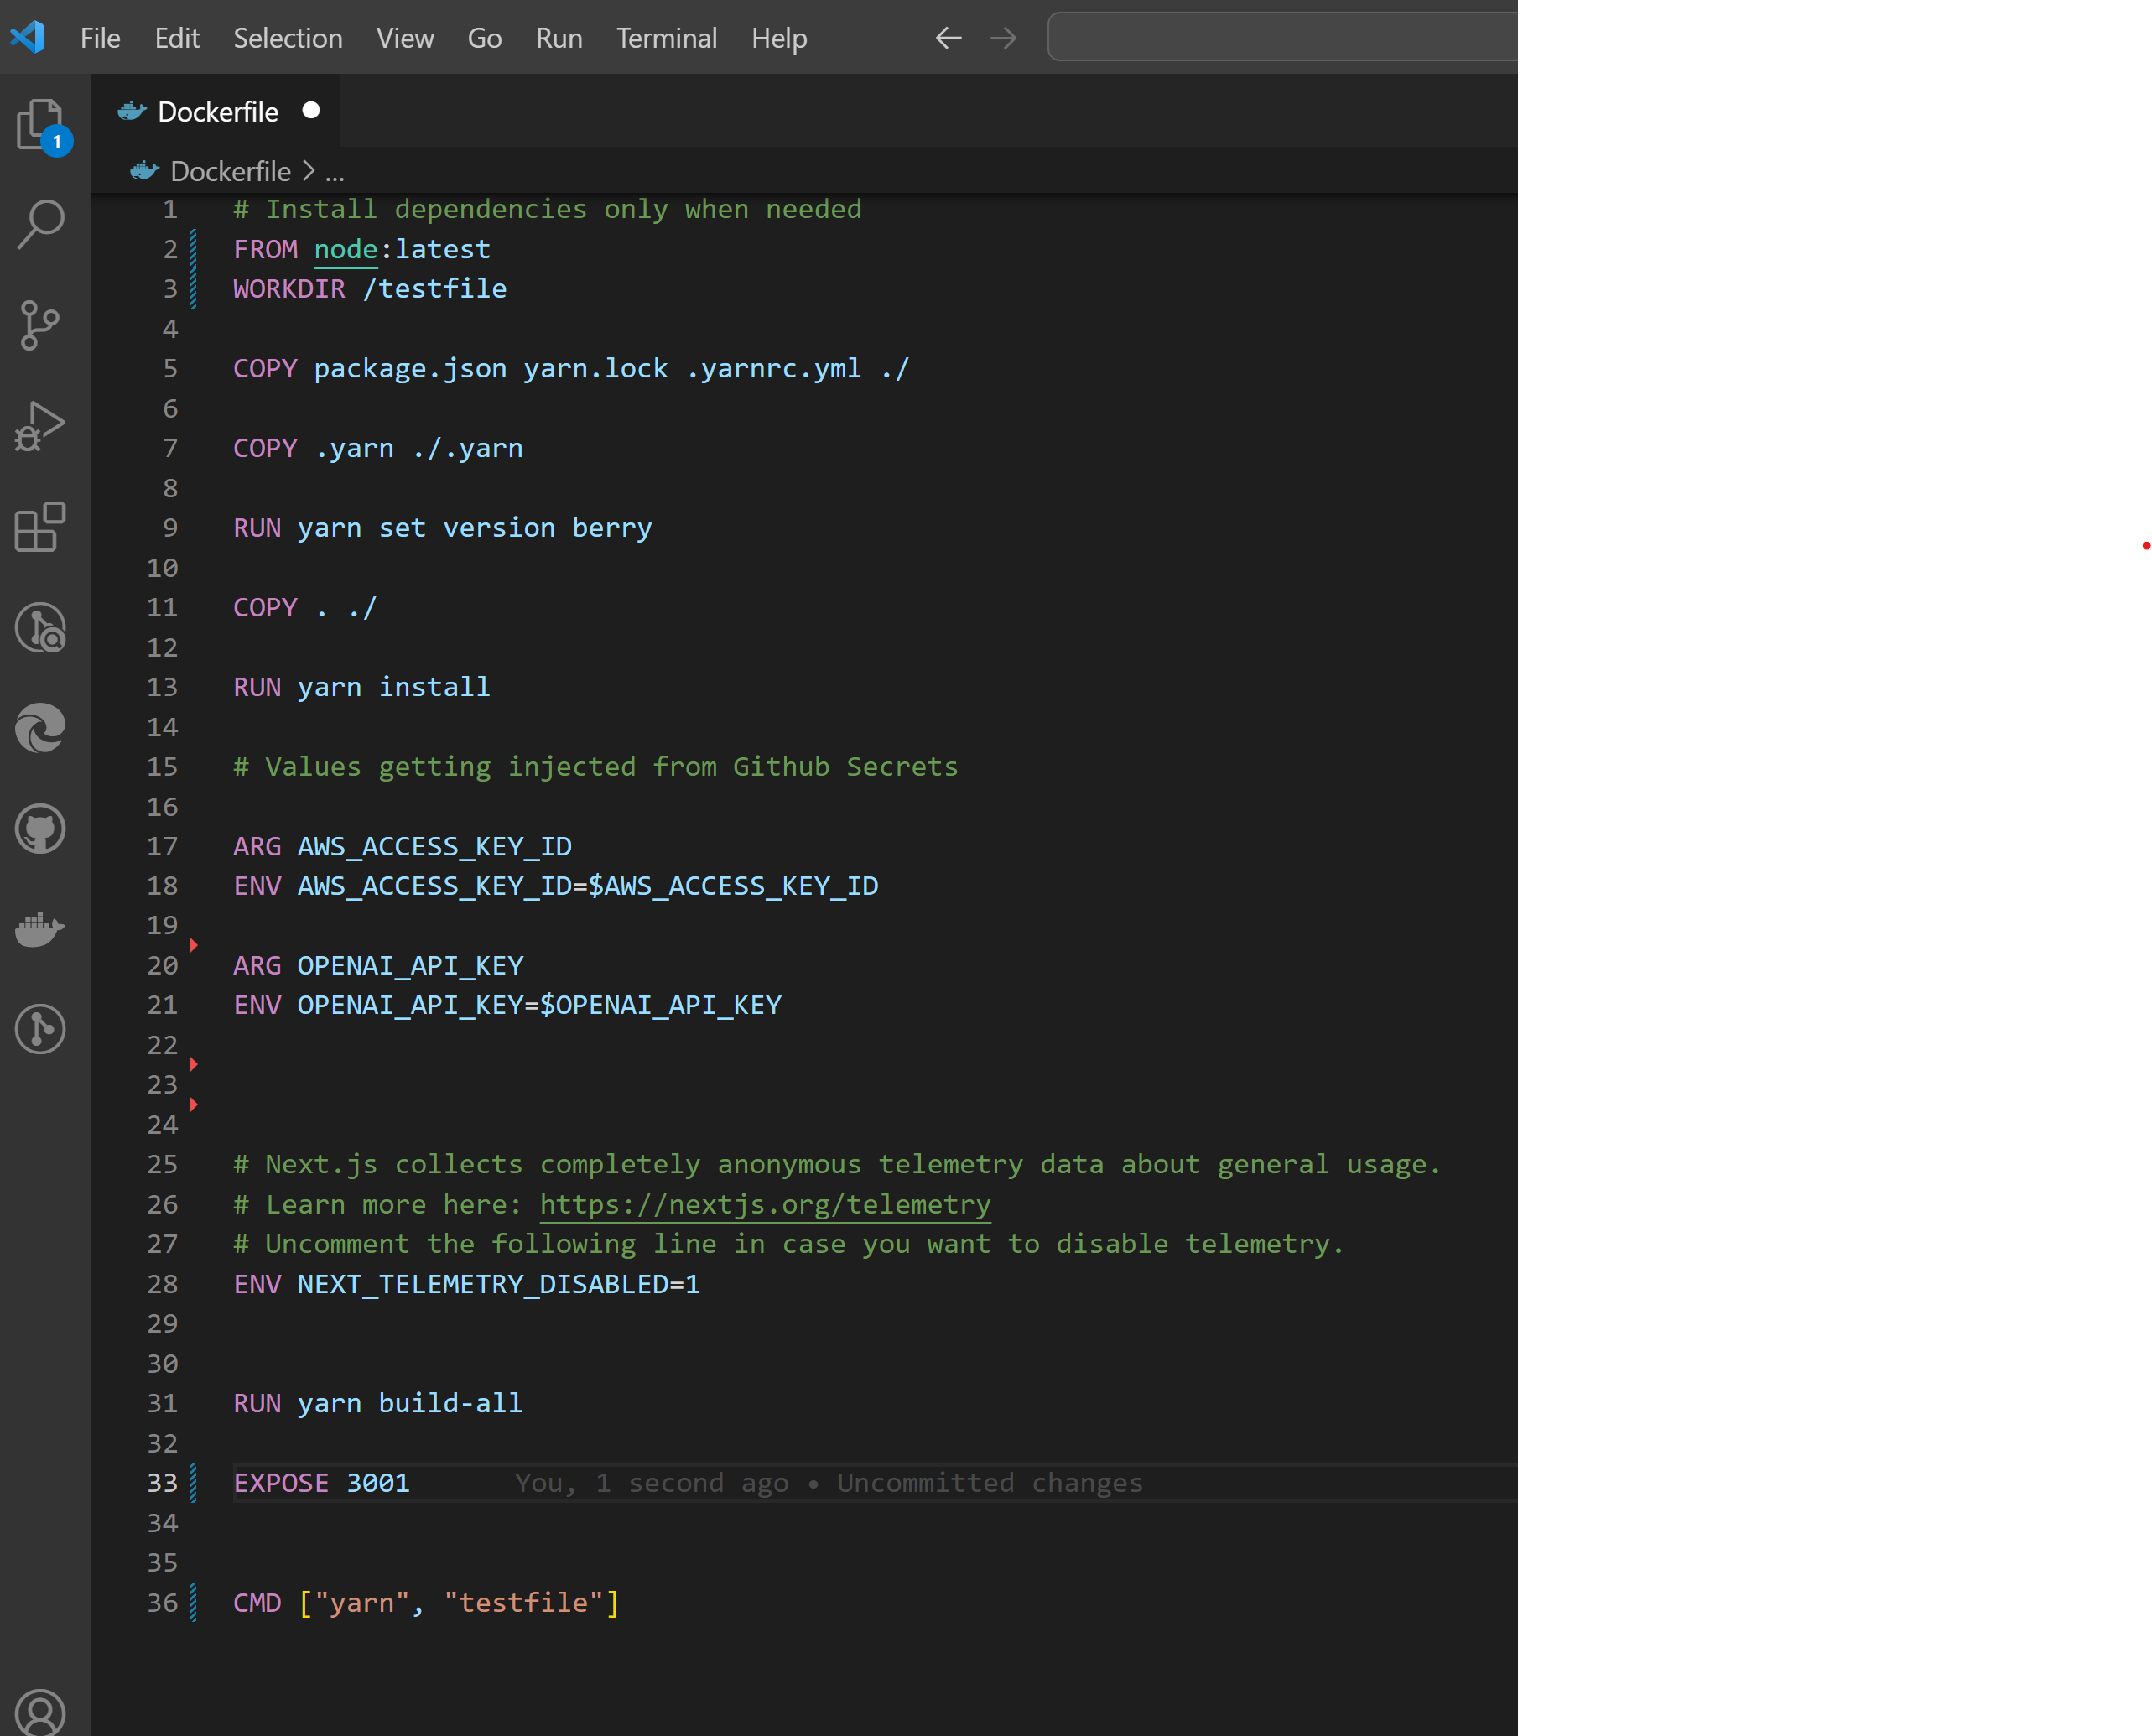

Slide 12
Thank you

